Slide 1

SMART INDIA HACKATHON 2026
AI-Powered Land Acquisition Delay Predictor
Problem Statement ID - 26017
Problem Statement Title-
AI - Powered Land Acquisition Delay Predictor
Theme- Agriculture,FoodTech & Rural Developnment
PS Category- Software
Team ID- AUS_SIH26_196
Team Name - IndusVision

Slide 2
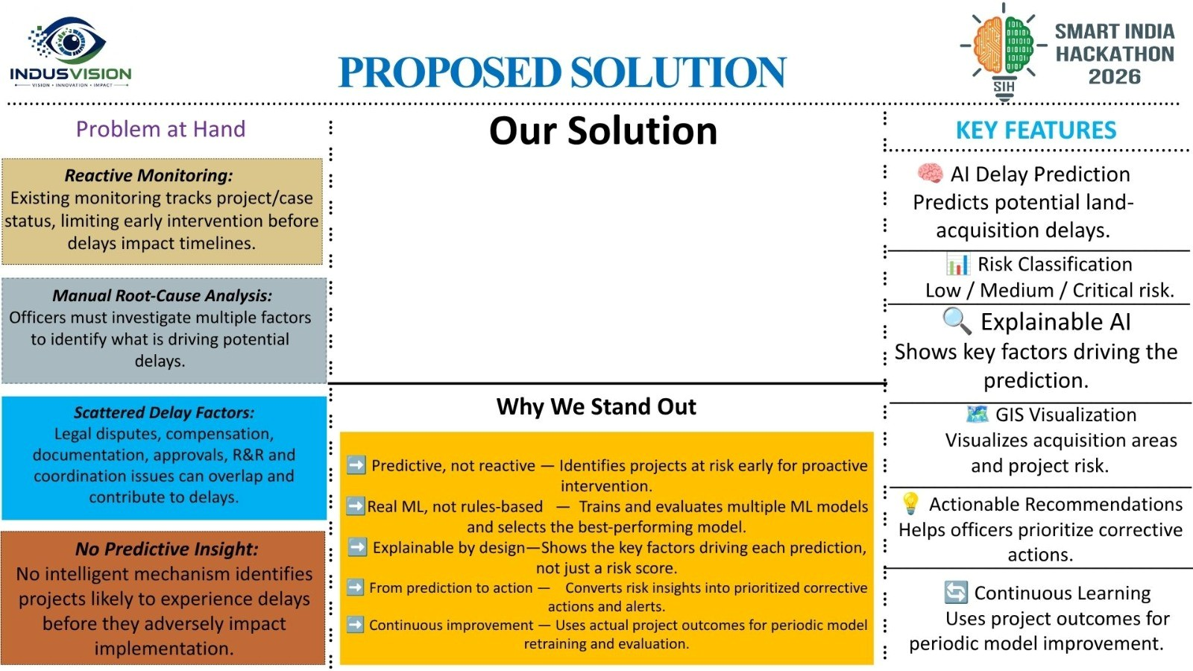
BhoomiDrishti – AI-Powered Land Acquisition Delay Prediction System
Admin → Manage users, projects & access
Officer → Upload data → Analyse → Predict risk → Identify delay factors → Take action
User → View land/case details → Track status → Submit information → Receive updates
Core Flow:
Data → ML Prediction → Risk → Explain → Prioritize → Action → Status Update → Re-analysis
Future: Secure Backend + Authorized Government Database Integration.

Slide 3

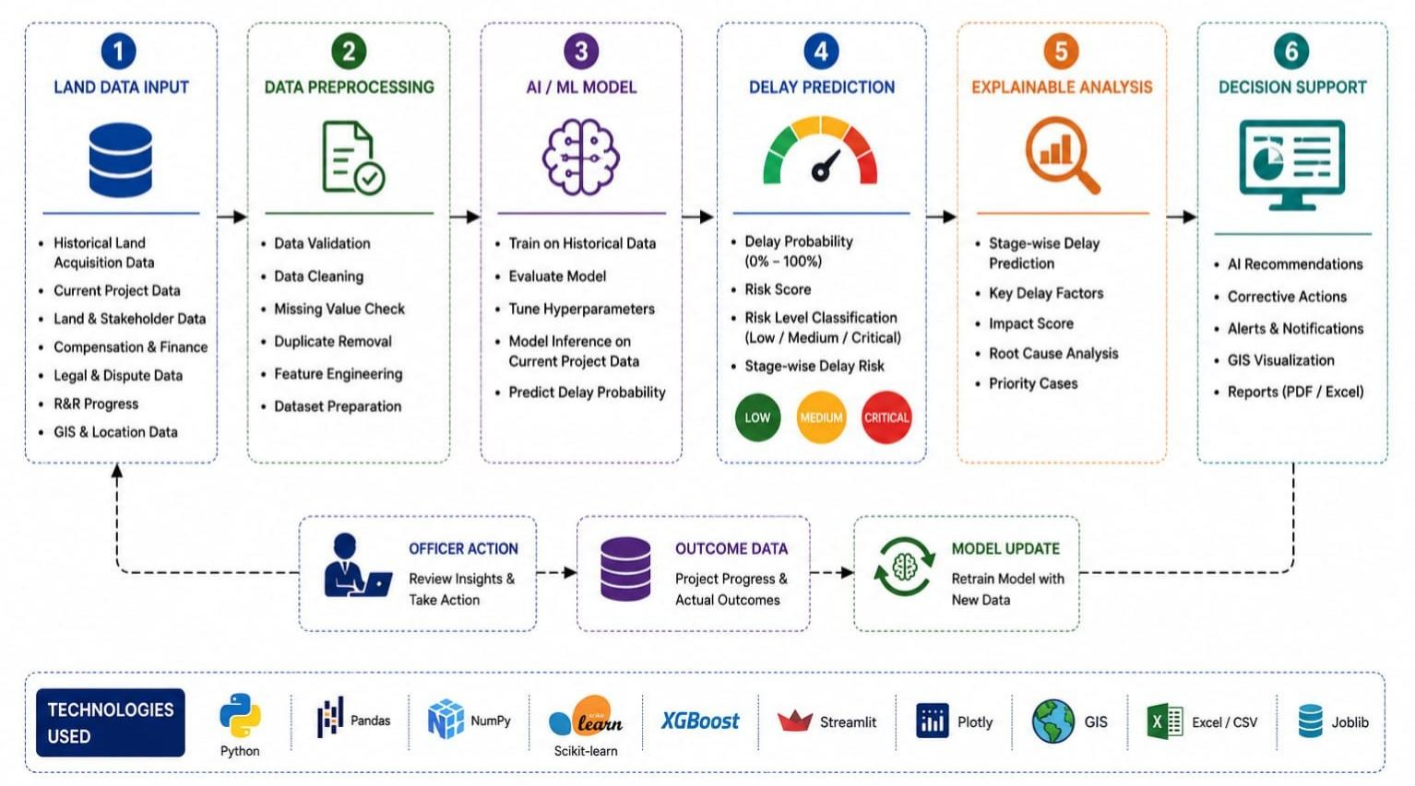
TECHNICAL APPROACH
................................................................
................................................................
................................................................
................................................................

Slide 4
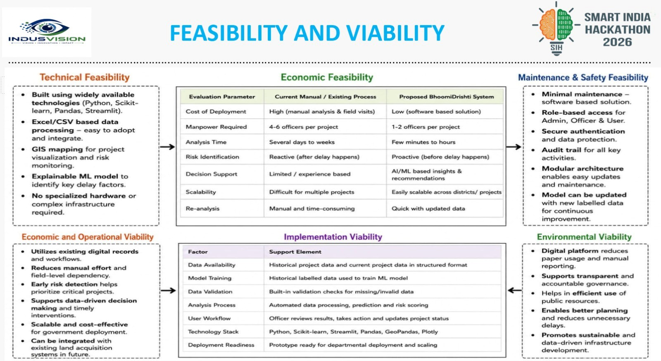

Slide 5
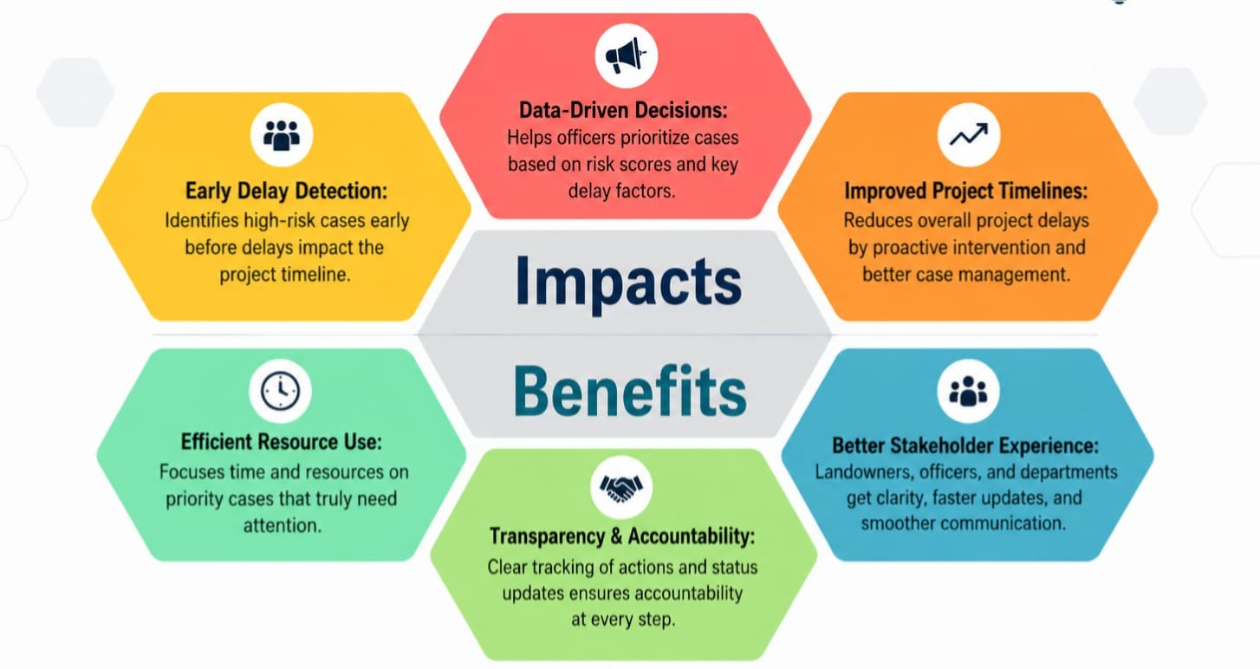
- - - - - - - - - - -- - - - - - - - - - -- - - - - - - - - - -- - - - - - - - - - -- - - - - - - - - - -- -
IMPACT AND BENEFITS

Slide 6
RESEARCH AND REFERENCES
...............................................................................................................................................................................................................
Field & Applied Research
•Studied the existing Land Acquisition, Compensation, Rehabilitation & Resettlement Information System (LACRRIS) to understand the current land-acquisition workflow, project monitoring and reporting.
•Examined acquisition stages including Social Impact Assessment (SIA), Preliminary Notification, Declaration, Award, Compensation Payment, Rehabilitation & Resettlement and Possession.
•Analysed how project and case-level information can be used to identify potential delay patterns and support early intervention by responsible officers.
Academic & Government Sources
• Department of Land Resources — Land Acquisition, Compensation, Rehabilitation & Resettlement Information System (LACRRIS):
https://www.larr.dolr.gov.in/
•LACRRIS User Manual: Official documentation covering user roles, project management, data entry, reporting and system workflow.
https://www.larr.dolr.gov.in/faces/pdf/user-manual-revised.pdf
• LACRRIS Land Acquisition Progress: Official project/state-wise information on acquisition progress and stages.
https://larr.dolr.gov.in/faces/public/rptLandAcqProg2.xhtml

