Slide 1
An AIoT Solution to prevent SIDS
- Sudden Infant Death Syndrome
Abhishek Herbert Samuel – 21011102004
Aman Bhat – 21011102013
Sashank Kumar Kakaraparty – 21011102043
B.Tech – CSE(IoT-A)
Mentor - Dr. S. Vidhusha
Shiv Nadar University Chennai

Slide 2
Motivation –
SIDS, also known as crib death, is the unexplained death of an infant, typically during sleep, and is the leading cause of mortality in infants aged 1 month to 1 year and is characterized by abnormal breathing, irregular body temperature and suffocation.
Sudden Infant Death Syndrome (SIDS) remains a critical concern for parents and healthcare professionals due to its unpredictable nature. Despite advancements in healthcare, SIDS continues to affect infants worldwide, causing significant distress and loss.
The motive behind our project is to blend Artificial Intelligence(AI) and Internet of Things(IoT) technologies to develop a solution that can monitor and analyse infant behaviour in real-time by providing early warnings.

Slide 3
Problem Statement –
Our project addresses the critical issue of SIDS, which is a significant risk to infants aged 1 month to 1 year, often occurring during sleep without any prior warning.
The lack of real-time monitoring of vital signs and movements can lead to delayed responses in emergencies, increasing the risk of mortality.
The proposed system aims to provide continuous monitoring and immediate alerts to parents and healthcare providers, thereby enhancing infant safety and reducing the incidence of SIDS.
The challenge lies in the inability to monitor vital signs and detect critical changes in an infant's condition during sleep, and by developing a comprehensive monitoring system that utilizes Artificial Intelligence, Internet of Things and Cloud technology to provide real-time alerts.
The proposed architecture is designed to be embedded within a smart cradle or infant bed.

Slide 4
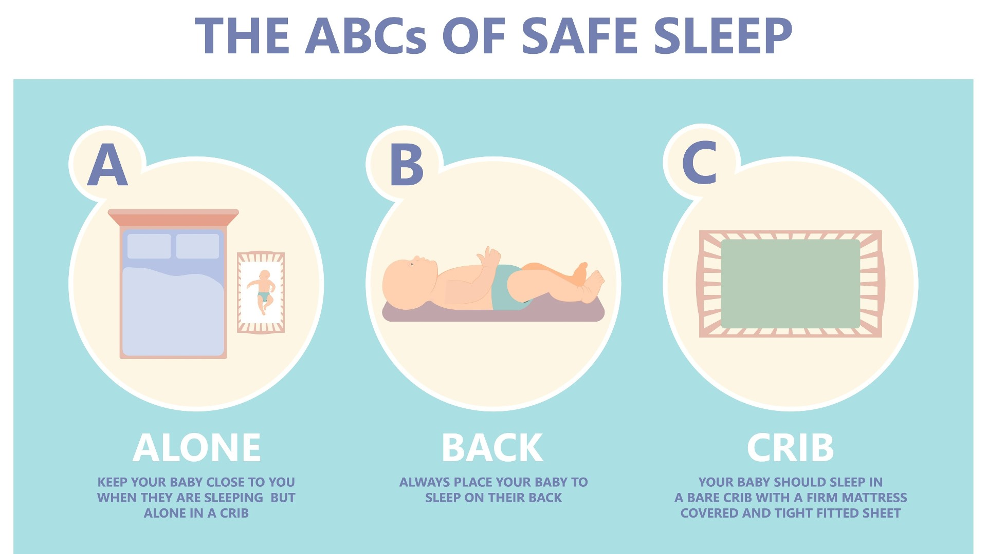


Slide 5
Literature Survey –
The literature survey for this paper examines various existing studies and technologies related to infant monitoring systems, particularly focusing on SIDS and the notable research include:
Infant Cry Classification - Research by Dror Lederman (2002) utilized Hidden Markov Models to classify infant cries, aiding in identifying potential health issues.
Monitoring Techniques - Studies like those by C.L. Parsley and S.J. Wilson (2005) explored methods for detecting respiratory events in infants, emphasizing the importance of real-time monitoring.
Wearable Technologies - Innovations such as the BBA bootee (2007) and sensory baby vests (2006) demonstrated the effectiveness of wearable multi-parameter monitors in tracking infant health metrics.
This survey highlights the evolution of monitoring technologies and highlights the need for integrated systems that deploy AI and IoT for enhanced infant safety and timely medical support.

Slide 6
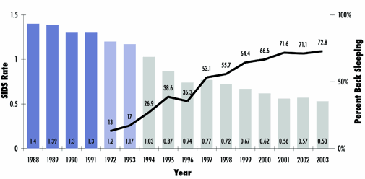
Gantt Chart –
The dark blue bars (1988-1991) are prior to the first AAP recommendation.
The light blue bars (1992-1993) are immediately after the AAP recommendation.
The grey bars (1994-present) are during the Back to Sleep campaign.
In India, as per a 2019 data, 32 infant deaths occur per 1000 live births.
In the US, the death rate due to SIDS was 90.1 deaths per 100,000 live births.

Slide 7
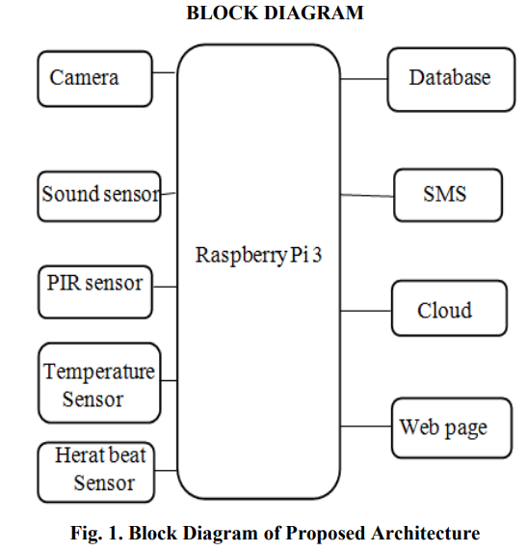
Proposed Architecture –
The proposed architecture is designed to be embedded within a smart cradle or infant bed.
It can be integrated into the structure of the cradle, allowing sensors to monitor the infant's vital signs and movements directly from the sleeping area.
This setup ensures continuous monitoring while providing a safe and comfortable environment for the baby.

Slide 8
Hardware -
Raspberry Pi 3 – For data processing and GPIO pins for sensor connectivity.
Heartbeat Sensor - Measures the infant's pulse rate; operates at 3.3V or 5V.
Temperature Sensor - Monitors the infant's body temperature to detect abnormalities.
Sound Sensor - Detects sound intensity and alerts if the infant cries above a certain threshold.
Camera Module - Captures video of the infant's movements for monitoring and analysis.
GSM Module - Enables SMS communication to alert parents when vital signs exceed thresholds.
Software -
Python - Programming language used to write the scripts for Raspberry Pi.
Cloud Storage - Used to store video data captured by the camera for later access by physicians.
AI/ML - Analyse input data from sensors to predict health outcomes to enhance monitoring
Encryption Algorithm - Provides data security during transmission between the cloud and users.
Protocols - HTTPS/MQTT for communication, allowing for the secure transfer of video and data.

Slide 9
Next Steps –
Non-tangible methods to detect pulse and oxygen rates of the infant.
Plan on deploying Heart sensors and Oxygen sensors under the mattress.
Understand the position of where to place the camera and other sensors.
Understand how to handle alert notifications.

