Slide 1
An AIoT Solution to prevent SIDS – Sudden Infant Death Syndrome
Abhishek Herbert Samuel – 21011102004
Aman Bhat – 21011102013
Sashank Kumar Kakaraparty – 21011102043
B.Tech CSE (IoT – A)
Mentor – Dr. S. Vidhusha
Shiv Nadar University Chennai

Slide 2
Approach -
We have divided our approach into two aspects which involves integrating sensors on the crib as well as design a PCB based smart band that too will consist some other sensors.
With respect to the smart-crib we plan to integrate a camera on the crib.
With respect to the smart band, we plan to develop one which will be placed on the baby’s wrist.
This smart band will be based on the PCB design and the SPO2 sensor, temperature sensor and the heart-beat sensor will be the main components of the band.
The radiations will be negligible and will not affect the infant’s health, hence making it safe for use.

Slide 3
Hardware Requirements –
Max30100 – It is an integrated pulse oximetry and heart-rate monitor sensor solution. It combines two LEDs, a photodetector, optimized optics, and low-noise analog signal processing to detect pulse oximetry and heart-rate signals.
IR Contactless Temperature sensor(MLX90614) – For measuring the current temperature of the baby.
ESP32 – Microcontroller that provides many GPIO pins that facilitate connection with and control of external devices and sensors. Provides wireless Wi-Fi and/or Bluetooth connectivity for embedded devices.
MAX30100 Pulse Oximeter and Heart Rate Sensor-Radiation: very low and safe Power consumption: pulse oximetry module - 600uA , heart rate module - 1.1mA MLX90614 Infrared (IR) Temperature Sensor- Radiation: no radiation emitted by the sensor, Power consumption: 1.5mA

Slide 4
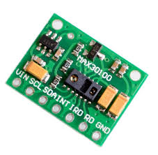
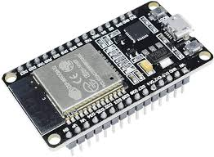
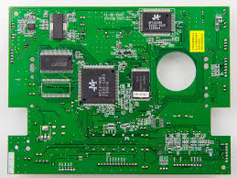
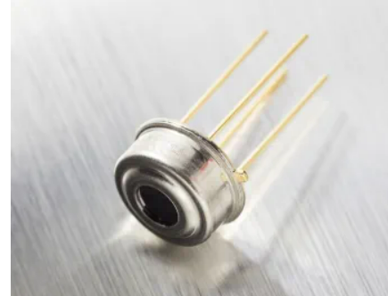
1. Max30100 2. ESP32 3. PCB 4.MLX90614
1
2
3
4

Slide 5
Software –
Programming for ESP32, developing an application to display infant’s health parameters.
Frontend: React Native
Backend: Python
Database: MySQL
CI/CD: GitHub

Slide 6
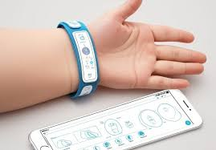
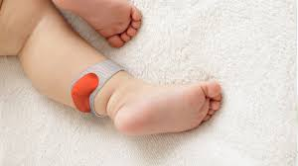
Advantages of following the contact approach –
Single piece of hardware to measure multiple vital signs.
Real - time high precision monitoring with timely alerts.
Portable and Affordable - can be used during transport.
Easy to use.

Slide 7
Advantages of the wearable –
Our wrist band will allow us to monitor them remotely while they are sleeping.
This allows us to know instantly when something is wrong after detecting abnormalities in a measured heartbeat or breathing pattern.
MAX30100 Pulse Oximeter and Heart Rate Sensor:
Radiation: very low and safe
Power consumption: pulse oximetry module - 600uA
heart rate module - 1.1mA
MLX90614 Infrared (IR) Temperature Sensor:
Radiation: no radiation emitted
Power consumption: 1.5mA

Slide 8
PCB -
A printed circuit board (PCB) is an electronic assembly that uses copper conductors to create electrical connections between components.
PCBs also provide mechanical support for electronic components so that a device can be mounted in an enclosure.
A rigid structure that contains electrical circuitry made up of embedded metal surfaces called traces and larger areas of metal called planes.
Components are soldered to the board onto metal pads, which are connected to the board circuitry which allows components to be interconnected.

Slide 9
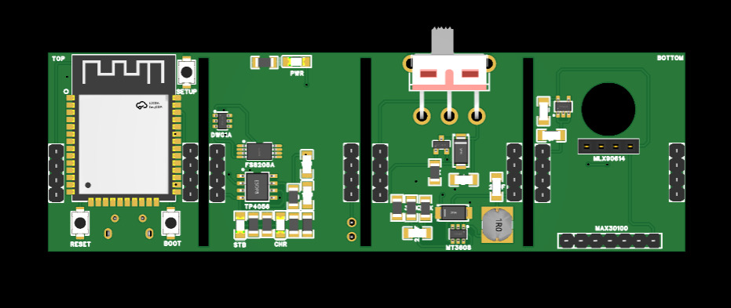
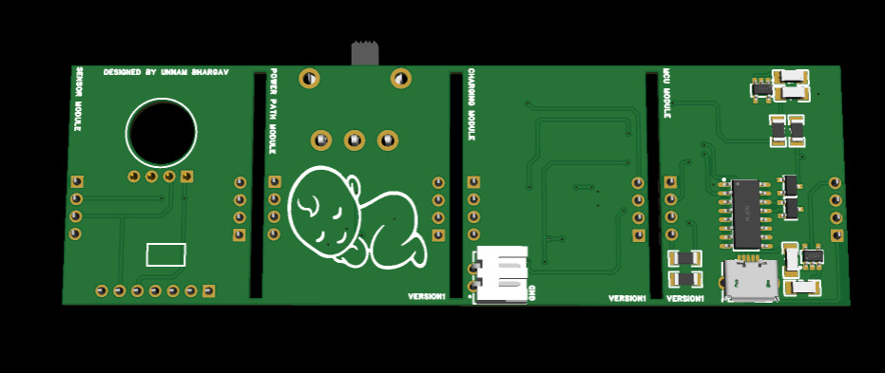
PCB DESIGN
TOP VIEW
BOTTOM VIEW
Top Layer:ESP32 and Programming Circuit.(CH340C,micro usb)
Second Layer: Power Management Circuit.(MT3608 buck boost)
Third Layer: Charging Circuit which offers dynamic charging method.(TP4056)
Bottom Layer: Temperature Sensor and spo2,heart rate sensor.(I2C to communicate with esp32)

Slide 10
Next Steps –
Our goal for Phase 1: Build an application that is capable of displaying the readings taken from the sensors for the following parameters: Pulse rate, SpO2, and Temperature.
Phase 2: Place the camera on the crib to capture the position of the infant 24*7 and implement AI Algorithms to detect abnormal movements and positions and alert the parents through the app.

