Slide 1
Department of Artificial Intelligence and Machine Learning
Machine Learning – Project Review
Course Code: 241AI005
PC Performance Predictor
Supervised Regression · pandas · scikit-learn · Linear Regression · Streamlit
Team No: 7
Done By:
Mohammed Akmal K M - 24B11AI262
Ch. Vijay Kumar - 24B11AI062
D. Sri Sashank - 24B11AI085
G. Sai Sri Pavan - 24B11AI139
Notes:
Replace the four name/roll-number placeholders with the team details.

Slide 2
Project Scope & Objectives
Overview of the Project
Predict the Performance Score (0–1000) of a desktop PC from 8 hardware and condition attributes.
Supervised learning (regression): every training PC has a known score.
Nine algorithms are trained and compared; the best one is chosen.
Only one model, Linear Regression, is deployed in the Streamlit PC-builder app.
Users pick real parts and the score updates live.
Objectives & Academic Scope
Clean raw data: types, duplicates, missing values, invalid rows.
Scale numbers and one-hot encode OS inside a leak-proof pipeline.
Tune with 5-fold CV (GridSearchCV); evaluate with MAE, MSE, RMSE, R².
Choose with the one-standard-error rule.
Diagnose bias–variance and regularisation (Ridge sweep).

Slide 3
Problem Statement
The Situation
Builders cannot easily tell how strong a PC will be before buying the parts.
Spec sheets list many numbers (RAM, cores, GPU tier, clock, age, temperature); their combined effect is not obvious.
No formula is given: the score must be learned from 503 labelled PCs.
A good model is accurate on unseen PCs, stable, and simple to explain.
Key Questions
Which specs drive the Performance Score most?
How accurately can the score be predicted, in points?
Which of many algorithms generalises best to unseen PCs?
Do we need nine models in the app, or just one?
What action does the result enable for a builder?

Slide 4
Solution Approach
1. LOAD + CLEAN
520 raw rows. Fix types, OS labels, duplicates, invalid and missing values. Keep 503.
2. ENCODE + SCALE
OS one-hot. StandardScaler z = (x − mean) / std, fitted on training data only.
3. TRAIN + TUNE
9 models, GridSearchCV, 5-fold CV, 80/20 split (402 train, 101 test).
4. SELECT + DEPLOY
One-SE rule picks Linear Regression. Refit on all rows and save for the app.
Why this design
Nine models are compared fairly with the same split and cross-validation, but only the winner is saved and used for predictions. Tools: Python, pandas, scikit-learn, joblib, Streamlit; fixed random_state = 42 for reproducibility.

Slide 5
Dataset Details
Feature | Type | Range / Values | Role
Record_ID | ID | 1 to 503 | Key, not a feature
RAM_GB | Integer | 4–64 GB | Input
CPU_Cores | Integer | 2–16 | Input
GPU_Level | Integer | 0–12 (0 = integrated) | Input
Storage_GB | Integer | 128–2048 GB | Input
Clock_GHz | Float | 2.0–5.0 GHz | Input
Age_Years | Float | 0–8 years | Input
Temperature_C | Float | 40–90 °C | Input
OS | Category | Windows / Linux | Input (one-hot)
Performance_Score | Float | 97.65–1000 | TARGET
Performance_Class | Category | Low … Very High | Derived, not used
At a Glance
Benchmark-style PC dataset.
Raw 520 rows, clean 503 rows.
8 inputs, 1 numeric target.
Score mean 509, median 510.
Windows 377, Linux 126.
Record_ID is never a feature.

Slide 6
Data Issues
520 × 11
raw shape
156
missing cells
6
duplicate rows
8
impossible rows
What is wrong
Missing: 26 cells in each of RAM, cores, storage, clock, temperature and OS.
Text numbers: 9 RAM values stored as “32GB”.
OS spellings: 11 variants (win10, Ubuntu, “ Windows”, LINUX …).
Impossible values: RAM 999, temperature 145, age −1.5, score 1450.
Why it matters
Models cannot learn from text such as “32GB” or from missing cells.
Duplicates leak between the train and test split and inflate the scores.
Impossible rows pull the fitted line away from real PCs.
Fix: coerce types, standardise OS, dedupe, range-filter, median/mode fill.

Slide 7
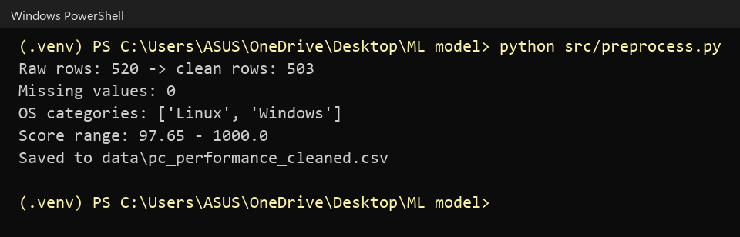
Preprocessing Output
What to read here
Raw 520 rows to 503 clean rows.
Missing values after cleaning: 0.
OS categories: Linux, Windows.
Score range 97.65–1000.
Output saved to pc_performance_cleaned.csv.
Preprocessing run: row counts, missing values and OS categories

Slide 8
Cleaning Steps
520
raw rows
514
after 6 duplicates
506
after 8 invalid rows
503
final clean rows
Cleaning pipeline
Coerce types: strip “GB” and spaces.
Standardise OS to Windows / Linux.
Drop exact duplicate rows.
Drop rows outside valid ranges.
Fill gaps: median (numbers), mode (OS).
Recompute class, round integers, dedupe again.
Deliberate choices
Median is robust to extreme builds.
Valid outliers are kept: they are real PCs.
Imputation uses the full file; scaling later uses training data only.

Slide 9
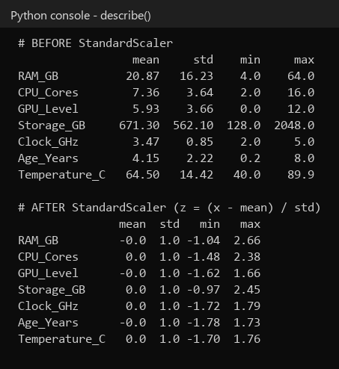
Scaling & Encoding
Before and after
Raw ranges differ widely: Storage 128–2048, Clock 2–5, GPU 0–12.
StandardScaler: z = (x − mean) / std, so every numeric column gets mean 0 and std 1.
OneHotEncoder turns OS into Linux / Windows columns.
Both steps sit in a ColumnTransformer inside the Pipeline.
They are fitted on training folds only, so no test information leaks.
Numeric columns before and after StandardScaler

Slide 10
Candidate Models
Model | Family | Hyperparameters searched
Linear Regression | Linear model | none (closed form)
Ridge Regression | Linear + L2 penalty | alpha: 0.1, 1, 10
KNN | Instance-based | k, weights, distance metric
SVR | Support vector machine | kernel, C, epsilon
Decision Tree | Tree | max_depth, min_samples_leaf
Random Forest | Ensemble: bagging | trees, depth, min leaf
Gradient Boosting | Ensemble: boosting | trees, learning rate, depth
Bagging | Ensemble: bagging | max_samples
AdaBoost | Ensemble: boosting | trees, learning rate
All nine share the same preprocessing pipeline, the same 80/20 split and the same 5-fold cross-validation.

Slide 11
The Selected Model
Linear Regression (OLS)
Score = intercept + Σ (weight × scaled feature).
Weights minimise the sum of squared errors, in closed form.
No hyperparameters to tune.
Intercept 507.6: the score of an average PC.
Each weight is points per +1 std of a feature.

Slide 12
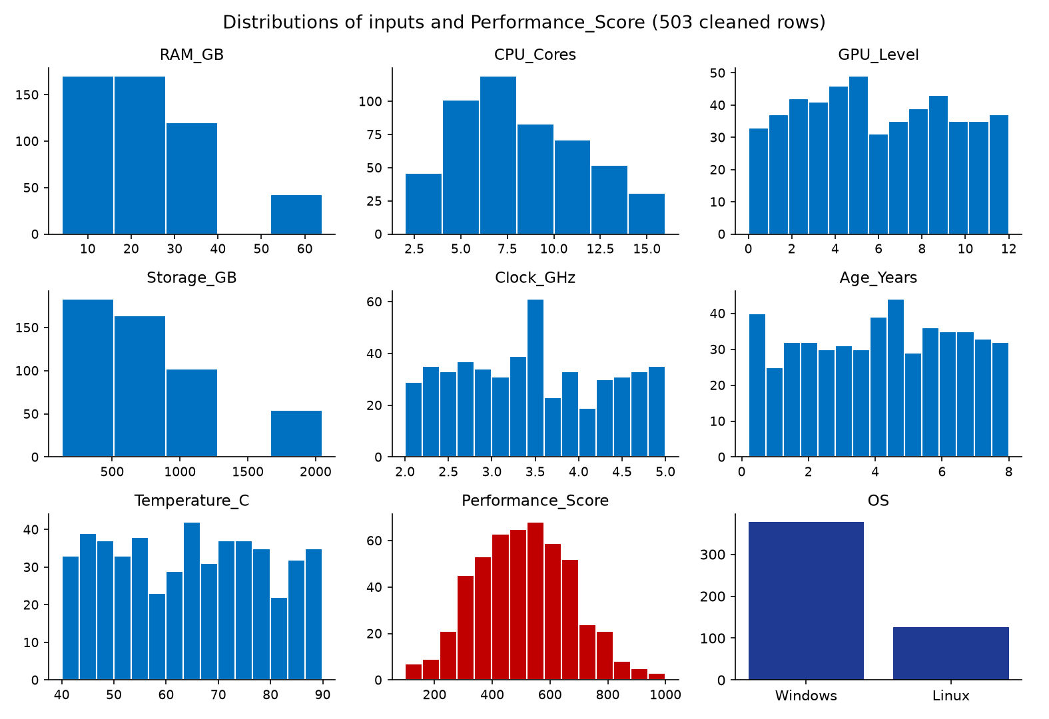
EDA: Distributions
Key observations
Score is bell-shaped, centred near 510 (range 98–1000).
RAM, cores, storage take a few discrete values.
Temperature, clock and age are spread fairly evenly.
Windows is about 3× more common than Linux.
Distributions of inputs and Performance_Score

Slide 13
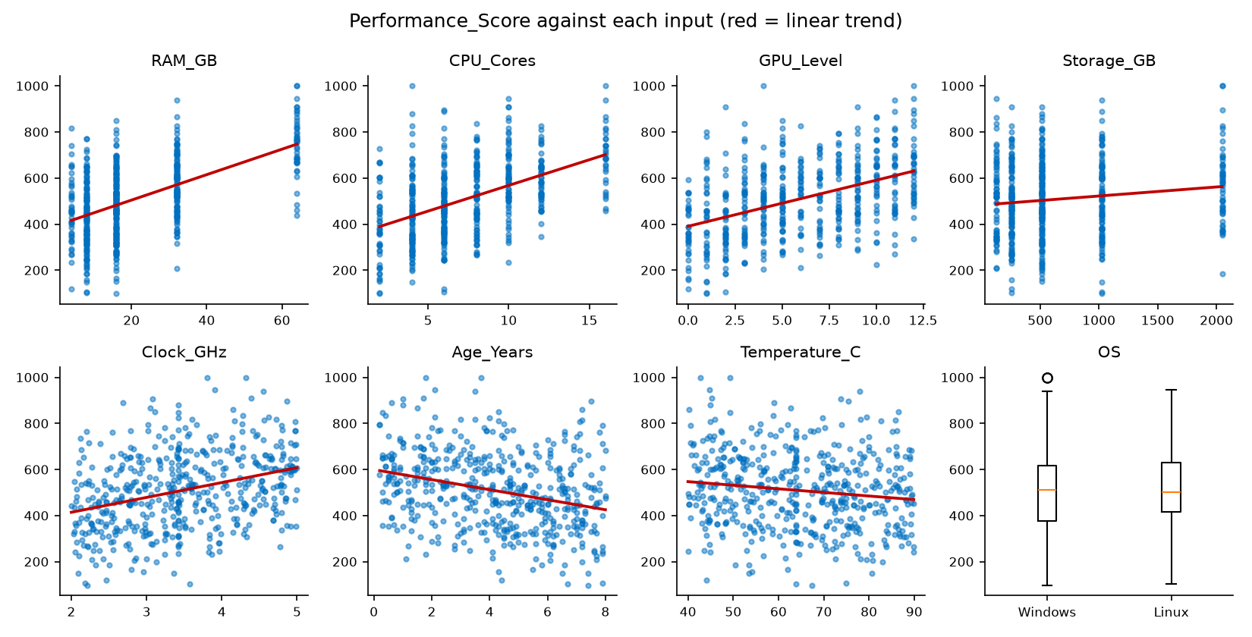
EDA: Score vs Specs
Key observations
Score rises with RAM, cores and GPU level.
Older and hotter PCs score lower.
Positive trends for RAM, cores and GPU; negative for age and temperature.
Moderate, steady trends suggest a simple model may be enough.
Performance_Score against each input

Slide 14
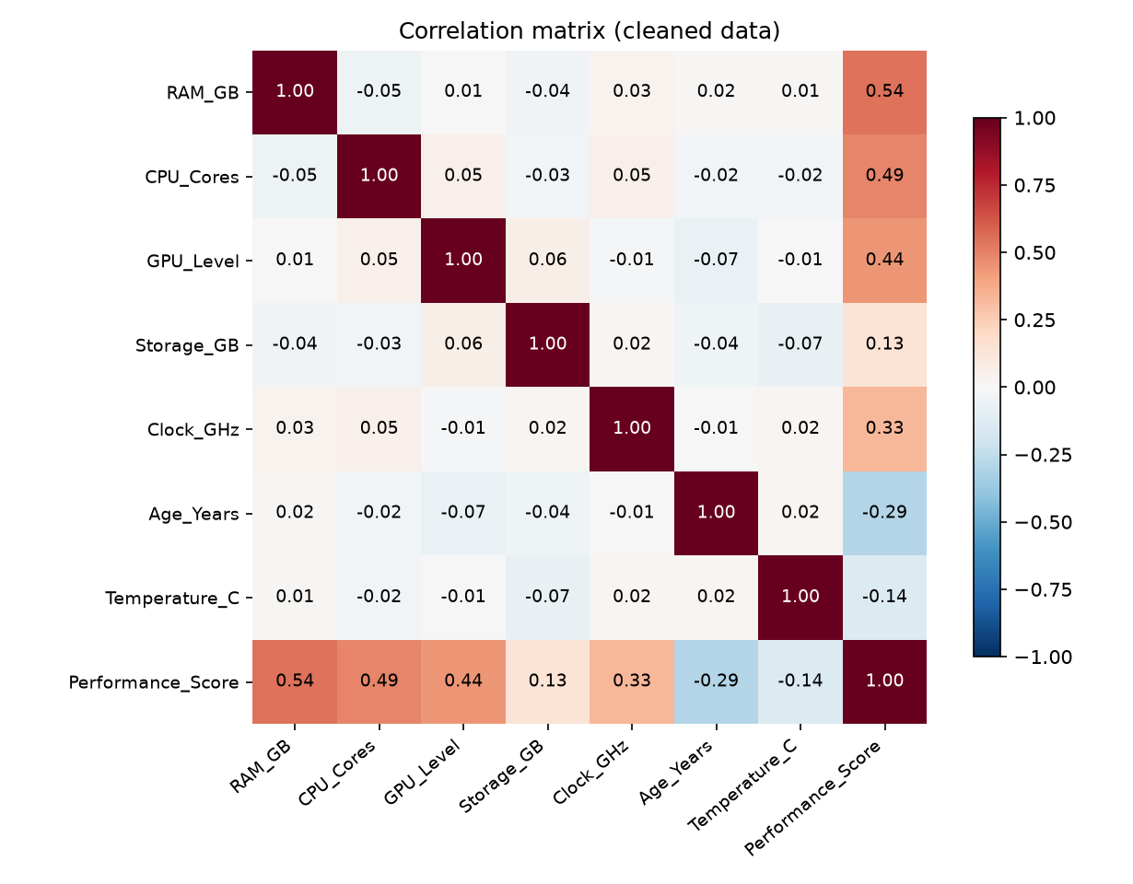
Correlation Heatmap
Key observations
Correlation with score: RAM 0.54, cores 0.49, GPU 0.44, clock 0.33.
Age −0.29 and temperature −0.14 pull it down.
Storage is weak at 0.13.
The strongest links are RAM, cores and GPU, the three largest weights.
Pearson correlation matrix

Slide 15
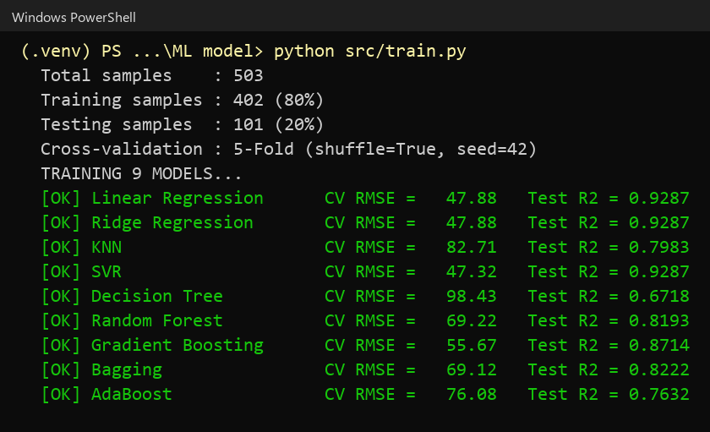
Training & Tuning
402
training rows (80%)
101
test rows (20%)
5
CV folds, shuffled
9
models tuned
How tuning works
GridSearchCV tries every setting for a model.
Each is scored by 5-fold CV RMSE.
The best setting is then tested once on the 101 held-out PCs.
Training run: CV RMSE and test R² for each model

Slide 16
Model Comparison
Model | CV RMSE | Train R² | Test R² | Test RMSE | Test MAE
SVR | 47.32 | 0.919 | 0.929 | 44.12 | 33.33
Linear Regression | 47.88 | 0.920 | 0.929 | 44.12 | 33.84
Ridge Regression | 47.88 | 0.920 | 0.929 | 44.12 | 33.85
Gradient Boosting | 55.67 | 0.958 | 0.871 | 59.27 | 45.29
Bagging | 69.12 | 0.974 | 0.822 | 69.69 | 53.29
Random Forest | 69.22 | 0.975 | 0.819 | 70.26 | 53.55
AdaBoost | 76.08 | 0.904 | 0.763 | 80.42 | 62.48
KNN | 82.71 | 1.000 | 0.798 | 74.22 | 57.31
Decision Tree | 98.43 | 0.873 | 0.672 | 94.68 | 77.86
Sorted by CV RMSE. Highlighted row = the deployed model.

Slide 17
Choosing the Final Model
One-standard-error rule
Best CV RMSE: SVR, 47.32.
Standard error: 6.73 / √5 = 3.01.
Threshold: 47.32 + 3.01 = 50.33.
Within it: SVR, Linear, Ridge.
They are statistically tied, so the simplest wins: Linear Regression.

Slide 18
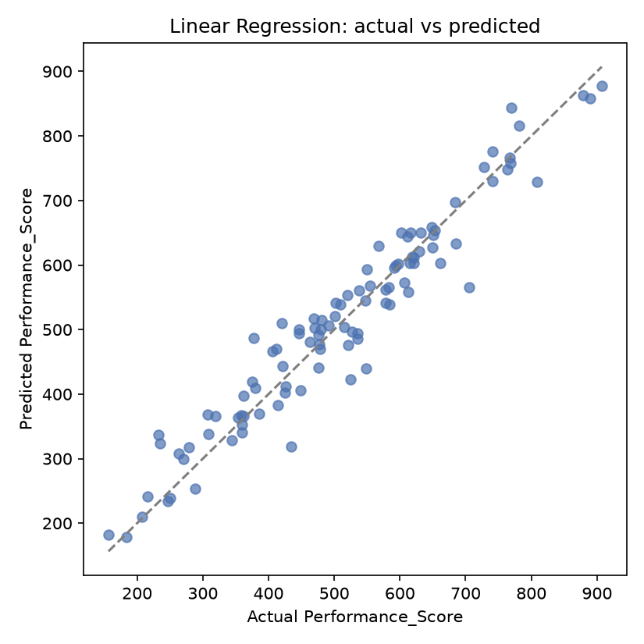
Final Model Performance
0.929
Test R²
33.84
Test MAE
44.12
Test RMSE
1946.5
Test MSE
What it means
93% of score variation explained on unseen PCs.
Typical error is about 34 points on a 1000-point scale.
Train R² 0.920 vs test 0.929: no overfitting.
Linear Regression: actual vs predicted

Slide 19
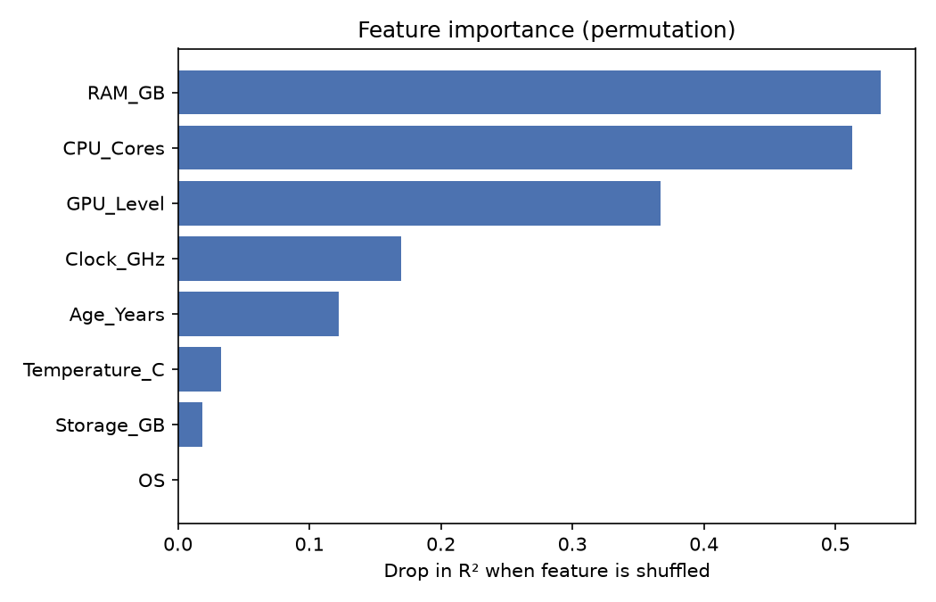
Feature Importance
Permutation importance
RAM_GB 0.53 and CPU_Cores 0.51 matter most.
GPU_Level 0.37, Clock_GHz 0.17, Age 0.12.
Temperature 0.03 and Storage 0.02 are minor.
OS is about 0.001: effectively irrelevant.
Drop in R² when each feature is shuffled

Slide 20
Bias–Variance Check
Reading the gap
Linear, Ridge, SVR: test ≥ train, so no overfitting.
Bagging, Forest, AdaBoost, KNN, Tree: gap above 0.14, so they overfit.
KNN memorises training data (train R² 1.000).

Slide 21
Regularisation: Ridge Sweep
Why Ridge adds nothing
Alpha 0.01–1: error stays at 47.88.
Alpha 100+: coefficients shrink too much, so it underfits.
Best alpha is tiny, so Ridge equals plain Linear Regression.

Slide 22
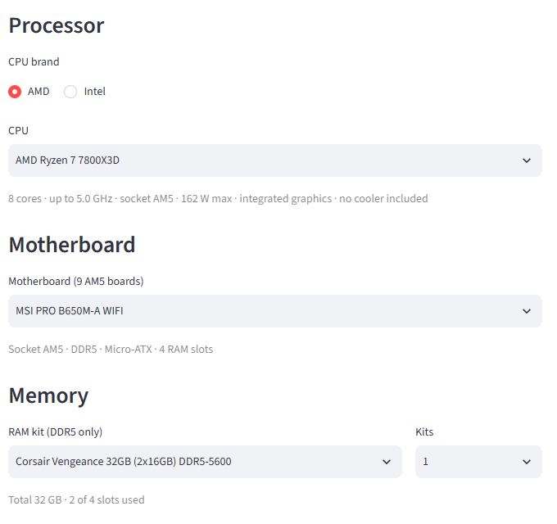
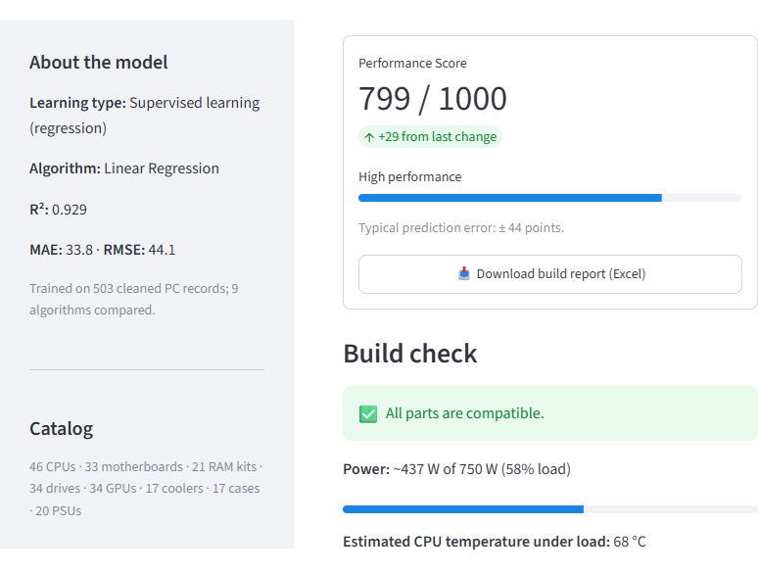
Deployed Application
PC parts
CPU, GPU, RAM, storage, cooler, OS
8 features
Derived from the chosen parts
Saved pipeline
Scaler + encoder + Linear Regression
Score
0–1000 with tier label
One model is used for every prediction: Linear Regression, loaded from performance_model.joblib.
Part-by-part builder
Live score and model metrics in the sidebar

Slide 23
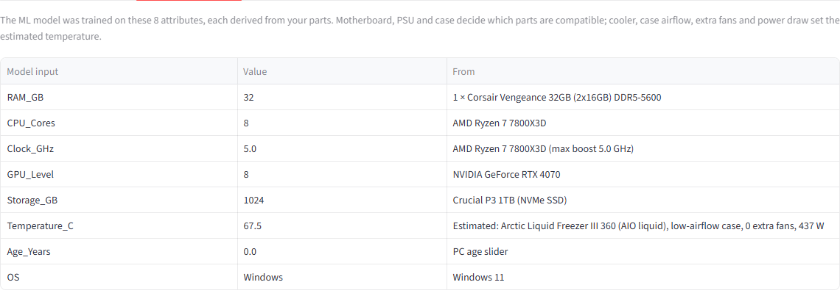
What the Model Sees
The 8 model inputs, each derived from the chosen parts
The pipeline scales the 7 numeric inputs, one-hot encodes OS, and Linear Regression returns the score.

Slide 24
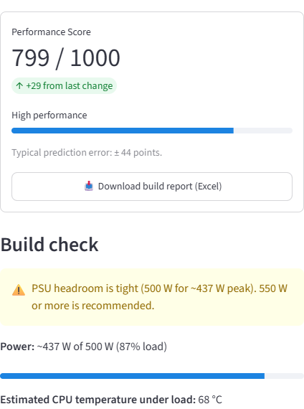
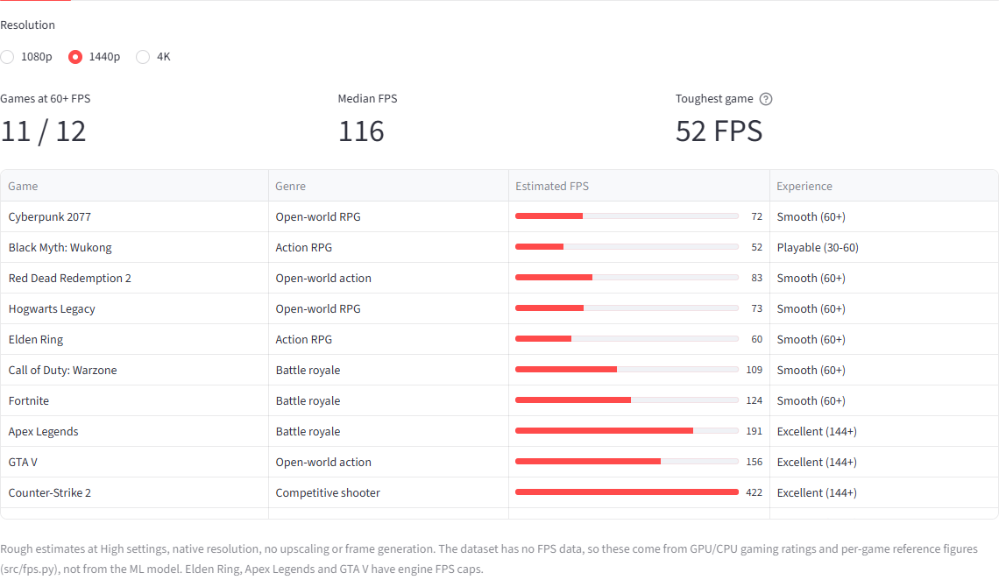
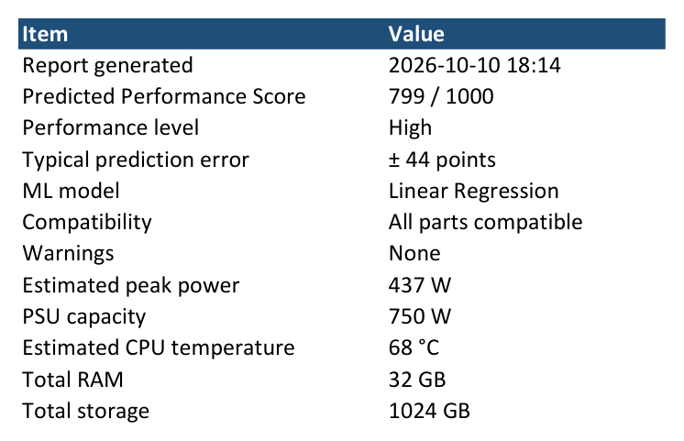
Application Extras
Build check (example: PSU headroom warning)
Estimated game FPS
Excel report export
Only the Performance Score comes from the ML model. Compatibility, power, temperature and FPS use rule-based formulas.

Slide 25
Conclusion
Summary
520 raw rows cleaned to 503 and fed to one leak-proof pipeline.
Nine models compared with 5-fold CV and a held-out test set.
Linear Regression chosen: Test R² 0.929, RMSE 44.1, MAE 33.8.
Deployed in the Streamlit app as the only model.
Limits & Next Steps
Only 503 benchmark-style rows; real benchmarks would help.
Linear fit may miss interactions between parts.
Scores cap at 1000; inputs beyond the training ranges are clipped.
Next: more data, interaction features, drift monitoring.

Slide 26
Thank You!
One clean pipeline. Nine models compared. One model deployed.
Questions & Discussion
Team No: 7 · Course Code: 241AI005

