Slide 1

PC Performance Predictor
Predicting a PC's performance score from its hardware using supervised learning (regression), with a real-time PC builder app
Team 7 (TT - 5)
Mohammed Akmal K M 24B11AI262
Sri Naga Vijay Kumar Chikkala 24B11AI062
Sri Sashank Devarakonda 24B11AI085
Sai Sri Pavan Guvvala 24B11AI139
Notes:
Introduce the team and the project: a supervised regression model that predicts a PC's Performance Score from its hardware, built into a real-time PC builder app.

Slide 2




Problem, objectives and learning type
Estimating how fast a PC will be from its individual parts is hard, and benchmarking every configuration by hand is slow. Raw performance records are also messy, with missing, duplicate and impossible values.
Learning type
Supervised learning: Regression
Input (X)
8 attributes: RAM, CPU cores, GPU level, storage, clock speed, age, temperature, OS
Objectives
Clean the raw data into an ML-ready dataset
Output (y)
Performance_Score, a number from 0 to 1000
Train and compare supervised regression models
Labelled data
503 PCs, each with a known score
Predict Performance_Score (0-1000) from 8 attributes
Not unsupervised
No clustering: the target is already known
Build an app that predicts the score for any PC build
Not classification
We predict a number, not a Low / High class
Notes:
The problem: there are thousands of PC configurations and no easy way to estimate performance without benchmarking, and raw records are messy. Our four objectives follow from that. The learning type is supervised regression: every PC in the data has a known score, and we predict a number, so we do not need unsupervised methods such as clustering, or classification.

Slide 3
The dataset and what was wrong with it
520
156
missing cells
11
OS spellings
26 each in RAM, cores, storage, clock, temperature, OS
Win10, WINDOWS, Ubuntu, 'Linux ' ... plus 26 blanks
raw PC records
11
9
RAM values as text
9
duplicate rows
Entries like ' 32GB' instead of a number
6 exact copies, 3 more after cleaning
attributes per record
8 physically impossible values, removed with valid domain limits
503
GPU level 25
0 CPU cores
145 °C
Age -1.5 years
clean records
RAM 999 GB
Clock 12.4 GHz
Storage -256 GB
Score 1450
Notes:
520 raw records with 11 attributes each. Before cleaning we found 156 missing cells (26 in each of six columns), 11 different spellings of the operating system plus 26 blanks, 9 RAM values stored as text, 9 duplicate rows and 8 values that are physically impossible.

Slide 4
Preprocessing: from 520 to 503 clean rows
1
2
3
4
5
6
7
Fix data types
Standardize OS
Remove duplicates
Filter invalid values
Impute missing
Recompute class
Round & dedupe
Strip 'GB', convert to numbers
11 spellings to Windows / Linux
Ignoring Record_ID
Domain limits per column
Median for numbers, mode for OS
From the cleaned score
Integer columns, second pass
520 → 503
0
0
2
rows in → rows out
missing values
duplicate rows
OS categories
Notes:
src/preprocess.py applies seven steps in this order. The result exactly matches the cleaned CSV from Review-1. Encoding and scaling are not done here; they happen inside the model pipeline so they are fitted on the training data only.

Slide 5
What the clean data shows
Class thresholds: Low below 400, Medium 400 to under 650, High 650 to under 850, Very High 850+. Mean score 509, median 510.
Notes:
Left: more than half the PCs are Medium; Very High has only 11 PCs. Scores average 509 and range from 97.65 to 1000. Right: RAM, CPU cores and GPU level have the strongest positive correlation with the score; age and temperature lower it; storage barely matters.

Slide 6
Nine supervised regression models compared
80/20 split (402 train / 101 test) · StandardScaler + one-hot OS in a pipeline · 5-fold GridSearchCV
Model | Family (unit) | CV RMSE | Train R² | Test R² | Test RMSE
SVR (linear kernel) | SVM (III) | 47.32 ± 6.73 | 0.919 | 0.929 | 44.12
Linear Regression | Linear model (III) | 47.88 ± 6.32 | 0.920 | 0.929 | 44.12
Ridge Regression | Linear + L2 (III, V) | 47.88 ± 6.32 | 0.920 | 0.929 | 44.12
Gradient Boosting | Boosting (V) | 55.67 ± 4.52 | 0.958 | 0.871 | 59.27
Bagging | Bagging (V) | 69.12 ± 4.65 | 0.974 | 0.822 | 69.69
Random Forest | Bagging (V) | 69.22 ± 4.70 | 0.975 | 0.819 | 70.26
AdaBoost | Boosting (V) | 76.08 ± 5.52 | 0.904 | 0.763 | 80.42
kNN (k = 7) | Instance-based (II) | 82.71 ± 7.39 | 1.000 | 0.798 | 74.22
Decision Tree | Tree | 98.43 ± 3.07 | 0.873 | 0.672 | 94.68
Final model: Linear Regression. SVR, Linear and Ridge are within one standard error of the best CV RMSE (47.32 + 6.73 ÷ √5 = 50.33), so the simplest is chosen. kNN overfits: 1.00 on training data, 0.80 on test data.
Notes:
Setup: 80/20 split (402 training, 101 test PCs). Each model is a pipeline that scales the 7 numeric attributes and one-hot encodes OS, tuned with 5-fold GridSearchCV. Training vs test R² shows overfitting: kNN scores 1.00 on training data but 0.80 on test data. SVR, Linear and Ridge are within one standard error of each other, so we keep the simplest, Linear Regression.

Slide 7


Final model: Linear Regression
Score = b₀ + b₁·RAM + b₂·Cores + b₃·GPU + b₄·Storage
+ b₅·Clock + b₆·Age + b₇·Temp + b₈·OS
OS is one-hot encoded; numeric attributes are standardized
0.929
33.8
44.1
R² on test set
MAE (points)
RMSE (points)
Fitted by ordinary least squares: minimizes Σ (actual − predicted)²; equal to the MLE under Gaussian noise (Unit II)
Ridge (L2) check: α up to 10 barely changes the error (CV RMSE 47.9 → 48.2); α = 10,000 underfits (160)
Notes:
Linear Regression predicts the score as a weighted sum of the attributes. The weights are fitted by ordinary least squares, which is the maximum-likelihood estimate when errors are Gaussian. On 101 unseen PCs it explains about 93% of the variation, with a typical error of about 34 points. Strong Ridge regularization only made it worse, so no penalty is needed.

Slide 8
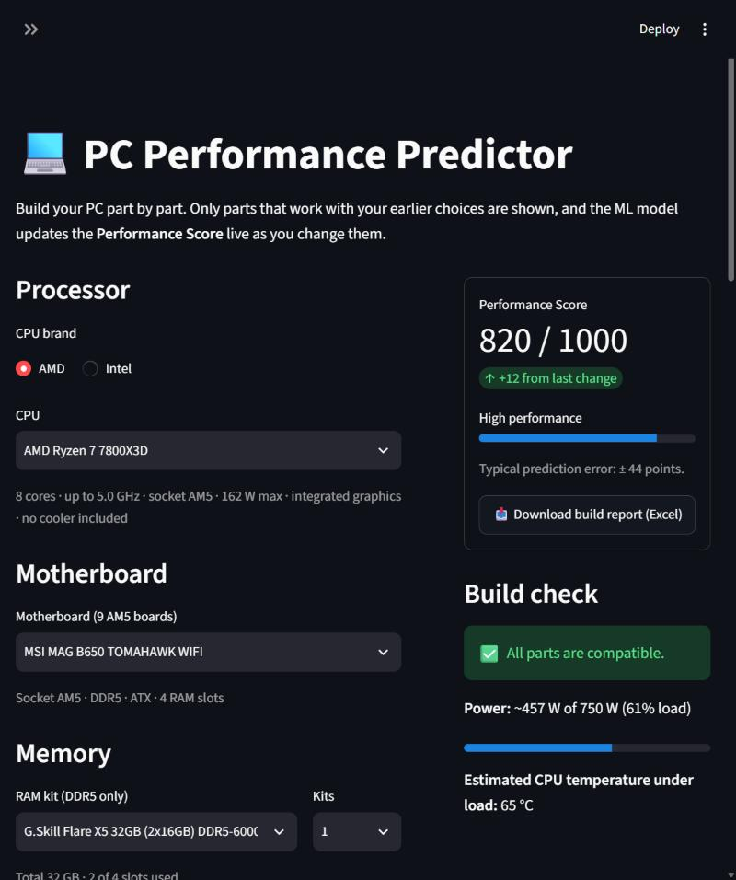





The PC builder app
Real-time filtering
AMD Ryzen 7 7800X3D → only AM5 boards → only DDR5 RAM; weak PSUs hidden
Compatibility checks
Socket, memory type, RAM slots, case size, PSU wattage, cooler, display output
Parts → 8 model inputs
Temperature estimated from cooler, case and power; values beyond the training range are capped
Live score
Linear Regression predicts the score instantly; e.g. 820 / 1000 for the build shown
FPS estimate and Excel report
12 games at 3 resolutions (rule-based); one-click .xlsx with score and parts
Notes:
The Streamlit app lets a user pick real parts from a 222-part catalog. Each choice filters the next, the build is checked for compatibility, converted into the 8 model inputs, and the score updates live. Game FPS is a separate rule-based estimate, not the ML model, because the dataset has no FPS data.

Slide 9
Syllabus mapping: Units I-V
Unit | Syllabus topics | Used in this project
I | Types of ML, main challenges, statistical learning | Supervised, batch, model-based learning; messy raw data cleaned (520 → 503 rows)
II | kNN, distance metrics, MLE | kNN tuned: k, uniform vs distance weights, Euclidean vs Manhattan; least squares = MLE
III | Linear Regression, SVM and kernels | Final model: Linear Regression. SVR with linear vs RBF kernel (linear won)
IV | Evaluation, cross-validation, encoding | 80/20 split, 5-fold CV, MAE / MSE / RMSE / R²; duplicates removed; OS one-hot encoded
V | Ensembles, overfitting, regularization | Bagging, Random Forest, Gradient Boosting, AdaBoost; train vs test R²; Ridge α sweep; one-SE rule
Not used: clustering (unsupervised; our data is labelled) · logistic regression, Naive Bayes and classification metrics (we predict a number, not a class) · Find-S / Candidate Elimination (boolean concepts only)
Notes:
How the course units appear in the project. Unit III gives the final model; Units II, III and V supply the alternatives we compared; Unit IV is how we evaluated them. Clustering, classification methods and concept learning were not used, for the reasons at the bottom.

Slide 10
Conclusion, limitations and future scope
Results
Limitations
Future scope
520 raw records cleaned to 503
Linear Regression: test R² 0.929, RMSE 44.1
Chosen from 9 supervised regression models
Real-time PC builder with 222 catalog parts
Small dataset: only 503 PCs
Modern parts exceed the training ranges and are capped
GPU tier and temperature in the app are estimates
FPS is rule-based, not learned
Train on real benchmark data
Learn FPS from real game benchmarks
Budget-based build suggestions
Deploy the app online
Thank you
Questions?
Notes:
Summarize the results, be upfront about the limitations, mention the next steps, then take questions.

