Slide 1

PC Performance Predictor
Predicting a PC's performance score from its hardware with supervised learning (regression), plus a real-time PC builder with game FPS estimates and Excel reports
Team 7 (TT - 5)
Mohammed Akmal K M 24B11AI262
Sri Naga Vijay Kumar Chikkala 24B11AI062
Sri Sashank Devarakonda 24B11AI085
Sai Sri Pavan Guvvala 24B11AI139
Notes:
Introduce the project and the team. The system predicts a numeric Performance Score for any PC from its hardware and condition, and wraps the model in a real-time PC builder app.

Slide 2
Agenda
01
02
03
04
Problem & objectives
Dataset & preprocessing
Exploratory analysis
Model training & results
Why predict PC performance, and the learning type
520 raw records to 503 clean ones
Score distribution and key drivers
9 supervised algorithms, best R² = 0.929
05
06
07
08
The PC builder app
Syllabus mapping
Limitations & future scope
Conclusion
Real-time builder, FPS, Excel export
Units I-V of the course in this project
What to improve next
Key takeaways and questions
Notes:
Walk through the eight parts of the talk: the problem, the data and how we cleaned it, what the data shows, the models we trained, the app we built, how the project maps to the course syllabus, and what comes next.

Slide 3
Problem & Objectives
01
Why estimating PC performance is hard, and what we set out to build

Slide 4




Judging PC performance from parts is hard
A PC's speed depends on how its CPU, GPU, memory, storage, age and cooling work together. With thousands of possible configurations, estimating performance from individual specs is guesswork, and benchmarking every build by hand is slow and costly.
Too many combinations
CPUs, GPUs, RAM and storage multiply into thousands of builds
Specs are hard to compare
Cores, clocks and GPU tiers don't add up in an obvious way
Raw performance records add another problem: inconsistent units and labels, duplicate rows, missing sensor readings and physically impossible values.
Benchmarking is slow
Testing every configuration needs the hardware in hand
Raw data is messy
Missing, duplicate and invalid records hurt analysis
Notes:
There are thousands of possible part combinations and no simple way to tell how fast a build will be without benchmarking it. On top of that, real-world PC records are messy, which makes any analysis unreliable until the data is cleaned.

Slide 5



Project objectives
01
02
03
04
Clean the data
Train & compare models
Predict the score
Build a usable app
Turn 520 inconsistent raw records into a reliable, ML-ready dataset
Evaluate 7 regression algorithms with 5-fold cross-validation
Estimate Performance_Score (0-1000) from 8 PC attributes
Real-time PC builder with compatibility checks, FPS and Excel export
Notes:
Four objectives: clean the data, train and compare models, predict the score, and make it usable through an app that anyone can use to build a PC and see its predicted performance.

Slide 6


Learning type: supervised learning (regression)
8 attributes (X)
Model f(X)
Performance_Score (y)
RAM, cores, GPU, storage, clock, age, temperature, OS
Learned from 402 labelled PCs
A number from 0 to 1000
Supervised learning: what we use
Unsupervised learning: not used
Labelled data: 503 PCs, each with a known score
Regression task: the output is a continuous number
Batch, model-based learning: trained once, then predicts new PCs
Works on unlabelled data to find groups (clustering)
Not needed: our target, Performance_Score, is known
Classification (Low / High classes) is also not our task
Notes:
This is a supervised learning problem. Every training example is a PC whose Performance Score is already known, so the model learns from labelled data. The output is a number from 0 to 1000, which makes it regression rather than classification. We do not use unsupervised learning such as clustering, because there is no need to discover groups: the target is given.

Slide 7
Dataset & Preprocessing
02
520 raw PC records, 11 attributes, and the steps that made them reliable

Slide 8
The dataset: 11 attributes per PC
520
Attribute | Description | Type
RAM_GB | Installed RAM in GB | Numeric
CPU_Cores | Number of CPU cores | Numeric
GPU_Level | GPU performance tier (0-12) | Numeric
Storage_GB | Storage capacity in GB | Numeric
Clock_GHz | CPU clock speed in GHz | Numeric
Age_Years | Age of the PC in years | Numeric
Temperature_C | Operating temperature in °C | Numeric
OS | Operating system | Categorical
Performance_Score | Measured performance (0-1000) | Target
Performance_Class | Low / Medium / High / Very High | Derived label
Record_ID | Unique record identifier | Identifier
raw PC records
11
attributes per record
503
clean records after preprocessing
Notes:
Each record describes one PC: seven numeric hardware and condition attributes, the operating system, the measured Performance Score and its class. Cleaning reduced 520 records to 503.

Slide 9

What was wrong with the raw data
156
11
9
9
missing cells
OS spellings
RAM values as text
duplicate rows
26 each in RAM, cores, storage, clock, temperature and OS
Win10, WINDOWS, Windows 10, Ubuntu, linux and more, plus 26 blanks
Entries like ' 32GB' instead of a number
Identical apart from Record_ID (6 + 3 after rounding)
8 physically impossible values
Filtered out using valid domain limits for each attribute
GPU level 25
0 CPU cores
145 °C
Age -1.5 years
RAM 999 GB
Clock 12.4 GHz
Storage -256 GB
Score 1450
Notes:
We profiled the raw file before cleaning. Six columns each had 26 missing values, the OS column had 11 different spellings plus blanks, some RAM values were stored as text, there were duplicate rows, and 8 records contained values that cannot physically exist.

Slide 10
Seven-step preprocessing pipeline
1
2
3
4
5
6
7
Fix data types
Standardize OS
Remove duplicates
Filter invalid values
Impute missing
Recompute class
Round & dedupe
Strip 'GB', convert to numbers
11 spellings to Windows / Linux
Ignoring Record_ID
Domain limits per column
Median for numbers, mode for OS
From the cleaned score
Integer columns, second pass
520 → 503
0
0
2
rows in → rows out
missing values
duplicate rows
OS categories
Notes:
src/preprocess.py runs these seven steps in order. The output exactly matches the team's cleaned CSV from Review-1: 503 rows, no missing values, no duplicates and two OS categories. Encoding and scaling are deliberately left to the model pipeline.

Slide 11
Exploratory Analysis
03
How scores are distributed and which attributes drive them

Slide 12
Most PCs fall in the Medium class
Performance Score
509 mean
510 median
97.6 minimum
1000 maximum
Class thresholds
Low below 400
27%
Medium 400 - 649
53%
High 650 - 849
18%
Very High 850 and above
2%
Notes:
Over half of the PCs are Medium. Very High has only 11 records, about 2 percent, which is a class imbalance to keep in mind for any classification work. Scores average about 509 and range from 97.6 to 1000.

Slide 13



RAM, CPU cores and GPU drive the score
Strongest positive
RAM (0.54), CPU cores (0.49) and GPU level (0.44)
Negative effects
Older and hotter PCs score lower (age -0.29, temperature -0.14)
Barely matters
Storage capacity has only a weak link to the score (0.13)
Notes:
Correlation of each attribute with the Performance Score on the clean data. RAM, CPU cores and GPU level have the strongest positive relationship, age and temperature pull the score down, and storage capacity barely matters.

Slide 14
Model Training & Results
04
Nine supervised regression algorithms, tuned with cross-validation

Slide 15







Training pipeline
1
2
3
4
Clean data
Train / test split
Preprocess
Tune 9 models
503 rows, 8 features, target = Performance_Score
80 / 20: 402 train rows, 101 test rows
StandardScaler on 7 numbers, one-hot encode OS
GridSearchCV with 5-fold cross-validation
5
6
7
Pick the model
Evaluate
Save
One-standard-error rule on CV RMSE
MAE, MSE, RMSE and R² on the 101 test rows
Refit on all 503 rows, save with joblib
Scaling and encoding sit inside the pipeline, so they are fitted on the training split only: no data leakage.
Notes:
src/train.py. We split 80/20, wrap each algorithm in a scikit-learn pipeline that scales the seven numeric features and one-hot encodes OS, and tune hyperparameters with 5-fold GridSearchCV. The best model is picked on cross-validation RMSE only, so the test set stays unbiased.

Slide 16
Nine supervised algorithms compared
Model | Family and unit | CV RMSE | Test RMSE | Test R²
SVR (linear kernel) | SVM, Unit III | 47.32 ± 6.73 | 44.12 | 0.929
Linear Regression | Linear model, Unit III | 47.88 ± 6.32 | 44.12 | 0.929
Ridge Regression | Linear + L2, Unit III / V | 47.88 ± 6.32 | 44.12 | 0.929
Gradient Boosting | Boosting, Unit V | 55.67 ± 4.52 | 59.27 | 0.871
Bagging | Bagging, Unit V | 69.12 ± 4.65 | 69.69 | 0.822
Random Forest | Bagging, Unit V | 69.22 ± 4.70 | 70.26 | 0.819
AdaBoost | Boosting, Unit V | 76.08 ± 5.52 | 80.42 | 0.763
KNN (k = 7, distance-weighted) | Instance-based, Unit II | 82.71 ± 7.39 | 74.22 | 0.798
Decision Tree | Tree, Unit V | 98.43 ± 3.07 | 94.68 | 0.672
Highlighted: the final model. CV RMSE is the 5-fold mean ± standard deviation on 402 training PCs; test scores use the 101 held-out PCs.
Notes:
All nine models, sorted by cross-validation RMSE, with the syllabus unit each one comes from. SVR (which chose a linear kernel), Linear Regression and Ridge are effectively tied at the top. Ensembles come next, and kNN and a single decision tree do worst.

Slide 17

Overfitting check: training vs test R²
Linear models generalize
Training 0.92, test 0.93: no gap, low variance
kNN overfits
Training 1.00, test 0.80: it memorizes the training PCs
Ensembles help trees
Bagging and boosting beat a single tree (0.67) but still overfit
Notes:
Comparing the score on training data with the score on unseen test data shows bias and variance. The linear models score the same on both, so they generalize. kNN scores a perfect 1.00 on training data but 0.80 on new data: it memorizes the training PCs, which is high variance. The tree ensembles also drop noticeably.

Slide 18
Regularization and choosing the final model
One-standard-error rule
Pick the simplest model whose CV RMSE is within one standard error of the best.
SVR (linear kernel)
47.32
Linear Regression
47.88
Ridge Regression
47.88
Threshold: 47.32 + 6.73 ÷ √5 = 50.33
All three are tied, so we keep the simplest and most explainable: Linear Regression.
Notes:
Left: Ridge regression adds an L2 penalty of strength alpha. Small penalties change nothing, but large ones force the weights toward zero and the model underfits: error rises from 48 to 160. Right: SVR, Linear and Ridge are within one standard error of each other, so they are statistically tied. Following Occam's razor we keep the simplest, Linear Regression.

Slide 19




How Linear Regression works
Score = b₀ + b₁·RAM + b₂·Cores + b₃·GPU + b₄·Storage + b₅·Clock + b₆·Age + b₇·Temp + b₈·OS
b₀ is the intercept; b₁ ... b₈ are the weights the model learns from the 402 training PCs
Ordinary least squares
Same as MLE (Unit II)
Chooses the weights that minimize Σ (actual − predicted)² over the training data
With Gaussian noise, least squares is the maximum-likelihood estimate of the weights
Easy to explain
Fast in the app
Each weight is the effect of one attribute: +95 points per standard deviation of RAM, −43 for age
A prediction is just 9 multiplications, so the score updates instantly
Notes:
Linear Regression predicts the score as a weighted sum of the attributes plus an intercept. Training finds the weights that minimize the sum of squared errors on the training PCs (ordinary least squares). Under Gaussian noise this is exactly the maximum-likelihood estimate from Unit II. It is fast and every weight is directly interpretable.

Slide 20
Linear Regression: R² of 0.929 on unseen PCs
0.929
R² on the test set
33.8
mean absolute error (points)
44.1
root mean squared error (points)
Notes:
On the 101 test PCs the model explains about 93 percent of the variation in score. A typical error is about 34 points (MAE) and RMSE is 44 points on a 0-1000 scale. Points close to the diagonal line mean the prediction matches the real score.

Slide 21

Why the simplest model works best
Additive effects
Each part adds to the score on its own, with almost no interactions
Near-linear data
Score rises steadily with RAM, cores, GPU and clock
Small dataset
With 402 training rows, simple models generalize better than deep trees
Notes:
Standardized coefficients of the final model: how many score points change for a one-standard-deviation increase in each attribute. Every attribute adds or subtracts roughly independently, so a straight-line model fits the data better than tree models that split it into steps.

Slide 22
The PC Builder App
05
Pick real parts, see the predicted score update live

Slide 23







How the app works
Pick parts
Filter & check
Map to inputs
ML model
Live score
Streamlit web UI (app.py)
222-part catalog + compatibility rules
8 model attributes + estimated temperature
Saved Linear Regression pipeline
0-1000 with change indicator
Game FPS estimator
Excel report
fps.py: 12 games at 1080p, 1440p and 4K from GPU and CPU gaming ratings
export.py: score, parts, FPS and model inputs in a 4-sheet workbook
Notes:
The user picks parts in a Streamlit web app. The catalog and compatibility rules only offer parts that fit together. The build is converted into the 8 attributes the model knows, the saved Linear Regression pipeline predicts the score, and two side modules estimate game FPS and produce the Excel report.

Slide 24
Every choice filters the next part
AMD
Ryzen 7 7800X3D
Socket AM5
9 AM5 boards
DDR5 kits only
PSU ≥ 457 W
Example: building an AMD gaming PC
When you choose... | ...the app shows
CPU brand (AMD / Intel) | Only that brand's CPUs
CPU socket (AM4, AM5, LGA1200, LGA1700, LGA1851) | Only motherboards with that socket
Motherboard memory type and slots | Only DDR4 or DDR5 kits, and how many kits fit
CPU without integrated graphics / without a bundled cooler | A graphics card becomes required / stock cooler removed
Motherboard form factor (ATX, Micro-ATX, Mini-ITX) | Only cases the board fits in
CPU + GPU power draw | Only PSUs strong enough; recommended wattage preselected
Notes:
Like PCPartPicker, each choice narrows the options for the next one. Pick AMD and a Ryzen 7 7800X3D, and the app shows only the 9 AM5 motherboards, then only DDR5 memory. Incompatible parts never appear, and the score updates the moment anything changes.

Slide 25





Built-in compatibility checks
Error
Error
Error
Error
CPU socket
Memory type
RAM slots
Case size
CPU must match the motherboard socket
DDR4 / DDR5 must match the motherboard
Number of sticks must fit the board's slots
Motherboard form factor must fit the case
Error + warning
Error
Error + warning
Error + warning
PSU wattage
Display output
CPU cooler
Storage
PSU must cover peak draw; warns below 30% headroom
CPU without graphics needs a graphics card
Stock cooler only if included; warns if undersized
Needs a drive; warns if there is no SSD
Notes:
These checks run on every change. Red ones are errors that hide the prediction until fixed; amber ones are warnings. With the filters on, most errors cannot happen, but the checks act as a safety net.

Slide 26


Turning real parts into model inputs
Model input | Comes from
RAM_GB | RAM kit capacity × number of kits
CPU_Cores | CPU core count
Clock_GHz | CPU maximum boost clock
GPU_Level | Graphics card tier (0 = integrated, 12 = flagship)
Storage_GB | Total capacity of all drives
Temperature_C | Estimated from cooler, case, fans and power
Age_Years | PC age slider (0 for a new build)
OS | Windows 10 / 11 or a Linux distribution
Temperature estimate
38 °C base
+ 35 × CPU watts ÷ cooler capacity
+ case airflow penalty (0 / 4 / 9 °C)
+ GPU watts ÷ 60
− extra case fans (up to 5 °C)
Capped to training range
16 cores · 5.0 GHz · 64 GB RAM · 2 TB storage · 90 °C. A 24-core i9 is treated as 16 cores, and the app says so.
Notes:
The model only knows the dataset's 8 attributes, so each build is converted. Temperature is not a part you buy, so we estimate it from the cooling setup. Values beyond what the model saw in training are capped to the training range, and the app tells the user.

Slide 27
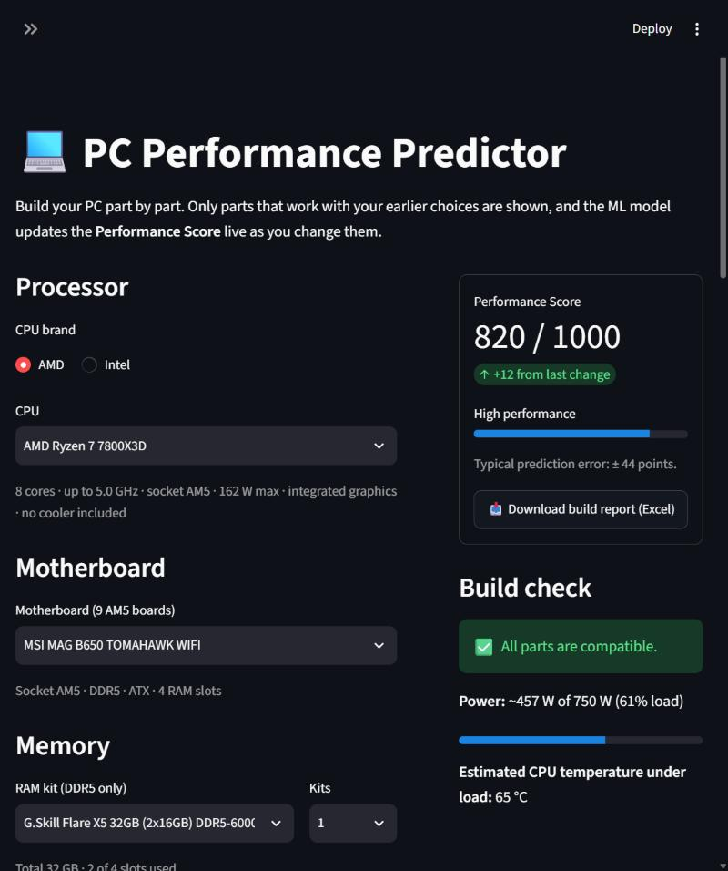
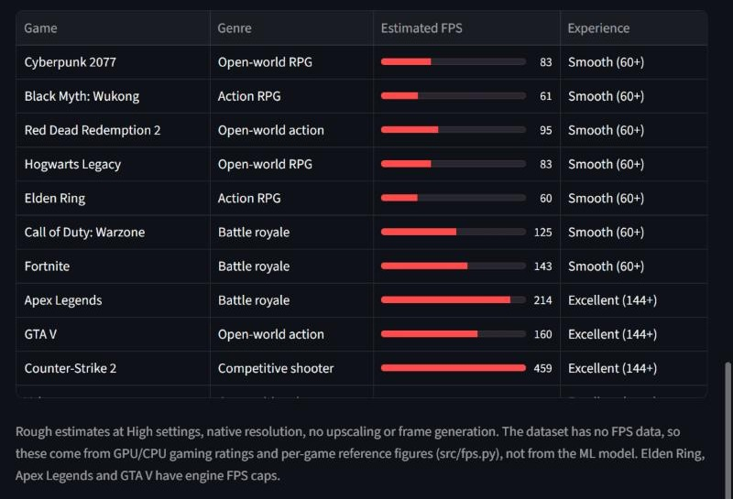
The app in action
Ryzen 7 7800X3D + RTX 4070 SUPER: score 820 / 1000, High performance, all parts compatible
Notes:
Left: building a Ryzen 7 7800X3D + RTX 4070 SUPER PC. The motherboard list shows only AM5 boards and the memory only DDR5. The score is 820 (High) and the build check passes. Right: the Game FPS tab for the same build at 1440p.

Slide 28

Game FPS estimates
GPU-limited FPS
Game reference FPS × GPU rating
CPU-limited FPS
Game CPU limit × CPU gaming rating
Combine & adjust
Lower of the two, minus low-RAM and heat penalties, engine caps
Estimate only: High settings, native resolution
Notes:
The dataset has no FPS data, so FPS is a separate rule-based estimate, not the ML model. Each GPU has a performance rating (RTX 4090 = 100) and each CPU a gaming rating (Ryzen 7 9800X3D = 100). The lower of the GPU-limited and CPU-limited FPS wins, adjusted for low RAM, heat and engine caps.

Slide 29



One-click Excel build report
Sheet 1
Sheet 2
Sheet 3
Sheet 4
Summary
Parts
Game FPS
Model Inputs
Predicted score, performance level, error margin, compatibility, power draw and temperature
Every selected component with its key specs
All 12 games at 1080p, 1440p and 4K
The exact 8 values the ML model received
pc_build_report_YYYYMMDD_HHMM.xlsx
Generated in memory with pandas + openpyxl: styled headers, sized columns, frozen header rows
Notes:
The download button under the score creates an .xlsx file with four formatted sheets, so a build and its predictions can be saved, shared or compared later.

Slide 30

A catalog of 222 real components
46
33
21
34
CPUs
Motherboards
RAM kits
Storage drives
Intel 10th-14th gen, Core Ultra, Ryzen 3000-9000
LGA1200 / 1700 / 1851, AM4, AM5
DDR4 and DDR5, 4 GB to 128 GB
NVMe, PCIe 5.0, SATA SSD, HDD
34
20
17
17
Graphics cards
Power supplies
CPU coolers
Cases
GTX 16 to RTX 50, RX 6000-9000, Arc
500 W to 1600 W, Bronze to Titanium
Stock, air towers, 240 / 360 mm AIO
Mini-ITX, Micro-ATX and ATX
Notes:
The catalog in src/catalog.py covers current and recent parts from Intel, AMD and NVIDIA, with the specs needed for compatibility checks and model inputs. It is plain Python data, so adding parts is easy.

Slide 31




Technology stack
Python
pandas
NumPy
scikit-learn
Core language
Loading, cleaning, analysis
Numerical operations
Pipelines, models, tuning, metrics
Matplotlib & Seaborn
Streamlit
joblib
openpyxl
Charts and EDA figures
Interactive web app
Saving the trained model
Excel report export
Notes:
Everything is written in Python. pandas and NumPy for data handling, scikit-learn for the models, Matplotlib and Seaborn for figures, Streamlit for the web app, joblib to save the model and openpyxl for the Excel report.

Slide 32
Syllabus Mapping
06
How the project covers Units I-V of Machine Learning (241AI005)

Slide 33
Syllabus mapping: Units I-III
Unit | Syllabus topic | Where it is used in this project
I | Types of ML systems | Supervised, batch and model-based learning
 | Main challenges of ML | Poor-quality data (missing, duplicate, impossible values), small dataset, overfitting
 | Statistical learning: the learning problem | Learn f(attributes) → Performance_Score from 402 labelled PCs
 | Practice: preprocess and analyse a dataset | 7 cleaning steps (520 → 503 rows), correlation and class analysis
II | kNN, distance-weighted kNN, distance metrics | kNN with k = 3-11, uniform vs distance weights, Euclidean vs Manhattan
 | Bayesian learning: MLE | Least squares in Linear Regression = maximum-likelihood estimate
III | Linear Regression | Final model: test R² 0.929, RMSE 44.1
 | SVM: soft margin, kernels, RBF | SVR with linear vs RBF kernel, C and ε tuned; linear kernel won
Notes:
How each topic from Units I to III appears in the project. The final model itself, Linear Regression, is a Unit III topic, and SVM and kNN were trained and compared as alternatives.

Slide 34
Syllabus mapping: Units IV-V
Unit | Syllabus topic | Where it is used in this project
IV | Evaluation: scores, sampling, cross-validation | 80/20 train/test split, 5-fold CV, MAE / MSE / RMSE / R²
 | Practice: bias, variance, remove duplicates | Training vs test R² per model; duplicates removed in preprocessing
 | Practice: one-hot and categorical encoding | OS: 11 spellings → 2 categories, then one-hot encoded
V | Bagging, boosting, AdaBoost, Random Forest | All four trained and compared against the linear models
 | Training vs testing, overfitting | kNN: training R² 1.00 vs test 0.80 (overfits)
 | Regularization and validation | Ridge L2 penalty sweep: large alpha underfits (RMSE 48 → 160)
 | Theory of generalization | One-standard-error rule (Occam's razor) picks the simplest tied model
Notes:
Unit IV covers how we evaluated the models and the encoding practice; Unit V covers the ensembles, overfitting, regularization and the generalization reasoning behind our model choice.

Slide 35


Syllabus topics we did not use, and why
Clustering
Classification methods
Concept learning
Unit IV: k-means, hierarchical, DBSCAN
Units II-IV: Logistic Regression, Naive Bayes, accuracy, precision, recall, ROC
Unit II: Find-S, Candidate Elimination
Unsupervised: it finds groups in unlabelled data. Our data already has a label, Performance_Score.
We predict a continuous score (regression), not a class, so regression metrics are used instead.
These learn yes/no concepts from boolean attributes, not a numeric output.
Notes:
Being clear about what we did not use: clustering is unsupervised and our data is labelled; classification methods and metrics do not apply because we predict a number; and concept learning algorithms like Find-S are for boolean concepts.

Slide 36
Limitations & Future Scope
07
What the current version cannot do, and where it goes next

Slide 37

Limitations
Small, near-linear dataset
Modern parts exceed the ranges
503 records whose scores follow the specs almost in a straight line
Above 16 cores, 5 GHz, 64 GB or 2 TB, values are capped
Several inputs are estimates
FPS is not learned
GPU tier, cooler capacity and CPU temperature are our approximations
No FPS data in the dataset, so FPS uses a rule-based estimate
Class imbalance
Storage type ignored
Only 11 PCs (2%) are in the Very High class
The data records capacity only, so SSD vs HDD does not change the score
Notes:
Be upfront about these. The dataset is small and nearly linear, modern high-end parts exceed its ranges, several app inputs are estimates, and FPS is rule-based because the data has no FPS values.

Slide 38




Future scope
Real benchmark data
Learned FPS model
Prices & budget optimizer
Train on measured results from real PCs, including modern high-end parts
Replace the rule-based FPS estimate with a model trained on game benchmarks
Suggest the best-performing build for a given budget
Upgrade suggestions
Deploy online
Live monitoring
Show which single upgrade raises the score the most
Host the app publicly and expose the model through an API
Read real temperature and usage from the user's own PC
Notes:
Next steps, roughly in order of impact: real benchmark data, a learned FPS model, prices and budget optimization, upgrade suggestions, public deployment and live hardware monitoring.

Slide 39
Conclusion
520 → 503
R² 0.929
222 parts
clean, consistent records from a messy raw file
Linear Regression, chosen from 9 supervised models, predicts within about ±44 points
real-time PC builder with compatibility checks, FPS estimates and Excel export
Thank you
Questions?
Notes:
Summarize: clean data, an accurate and simple model, and a practical app on top of it. Then open for questions.

