Slide 1

RoadSide
Hold your phone near your bike. It listens to the noise, looks at the chain, and tells you what may be wrong and what to do.
Fully on-device
Works offline
Private by design
iQOO Hackathon · Open Innovation
Notes:
RoadSide: an on-device roadside check. Sound plus sight, plain-language help, no internet needed.

Slide 2



A new noise, and no way to know what it means
Every rider knows the moment: a rattle, click or squeal appears out of nowhere.
You can't search a sound
Breakdowns happen off-grid
Paying just to find out
Is it a dirty chain, worn sprocket teeth, or nothing at all? Typing "weird rattle" into a search box does not help.
The problem shows up on the highway or a village road — exactly where there is no signal for online help.
The fallback is ignoring it and risking a snapped chain, or a mechanic visit for work the bike may not need.
Notes:
Three pains: sounds are unsearchable, faults happen without signal, and finding out costs money.

Slide 3
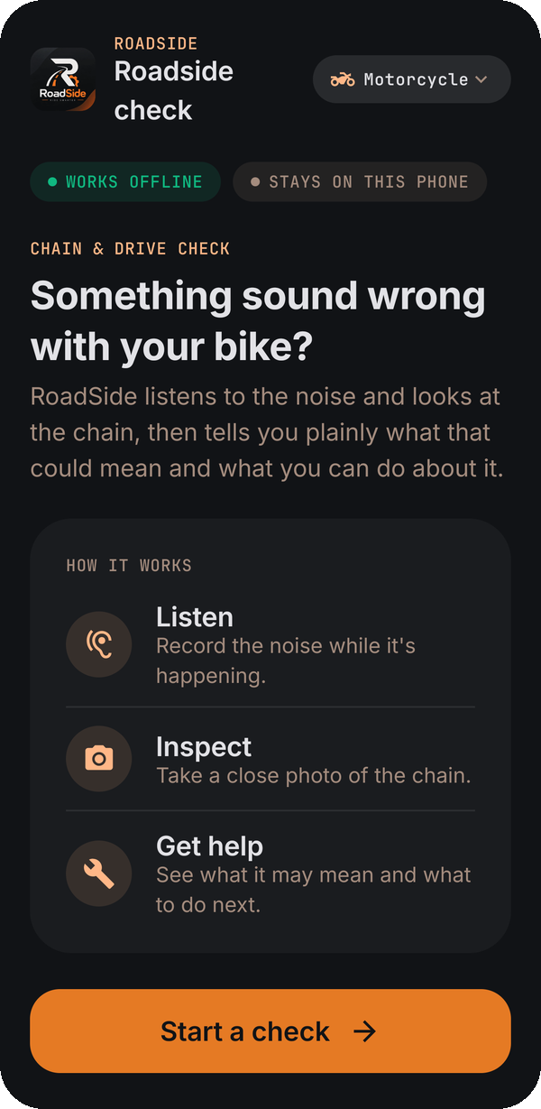
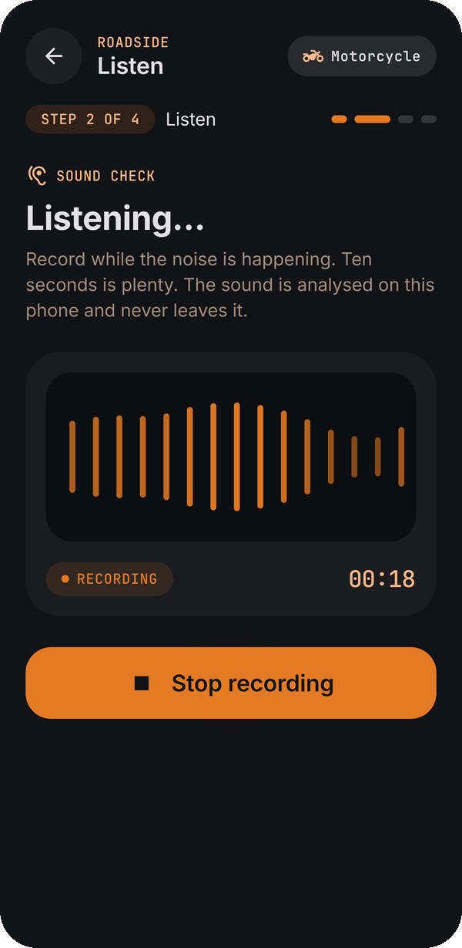



Your phone becomes a roadside check
Three steps, about a minute, nothing leaves the phone.
1. Listen
Record the noise for a few seconds while it happens.
2. Inspect
Take a close photo of the chain and sprocket.
3. Get help
What RoadSide found, what it may mean, what to do — and a safety note.
Notes:
Home, then Describe, Listen, Inspect, Assessment, Solution. Screens are real captures from the app.

Slide 4

How it works — two senses, one plain answer
Open pretrained models with small trained heads, all running on the handset.
YAMNet
open everyday-sound model + a trained drivetrain-sound head
Chain-like rattling?
Rules engine
fuses sound + sight into one assessment
Sound
MobileNetV3
chain + condition head: dirt, dryness, worn teeth
What the photo shows
Photo
Assessment
What you can do
Ask RoadSide
No internet needed · works in airplane mode · nothing leaves the phone
Notes:
Frozen open backbones (YAMNet, MobileNetV3) plus tiny trained heads. Rules fuse the evidence; typed text never changes the result.

Slide 5
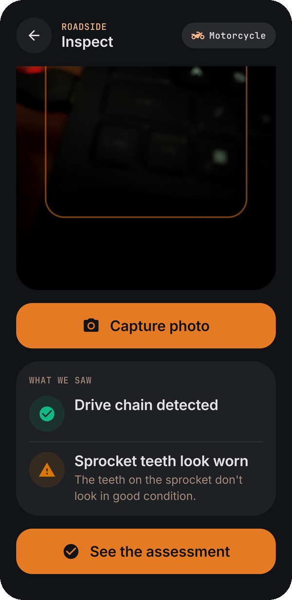
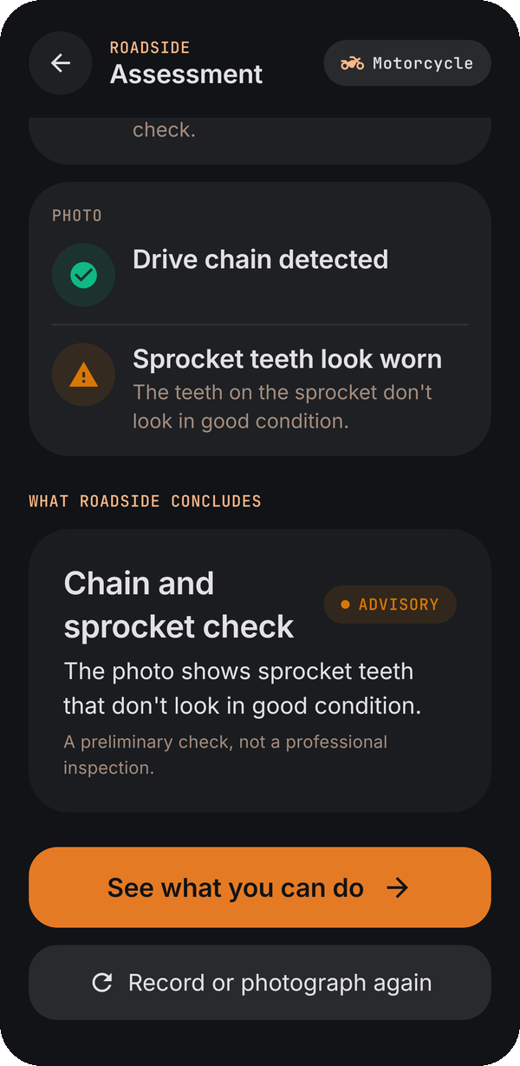
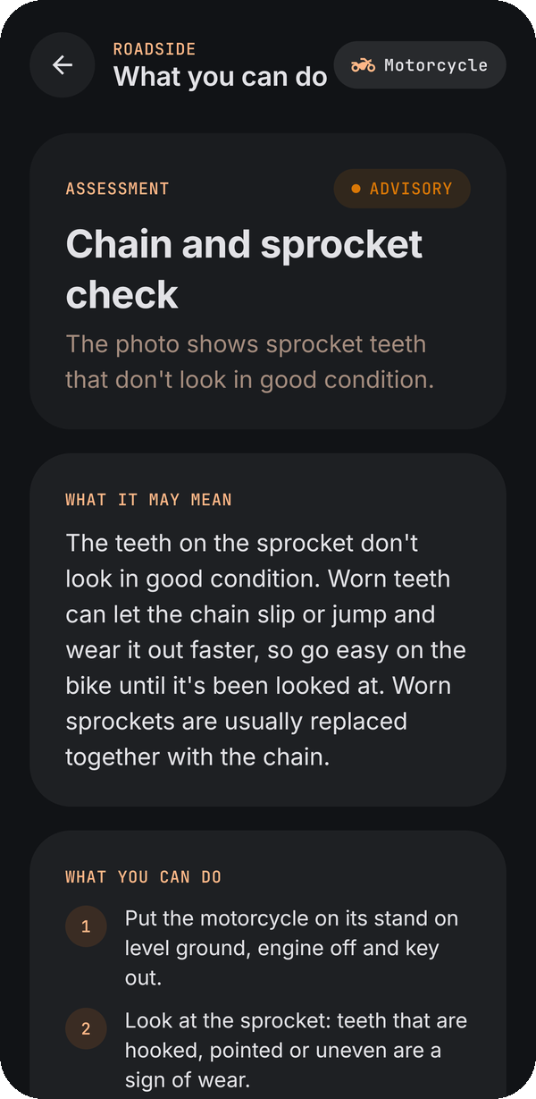
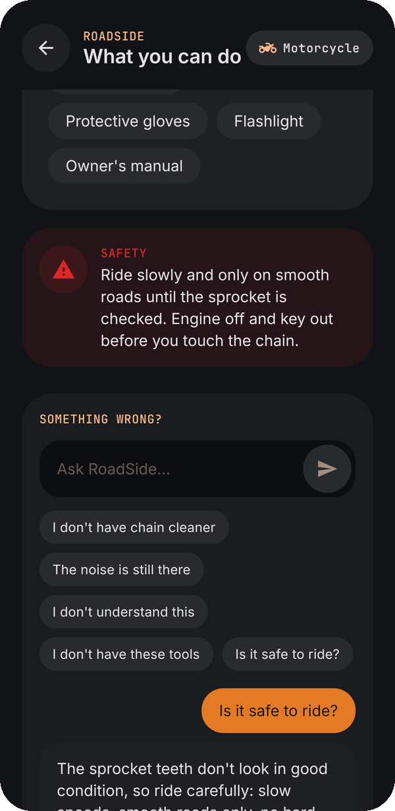
From photo to plain advice
Real screens from the working app.
Inspect
Assessment
What you can do
Ask RoadSide
Chain detected; sprocket teeth look worn
Observations kept separate from the conclusion
What it may mean, actions, tools, safety
"Is it safe to ride?" answered in context
Notes:
Worn sprocket example: RoadSide suggests riding slowly on smooth roads until it is checked, and points to a mechanic.

Slide 6




Honest by design
A wrong "your chain is fine" is worse than "not sure". RoadSide is built to say so.
Observations ≠ conclusions
"Not clear enough" beats a guess
What the camera saw and what RoadSide concludes are shown separately.
Low-confidence photos and sounds return an honest unknown, with a tip to retake.
No invented numbers
Your words never change the result
No fake Hz, millimetres, torque or percentages anywhere a rider reads.
Only the microphone and camera decide; typed text is context for you.
Notes:
Each of these rules is checked automatically on the device.

Slide 7




Built for the roadside
Designed for the places where help is hardest to find.
Works offline
Private by design
Answers in moments
Speaks plainly
No signal, no problem. Every check runs in airplane mode.
Recordings and photos never leave the phone. The app has no internet access at all.
Results appear right after you record or take the photo, with smooth, responsive screens.
No jargon: what was found, what it may mean, what to do, and when to see a mechanic.
Notes:
Offline, private, quick and plain-spoken: the four things a rider stuck at the roadside needs.

Slide 8


From two-wheelers to cars
One on-device pipeline; every new fault is a new small trained head.
What RoadSide checks
Coming next
Chain and sprocket condition from a photo: dirt, dryness, worn teeth
Drivetrain rattling from sound
Listens for brake squeal and starter or battery clicking
Plain-language solution and Ask RoadSide, fully offline
Cars: engine knock, belt squeal, brake wear, battery and starter faults
Scooters and more motorcycles, tyres and brakes by photo
Car-specific sound and photo checks trained on labelled data
An on-device language model for richer Ask RoadSide answers
Notes:
Two-wheeler checks work today; cars are next on the same pipeline.

Slide 9
Ride smarter.
A roadside check that listens, looks and explains — on the phone you already carry.
Notes:
Thank you.

