Slide 1

ROADSIDE
Your vehicle’s roadside mechanic.
Hold your phone near your vehicle. It listens, looks, and tells you what to do — fully on-device.
iQOO Hackathon 2026 | Hyderabad City Battle
Notes:
Open with the sound: everyone has heard a new noise from their bike and wondered if it is serious.

Slide 2
THE PROBLEM
A new noise, and only two bad options
IGNORE IT
GO TO A MECHANIC
Keep riding and hope.
Travel, wait and pay — just to find out.
A worn part fails on the road, and a small engine problem becomes an expensive one.
Often far away, often for something you could have checked yourself in five minutes.
There’s nothing in between.

Slide 3
THE GAP
Drivers can describe the sound. Not the fault.
“It rattles when I ride”
Spark plug?
Brake pads?
Drive belt?
Chain & sprocket?
“It knocks when I accelerate”
“It squeals when I brake”
Everyone can hear this.
Nobody knows what it means.

Slide 4
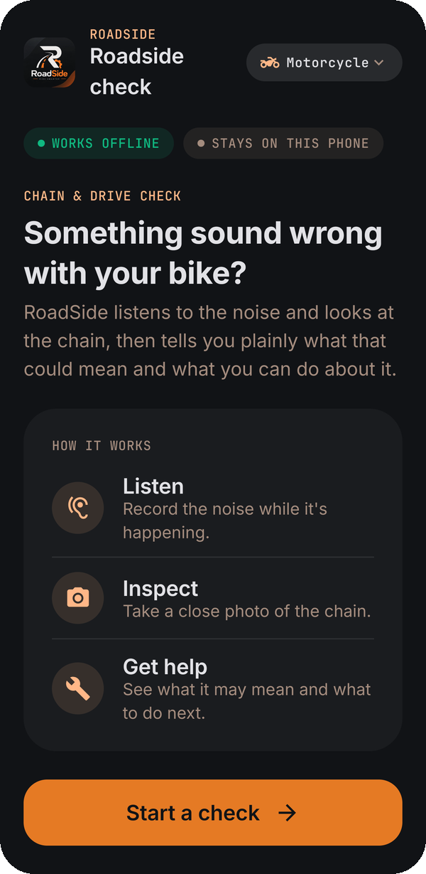
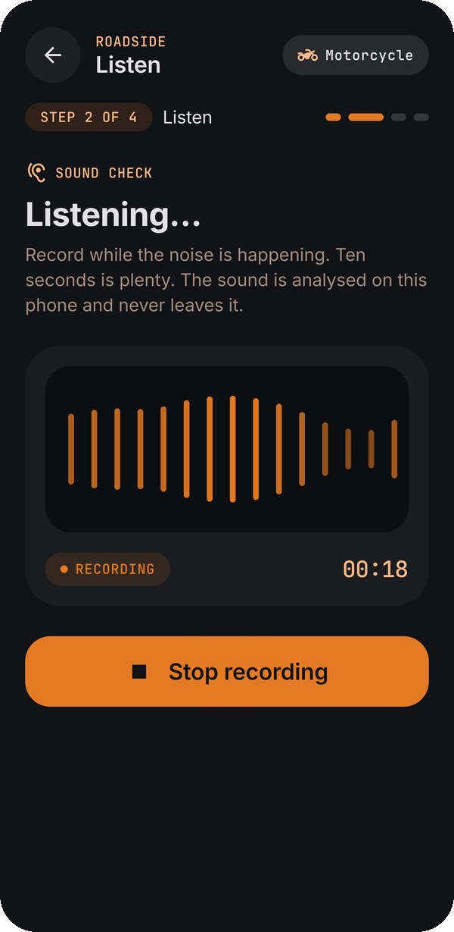
THE IDEA
Your phone becomes a roadside mechanic
Record the noise. Photograph the part.
RoadSide listens to the sound, looks at the photo, and tells you in plain words what it found, what it may mean, and what you can do — with a safety note and when to see a mechanic.
No internet. No account. Nothing leaves the phone.

Slide 5
WHAT ROADSIDE CATCHES
Current + planned checks, across bikes and cars
● Working today ○ Planned
●
Chain rattle
→
Clean and lube the chain, check slack
BIKE
●
Worn sprocket teeth
→
Ride slowly on smooth roads, see a mechanic
BIKE
○
Brake squeal
→
Check the pads, never oil near the brakes
BIKE + CAR
○
Starter clicking
→
Check battery terminals, charge the battery
BIKE + CAR
○
Engine knocking
→
Ease off, check fuel and engine oil
BIKE + CAR
○
Misfire / spark plug
→
Inspect or replace the spark plug
BIKE + CAR
○
Belt squeal
→
Check belt tension and wear
CAR
○
Uneven idle
→
Check air filter and plugs, then a mechanic
BIKE + CAR
Notes:
One pipeline for bikes and cars: each fault is a small trained check on the same on-device sound and vision models.

Slide 6
HOW IT WORKS
Three stages, all on the phone
1
2
3
Listen
Look
Advise
An on-device sound model picks out the fault in a short recording — a rattle, a knock, a squeal or a misfire.
An on-device vision model checks the photo for visible problems — a dirty chain, worn teeth, a corroded terminal.
A rules engine combines sound and sight into one assessment, a plain-language solution and Ask RoadSide.
Only the microphone and camera decide. What the rider types never changes the result.

Slide 7
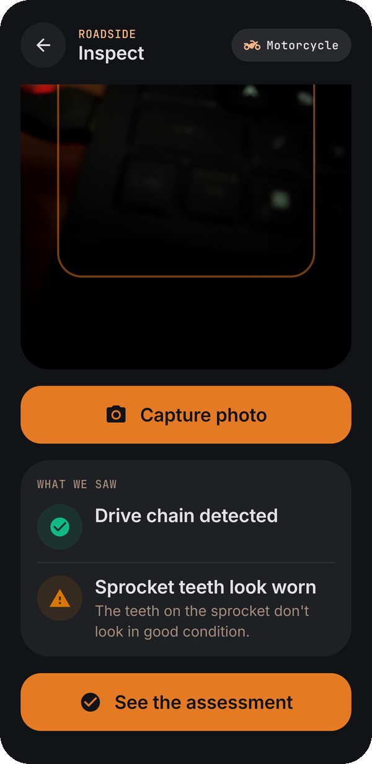
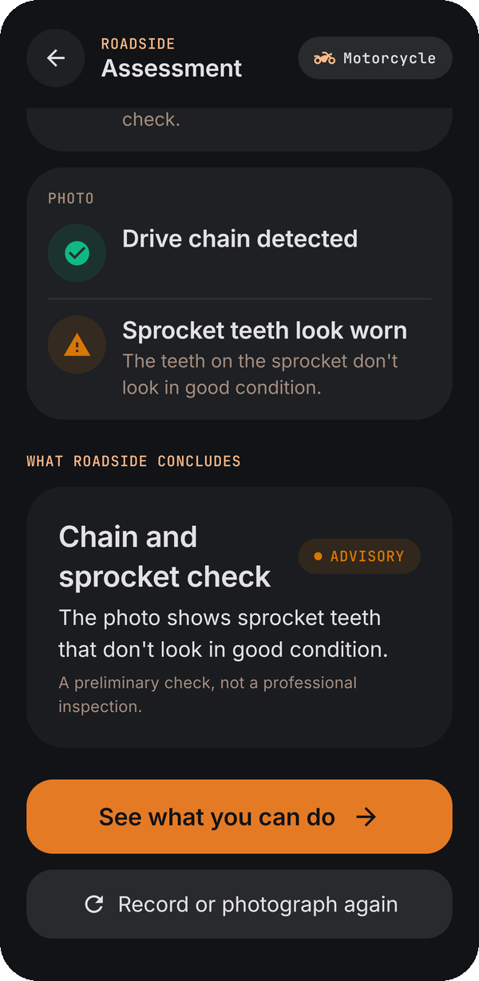
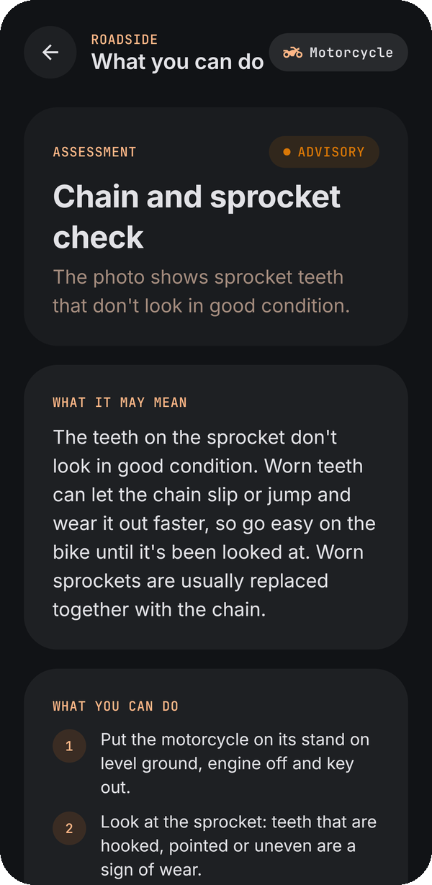
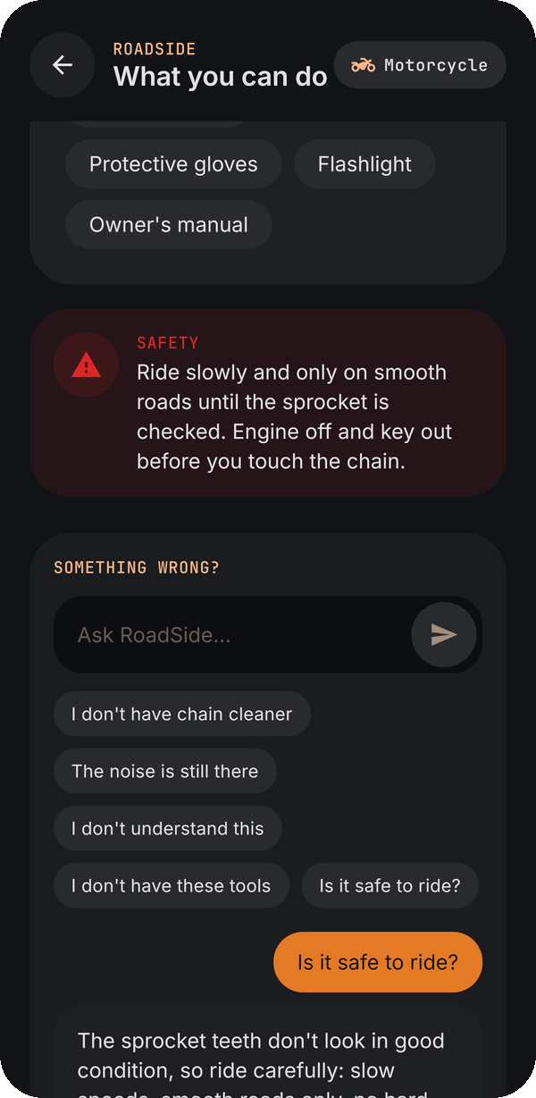
SEE IT WORK
From one photo to plain advice
Inspect
Assessment
What you can do
Ask RoadSide
Chain detected, sprocket teeth look worn
What it saw, kept apart from what it concludes
Meaning, actions, tools and safety
“Is it safe to ride?” answered in context

Slide 8
THE PROTOTYPE
What we’ve already built
We built the first check end to end — chain and drivetrain — to prove the whole pipeline runs on a phone.
Sound
YAMNet — an open, on-device sound model — with our trained drivetrain-noise head
Vision
MobileNetV3 — an open, on-device image model — with our trained head for the chain, visible dirt and possible sprocket wear
Advice
Rules engine that fuses sound and sight into a plain-language solution, plus Ask RoadSide
Runs on
Android · Kotlin · Jetpack Compose · CameraX · LiteRT — fully offline, no internet permission
At the hackathon, the same pipeline grows to engine, brake and car checks — one small trained head per fault.
Notes:
Frozen open backbones with tiny trained heads: adding a new fault means training a small head, not a new model. The models can be swapped later without changing the app flow.

Slide 9
WHY ON-DEVICE
It works where breakdowns happen
Instant
Private
No upload, no server queue. The answer appears right after you record.
Recordings and photos never leave the phone.
Anywhere
Free to run
Airplane mode, no signal, no data pack — still works.
No per-use cost, nothing to host.
Compact sound and vision models run on the phone itself, with no internet permission at all.

Slide 10
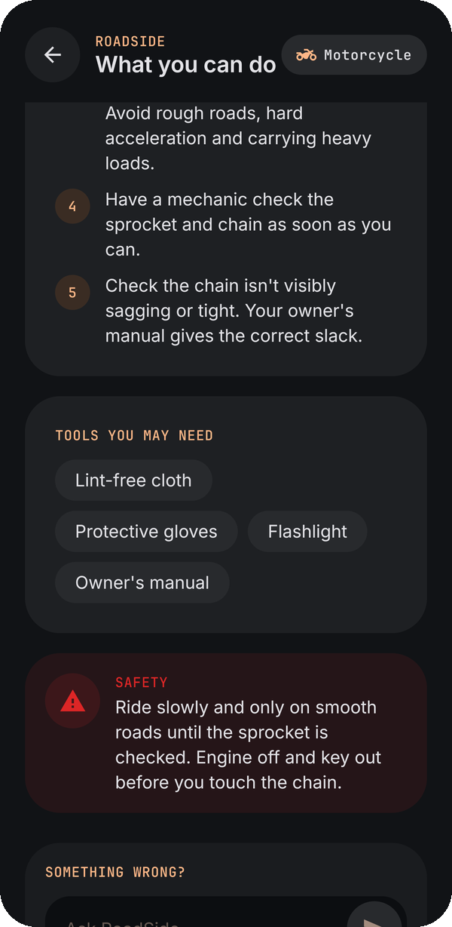
THE DEMO
Live on the phone, in airplane mode
1
Record the noise from the vehicle
2
Photograph the part
3
RoadSide shows what it heard and saw
4
The assessment and what to do next
5
A judge asks “Is it safe to ride?”

Slide 11
HONEST LIMITS
What we’re claiming, and what we’re not
A first check, not a mechanic
RoadSide tells you what to look at and when to get help. It does not replace an inspection.
Unsure means unsure
When a sound or photo isn’t clear, it says so and asks for a retake instead of guessing.
No invented measurements
No fake frequencies, millimetres or percentages — only what it actually observed.
Built to be the first thing a rider opens, and honest about when to see a mechanic.

Slide 12
BUILD
Stack and team
Stack
Team
Android, Kotlin, Jetpack Compose, CameraX
Compact on-device sound model with a small trained head per fault
Compact on-device vision model for visible wear and damage
On-device rules engine and Ask RoadSide
No network permission, no cloud services
D Sri Sashank
M N B Prasad Reddy
L Atchut Kumar

Slide 13
A new noise means guesswork.
A mechanic means a trip.
RoadSide tells you right there.
ROADSIDE | iQOO Hackathon 2026 | Hyderabad

