Slide 1
African mobile sales dashboard
TIRLANGI SASHIDHAR

Slide 2
CONTENTS
Project Description
Column Distribution
Column Profiling And Quality
Analysis

Slide 3
PROJECT DESCRIPTION
You are a Data Consultant brought in by African Mobile, a mobile company that aggressively expanded across the entire continent of Africa beginning in 2013. The business has been humming along for the past four years and they would like you to conduct a profitability analysis of their business. This will involve looking at not only profitability but also a dashboard with analysis as requested by Salesperson.

Slide 4
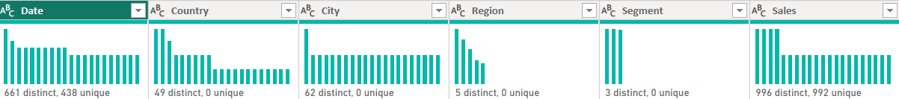
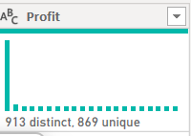
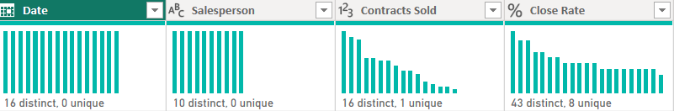
COLUMN DISTRIBUTION

Slide 5
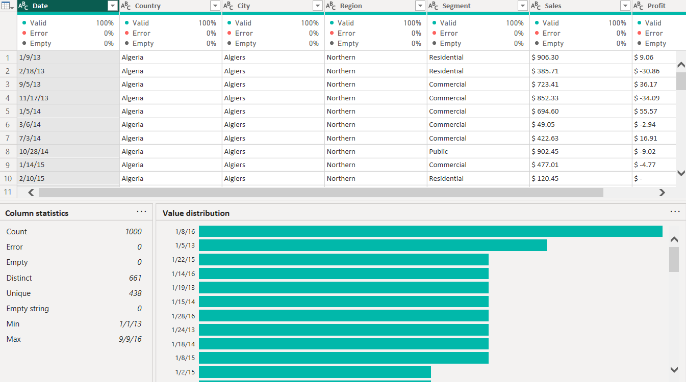
COLUMN PROFILING AND QUALITY

Slide 6
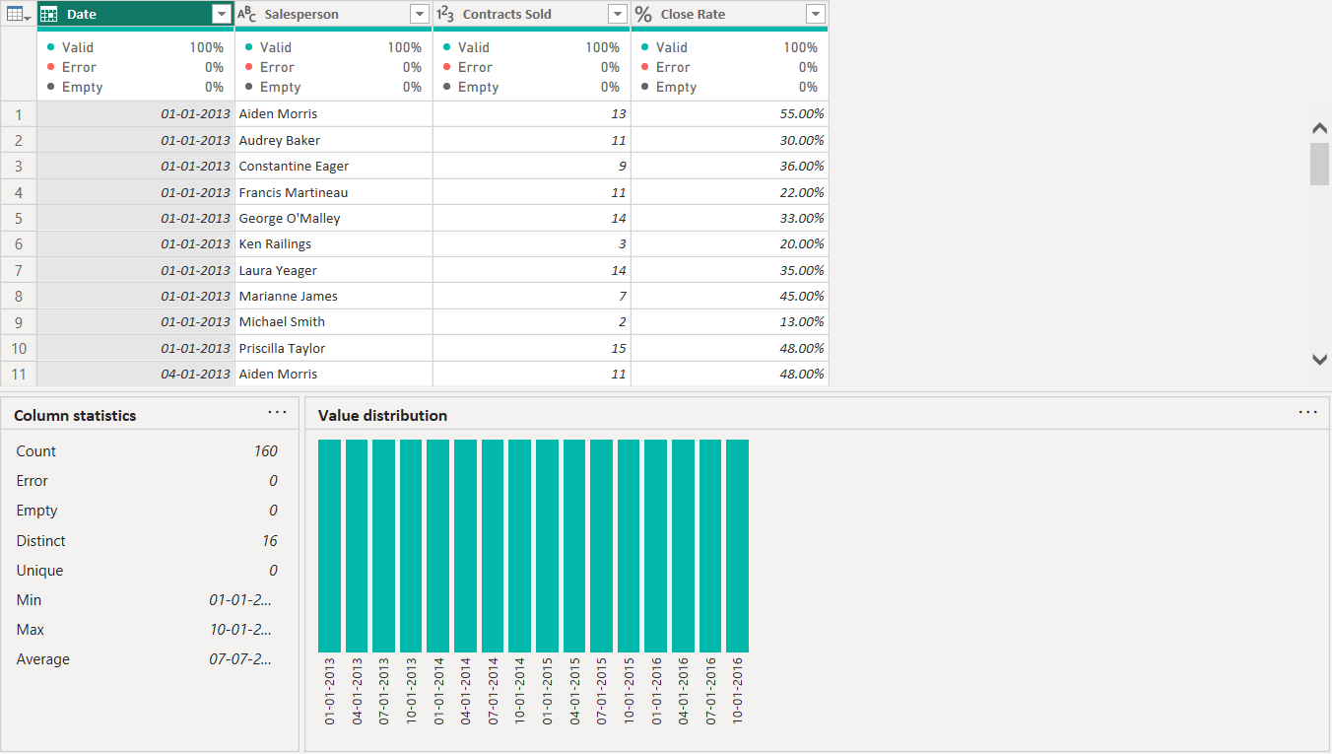
COLUMN PROFILING AND QUALITY

Slide 7
SALES ANALYSIS
DASHBOARD

Slide 8
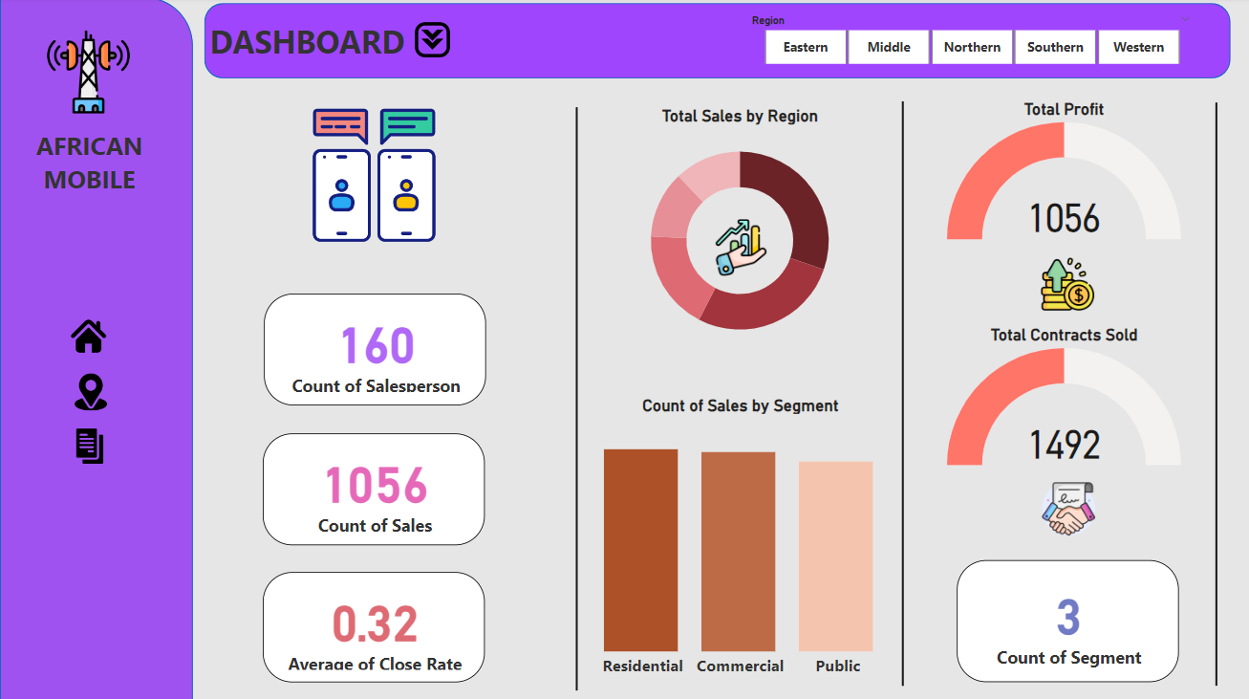

Slide 9
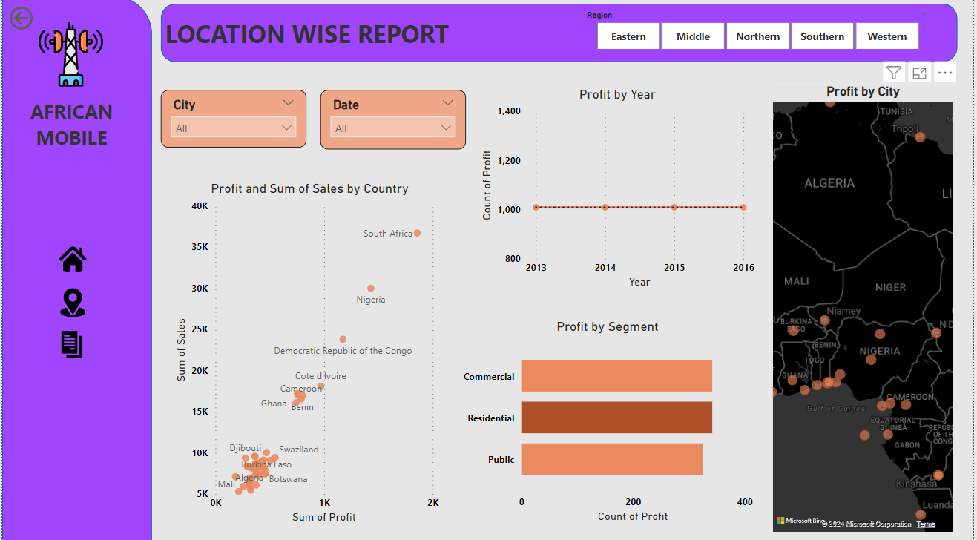

Slide 10
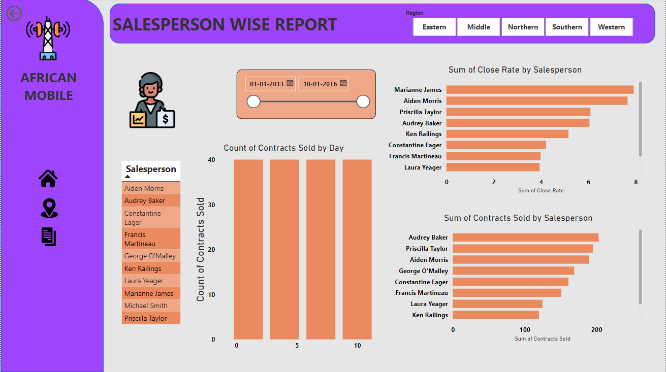

Slide 11
THANK YOU

