Slide 1


Modernization Assis-tance & Real Estate Concierge​
Team 3: Hichem Ben Aoun, Kira Feinauer, Robin Gansäuer, Jonas Michel, Aleksandar Bachvarov
June 2024

Slide 2



The market for property modernization is influenced by three key factors
Regulatory Changes
Energy Prices
Technological Advances
Inventory of central heat generators for heating in Germany by category in 2022 in millions¹
Index for the development of electricity prices for households in Germany (1998 = Index 100)²
Forecast of the number of smart home households in Germany for the years 2020 to 2028 (in millions)³
+ 270%
The Building Energy Act (GEG) mandates the transition to renewable energy sources.⁴
Electricity prices for households in Germany have more than doubled since 1998, reaching an index of 270.²
The number of smart home households in Germany is projected to grow to nearly 40 million by 2028.³
Source: Statista^{1,3}; BDH²; Bundesverband des Schornsteinfegerhandwerks²; §72 Gebäudeenergiegesetzt (GEG)⁴
Notes:
1min

Slide 3

The current state of
real estate modernization necessitates a better
approach
1 | Regulation | How to navigate the complex regulatory landscape? Navigating through various regulatory requirements can be challenging and time-consuming. Continuous updates and changes in laws necessitate ongoing monitoring and adaptation.
2 | Planning | Why is personalized planning expensive? Custom solutions tailored to individual properties require extensive analysis and bespoke design. Hiring specialized consultants and planners adds to the cost.
3 | Time | What makes modernization time-consuming? Thorough assessment and planning stages involve multiple inspections and evaluations. Obtaining necessary permits and approvals extends the timeline.
4 | Investment | What are the potential financial risks? Upfront costs are involved in modernization projects, including expenses for planning, materials, and hiring specialized professionals. Potential for sunk costs exists if the project is discontinued after initial investments, resulting in the loss the initial investment.
Notes:
2min - Jonas

Slide 4
First findings identify four key features for the AI concierge
1 | Regulation | Continuous regulatory updates needed. MARC should provide continuous updates about housing and building regulations, along with an individual assessment of the individual applicability.
2 | Planning | Provide a detailed financial planning. MARC should provide a detailed financing plan developed to assess the cost-effectiveness of implemented measures over time.
3 | Conflict of Interest | Remove energy consultant’s conflict of interest. MARC should provide product recommendations and referrals without following its own interest, ensuring that all suggestions are based purely on the user's preferences and needs.
4 | Easy access | Reduce time consumption. MARC should provide a simple access, a user-friendly interface and an effortless interaction, reducing the existing entry barrier for home modernization.
Age distribution of interview partners (n=7)¹
Types of modernization done in the last ten years (n=7)¹
¹ Further interviews scheduled
Capstone Project Team 3 – Designing Interactive Systems
4
Notes:
2min

Slide 5
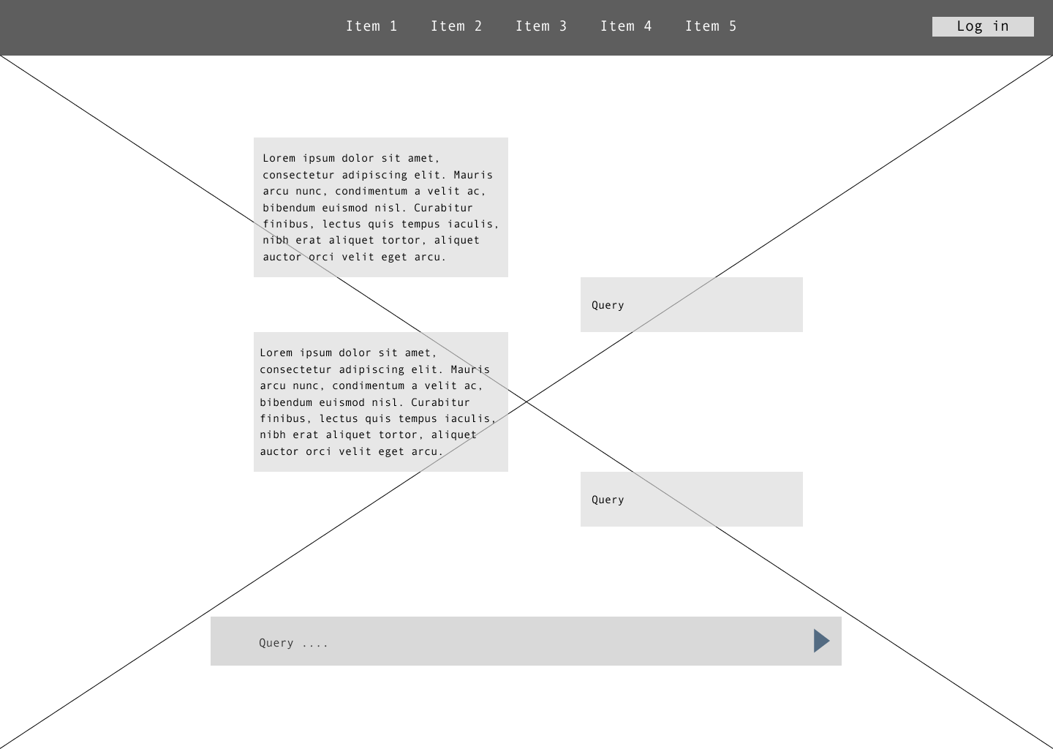
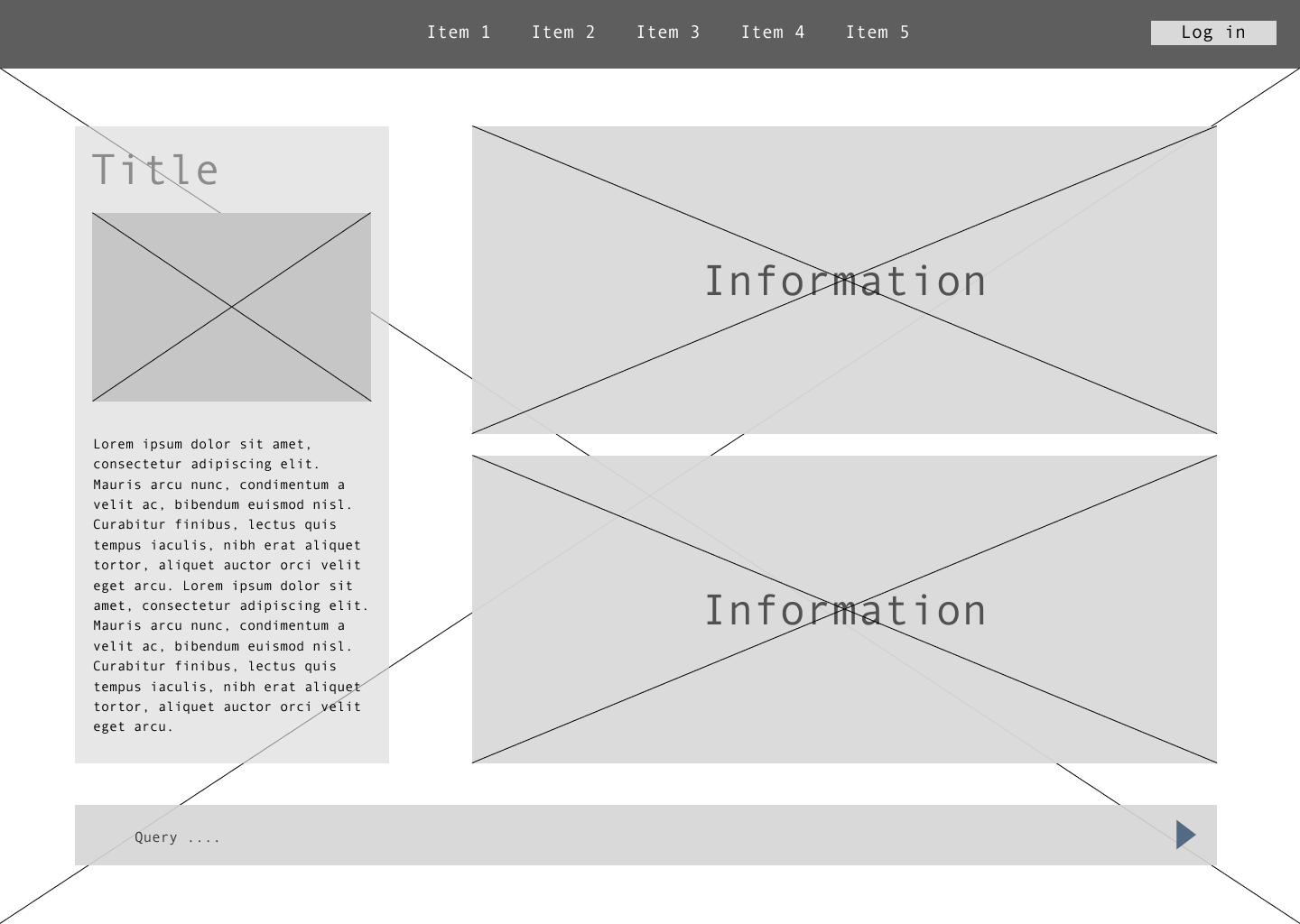
Developing an AI concierge low-fidelity prototype
Central point of information
The central point of information will serve as the primary source of relevant data for users seeking modernization insights. This section will include titles, descriptions, and detailed content to assist users in accessing the latest trends, strategies, plans, and resources for modernizing their operations efficiently.
Central point of interaction
Display relevant regulatory information in a feed-like design with applicability assessment.
MARC can answer user questions about the displayed information
The central point of interaction will be the main interface where users can engage with the AI concierge. This area is designed to be intuitive and user-friendly, ensuring easy navigation and interaction. MARC can interact with all data from this interface.
Notes:
2min

Slide 6
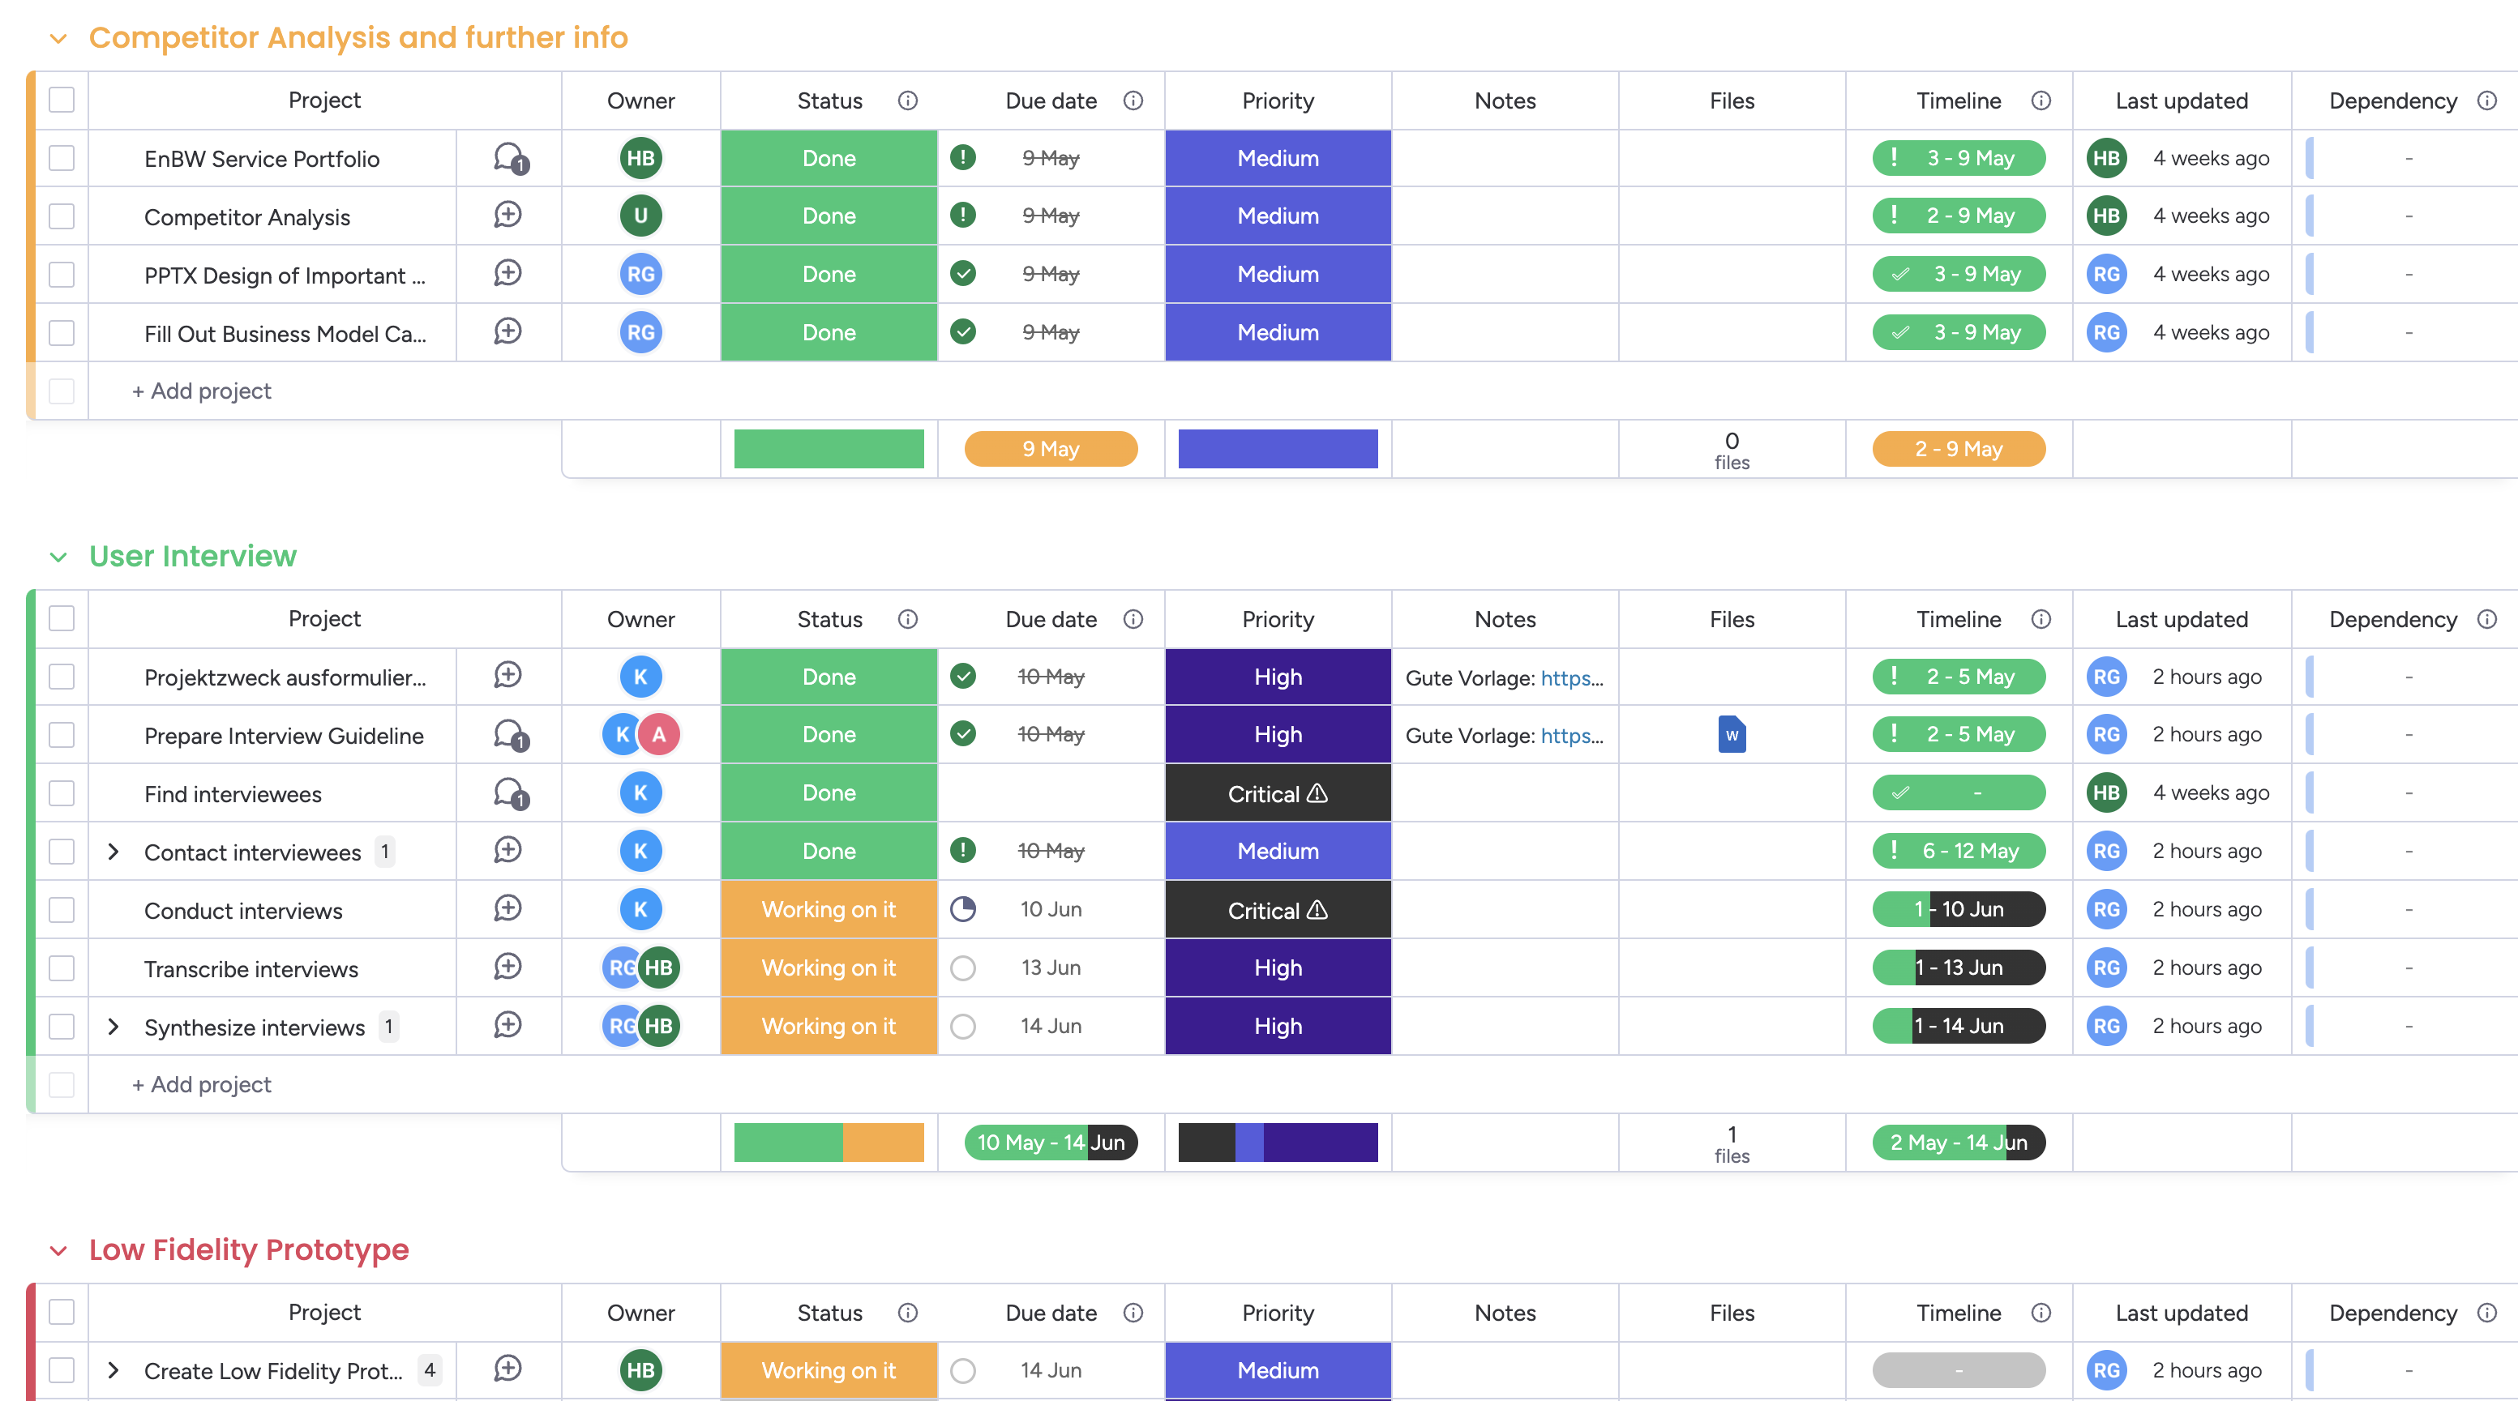





Overview of our team structure, organizational strategies, and planned next steps
Project Management Tool
Next Steps
Plan
Analyze
Evaluate
Specify
Design
Done
Analyze interviews
The analysis is scheduled to be finalized at the end of next week.
Current status
High fidelity prototype
The high-fidelity prototype is expected to be finalized on the 17th of June.
Project
structured
Conducting interviews
Designing
low-fidelity prototype
Notes:
30s-1min

