Slide 1
The Gadgets We Live With
A short tour through ten pieces of technology most of us reach for without thinking twice — from the phone by the pillow to the speaker in the kitchen.
Modern Gadgets · Everyday Tech

Slide 2

2 / 10
Smartphones
One device replaced a camera, a map, a wallet, a music player and a landline — and then kept adding jobs.
A camera good enough to retire the point-and-shoot
Banking, tickets and boarding passes in one app
The main way most people get online

Slide 3

3 / 10
Laptops
Thin, fast and battery-friendly enough that "working from the laptop" now means anywhere with a chair.
Full software, not just simplified apps
Video calls, spreadsheets and code on one machine
Battery life now measured in a full workday

Slide 4

4 / 10
Tablets
Bigger than a phone, lighter than a laptop — a screen just as happy showing a film as a sketchbook.
Reading, drawing and note-taking with a stylus
A second screen for video calls or recipes
Often a kid's first computer

Slide 5

5 / 10
Wireless Earbuds
No cable to untangle, no cable to catch on a doorknob — just a case that lives in a pocket or bag.
Noise cancelling turns a train into a quiet room
Quick taps handle calls, music and assistants
A charging case that doubles the battery life

Slide 6

6 / 10
Smartwatches & Fitness Trackers
A screen on the wrist that counts steps, tracks sleep and quietly buzzes when a message can wait.
Heart rate and sleep tracked without a second thought
Notifications filtered before they reach a phone
Contactless payments with a tap of the wrist

Slide 7

7 / 10
Smart Speakers & Voice Assistants
Ask a question, set a timer or start a playlist — the room answers without anyone touching a screen.
Timers and reminders set hands-free while cooking
Music, news and weather on request
A hub that ties other smart devices together

Slide 8

8 / 10
Smart Home Devices
Lights, locks and thermostats that respond to a schedule, a voice, or nobody at all.
Lights that dim themselves at sunset
Doors that unlock for a delivery, not a stranger
Thermostats that learn a routine over time

Slide 9
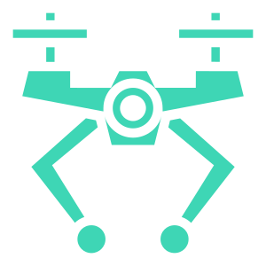
9 / 10
Drones & VR/AR Headsets
Two very different ways to see something from a place your eyes have never been.
Aerial footage once reserved for film crews
Games and training that put you inside the scene
Both still finding their everyday, non-hobby use

Slide 10
10 / 10
Small Devices, Big Habits
None of these existed a generation ago. Now they quietly shape how we work, talk, move and relax — one notification at a time.

