Slide 1
SASHWATH J | 24BAI0059
Machine Learning Assisted Adaptive Chunk Caching for I/O Workloads
Review 2 methodology and Review 3 completed implementation
A trained model decides whether a fetched 4 KB block should occupy a limited cache slot. The measured benefit is fewer backing-file read calls on the tested request streams.
Evidence-led presentation • Native C replay • Python / scikit-learn training
01

Slide 2
REVIEW 2 + REVIEW 3
Review 2 finding and the final scope change
Review 2: CPU chunk scheduling
Final work: I/O chunk caching
The earlier prototype assigned chunks of CPU work to processors. A decision tree and a cost-based policy were compared. Those experiments did not establish a reliable improvement in overall completion time on the available machine.
I changed the managed resource from CPU work chunks to cached I/O chunks. The new question is whether a learned admission decision can reduce backing reads while serving the same request stream. This is a disclosed change of scope, not the same implementation.
Reviewer point: the old CPU result motivates the change; none of its numbers are mixed into the new cache results.
02

Slide 3
REVIEW 2 + REVIEW 3
Abstract and key terms
The system trains a gradient-boosted classifier to estimate whether a requested key will reappear within the next 1,024 requests. On a cache miss, a native C program fetches the 4 KB block and uses the frozen score to admit it to ARC or a local S3-FIFO cache, or to bypass insertion.
At 512 blocks of capacity, both ML-assisted variants used fewer backing-file read calls than their own parent policies in all eight saved comparisons. Reductions ranged from about 1% to 7.5%. Median loop time improved in six comparisons and worsened in two.
Keywords: cache admission, chunk caching, future reuse, gradient boosting, direct I/O, ARC, S3-FIFO.
03

Slide 4
REVIEW 2 + REVIEW 3
The operating-systems problem
A cache holds 512 blocks of 4 KB each, so it has 2 MB of data capacity. A repeated request for a resident block is a hit. Otherwise the program must read its backing block, which is a miss.
After a miss, the cache must choose whether to keep the fetched block. If a one-time block displaces a block needed soon, later requests cause extra reads. The model tries to filter out some of these low-reuse admissions.
Every miss is still served correctly. ML changes retention after the read, not whether the request receives data.
04

Slide 5
REVIEW 2 + REVIEW 3
Problem statement, objectives and contribution
Question and objectives
What is genuinely new here
Can a frozen prediction of near-term reuse reduce backing-file reads when inserted before a conventional replacement policy? Train without future leakage in online features. Run the decision in native C. Compare each ML variant with its unchanged parent and verify equal returned data.
The work is a measured integration and comparison, not a new general cache algorithm. It tests one model before two parent policies in the same 512-block direct-I/O replay and records read savings, timing failures and transfer limits. Existing work already studies learned caching.
05

Slide 6
REVIEW 2 + REVIEW 3
Project-specific novelty: model choice and reuse
Validation based on cache misses
One admission rule before two policies
I did not choose the model by classification accuracy alone. I compared six stage-count and threshold combinations on three validation streams. For each candidate, I measured cache misses relative to the best tested simple policy on each stream and selected the lowest worst-stream ratio.
The selected model is frozen and exported to native C once. On a miss, the same eight features and tree evaluator decide admit or bypass. An admitted block then goes to ARC or local S3-FIFO; their replacement logic remains separate. This lets me test ML+ARC against ARC and ML+S3-FIFO against S3-FIFO.
Claim boundary: this is the project’s implemented design and controlled comparison. It does not claim the first ML cache or a new universal caching algorithm.
06

Slide 7
REVIEW 2 + REVIEW 3
Related work and research gap
CACHEUS (Rodriguez et al., 2021) learns how to adapt among cache experts. S3-FIFO (Yang et al., 2023) studies simple queue-based replacement. Baleen (Wong et al., 2024) includes learned admission in a flash-cache system.
These studies mean “ML cache admission is completely new” would be a false claim. The narrower question tested here is how one frozen reuse filter affects two parent policies in a reproducible native trace replay, including cases where read counts improve but time does not.
Paper status: these three verified anchors do not satisfy the guideline’s 30-paper, 2021–2026 literature-survey requirement. That written survey remains to be completed and checked.
07

Slide 8
REVIEW 2 + REVIEW 3
Overall methodology
The method has two phases. Offline, chronological trace slices supply training labels and validation candidates. The selected model is exported as numeric tree rules. Online, the C replay reads on misses, evaluates those rules, then decides whether to insert the fetched block.
Testing keeps the request order, 512-block capacity and 4 KB backing blocks fixed. Each ML variant is compared with its own parent policy. Read calls, cache hits, elapsed loop time and checksums are recorded.
The next two diagrams show the data/model pipeline and the exact cache request loop.
08

Slide 9
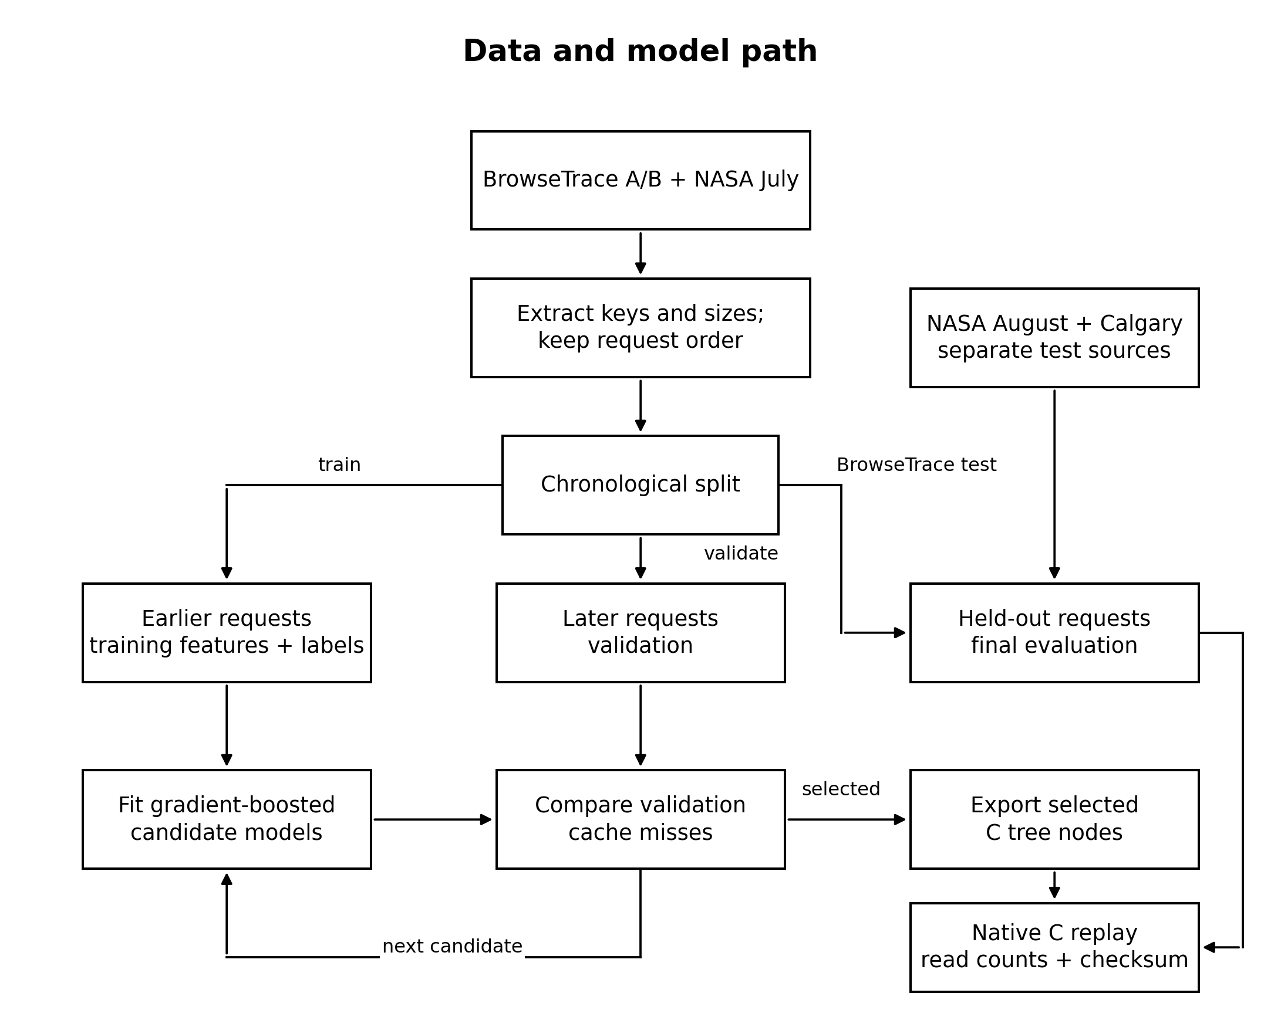
REVIEW 2 + REVIEW 3
Data and model pipeline
Read the left side as earlier trace data becoming training features and future-reuse labels. Validation compares six stage/threshold choices. The chosen trees are exported to C. Separate later or external streams feed the native final replay.
09

Slide 10
REVIEW 2 + REVIEW 3
Dataset sources and chronological splits
BrowseTrace A: 49,473 training requests, 16,491 validation requests, then 16,491 final-test requests. BrowseTrace B: 214,669 training, 71,556 validation, then 71,557 final-test requests. These partitions preserve request order.
NASA July web requests: 150,000 training and 50,000 validation requests. Its later 100,000-request tail was excluded after a prior transfer failure. NASA August supplies a later-time 100,000-request test. Calgary supplies a separate-server 100,000-request test.
“NASA” means a historical web-server log, not spacecraft telemetry. The logs provide request keys and metadata, not original response bodies. The native read test therefore uses deterministic surrogate 4 KB backing blocks.
10

Slide 11
REVIEW 2 + REVIEW 3
How the request logs become training inputs
One model learns from 414,142 earlier requests: BrowseTrace A 49,473; BrowseTrace B 214,669; NASA July 150,000. The next 138,047 requests are validation only. NASA August and Calgary supply no training rows.
For every request, calculate eight inputs
1 Response size: bytes reported in the trace row.
2 Previous key count: earlier requests for the same URL/key.
3 Recency: requests since that key last appeared.
4 Previous host count: earlier requests to its URL host.
5 Path length: characters in the URL path.
6 Static suffix: whether the path ends in CSS, JS, image or font type.
7 Query flag: whether the URL has a query string.
8 Key length: characters in the complete URL/key.
The URL/key and size come from each dataset row; counts and recency come from earlier rows in the same ordered slice. Training labels look ahead 1,024 requests, but live C inputs never do. Original response bodies are not used.
11
Notes:
The three training sources are BrowseTrace A, BrowseTrace B, and NASA July. All eight features are computed by the same feature extractor across sources. Source CSVs retain keys and sizes; NASA and Calgary derived CSVs omit timestamps and client hosts. The previous-host count uses the URL host, not the client host. Counts and recency reset at partition boundaries. The reported size is metadata; each distinct key maps to a deterministic 4 KiB surrogate backing block for native replay.

Slide 12
REVIEW 2 + REVIEW 3
Data collection, labels and leakage control
From raw requests to model inputs
How the target is made
The parser keeps valid request records and their order, forms cache keys, and calculates features such as previous key frequency and recency. The final NASA August and Calgary test streams are separate from model fitting.
Offline, label a request 1 when the same key appears in the next 1,024 requests; otherwise label it 0. At runtime the model receives only current/past information. At a finite trace end, some “no reuse” labels can be uncertain because later traffic was not recorded.
Qualification: Calgary was examined before the later ML+S3-FIFO pairing, so that particular comparison is not a fully blind external test.
12

Slide 13
REVIEW 2 + REVIEW 3
Eight runtime features and what they mean
History features
Request-shape features
Response size is the object’s recorded size. Previous key frequency counts earlier requests for this exact key. Recency measures requests since the last occurrence. Previous host frequency measures prior activity from its host. Counts and distances are log-transformed to reduce extreme values.
Path length is the number of characters in the URL path. A static-suffix flag identifies common CSS, JS, image and font endings. A query flag records a query string. Key length measures the complete cache key. These are predictive clues, not proof that a request will repeat.
No future-reuse label is one of the eight runtime inputs.
13

Slide 14
REVIEW 2 + REVIEW 3
Training algorithm and frozen decision rule
Python trains a scikit-learn HistGradientBoostingClassifier. The configured maximum is 100 boosting stages, 15 leaves per tree, a minimum of 40 samples per leaf, learning rate 0.07 and L2 regularization 2. The selected export contains 100 stages and 2,900 nodes.
Validation checks six candidate combinations: 40 or 100 stages, each with a threshold of 0.2, 0.4 or 0.6. Selection uses validation cache misses and minimizes the worst relative result across the three validation streams. Final ARC/S3-FIFO results do not choose the threshold.
The frozen C rule is simple to state: on a miss, a score below 0.2 bypasses insertion; a score of 0.2 or more passes the block to ARC or local S3-FIFO.
14

Slide 15
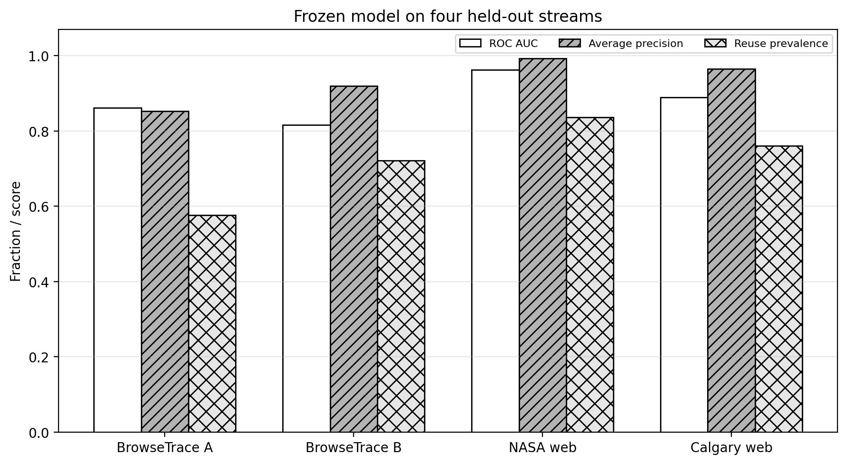
REVIEW 2 + REVIEW 3
Model check before system evaluation
ROC AUC measures whether higher scores tend to rank future-reuse requests above non-reuse requests. It ranges from 0.816 on BrowseTrace B to 0.962 on NASA August. Average precision is shown beside the share of positives, because reuse is common in these slices.
A good classifier score alone does not prove cache savings. The next comparison measures actual native read calls.
15

Slide 16
REVIEW 2 + REVIEW 3
Major modules in the completed system
Offline modules
Online and evaluation modules
Trace preparation preserves chronological requests and computes valid keys. Feature/label generation turns the earlier slices into supervised data. Training selects a model using validation streams. Export writes numeric trees and the 0.2 threshold for the C program.
The native replay checks hits, reads backing blocks on misses, evaluates frozen trees and calls ARC or local S3-FIFO for admitted blocks. The benchmark repeats each policy. Independent Python replays check miss counts; a checksum checks that every policy returned the same data.
The Python model trains offline; each live admission decision in the measured request loop runs in C.
16

Slide 17
REVIEW 2 + REVIEW 3
Where training and cache decisions run
Before the cache test: Python
Python reads earlier request logs and trains the reuse-prediction model with scikit-learn. It then exports the selected decision trees and threshold as numbers for the C program.
During the cache test: native C on Linux
The C program replays requests, checks its RAM cache, reads a 4 KB backing block on a miss, and evaluates those frozen tree rules to decide whether to keep the block. Python does not make each cache decision.
This Linux program runs through WSL on the test machine as an ordinary user-space process. It does not modify the Linux kernel or the CPU hardware cache.
17
Notes:
Offline means model fitting occurs before the measured request loop. The exported tree nodes are fixed during native replay; the C process does not retrain. WSL provides the Linux execution environment on Windows. User-space means the process allocates and manages its own RAM cache rather than installing a kernel cache module.

Slide 18
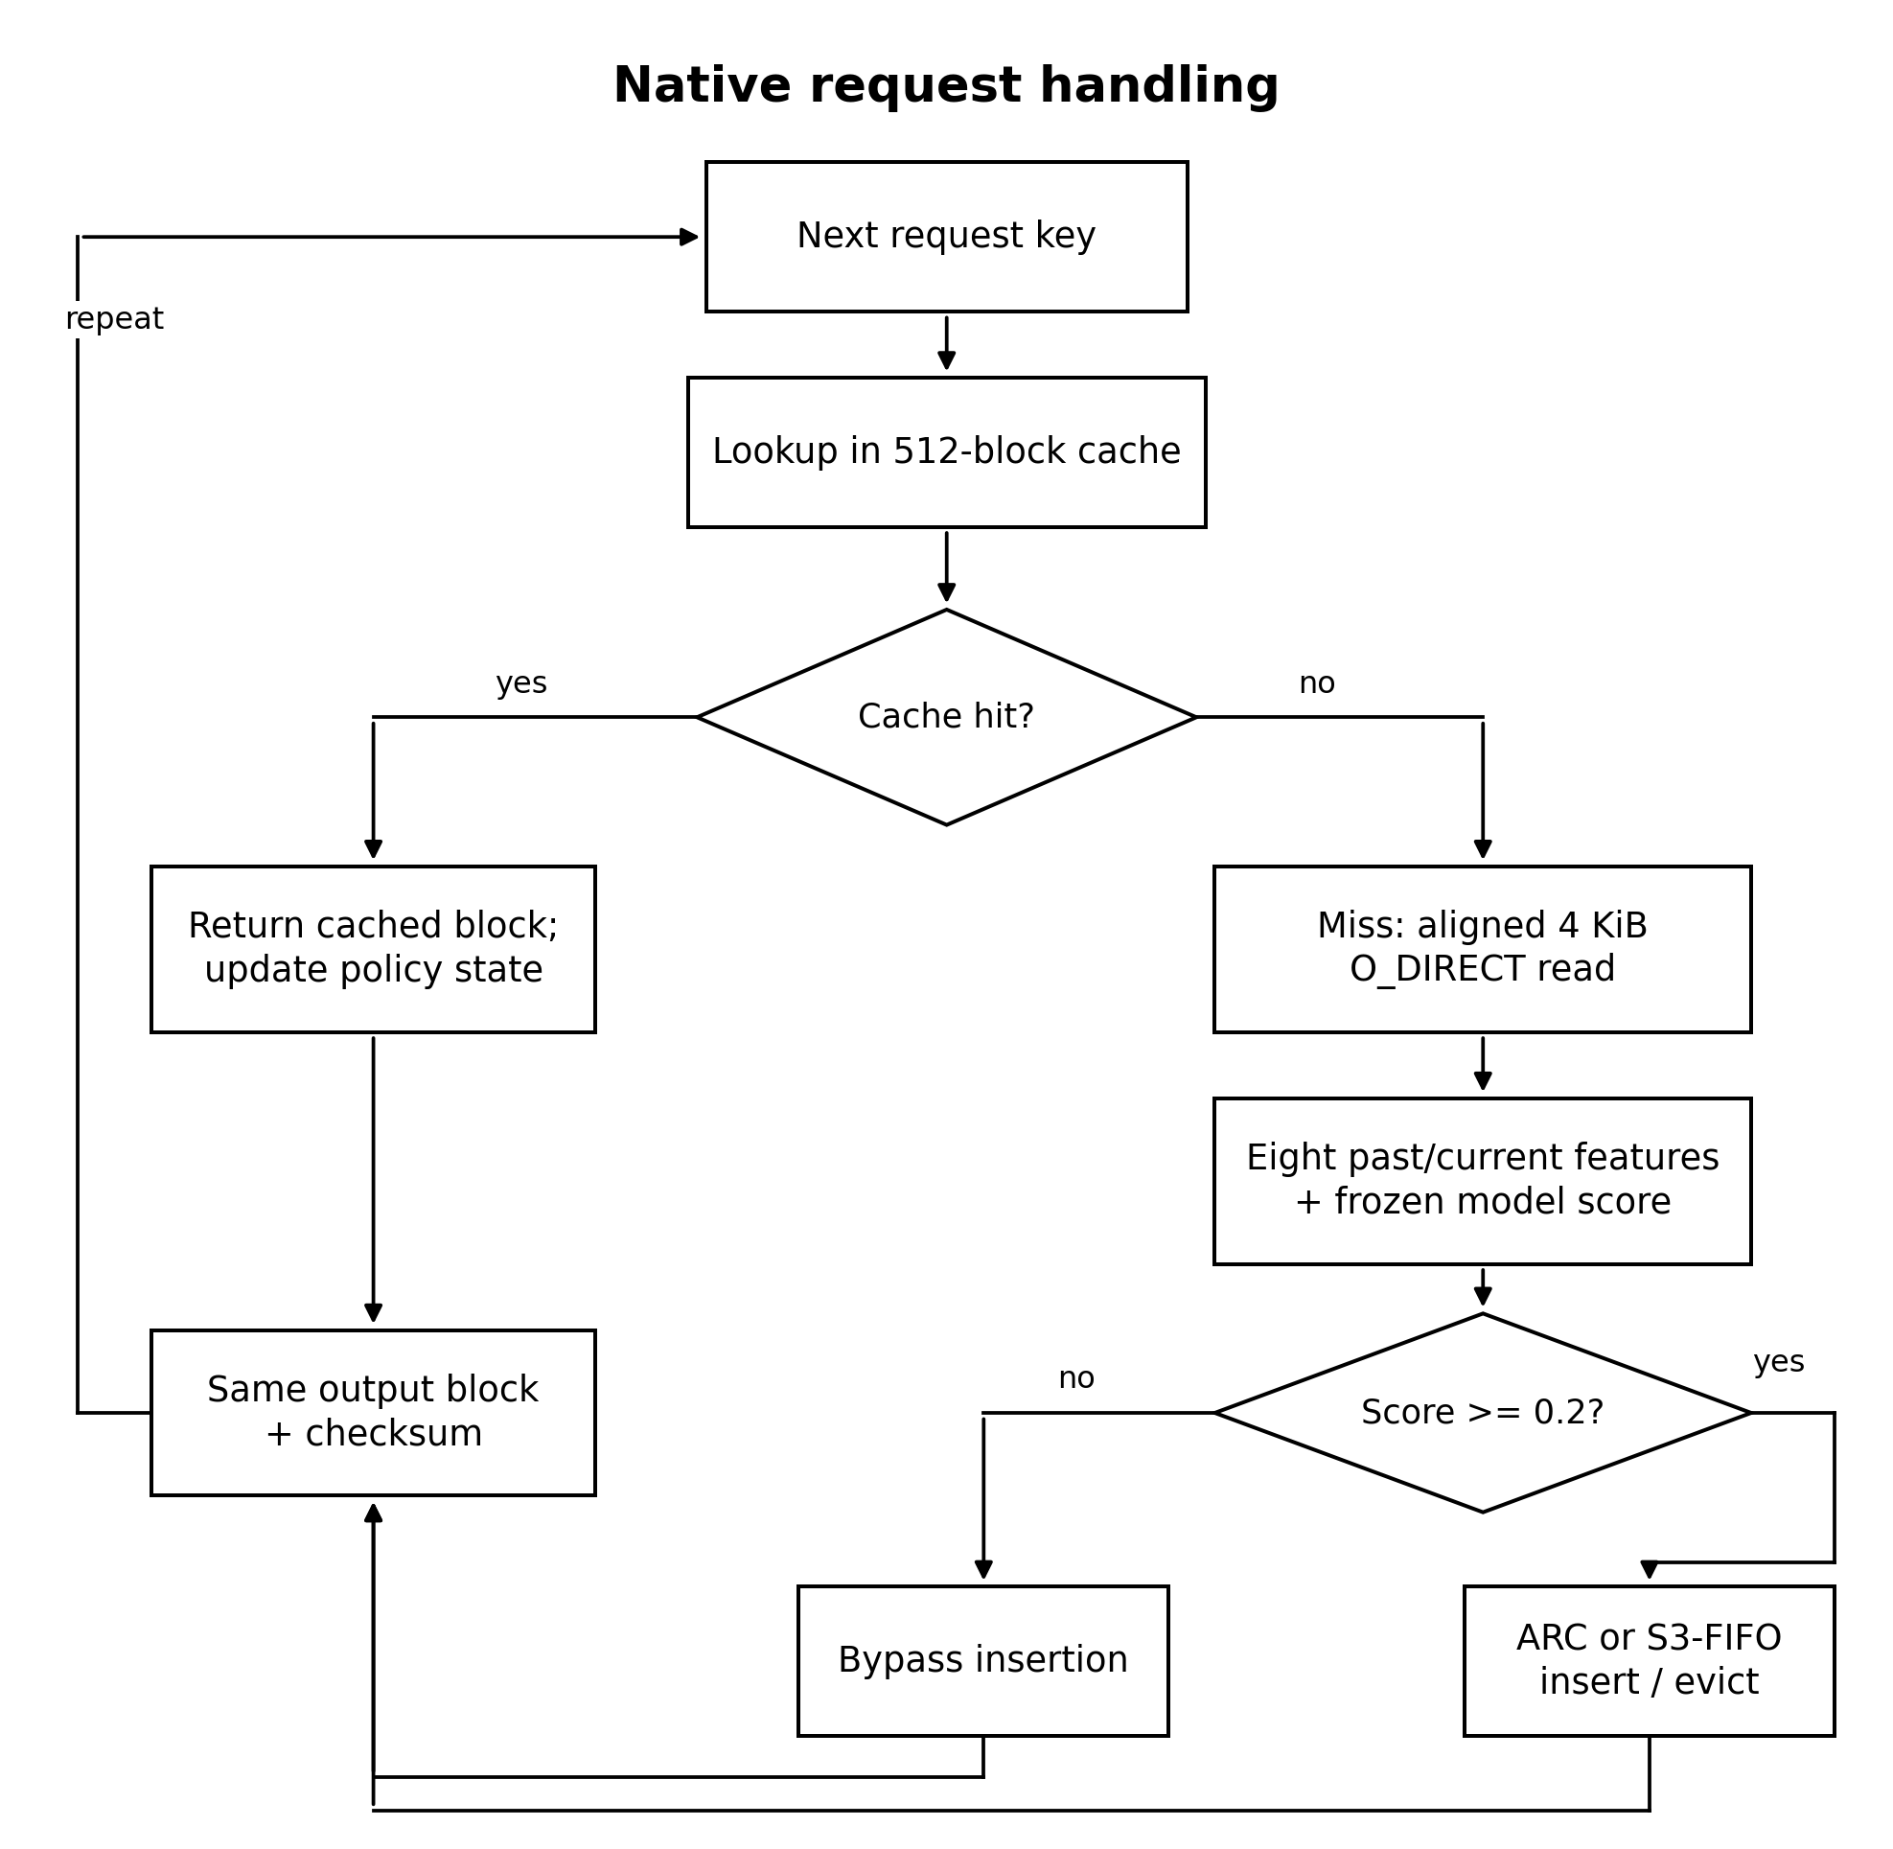
REVIEW 2 + REVIEW 3
Native request workflow, with branches and loop
On a hit, the program returns the cached block. On a miss, it makes an aligned 4 KB O_DIRECT pread, builds eight features and evaluates the exported model. Low-scoring blocks bypass insertion; admitted blocks enter ARC or local S3-FIFO. Both paths update the checksum and move to the next request.
18

Slide 19
REVIEW 2 + REVIEW 3
Experimental setup and fair baselines
The fixed setup is one user-space C request replay, 512 cache entries, 4 KB deterministic backing blocks and the same ordered stream per policy. A miss invokes a direct-read call. Baselines are ARC and a local S3-FIFO implementation.
Compare ARC with ML+ARC, then S3-FIFO with ML+S3-FIFO. This isolates the learned admission filter within each parent. Compare all policies on the same stream and capacity. Five loop-time runs per policy/stream are stored; their median summarizes timing.
This is a trace replay, not a kernel patch, deployed web cache or demonstrated multiprocess throughput result.
19

Slide 20
REVIEW 2 + REVIEW 3
Evaluation metrics in plain language
System metrics
Model metrics
Direct-read calls count the backing-file reads requested on misses. Fewer calls mean more requests served from cache in this replay. Hit rate is hits divided by all requests. Loop time measures the elapsed native request loop; it includes the model’s compute cost. Equal checksums show equal returned data.
ROC AUC measures score ranking over all thresholds. At the selected 0.2 threshold, precision asks: among predicted reusable requests, how many reused? Recall asks: among truly reusable requests, how many were predicted reusable? These diagnose the classifier, while read calls test the cache.
20

Slide 21
REVIEW 2 + REVIEW 3
Implementation progress and verified outputs
The final prototype implements trace parsing, chronological training/validation, model export, native C inference, two hybrid cache policies, repeated benchmarks and diagnostic plots. The source, saved model, test traces and measured JSON are retained.
The verification command checks source hashes, model settings, parent/hybrid counts and matching output checksums. Independent Python reference replays match native miss counts. A fresh WSL/GCC run can reproduce exact counts; elapsed time can vary from the stored median.
Review 2 had a partial CPU scheduler implementation. The completed cache system was developed after that scope change, so the Review 2 “50% complete” milestone should not be claimed for this exact final code.
21

Slide 22
REVIEW 2 + REVIEW 3
Native direct reads: each ML policy vs its parent
Stream
ARC
ML+ARC
S3-FIFO
ML+S3
BrowseTrace A
7,430
7,104
7,773
7,336
BrowseTrace B
17,913
17,740
18,950
18,586
NASA August
8,792
8,130
8,349
8,048
Calgary
16,493
15,718
15,406
15,177
Example: on NASA August, ML+ARC made 8,130 backing-read calls versus ARC’s 8,792. That saves 662 calls, or 7.5%, while serving the same 100,000 requests. All policies returned the same checksum per stream.
22

Slide 23
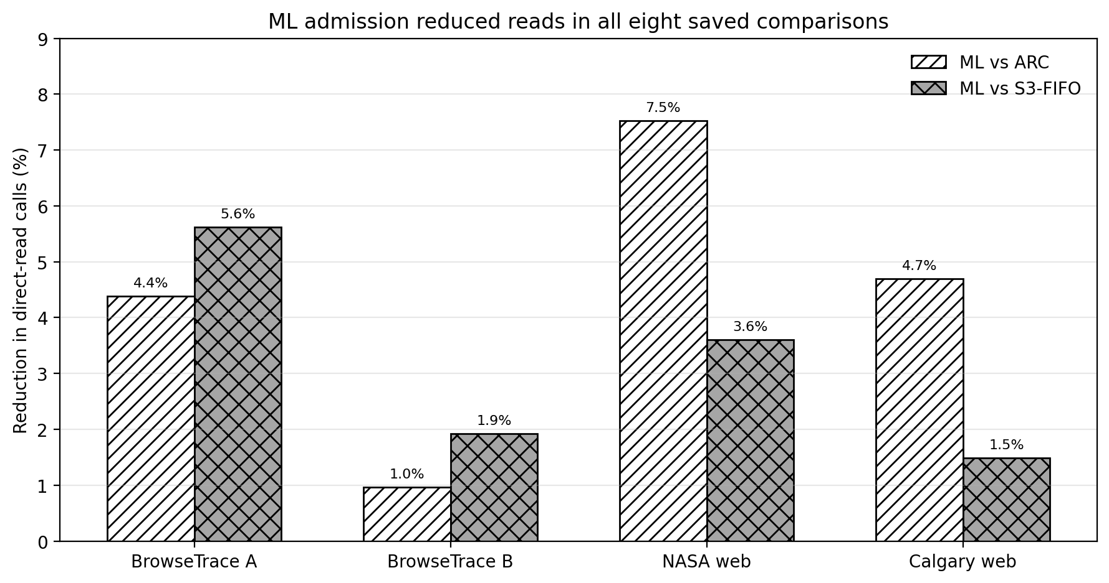
REVIEW 2 + REVIEW 3
Read-call savings vary by stream and parent
Every bar is positive in the saved tests. The gain is about 1.0% to 7.5%, depending on the request stream and parent policy. The numerator is parent read calls minus hybrid read calls. The denominator is that same parent’s read calls.
This supports a modest, workload-dependent read-efficiency benefit. It does not establish a universal speedup.
23

Slide 24
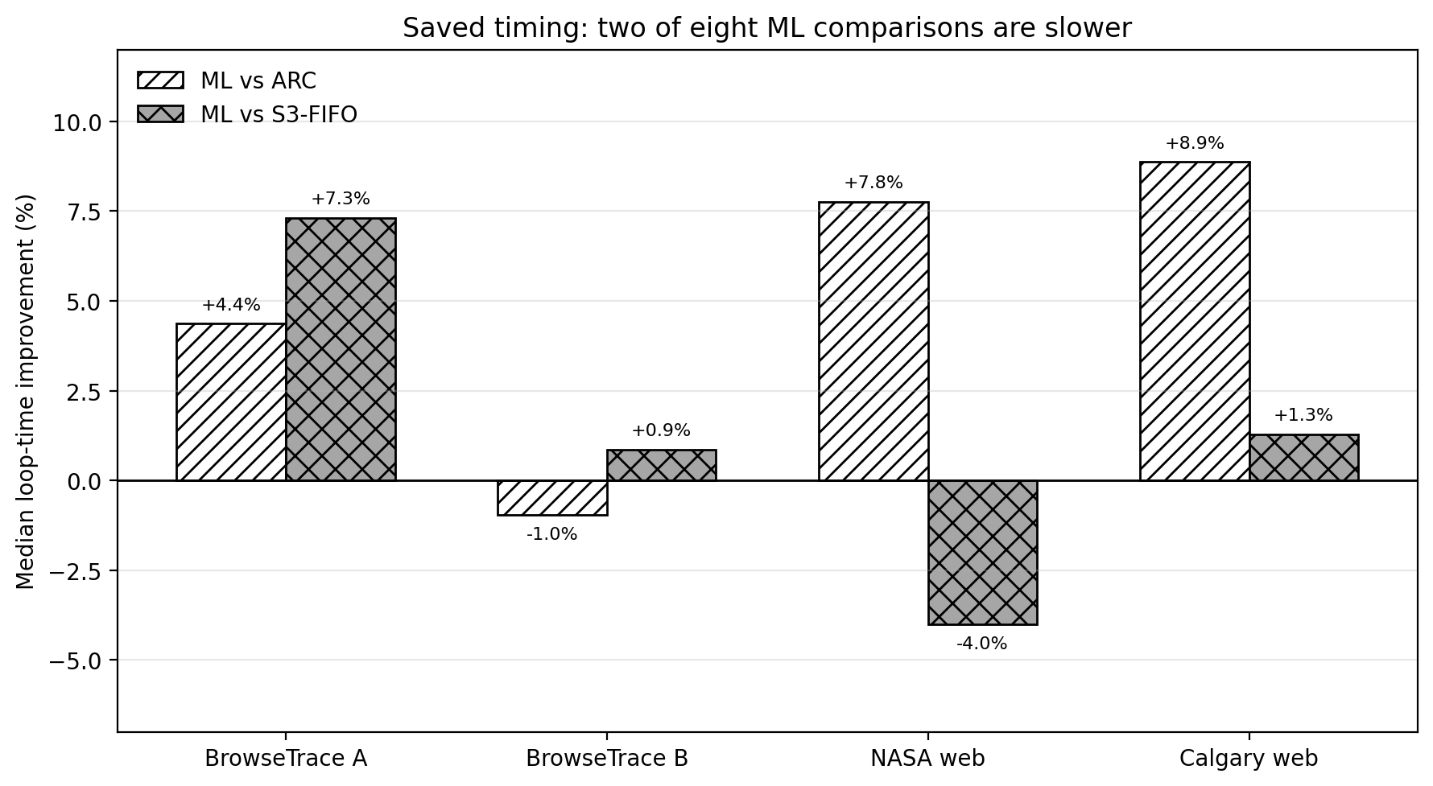
REVIEW 2 + REVIEW 3
Elapsed time shows a trade-off
Six of eight saved median comparisons improve, but two get slower: ML+ARC on BrowseTrace B and ML+S3-FIFO on NASA August. Positive bars mean less loop time. These are five-run single-host observations, so a small time difference should not be treated as a stable performance guarantee.
The model has CPU cost. The experiment does not isolate every cause of the timing variation.
24

Slide 25
REVIEW 2 + REVIEW 3
Why fewer reads can matter without faster runtime
The model can keep useful blocks and avoid later backing reads. That explains the main measured benefit. But each miss also executes tree inference, and a read-call count does not equal physical-device time. OS and host timing noise can outweigh a small reduction in reads.
The benefit matters when reducing requested backing reads is the objective. It should not be advertised as lower network latency, lower energy, fewer physical disk transactions or better multiprocess throughput because those were not measured.
Correct conclusion: read-call efficiency improved in these four streams and at this fixed cache size; runtime remained workload-dependent.
25

Slide 26
REVIEW 2 + REVIEW 3
Limitations, challenges and next experiments
What limits the claim
What should happen next
The replay is single-process and user-space. Backing blocks are surrogate data because real response bodies are unavailable. The local S3-FIFO is not the official optimized release. Finite traces censor some labels. Calgary is not fully blind for the later ML+S3 pairing. Five timing repeats come from one host.
Test more cache sizes and chunk sizes, collect more truly untouched sources, replace the replay-only unseen-key recency sentinel, profile inference separately, and measure an actual concurrent shared cache before claiming multiprocess benefit. Complete and verify the required 30-paper survey for the final written paper.
26

Slide 27
REVIEW 2 + REVIEW 3
Conclusion and final demonstration
The completed prototype uses a real trained model inside the native cache miss path. It reduces direct-read calls against both parent policies on four saved streams while preserving equal outputs. The improvement is modest, and two timing comparisons get worse.
From the project directory, run “python demo_hybrid_final.py” to verify saved data and display the comparison. Run “python demo_hybrid_final.py --live calgary” for a fresh WSL/GCC direct-I/O replay. Show the exact read counts and identical checksums; do not promise identical elapsed times.
If asked to show the ML implementation, open train_three_source_cache.py for fitting and cache_native.c for the C decision after a miss.
27

Slide 28
REVIEW 2 + REVIEW 3
References and academic submission status
Rodriguez et al. (2021). “Learning cache replacement with CACHEUS.” 19th USENIX Conference on File and Storage Technologies.
Yang et al. (2023). “FIFO queues are all you need for cache eviction.” 29th Symposium on Operating Systems Principles.
Wong et al. (2024). “Baleen: ML admission and prefetching for flash caches.” 22nd USENIX Conference on File and Storage Technologies.
These are prior-work anchors cited on the related-work slide. The Review 3 guideline requires at least 30 relevant 2021–2026 papers, APA formatting and matching in-text citations in the final paper. This presentation and the technical evidence report do not claim that written-paper requirement is finished.
Source code, model, traces, result JSON and plots are included in the project evidence package.
28

