Slide 1
Queue-aware shortest-path routing
A ten-node packet simulation comparing fixed-weight Dijkstra with a queue-aware extension.
Question
Answer from this experiment
Can a route that reacts to waiting queues deliver more packets when the fixed shortest path reaches its capacity limit?
Yes, after congestion begins in the tested topology. The benefit is conditional: at light load both methods match, and at heavy load the proposed method also drops packets.
BCSE308P Computer Networks Lab 01

Slide 2
Existing method and the gap it leaves
Fixed-weight Dijkstra
Why queue information matters
The baseline uses propagation delay as each nonnegative link weight. It always picks S-A-D-G-T: total cost 4, lower than the middle path at 5 and lower path at 6. This is a correct shortest path for those fixed weights, even if its capacity-1 links become congested.
A full waiting queue is absent from the fixed cost. Packets keep entering the narrow path while other corridors have spare capacity. Dijkstra (1959) supplies the path algorithm; Shen, Ren and Liu (2016) and Bhorkar et al. (2012) motivate congestion-aware routing. Our rule is a simpler lab adaptation.
Practical context: OSPF uses Dijkstra to build a shortest-path tree (RFC 2328); this simulation is not an OSPF implementation.
BCSE308P Computer Networks Lab 02

Slide 3
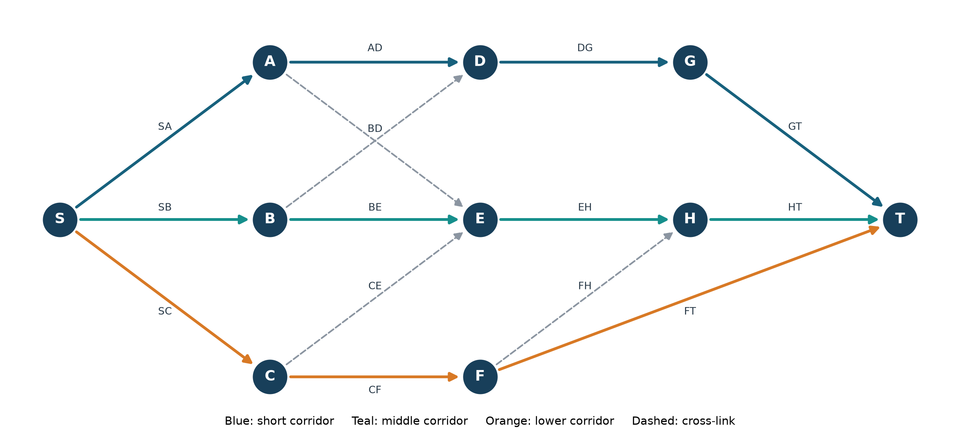
The executable network: 10 nodes and 15 directed links
Three colored corridors connect S to T. Four dashed cross-links make seven valid S-to-T paths in total. Each arrow and link ID corresponds exactly to the Python topology and the link table on the next slide.
BCSE308P Computer Networks Lab 03

Slide 4
Every link parameter used by the simulator
Link | Direction | Delay | Capacity | FIFO size
SA | S→A | 1 | 1 | 6
AD | A→D | 1 | 1 | 6
DG | D→G | 1 | 1 | 6
GT | G→T | 1 | 1 | 6
SB | S→B | 2 | 2 | 8
BE | B→E | 1 | 2 | 8
EH | E→H | 1 | 2 | 8
HT | H→T | 1 | 2 | 8
SC | S→C | 2 | 3 | 10
CF | C→F | 2 | 3 | 10
FT | F→T | 2 | 3 | 10
AE | A→E | 3 | 1 | 6
BD | B→D | 3 | 1 | 6
CE | C→E | 3 | 1 | 6
FH | F→H | 3 | 1 | 6
Units and scenario
Delay is in ticks. Capacity is packets transmitted per tick. FIFO size is packets waiting at that directed link. In the balanced check, only SA, AD, DG and GT change capacity from 1 to 2; all delays and buffer sizes stay fixed.
BCSE308P Computer Networks Lab 04

Slide 5
Seven possible paths, with three usable main corridors
No. | Node sequence | Delay cost | Min link capacity
1 | S-A-D-G-T | 4 | 1
2 | S-A-E-H-T | 6 | 1
3 | S-B-E-H-T | 5 | 2
4 | S-B-D-G-T | 7 | 1
5 | S-C-F-T | 6 | 3
6 | S-C-F-H-T | 8 | 1
7 | S-C-E-H-T | 7 | 1
Reading this table
The fixed cost is the sum of link delays. The last column is the narrowest link on that path. Cross paths share links with the main corridors, so seven paths do not mean seven independent channels. The final queue-aware runs selected the three main corridors.
BCSE308P Computer Networks Lab 05

Slide 6
Packet flow and Python program structure
One packet’s journey
Where this happens in code
At S, a packet receives a complete route and enters its first finite FIFO queue. Each tick, a link serves up to its capacity. The packet then spends its propagation delay in flight. At each next hop it joins the next queue or is dropped if that queue is full. Delivery at T ends its delay measurement.
Packet stores creation tick, route and position. Link stores endpoints, delay, capacity, buffer, FIFO queue and in-flight packets. Network builds the adjacency list. shortest_route runs Dijkstra; run advances ticks and checks packet conservation. main writes the per-run CSV, means and graphs.
Invariant checked every run: generated = delivered + dropped + still waiting or in flight.
BCSE308P Computer Networks Lab 06

Slide 7
How the link weight changes when a queue builds
Fixed weight: w = d Queue-aware weight: w = d × (1 + 2.5q/B)
Meaning of the variables
Worked SA example
d is propagation delay. q is the peak number of packets waiting during the preceding five-tick interval. B is that link’s FIFO size. In-flight packets do not count as q. The route is recalculated every five ticks and cached between updates.
SA has d=1 and B=6. If its observed q=3, its weight becomes 1 × (1 + 2.5 × 3/6) = 2.25. If the other upper links stay at weight 1, upper-route cost becomes 5.25. The middle route at cost 5 then wins.
BCSE308P Computer Networks Lab 07

Slide 8
Fair comparison across two scenarios and nine loads
Experiment controls
Metric definitions
Loads are 0.5, 0.8, 1.0, 1.2, 1.5, 2.0, 2.5, 3.0 and 3.5 offered packets/tick. Ten matched seeds and 5,000 ticks give 180 runs in the bottleneck topology. The balanced-capacity topology adds 180 more. Each pair uses identical generated arrivals.
Delay: mean creation-to-delivery time among delivered packets. Loss: dropped/generated. Throughput: delivered/5,000 ticks. Route changes: switches between routes assigned to consecutive packets. Route counts verify which corridors actually carried assigned traffic. Each graph point is a ten-run mean.
BCSE308P Computer Networks Lab 08

Slide 9
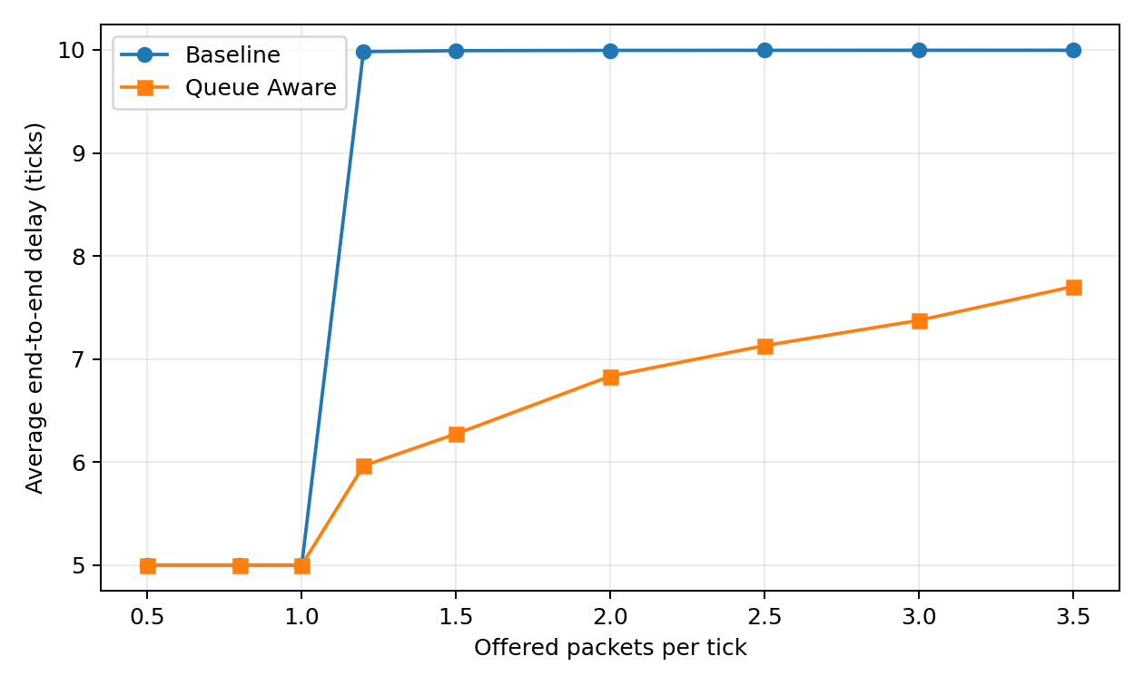
Delay: when the short path congests
What the measurement says
Up to load 1.0, neither method builds a waiting queue and delays match. At load 1.2, fixed delay is 9.983 ticks while queue-aware delay is 5.963. A packet on a longer physical route can still arrive sooner than one waiting behind a saturated bottleneck.
BCSE308P Computer Networks Lab 09

Slide 10
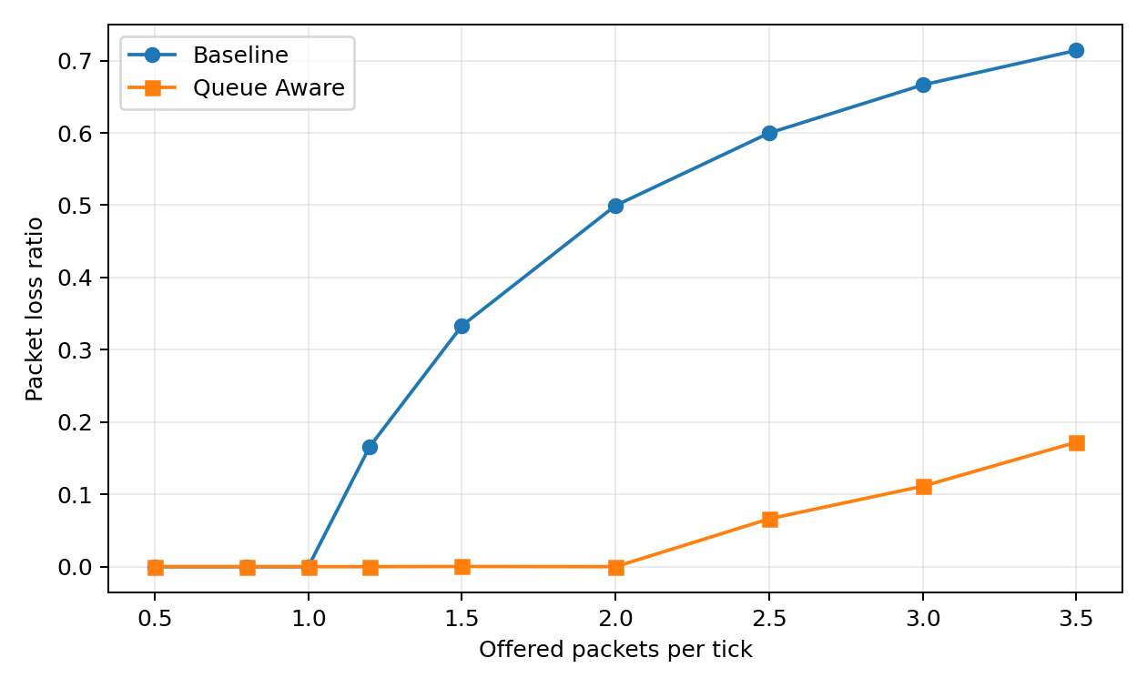
Loss: the benefit has a limit
What the measurement says
At load 1.2, fixed routing loses 16.612% while queue-aware loss is about 0.0017%. At load 2.0, the proposed runs record no drops; at 3.5, its loss rises to 17.224%. The graph therefore supports congestion relief, not a zero-loss guarantee.
BCSE308P Computer Networks Lab 10

Slide 11
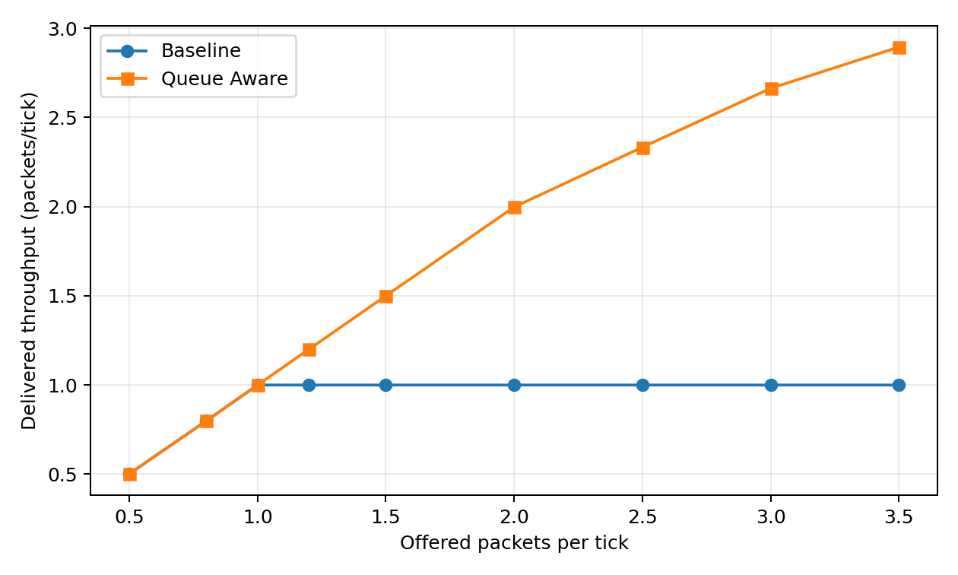
Throughput: route distribution explains the gain
What the measurement says
At load 2.0, fixed routing delivers 0.999 packets/tick and queue-aware routing delivers 1.997. Route counts show roughly 3,340 upper, 3,330 middle and 3,330 lower assignments per run. The result comes from using spare parallel capacity.
BCSE308P Computer Networks Lab 11

Slide 12
Balanced-capacity check and honest trade-offs
Load 3.5 | Delay ticks | Loss | Throughput
Fixed | 6.999 | 42.85% | 1.998
Queue-aware | 7.180 | 9.67% | 3.159
What changed
What did not improve
Upper-corridor capacity alone rose from 1 to 2 packets/tick. At light and moderate loads both methods match because the fixed shortest route is not congested. At 3.5, queue-aware throughput is higher and loss lower.
In the balanced scenario at 3.5, mean delay of delivered packets is higher for queue-aware routing. More packets take longer paths and arrive, while the fixed method drops many. Route updates and queue-state communication would also add real overhead not modeled here.
BCSE308P Computer Networks Lab 12

Slide 13
Conclusion and review demonstration
Conclusion
Show the reviewer
The queue penalty makes Dijkstra react to waiting traffic and use three corridors after the fixed shortest path becomes a bottleneck. The gain is measured, paired by seed, checked by route counts, and bounded by high-load loss and the balanced-scenario delay trade-off. The seven cross-path possibilities were not selected in these runs.
Open the topology, exact link table and seven-route table; then show delay, loss and throughput graphs. Run the command in README.md and open ten_node_final/summary.csv. The actual cmd.exe text log is saved; a literal Command Prompt screenshot must be captured from the visible window.
References: Dijkstra (1959); Moy, RFC 2328 (1998); Shen, Ren & Liu (2016); Bhorkar, Javidi & Snoeren (2012).
BCSE308P Computer Networks Lab 13

