Slide 1
Efficient Route Planning and Scheduling for Electric Vehicle Charging
Submitted by-
Sashwat Rawat (200107074)
Saurabh Kumar (200107076)

Slide 2
Content
Introduction
Problem Definition
Case study
Time Optimization
Decisions variables
Genetic Algorithm
Final Solution from Genetic Algorithm

Slide 3
Introduction
The increasing popularity of Electric Vehicles (EVs) has led to a surge in demand for efficient routing and charging infrastructure. To minimize the total traveling time of EVs from their initial position to the final position,i.e., passenger and maximize the utilization of charging stations, it is necessary to optimize the routing and scheduling of EVs. Optimal routing and scheduling of EV charging stations involve finding the optimal route and charging schedule for EVs based on various factors, such as the location and capacity of charging stations, the battery capacity of EVs, and the travel distance.

Slide 4
Problem Definition
We have considered a particular city where we have n no. of passengers, n no. of vehicles, and m no. of charging stations and we are given data like -
Location of passengers, location of vehicles, and location of charging stations.
The current charge of each vehicle and the charging rate of each station.
The average speed of each vehicle.
etc...
Based on these data we have to find-
Which vehicle is going to which charging station and then to which passenger.
The time taken by the vehicle between its initial location and charging station, and between charging station and passenger.

Slide 5
Case Study
Let the no. of passengers = 5 = no. of vehicles
No. of charging stations be 3.
Let the location of vehicles, passengers and charging stations on cartesian coordinate be :-
EVs | X | Y
1 | 0 | 0
2 | 20 | 28
3 | 26 | 45
4 | 55 | 71
5 | 78 | 34
Passenger_Loc | X | Y
1 | 10 | 8
2 | 39 | 55
3 | 51 | 43
4 | 62 | 59
5 | 83 | 72
Station_Loc | X | Y
1 | 77 | 45
2 | 42 | 59
3 | 29 | 25

Slide 6
q_{i} = [6 8 4 12 7] = current charging capacity of the vehicle.
R_{i} = [6 8 10] = charging capacity of the station
S = 30 Km/hr = average speed of the vehicle
Q = 20 units = total capacity of the vehicle

Slide 7
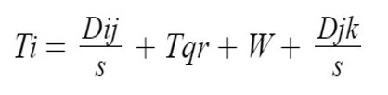

Time Optimization
The time for each vehicle to complete the task is given by
here, i represent the i^{th} electric vehicle
here, j represents the j^{th} charging station
here, k represents kth passenger
For each vehicle we can break the whole process into 3 parts.
T1= Time taken by a vehicle to travel from their initial location to charging station.

Slide 8
T2=W+Tqr= Time spent by each vehicle in Charging Stations
W= Waiting time for each vehicle in their respective station
Tqr= Total Charging time
T3= Time taken by vehicle to travel from charging station to their respective passenger
For solving this problem we will use inbuilt GA toolbox
For finding W ,i.e., waiting time in the same charging station we have to consider all the order and the least will be taken by the GA
So, in total we will use GA two times one time for W and one time for all the 4 time.

Slide 9
Decision Variable:
For solving GA
X_{i} : This will be of length 2n; it is a combination of two array of size n each. Where;
1st half- i^{th} vehicle is going to the j^{th} charging station
2nd half- i^{th} vehicle will pick-up the k^{th} passenger
1st half 2nd half
Eg: [3 2 3 3 1 3 1 2 5 4] 1st arrow means Vehicle 2 will go to station 3
2nd arrow means vehicle 3 will pick up Passenger 2

Slide 10
2. For solving the order in which the vehicles will charge (to find their waiting time in charging station) we will again use GA
Y_{i} : This will be of length depending on the no. of vehicles coming to a particular station. Where;
1st half- i^{th} vehicle is going to the j^{th} charging station
2nd half- i^{th} vehicle will pick-up the k^{th} passenger
From the previous example we can say vehicles 1,3 and 4 come to station 3 so their optimised Yi will give the order in which they will charge and the others will wait.
eg: Y=[3 1 2] - means Vehicle 4 will charge first then vehicle 1 and vehicle 4 will be charged at last.

Slide 11
Genetic Algorithm:
A genetic algorithm is a type of optimization algorithm that is inspired by the process of natural selection in biological evolution. It works by evolving a population of potential solutions to a problem over successive generations, using selection, crossover, and mutation operations that mimic the natural processes of reproduction and genetic variation.
Overall, the genetic algorithm is a powerful optimization technique that can efficiently search the solution space for optimal solutions. By mimicking the principles of natural selection and genetic inheritance, it can explore a wide range of potential solutions and converge on the best solution over time.

Slide 12
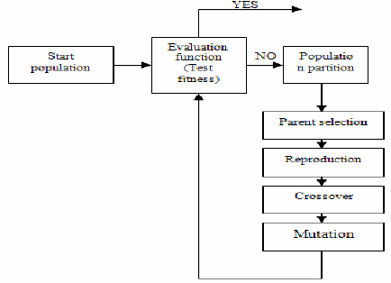
The genetic algorithm can be summarized in the following steps:

Slide 13
Solution Representation: The solution space is represented as a set of chromosomes, where each chromosome is a vector of values representing a potential solution to the problem. The chromosomes are typically encoded as binary strings or real-valued vectors.
Fitness Function: The fitness function evaluates the quality of each chromosome in the population. It maps each chromosome to a fitness score that represents how well it solves the problem. The fitness function is typically a mathematical function that evaluates the performance of the solution.
Selection: The selection operator chooses which chromosomes will be used to generate the next generation. Chromosomes with higher fitness scores have a higher probability of being selected. The selection operator can use different selection methods, such as roulette wheel selection or tournament selection.

Slide 14
Crossover: The crossover operator combines the genetic material of two parent chromosomes to produce one or more offspring chromosomes. This is done by selecting a crossover point in the parent chromosomes and swapping the genetic material beyond that point. The result is two new chromosomes that inherit some genetic material from each parent.
Mutation: The mutation operator randomly changes the genetic material of a chromosome. This is done to introduce new genetic material into the population and prevent the algorithm from getting stuck in local optima. The mutation operator selects a random position in the chromosome and changes the value of that position with some probability.
Termination: The algorithm terminates when some stopping criterion is met, such as a maximum number of generations or a target fitness score.

Slide 15
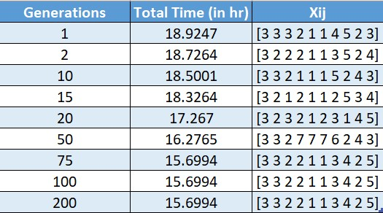
Final Solution from Genetic Algorithm Performance

Slide 16
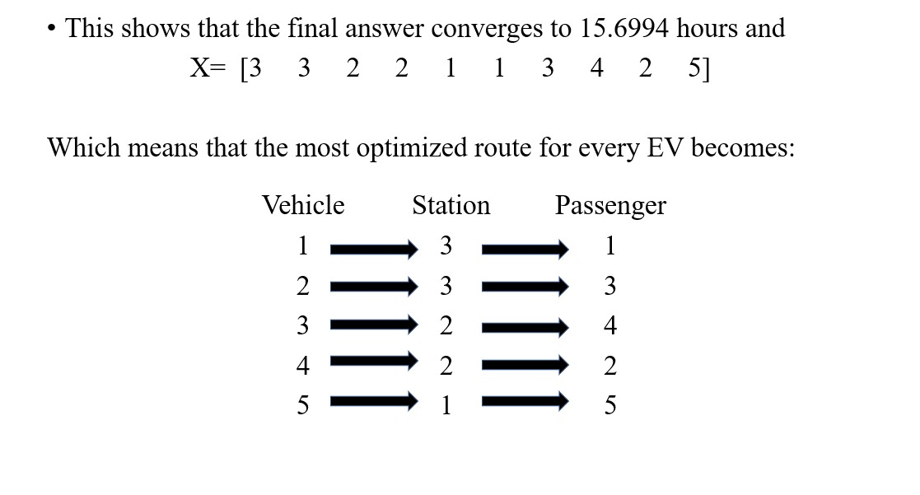

Slide 17
Thank You

