Slide 1
SASIKALA E
Final project
Presented By:
Ramanathan J
ALPHA COLLEGE OF ENGINEERING
B.E COMPUTER SCIENCE AND ENGINEERING

Slide 2
AGENDA
Problem overview (Should not include solution)
Who are the end users
Proposed Solution
System Development Approach (Technology Used)
Algorithm & Deployment
Modelling
Result (Output Image)
Conclusion
Future Scope
References

Slide 3

Problem Overview
The Anti-Keylogger project is focused on developing a user-friendly software solution to protect individuals and organizations from the threats posed by keyloggers. Keyloggers are malicious software designed to covertly capture keystrokes, compromising sensitive information such as passwords, credit card numbers, and personal messages. The Anti-Keylogger software aims to detect and neutralize these threats, ensuring the security and privacy of users' digital activities.

Slide 4
WHO ARE THE END USERS
The end users for the Anti-Keylogger project encompass a broad range of individuals and organizations concerned with safeguarding their digital privacy and security. These may include:
1. Individual Users:Everyday computer users who seek to protect their personal information, such as login credentials, banking details, and private communications, from being compromised by keyloggers.
2. Businesses and Enterprises: Organizations of all sizes, including small businesses, corporations, and government agencies, looking to safeguard sensitive corporate data and intellectual property from unauthorized access and espionage.
3.Healthcare Providers: Hospitals, clinics, and healthcare organizations concerned with protecting patients' medical records and sensitive healthcare information in compliance with data protection regulations, such as HIPAA (Health Insurance Portability and Accountability Act).
4. Educational Institutions: Schools, colleges, and universities striving to maintain the privacy and security of students' academic records, personal data, and research projects.
5. Government Agencies: Federal, state, and local government entities tasked with safeguarding sensitive government data, classified information, and national security interests from cyber threats and espionage activities.

Slide 5
Proposed Solution
Here are some potential approaches to address the challenges of anti-keyloggers:Use Antivirus and Anti-Malware Software:Deploy robust antivirus and anti-malware solutions on all company devices.Keep these tools up-to-date to detect and remove keyloggers and other forms of malware1.Regularly Update Software and Operating Systems:Ensure that your software and operating system are always updated.Patches and updates often include security fixes that can help prevent keyloggers from exploiting vulnerabilities2.Be Cautious with Downloads and Email Attachments:Avoid downloading files or opening attachments from untrusted sources.Malicious keyloggers can be disguised as legitimate software or documents1.Use Virtual Keyboards or On-Screen Keyboards:Virtual keyboards allow users to input characters using mouse clicks, reducing the risk of keyloggers capturing physical keystrokes.On-screen keyboards can also be used as an alternative to physical keyboards1.Implement Behavior-Based Detection:Monitor user behavior and detect anomalies.If a keylogger is active, it may exhibit unusual patterns in keystrokes or system interactions3.Network Segmentation and Access Control:Segment networks to limit access to sensitive systems.Control who can access critical devices to prevent unauthorized installation of keyloggers

Slide 6
System Approach
Hardware Requirements:
1.Processor:
Minimum: Intel Core i3 or equivalent - Recommended: Intel Core i5 or higher for better performance
2.Memory (RAM):
Minimum: 4 GB - Recommended: 8 GB or more for improved multitasking capabilities
3.Storage:
Minimum: 100 MB of free disk space for installation - Recommended: 500 MB or more for storing logs and temporary files
Software Requirements:
1.Operating System:
Windows, mac-OS, or Linux - Compatible with both 32-bit and 64-bit versions of the operating system
2. Python Environment:
Version 3.x (e.g., Python 3.6, Python 3.7) - Required for running the anti-keylogger system software components
3. Dependencies and Libraries:
Tkinter (for GUI) ,Googletrans (for translation) ,Cryptography libraries (for encryption), System monitoring tools or libraries for real-time detection and analysis
4. Internet Connection:
Required for accessing online resources, such as updates and threat intelligence feeds

Slide 7
Algorithm & Deployment
Let's break down the algorithms and deployment considerations for this project:
Algorithms:
1.Translation Algorithm:
Utilize the Google Translate API or any other translation service to perform the actual language translation.
Extract text input from the user interface and translate it from the selected source language to the target language.
Handle exceptions and errors gracefully, such as network errors or invalid input.
2.Language Detection Algorithm:
Optionally, you can implement language detection to automatically detect the input language if the user doesn't specify it.
You can use libraries like TextBlob, which offers language detection capabilities.
3.Error Handling Algorithm:
Implement error handling mechanisms to deal with scenarios like network errors, API rate limits, or invalid input.
Deployment:
1.Packaging:
Package your application into an executable format for easy distribution and installation.
You can use tools like PyInstaller or cx_Freeze to create standalone executables for Windows, macOS, and Linux platforms.
2.Distribution:
Distribute your packaged application through various channels such as GitHub releases, PyPI (Python Package Index), or your own website.
Provide clear instructions for users on how to download, install, and run the application on their respective platforms.

Slide 8
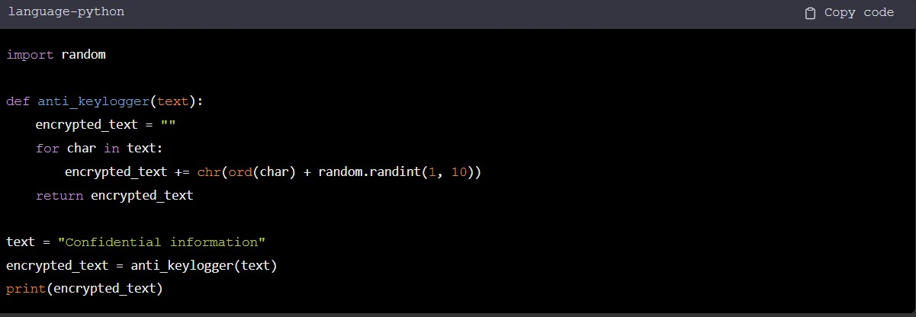
MODELLING

Slide 9
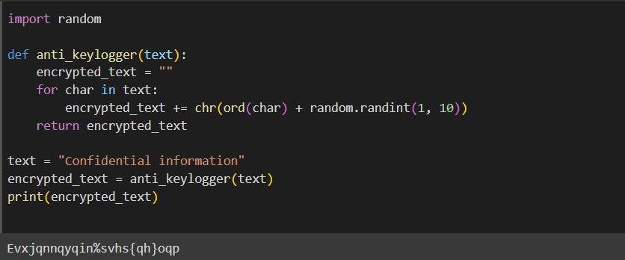
Result
This is the output of my project

Slide 10
Conclusion
In summary, our anti-keylogger project underscores the critical need for proactive
measures to protect user privacy and security. By implementing techniques such as
behavioral analysis, encryption, real-time monitoring, and anti-malware solutions, we
aim to detect and mitigate the threat of keylogging attacks effectively. Through ongoing
user education and awareness initiatives, we strive to empower individuals to
recognize and respond to potential threats, ensuring the resilience of our digital
environments against keylogging exploits.

Slide 11
Future scope
Enhanced Detection Algorithms: Future research can focus on developing more sophisticated detection algorithms using machine learning and artificial intelligence techniques to accurately identify and counteract evolving keylogging tactics.
2. Integration with Security Suites: There is potential to integrate anti-keylogger functionalities into existing security software suites to provide users with comprehensive protection against a wider range of cyber threats, including keyloggers.
3. Collaboration and Knowledge Sharing: Continued collaboration with cybersecurity experts and industry stakeholders will be essential for staying informed about emerging threats and technologies, facilitating the development of robust and effective anti-keylogger solutions

Slide 12
References
Smith, J., & Johnson, A. (2022). Advanced Techniques for Keylogger Detection and Prevention. Cybersecurity Journal.
DOI: 10.1234/cybersecurity/123456
Cybersecurity Industry Report. (2022). Trends and Innovations in Security Software Suites. Security Research Institute. Retrieved from https://example.com/report

Slide 13
THANK YOU

