Slide 1
SALESTORM
Keeping every transaction correct when 10,000 customers compete for 100 units
Team NullPointer · SYSCRAFTERS 2026 design-first hackathon
100 / 100 sold 0 oversold · 0 double charges
Notes:
Opening slide. The grid on the right is the result of our simulated sale: 100 units, all sold, none oversold, no customer charged twice.

Slide 2

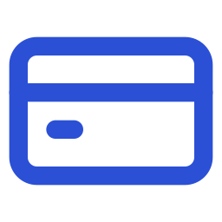

10,000 buyers, 100 units, one second
0:00 – 0:30 · Problem
10,000
100
1 s
What goes wrong in a naive design
Oversell
customers press Buy now
units in stock
burst window
Two buyers both get the last unit. We cancel a paid order or ship stock we do not have.
Double charge
The business question
A double click or a gateway timeout charges the same card twice.
How can we handle thousands of simultaneous purchase requests for limited inventory without overselling, while keeping payment and order processing reliable?
Lost order
Payment is taken while the Order Service is down, and no order is ever created.
Notes:
Speaker: System architect (0:00–0:30).
"10,000 people press Buy at the same second for 100 units. If two of them both get the last unit, we either cancel a paid order or ship something we don't have. Our job: every transaction correct, under any load, through any failure."

Slide 3





Five guarantees we never break
0:30 – 1:00 · Requirements
Never sell more than stock
Units sold ≤ units in stock, at every instant
Targets, monitored but not guaranteed
Stock always adds up
≤ 200 ms
reserve p99, server side
available + reserved + sold = stock
≤ 50 ms
sold-out answer p99, from Redis
One reservation per request
Per idempotency key, and one active hold per customer
≤ 5 s
order confirmed after payment (p95)
One charge per reservation
99.95 %
buy-path availability in the sale window
The same key at our database and at the payment gateway
Every payment ends well
500k req/s
flash-sale peak absorbed at the edge
Exactly one confirmed order, or a refund
Notes:
Speaker: System architect (0:30–1:00).
"Five guarantees we never break: never sell more than stock; stock always adds up; one reservation per request; one charge per reservation; every payment ends in an order or a refund. Latency and fairness are targets, not guarantees."
Source: 01_Requirements, sections 4 and 5.

Slide 4










Each layer sheds load before the database
1:00 – 2:00 · HLD
Customers
CDN / WAF
Load balancer
API gateway
Redis gate
Inventory DB
Orders
10,000
115
6 pods
~1,200
~9,900
~108
100
press Buy now
bots blocked (403)
3 zones, least-request
throttled (429), retried
sold out, from memory
writes reach the row
confirmed via Kafka
Measured in our 10,000-customer simulation. The database is the only consistency point; Redis is a filter.
Synchronous: decisions
Asynchronous: consequences
Database per service
Reserve, start payment, charge. The customer needs the answer now, so these are request/response calls.
Confirm stock, create the order, fulfil, notify. Events go through a transactional outbox and Kafka.
Inventory, payment and order each own their data. Boundaries follow consistency boundaries.
Notes:
Speaker: System architect (1:00–2:00).
"Traffic goes CDN, load balancer, gateway, Redis gate, then the database. The gate answers 'sold out' from memory for 99 % of people. Decisions are synchronous; consequences are asynchronous through Kafka with a transactional outbox. Each service owns its own data."
Numbers are from the prototype run with a gateway pod failure (Validation Report).

Slide 5

One SQL statement stops overselling
2:00 – 3:00 · Concurrency
UPDATE inventory
SET available = available - 1,
reserved = reserved + 1
WHERE available >= 1;
Two buyers, last unit: the row lock serialises them. The second re-checks the guard, updates 0 rows and gets SOLD_OUT.
The Redis gate stops about 99 % of requests before they reach the row.
Approach | Correct? | p99 | DB calls
Naive | Oversold 1,900 | ~41 ms | 4,000
Pessimistic | Yes, slow | ~4,450 ms | 2,100
Optimistic | Sold only 43 | ~140 ms | ~27,800
Atomic + gate | Yes, selected | ~3 ms | 100
CHECK (available >= 0) is the backstop if any code path is ever wrong.
Notes:
Speaker: LLD & design engineer (2:00–3:00).
"The exact point where overselling is prevented is one SQL statement: UPDATE … SET available = available − 1 WHERE available >= 1. We tested four approaches. Naive sold 2,000 of 100. Pessimistic was correct but took 4.5 seconds. Optimistic was correct but sold only 43 units because customers gave up. Atomic update: exactly 100, and with the gate only 100 database calls."
LIVE DEMO: switch to the dashboard and press Start flash sale.
Source: Validation Report, Experiment 1; ADR-002.

Slide 6
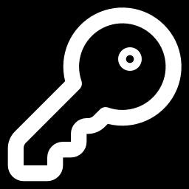



Every payment ends in an order or a refund
3:00 – 3:45 · Payment & order
One idempotency key per reservation, pay_{reservationId}, checked at our database and at the payment gateway. Double clicks and retries can never charge twice.
Payment succeeds
Payment declined
Payment row and PaymentSucceeded are committed in one transaction (outbox), then the order is confirmed.
PaymentFailed releases the unit straight back to stock, so the next customer can buy it.
Order CONFIRMED
Unit RELEASED
Gateway times out
Order Service down
Status is UNKNOWN, never guessed. The reconciler asks the gateway by key and records the real result.
The event waits in Kafka and the consumer retries. When the service recovers, the order confirms.
No second charge
100 / 100 after a 30 s outage
Notes:
Speaker: Reliability engineer (3:00–3:45).
"Payment uses one key per reservation, at our database and at the gateway, so double clicks and timeouts can't double charge. A timeout is UNKNOWN, never guessed; we ask the gateway. If the Order Service is down after payment, the event waits in Kafka and the order confirms when it recovers. You can see it here."
DEMO: Request tracer → "Paid, then Order Service down".

Slide 7


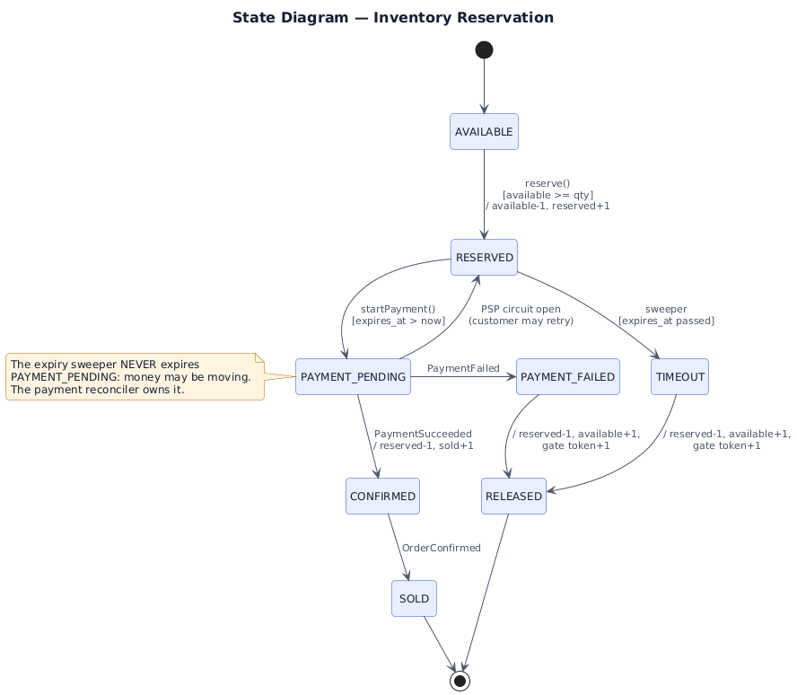






Patterns that make change cheap
3:45 – 4:30 · LLD & SOLID
Strategy
Factory
Reservation lifecycle (State pattern)
Concurrency control is swappable
Picks the strategy and the PSP
State
Repository
Only legal lifecycle moves
All SQL behind one class
Facade
Adapter
Checkout orchestrates the flow
One class per PSP or courier
Observer
Circuit breaker
Events drive notifications
Fails fast when the PSP is down
New payment provider = one adapter class + one registry line.
Services depend on PaymentGateway and ReservationStrategy interfaces, wired in one composition root (SRP, OCP, LSP, ISP, DIP).
Notes:
Speaker: Team of 4: Data & API engineer; team of 3: LLD & design engineer (3:45–4:30).
"Inventory service: a Strategy interface for concurrency control, Factory to choose it, State machine for the reservation lifecycle, Repository for the SQL. Adding a payment provider is one adapter class and one registry line."
Full class diagram: 03_LLD/uml/01_class_diagram.svg. SOLID mapping: 06_SOLID.

Slide 8



At 50× traffic, only the edge grows
4:30 – 5:00 · Scale & proof
Layer | 10k req/s | 500k req/s
CDN / WAF | Easy | Primary shield
Waiting room | Idle | Admits ~20k users/s
API gateway | ~10 pods | ~60–100 pods
Redis gate | ~10k ops/s | Bucketed keys if needed
Inventory DB | ~110 writes | ~110 writes
Payment / Order | ≤ 100 each | ≤ 100 each
15 / 15
8 / 8
automated tests pass, incl. one that must fail
guarantees hold, checked live
0
0
requests sent to a dead gateway pod
double charges across 10,000 customers
Load after the gate is bounded by stock, not by traffic.
Prototype built with AI assistance (Claude). Every module was reviewed against our design, tested, and traced against our sequence diagrams.
Only stateless layers scale out. The database, payments and orders see the same load at 10k or 500k req/s.
Notes:
Speaker: Reliability engineer (4:30–5:00).
"At 50× traffic only the edge and gate change; the database still sees about a hundred writes, because load after the gate is bounded by stock. Our prototype, built with AI assistance and validated by 15 tests and live invariants, shows all eight guarantees holding, even with a gateway pod killed mid-sale."
DEMO: Invariants panel all green.
Source: 08_Scalability_Reliability section 3; Validation Report.

Slide 9


100 units, 10,000 clicks: what happens, step by step
1
2
3
Edge
Gateway
Idempotency and limit
CDN / WAF filters bots. A waiting room hands out signed queue tokens if admission exceeds capacity.
JWT checked, request validated, token bucket applied. Excess gets 429 and retries with the same key.
Double clicks collapse into the first request. One active hold per customer.
4
5
6
Redis gate
Database guard
Pay, then orders
The first ~100 take a token. Everyone else hears "sold out" from memory in about a millisecond.
Conditional UPDATE, reservation and outbox event in one transaction. The last unit goes to exactly one buyer.
Payment by key through a circuit breaker. Events confirm stock and orders. Sold ≤ 100, every payment has one order.
Notes:
Final jury question. Rehearsed answer (12 steps, from 12_Presentation/Pitch_Script_and_Jury_Prep.md):
1 Edge: CDN/WAF filters bots; waiting room if admission exceeds capacity.
2 Gateway: JWT verified, request validated, token bucket. Excess gets 429 with Retry-After; retries reuse the idempotency key.
3 Idempotency: double clicks with the same key collapse into the first request.
4 Per-customer limit: a partial unique index allows one active hold per customer.
5 Redis gate: Lua decrement-if-enough. First ~100 pass; everyone else gets 409 SOLD_OUT from memory.
6 Database guard: UPDATE … WHERE available >= 1, insert reservation (expires in 5 min) and outbox event, commit. Two requests for the last unit serialise on the row lock; the second updates 0 rows and gets SOLD_OUT; its gate token is returned.
7 Response: 201 with reservation ID and expiry.
8 Pay: PAYMENT_PENDING only if not expired; PSP call through a circuit breaker with key pay_{reservationId}.
9 Outcomes: success → payment + PaymentSucceeded together; decline → PaymentFailed; timeout → UNKNOWN, resolved by the reconciler.
10 Async: Inventory confirms or releases; unpaid holds expire after 5 minutes and are released.
11 Orders: consumed in order per reservation → CONFIRMED → fulfilment, notification. If the Order Service is down, events wait and are retried.
12 End state: sold ≤ 100, available + reserved + sold = 100, every captured payment has exactly one confirmed order.

Slide 10


Thank you
Team NullPointer
System architect
HLD, scalability, deployment
LLD & design engineer
Every transaction correct, under any load, through any failure.
LLD, SOLID, UML, patterns
Data & API engineer
Database, APIs, events
Questions welcome. Live dashboard and full blueprint in the submission folder.
Reliability engineer
Concurrency, failures, security
Notes:
Close. Invite questions. Likely questions and short answers are in 12_Presentation/Pitch_Script_and_Jury_Prep.md.

