Slide 1
IOC PROJECT
GetPaws – Pet Care and Vet Support System
Live Demo Screens & Architecture Overview
DONE BY:
SASI KIRUTHIK.P
2023103514
CSE-P
BE CSE

Slide 2
OBJECTIVE
Enable pet owners to:
Monitor and track pet health
Access medical history
Get symptom-based suggestions
View vet availability and ratings
Support veterinarians in managing availability and appointments.
Implement real-time communication using WebSockets .
Create a responsive, modern UI using React.
Use MongoDB for scalable data storage.

Slide 3
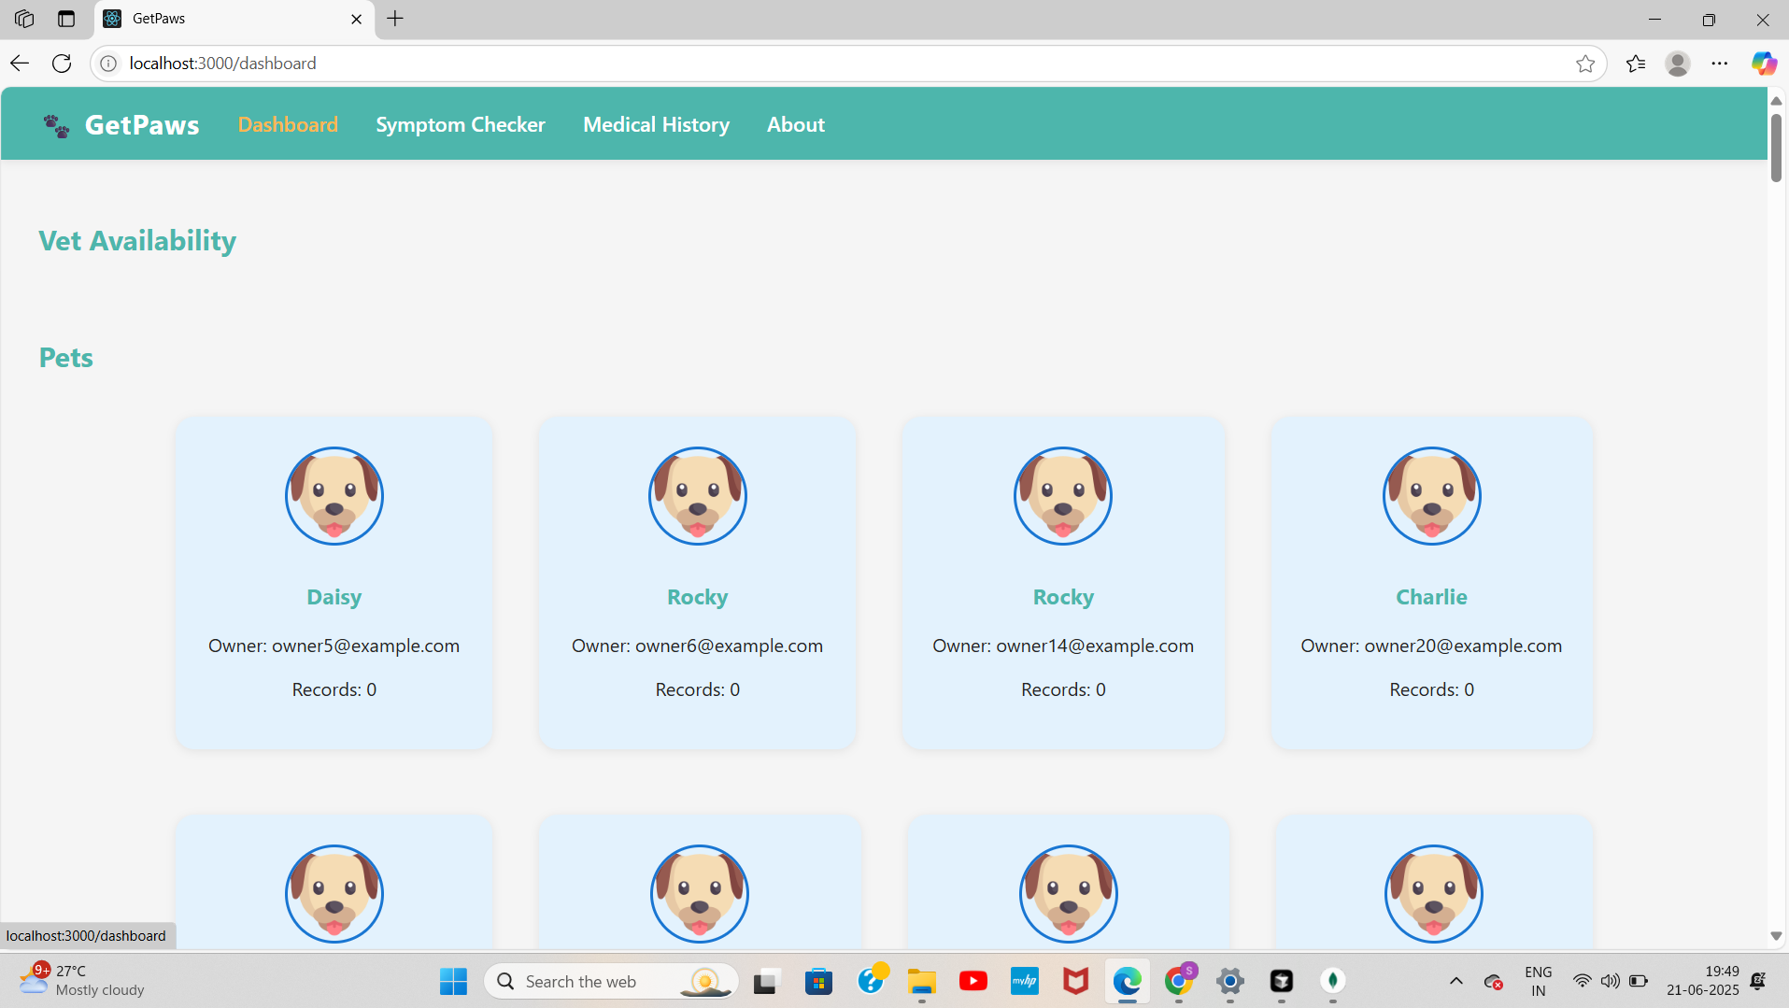
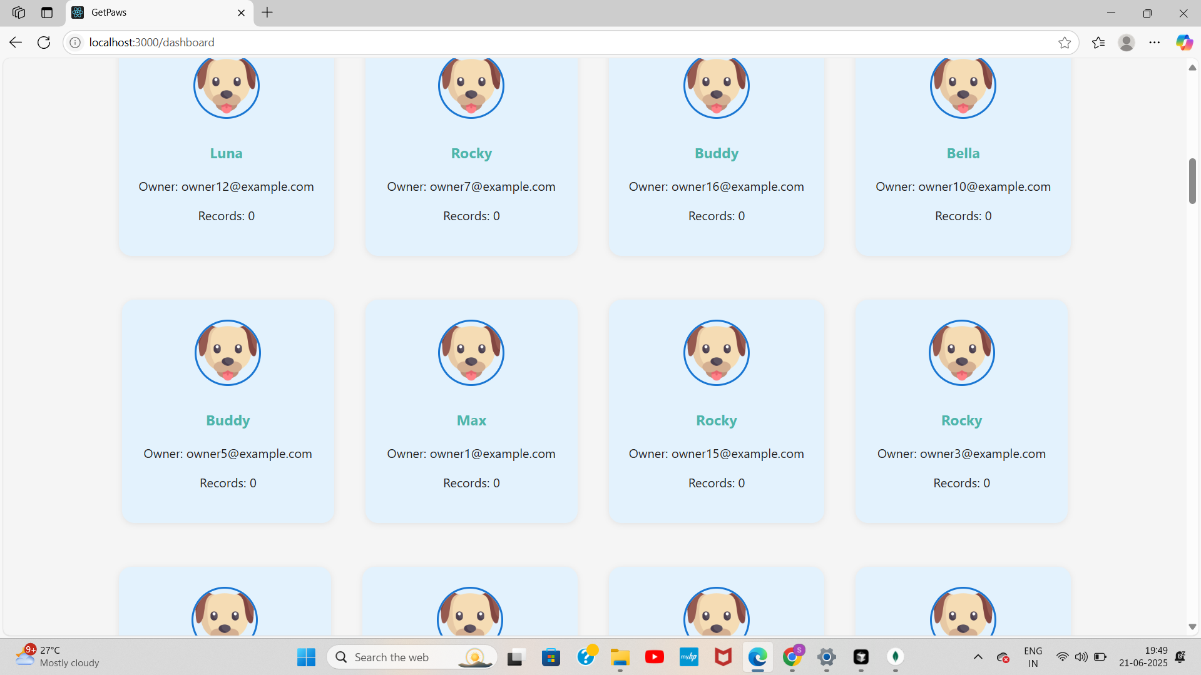
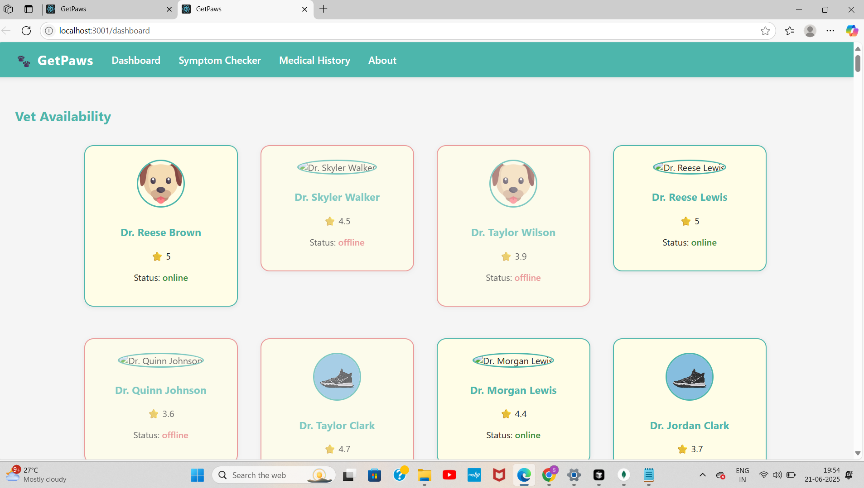
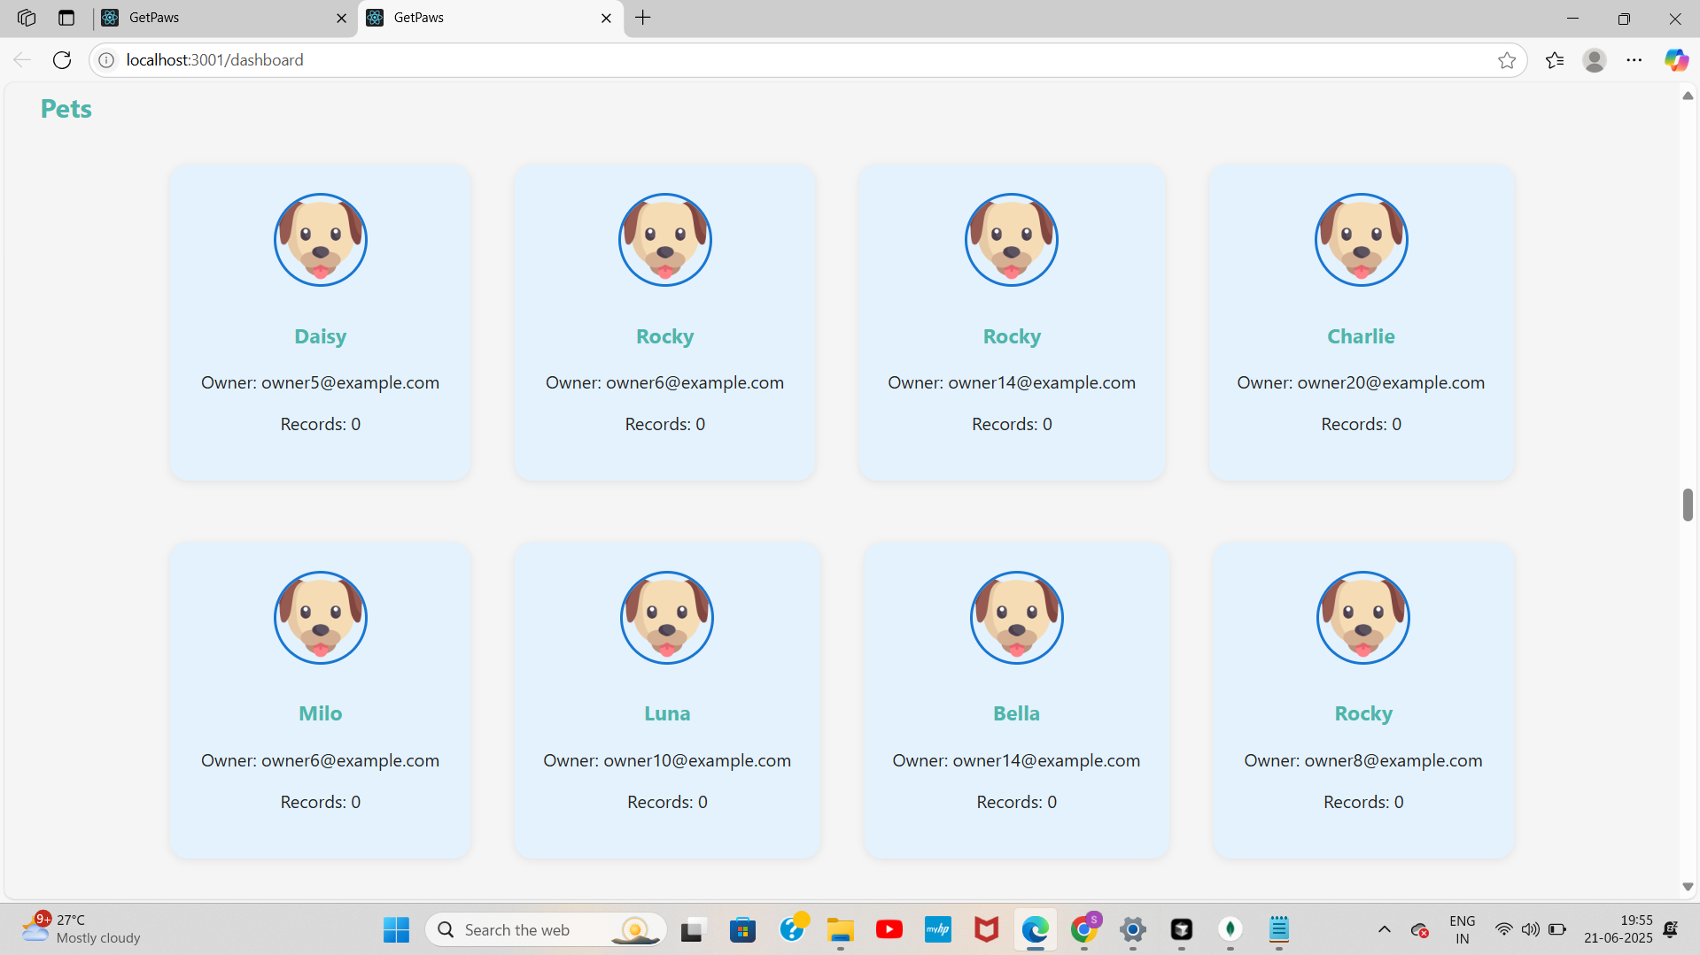
GETPAWS DASHBOARD
Displays pets registered with owner email and record count
Also Displays the veterinarian available under vet section,.

Slide 4
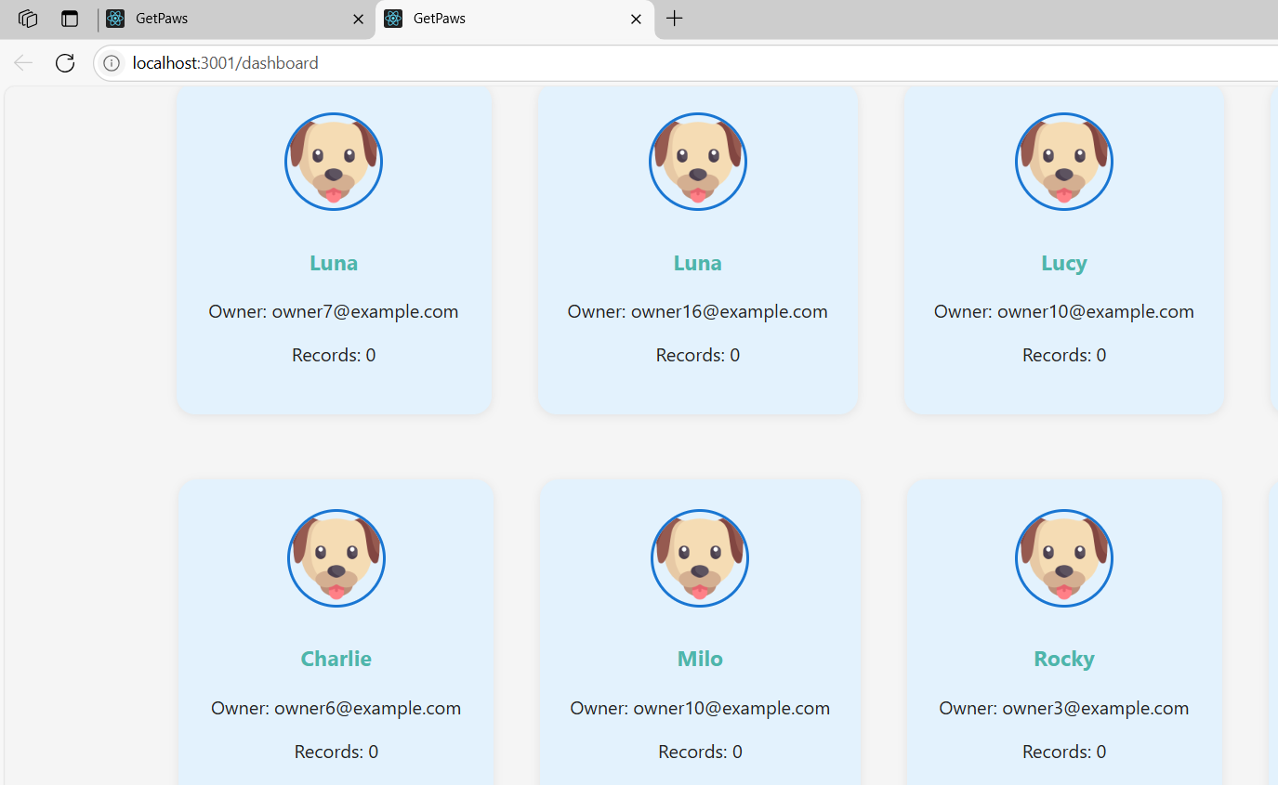
PET LIST
Shows The pets along with owner mail ids that are available for sell.

Slide 5
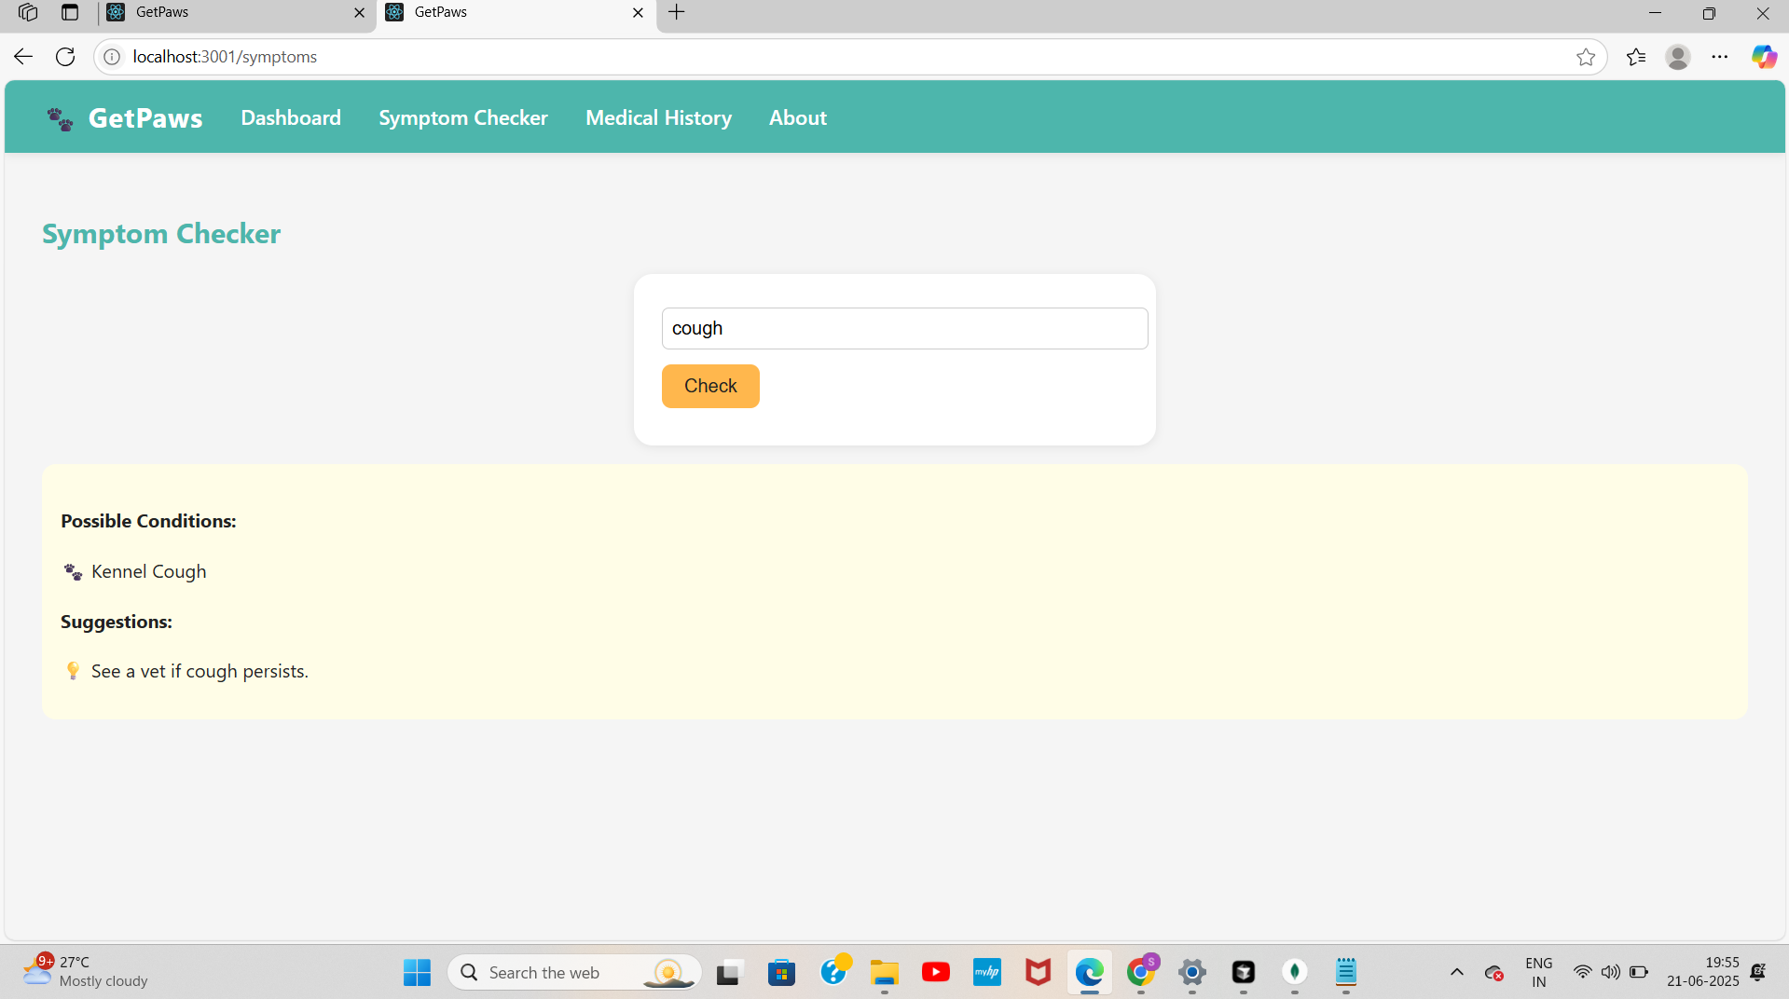
SYMPTOM CHECKER
You can check the Possible conditions of your pet by entering Symptoms and get corresponding suggestions

Slide 6
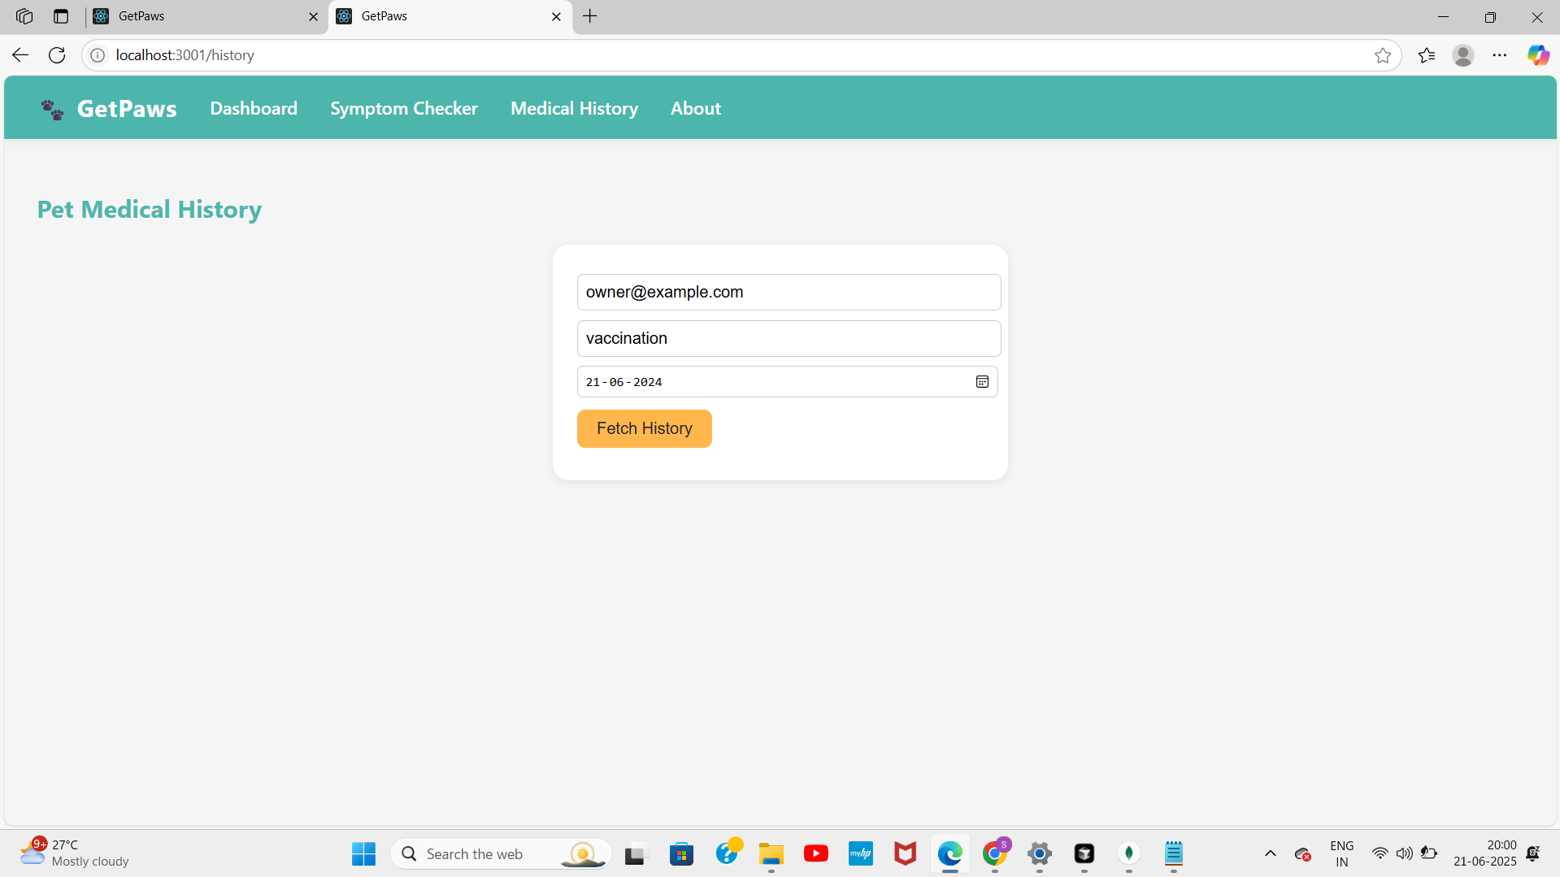
MEDICAL HISTORY
Get the Medical Records By entering the email used for appointment ,type (e.g.,vaccination) and date of appointment

Slide 7
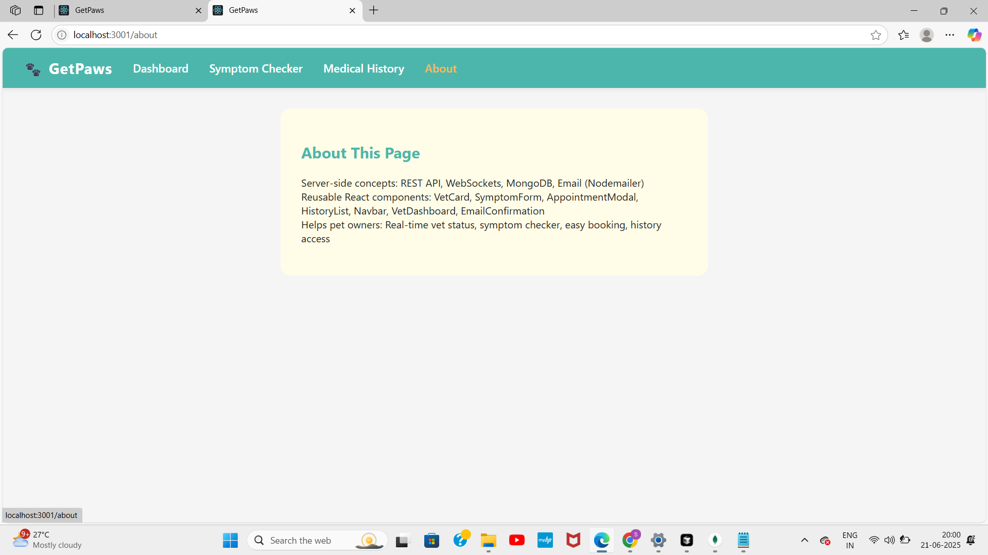
ABOUT PAGE
The About Page is designed to show the works that are done in the page for Educational purpose for staffs understanding . So instead of the projects goal I included this.

Slide 8
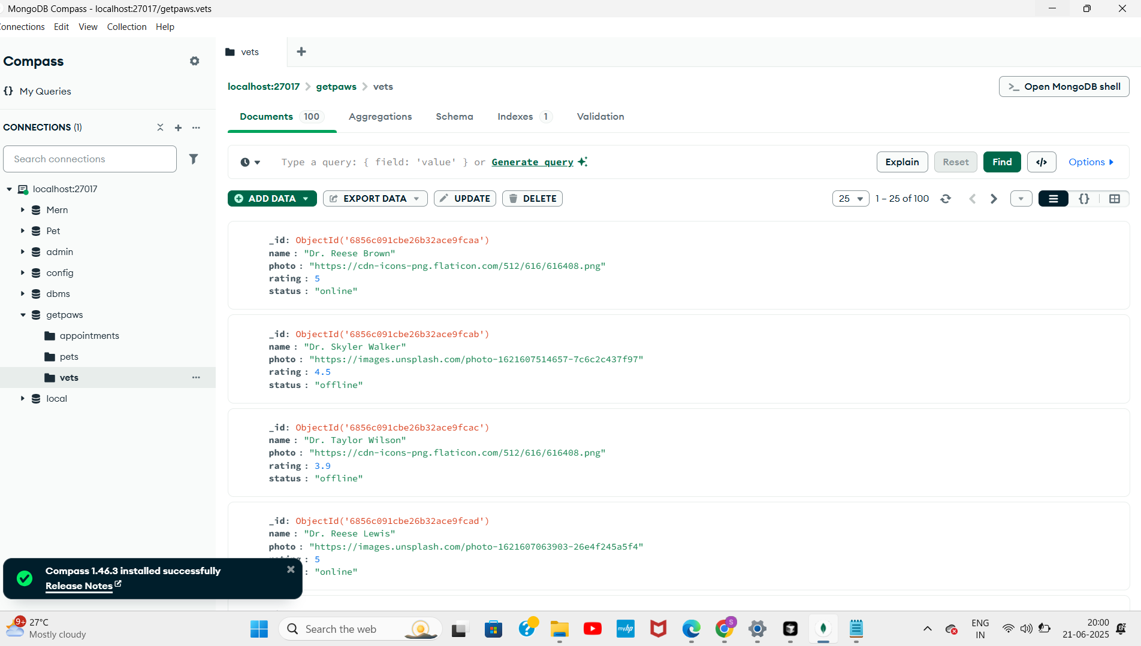
MONGO DB
VETS COLLECTION.

Slide 9
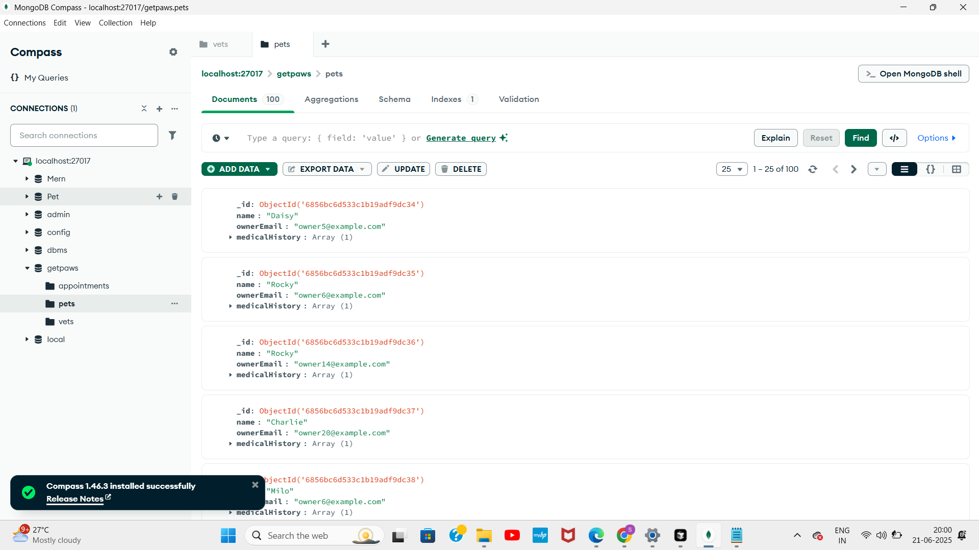
MONGO DB BACKEND VIEW
AVAILABLE PETS COLLECTION

