Slide 1
Public Health Awareness
Team members : Sasikala
Arathi
Savitha
Sudharshan reddy
Bhanu prakash reddy

Slide 2
Machine learning algorithm Machine Learning (ML) is a subtype of Artificial Intelligence (AI) technology that aims to improve the speed and accuracy of physicians’ work.
This paper identifies the need for ML in healthcare. Paper identifies and discusses the significant applications of ML for Healthcare. Paper explores how ML-based tools are used to provide various treatment alternatives and individualised treatments and improve the overall efficiency of healthcare systems. Paper finds that ML will be crucial in developing clinical decision support, illness detection, and personalised treatment approaches to provide the best potential outcomes.

Slide 3
Roles of machine learning
Countries are currently dealing with an overburdened healthcare system with a shortage of skilled physicians, where AI provides a big hope.
The healthcare data can be used gainfully to identify the optimal trial sample, collect more data points, assess ongoing data from trial participants, and eliminate data-based errors.
ML-based techniques assist in detecting early indicators of an epidemic or pandemic.

Slide 4
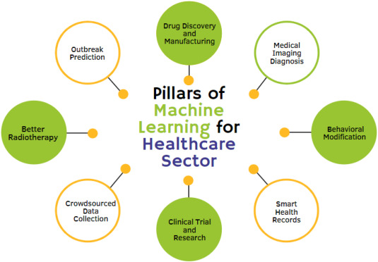

Slide 5
Ways for identification
It identified and discussed the significant applications of ML for healthcare.
The applications of this technology in healthcare operations can be tremendously advantageous to the organisation.
ML-based tools are used to provide various treatment alternatives and individualised treatments and improve the overall efficiency of hospitals and healthcare systems while lowering the cost of care.
Shortly, ML will impact both physicians and hospitals. It will be crucial in developing clinical decision support, illness detection, and personalised treatment approaches to provide the best potential outcomes.

