Slide 1
GIT
A Distributed Version Control System
1

Slide 2
What is Version Control Systems?
Version control, also known as source control, is the practice of tracking and managing changes to software code.
Version control systems are software tools that help software teams manage changes to source code over time.
The Version Control System helps manage the source code for the software team by keeping track of all the code modifications.

Slide 3
Why version control system?
Version control has several important benefits for organizations.
For example, it can help prevent or quickly undo errors, save time when working on and searching for documents, ensure sensitive information does not fall into the wrong hands, and enable retrospective review of team work.
With version control, you're able to track and merge branches, audit changes, and enable concurrent work to accelerate software delivery.

Slide 4
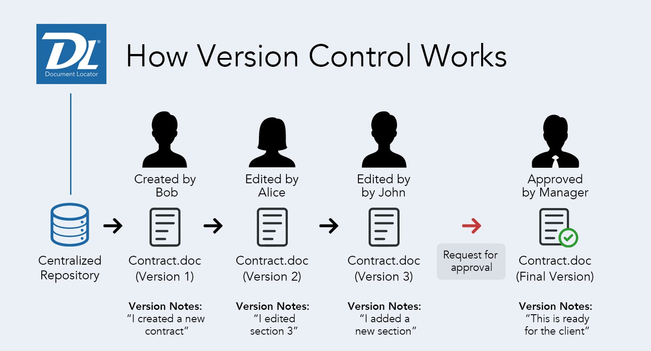
How version control system works?

Slide 5
Download and install GIT
Navigate to the latest Git for Windows installer and download the latest version.
Once the installer has started, follow the instructions as provided in the Git Setup wizard screen until the installation is complete.
Open the windows command prompt (or Git Bash if you selected not to use the standard Git Windows Command Prompt during the Git installation).
Type git --version to verify Git was installed.

Slide 6
Introduce yourself to Git
Start git Cmd / gitBash
Enter these lines (with appropriate changes):
  git config --global user.name “Valan"
  git config --global user.email valanmca@gmail.com
You need to do this only once.

Slide 7
GIT Commands

Slide 8
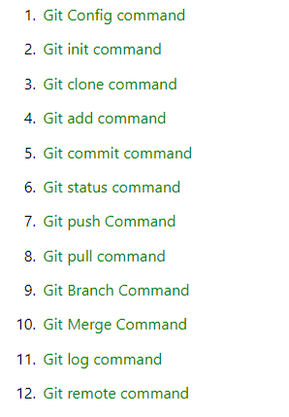
Basic GIT Commands
Here is a list of most essential Git commands that are used daily.

Slide 9
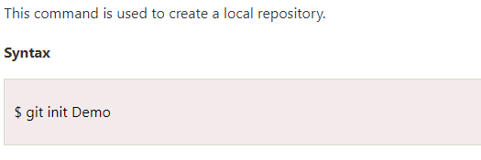
GIT init Command

Slide 10
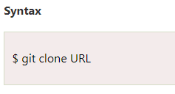
GIT clone Command
This command is used to make a copy of a repository from an existing URL.

Slide 11
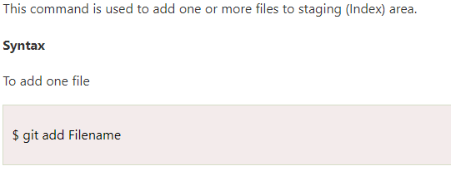
GIT add Command

Slide 12
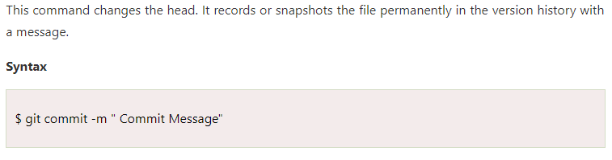
GIT commit Command

Slide 13
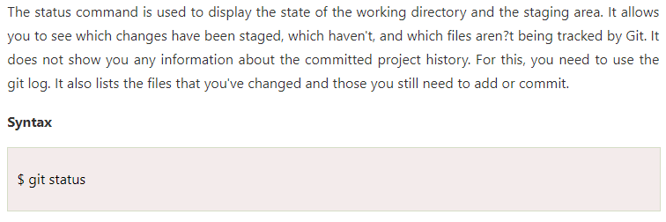
GIT status Command

Slide 14
GIT push Command
It is used to upload local repository content to a remote repository. Pushing is an act of transfer commits from your local repository to a remote repo.
It's the complement to git fetch, but whereas fetching imports commits to local branches on comparatively pushing exports commits to remote branches. Remote branches are configured by using the git remote command. Pushing is capable of overwriting changes, and caution should be taken when pushing.

Slide 15
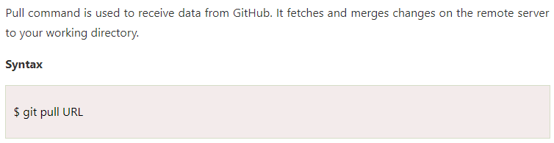
GIT pull Command

Slide 16
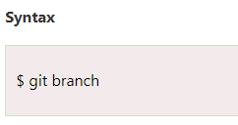
GIT branch Command
This command lists all the branches available in the repository.

Slide 17
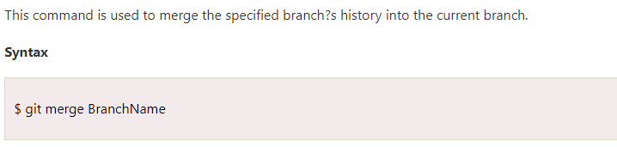
GIT merge Command
This command lists all the branches available in the repository.

Slide 18
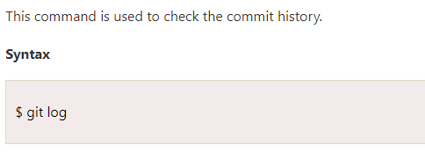
GIT log Command

Slide 19
GIT remote Command
Git Remote command is used to connect your local repository to the remote server.
This command allows you to create, view, and delete connections to other repositories.
These connections are more like bookmarks rather than direct links into other repositories.
git remote add origin https://github.com/valanmca/MyTestRepo1.git

Slide 20
GIT Cloning

Slide 21
What is git clone?
In Git, cloning is the act of making a copy of any target repository.
The target repository can be remote or local.

Slide 22
Git clone command.
The git clone is a command-line utility which is used to make a local copy of a remote repository. It accesses the repository through a remote URL.
Usually, the original repository is located on a remote server, often from a Git service like GitHub, Bitbucket, or GitLab. The remote repository URL is referred to the origin.
$ git clone <repository URL>

Slide 23
GIT Branches

Slide 24
GIT Branch
A branch is a version of the repository that diverges from the main working project.
It is a feature available in most modern version control systems. A Git project can have more than one branch.
These branches are a pointer to a snapshot of your changes. When you want to add a new feature or fix a bug, you spawn a new branch to summarize your changes.
So, it is complex to merge the unstable code with the main code base and also facilitates you to clean up your future history before merging with the main branch.

Slide 25
GIT master Branch
The master branch is a default branch in Git. It is instantiated when first commit made on the project. When you make the first commit, you're given a master branch to the starting commit point. When you start making a commit, then master branch pointer automatically moves forward. A repository can have only one master branch.
Master branch is the branch in which all the changes eventually get merged back. It can be called as an official working version of your project.

Slide 26
Operations on Branches
We can perform various operations on Git branches.
The git branch command allows you to create, list, rename and delete branches.
Many operations on branches are applied by git checkout and git merge command.
So, the git branch is tightly integrated with the git checkout and git merge commands.

Slide 27
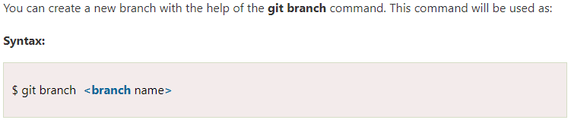
Create Branch

Slide 28
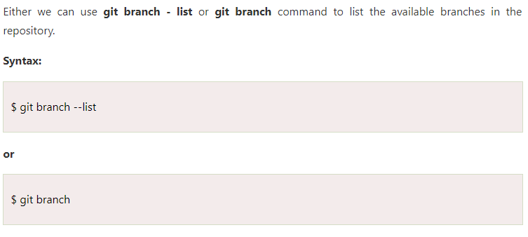
List Branch

Slide 29

Delete Branch
You can delete the specified branch. It is a safe operation. In this command, Git prevents you from deleting the branch if it has unmerged changes. Below is the command to do this.

Slide 30
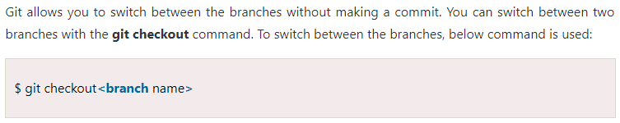
Switch Branch

Slide 31
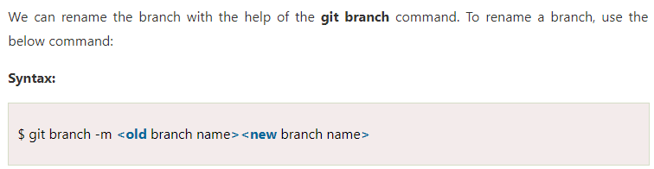
Rename Branch

Slide 32

Merge Branch
Git allows you to merge the other branch with the currently active branch. You can merge two branches with the help of git merge command. Below command is used to merge the branches:

Slide 33
GitHub

Slide 34
What is GitHub?
GitHub is a Git repository hosting service that provides a web-based graphical interface. It is the world’s largest coding community. Putting a code or a project into GitHub brings it increased, widespread exposure. Programmers can find source codes in many different languages and use the command-line interface, Git, to make and keep track of any changes.
GitHub helps every team member work together on a project from any location while facilitating collaboration. You can also review previous versions created at an earlier point in time.

Slide 35
GitHub Features
Easy Project Management
  GitHub is a place where project managers and developers come together to coordinate, track, and update their work so that projects are transparent and stay on schedule.
Increased Safety With Packages
  Packages can be published privately, within the team, or publicly to the open-source community. The packages can be used or reused by downloading them from GitHub.
Effective Team Management
  GitHub helps all the team members stay on the same page and organized. Moderation tools like Issue and Pull Request Locking help the team to focus on the code.

Slide 36
GitHub Features
Improved Code Writing
  Pull requests help the organizations to review, develop, and propose new code. Team members can discuss any implementations and proposals through these before changing the source code.
Increased Code Safety
  GitHub uses dedicated tools to identify and analyze vulnerabilities to the code that other tools tend to miss. Development teams everywhere work together to secure the software supply chain, from start to finish.
Easy Code Hosting
  All the code and documentation are in one place. There are millions of repositories on GitHub, and each repository has its own tools to help you host and release code.

Slide 37
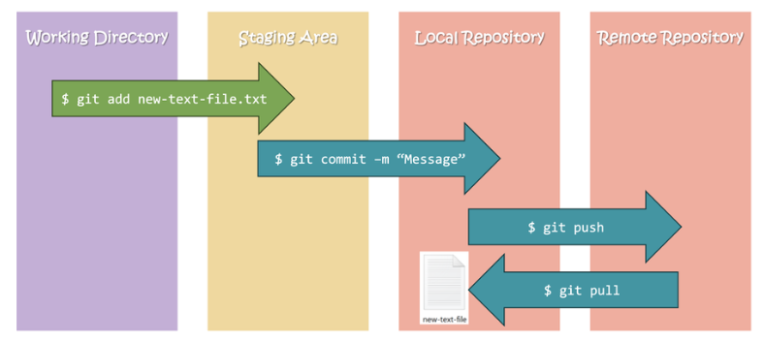
How Git works with GitHub?

Slide 38
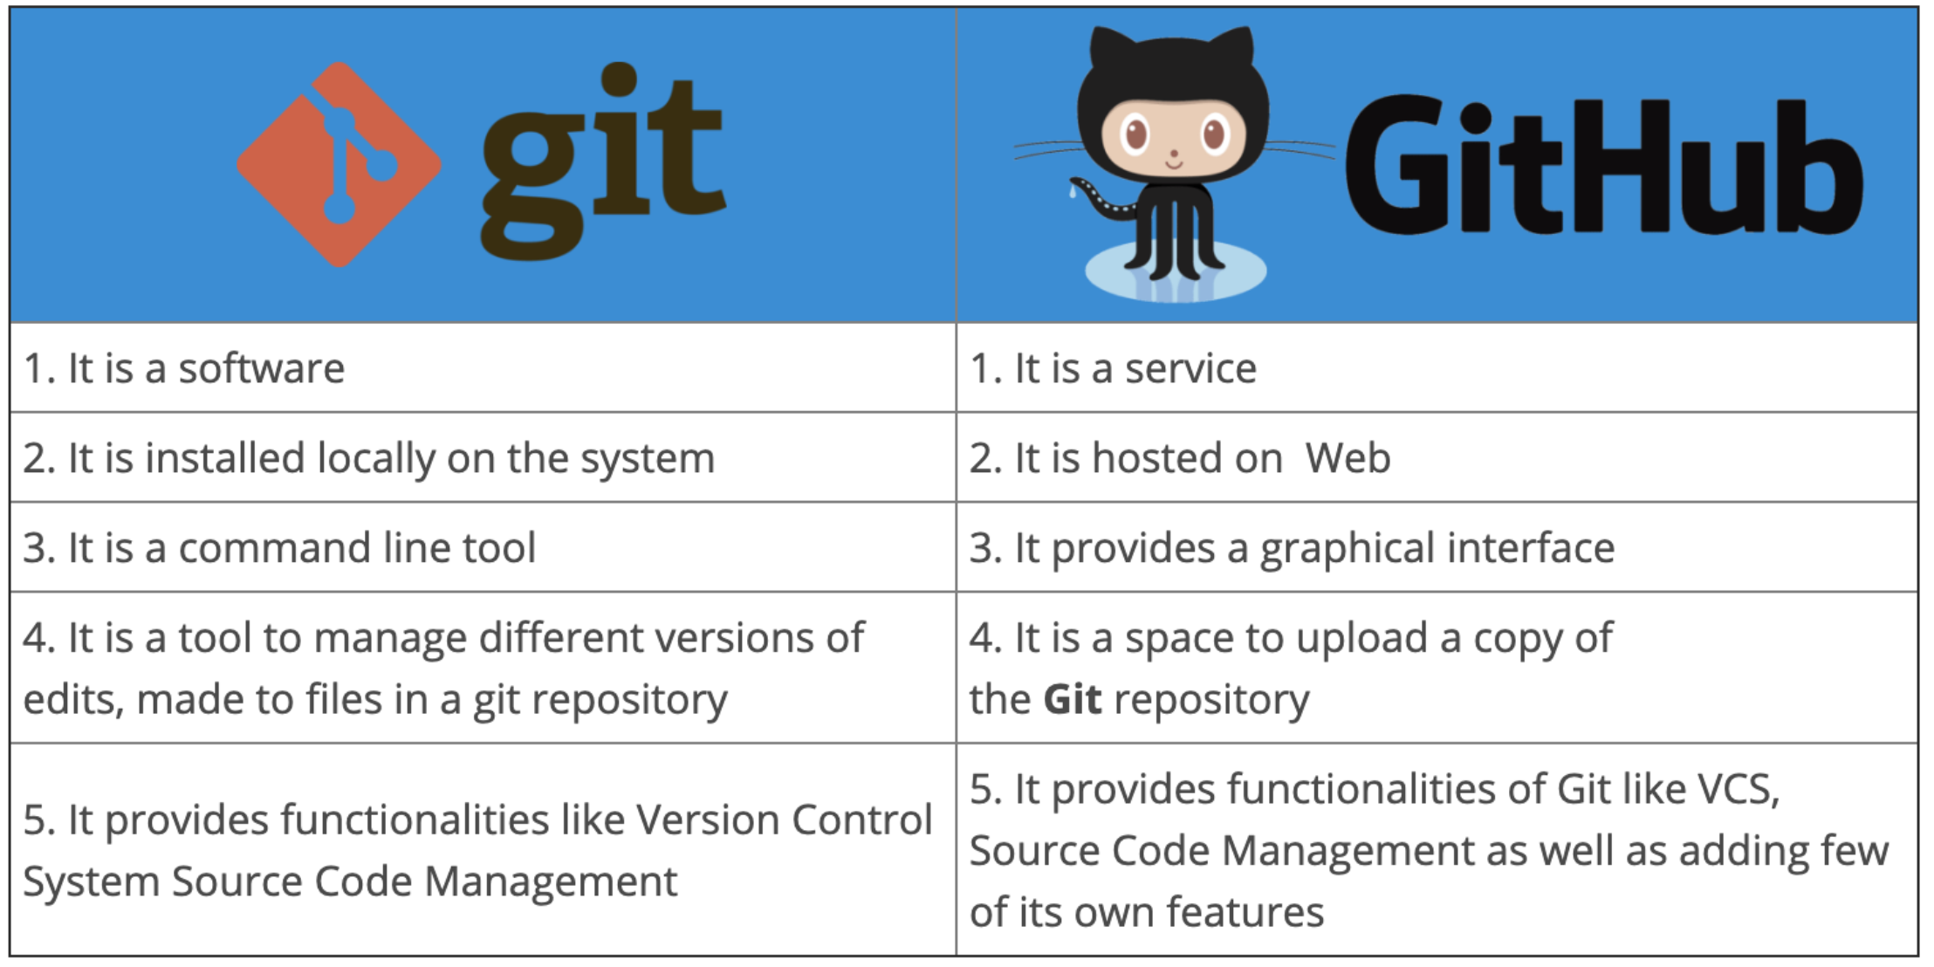
Git vs GitHub

Slide 39
Thank You
Valan Arasu M

