Slide 1
IT7712-MINI PROJECT-2021 A PRIVACY PRESERVING COMMUNICATION BETWEEN SMART VEHICLES
SUBMITTED BY
Sasirekha A (2018506109)
Riyana Saffrin M (2018506095)
Sathish Kumar Pillay R (2018506142)
UNDER THE GUIDANCE OF
Dr. B. Lydia Elizabeth

Slide 2
AGENDA
DoS Attack Detection
Web Attack Detection
Anonymous Communication between two nodes
Pseudo Code for Incentive Mechanism

Slide 3
DoS Attack in VANET
DoS Attack meant meant to shut down a machine or network
Making it inaccessible to its intended users
Flooding the target, which leads to crash

Slide 4
DATASET
CICIDS2017 – Canadian Institute of Cybersecurity IDS 2017
This dataset contains details of benign and 7 common attacks
Web attacks details are collected in the name of “Thursday-WorkingHours-Afternoon-WebAttack.pcap_ISCX.csv” file.
File Contains: Benign – 168,186 and Web Attack - 2180
DoS Attack details are collected in the name of “Wednesday-WorkingHours-DosAttack.pcap_ISCX.csv” file
File contains: Benign – 440031 and DoS attack - 252661

Slide 5
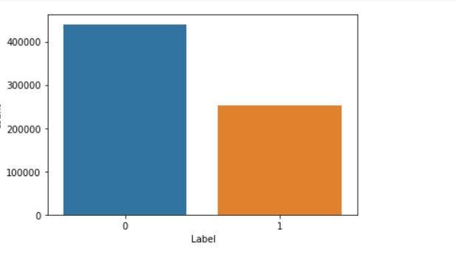
DATA VISUALIZATION
Normal
DoS Attack

Slide 6
DATA PREPROCESSING
Replace NaN value with mean values
Removed infinity floating values
Feature Scaling - Min Max Scalar
Splitting of dataset
80% - Training
20% - Testing

Slide 7
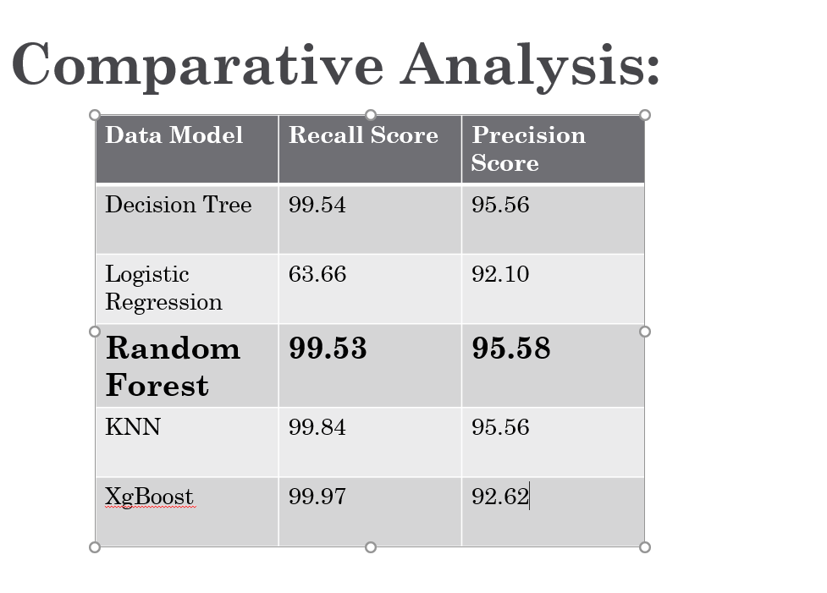
COMPARATIVE ANALYSIS

Slide 8
WEB ATTACK IN VANET
Web application attacks are the single most prevalent and devastating security threat facing organizations today. Attacks such as SQL injection and Cross-Site Scripting (XSS) are responsible for some of the largest security breaches in history.

Slide 9
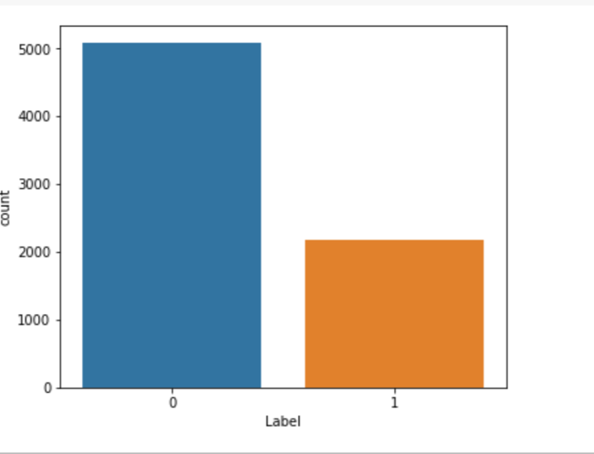
DATA VISUALIZATION
Normal
Web Attack

Slide 10
DATA PREPROCESSING
Deleted Blank Records
Replaced Non Numerical Values
Replace NaN values and infinity values with -1
Convert String Characters to numbers using Label Encoder
Undersampling against unbalance
Preparing data for training

Slide 11
UNDERSAMPLING AGAINST UNBALANCE
Undersampling is to correct class imbalances
Number of Benign records are more
This method is used to remove more benign records
Algorithm to form balanced dataset
enlargement = 1.1
benign_included_max = attack_total / 30 * 70
benign_inc_probability = (benign_included_max / benign_total) * enlargement
print(benign_included_max, benign_inc_probability)

Slide 12
HYPERPARAMETER SELECTION
Hyperparameter tuning is choosing a set of optimal hyperparameters for a learning algorithm. A hyperparameter is a model argument whose value is set before the learning process begins. The key to machine learning algorithms is hyperparameter tuning.
BEST ESTIMATORS USING HYPERPARAMETER TUNING
RandomForestClassifier(bootstrap=True, ccp_alpha=0.0, class_weight=None, criterion='gini', max_depth=17, max_features=7, max_leaf_nodes=None, max_samples=None, min_impurity_decrease=0.0, min_impurity_split=None, min_samples_leaf=3, min_samples_split=2, min_weight_fraction_leaf=0.0, n_estimators=50, n_jobs=None, oob_score=False, random_state=1, verbose=0, warm_start=False)

Slide 13
OUTPUT
Random Forest gave the best result
Accuracy = 0.9825767996331958
Precision = 0.966824644549763
Recall = 0.972972972972973
F1 = 0.9698890649762283

Slide 14
Anonymous Communication in VANET
To achieve privacy in VANET, messages are send anonymously to other vehicles
It provides security by not revealing any personal details about the initiator of a event message.
It also improves the participation rate

Slide 15
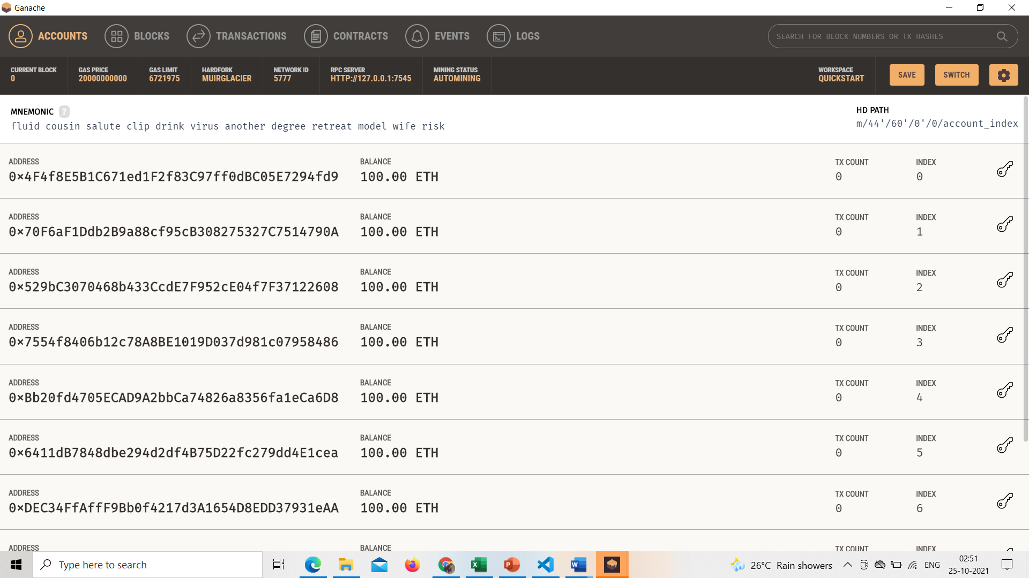
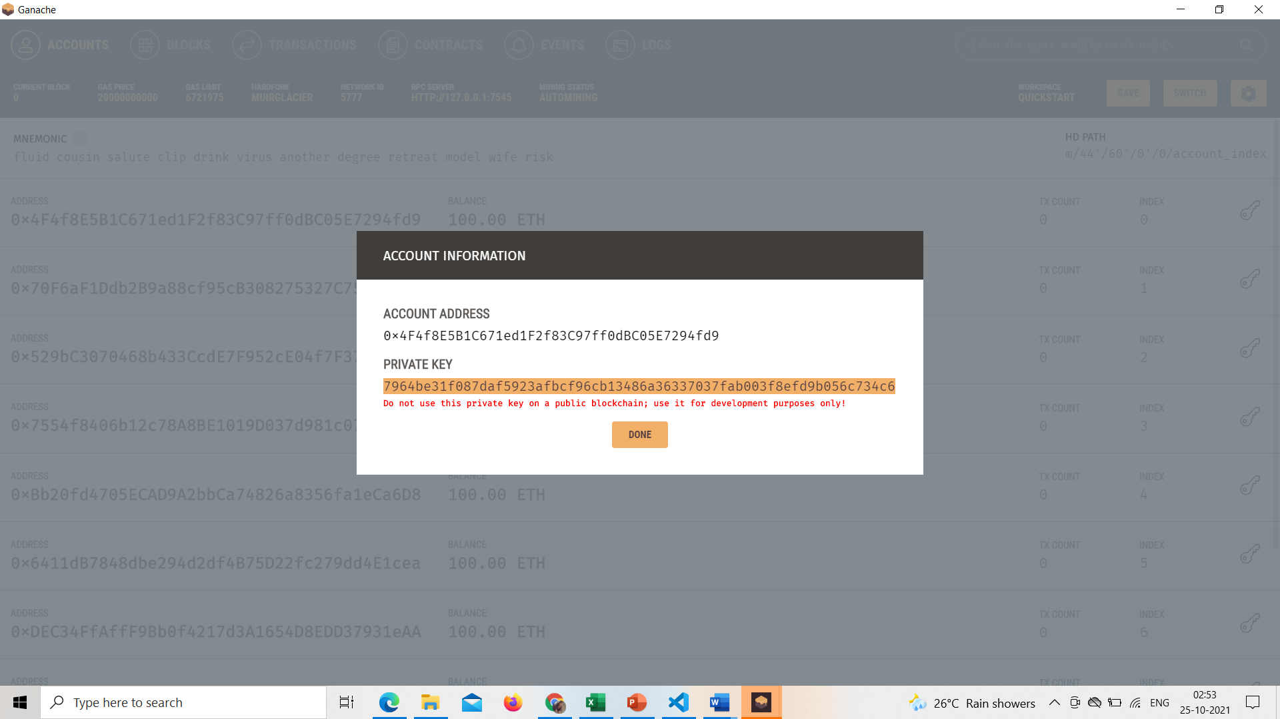
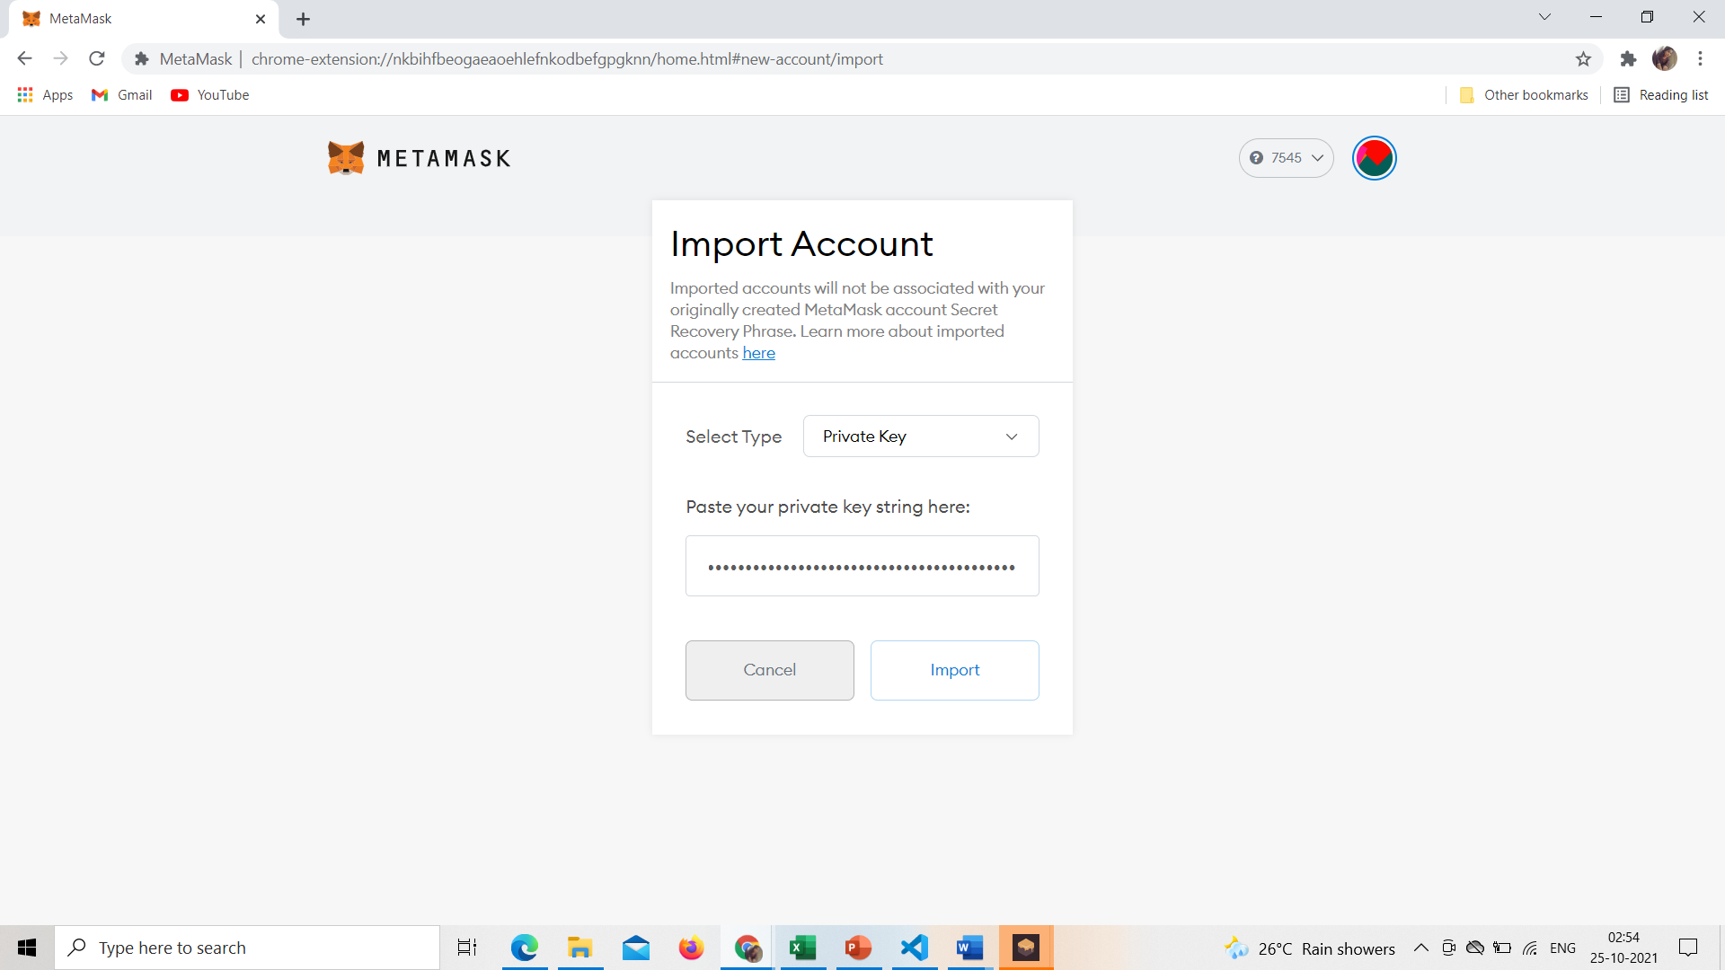
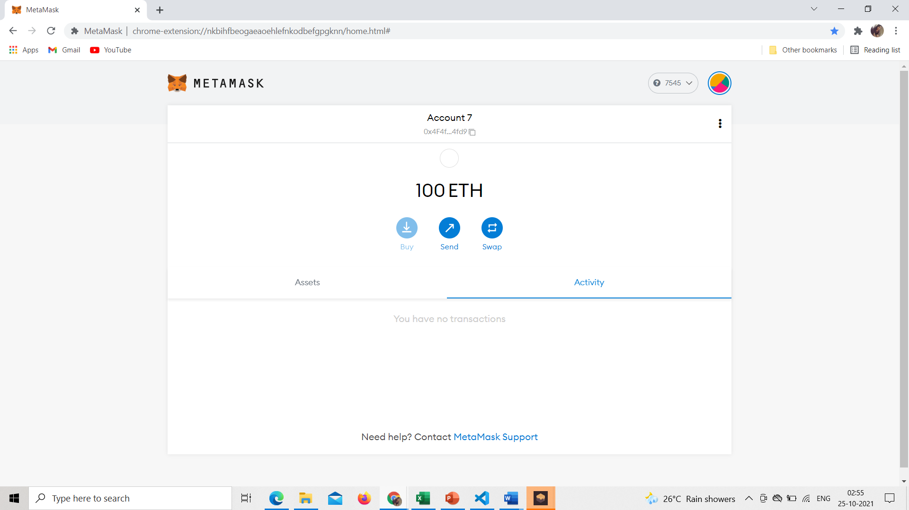
Steps: 1. Create account in Metamask 2. Install Ganache 3. Import Account in Metamask

Slide 16
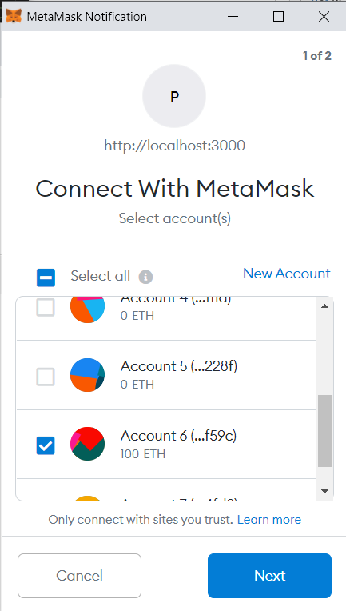
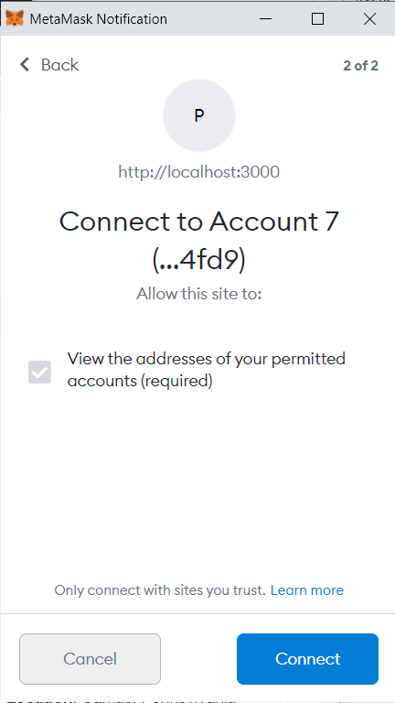
Localhost Connection with Metamask

Slide 17
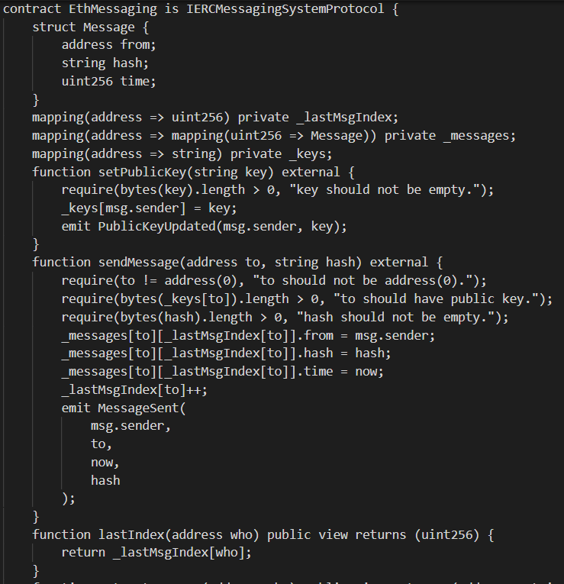
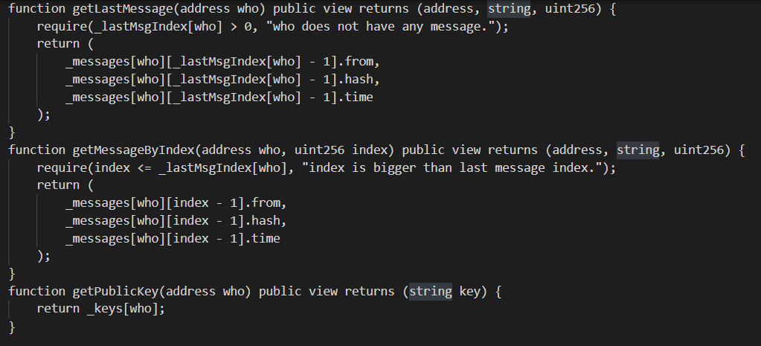
Smart Contract in Solidity Language

Slide 18
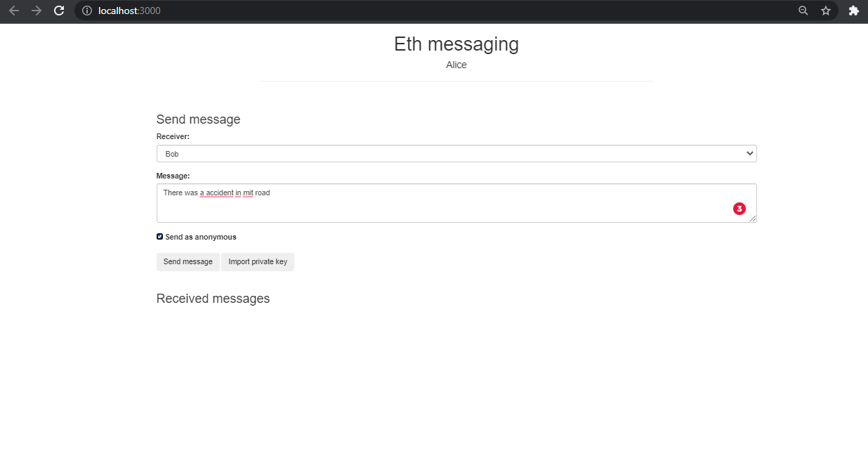
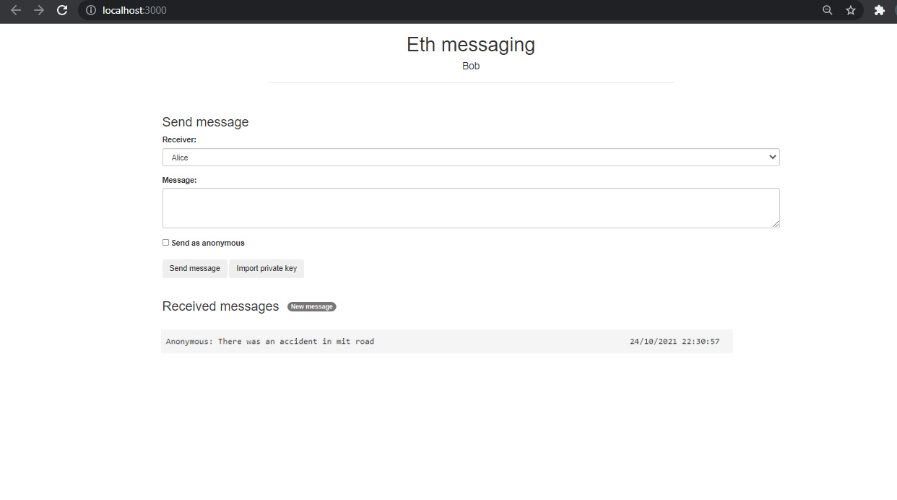
Anonymous Communication

Slide 19
INCENTIVE MECHANISM ALGORITHM Based on Trust Meter
Input:
Initiator account balance as bal
Number of Votes as N
trust score as t
threshold limit for votes as VT
threshold limit for trust score as TT
IncentiveMechanism(bal,N,t,VT,TT)
If(N>=VT and t>=TT)
status = Valid
bal+=10
t+=0.1
Else if(N<=VT and t>=TT)
status = Valid
bal+=10
Else
status = Invalid
bal -=10
t-=0.2

Slide 20
ALGORITHM TO INVITE REPLIERS
inviteRepliers(initiator_balance, responder_balance,amount)
Get Values: Initiator Balance and Responder Balance
Initiator balance = Initiator balance - amount
Responder balance = Responder Balance + amount
End
Emit : Initiator Balance , Responder Balance

Slide 21
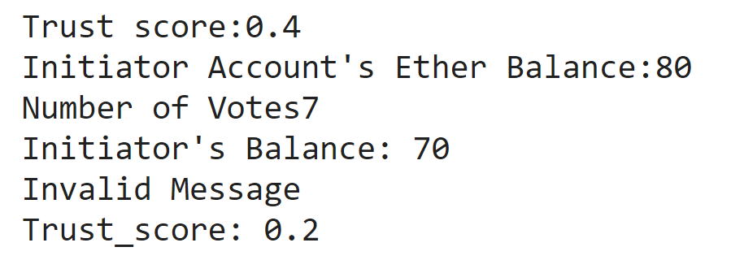
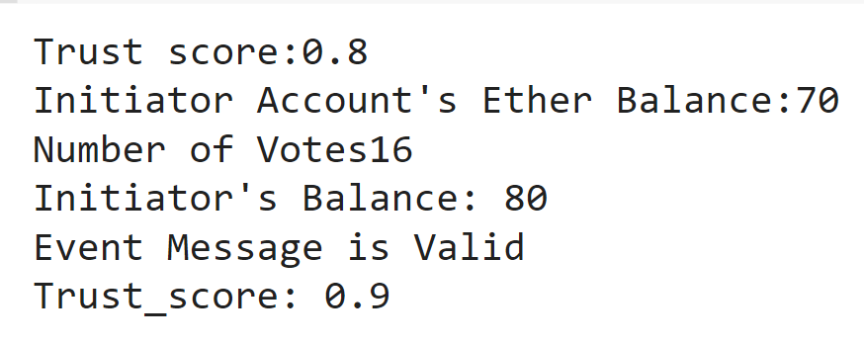
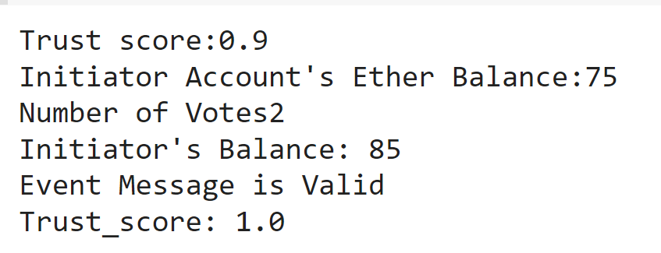
IMPLEMENTATION: Case 1: When Number of votes and trust scores are less than threshold limit Case 2: When Number of votes are greater than the threshold limit Case 3: When the number of votes are less than the threshold limit but trust score is more

Slide 22
TIMELINE
REVIEW | AMOUNT OF WORK DONE
Review - 1 | Manual Design DDoS Attack Detection in VANET
Review - 2 | DoS Attack Detection in VANET Web Attack Detection Anonymous Communication using Ethereum Incentive Mechanism
Review - 2 | Smart Contract For Incentive Mechanism Algorithm for Signature Verification Simulate VANET using simulation tools Graphs using Ethereum and solidity

Slide 23
REFERENCE
[1] Kang, Jiawen Zehui Xiong,Duist Nivato, Dongdong Ye, DonIn Kim and Jun Zhao.” Toward secure blockchain-enabled internet of vehicles: Optimizing consensus management using reputation and contract Theory.” IEEE Transactions on Vehicular Technology (2019)
[2] Y. A. O. Yu, L. E. I. Guo, Y. E. Liu, J. Zheng, and Y. U. E. Zong, “An Efficient SDN-Based DDoS Attack Detection and Rapid Response Platform in Vehicular Networks,” IEEE Access, vol. 6, pp. 44570–44579, 2018.
[3] A. Haydari, “Real-Time Detection and Mitigation of DDoS Attacks in Intelligent Transportation Systems,” no. September, 2018.
[4] Wang, Yuntao, Zhou Su, and Ning Zhang. “BSIS: Blockchain-based secure incentive scheme for energy delivery in vehicular energy network.” IEEE Transactions on Industrial Informatics 15, no. 6 (2019): 3620- 3631.
[5] Lu, Zhaojun, Qian Wang, Gang Qu, Haichun Zhang, and Zhenglin Liu. “A blockchain-based privacypreserving authentication scheme for vanets.” IEEE Transactions on Very Large Scale Integration (VLSI) Systems 27, no. 12 (2019): 2792-280

