Slide 1

PROJECT TITLE
IT7712 - MINI PROJECT – 2021
A Privacy preserving communications BETWEEN smart vehicles
SUBMITTED BY
Sasirekha A(2018506109)
Riyana Saffrin M(2018506095)
Sathish kumar Pillay R (2018506142)
Under the guidance of
Dr.B.Lydia Elizabeth

Slide 2
OBJECTIVE:
To build a privacy preserving communication between smart vehicles

Slide 3
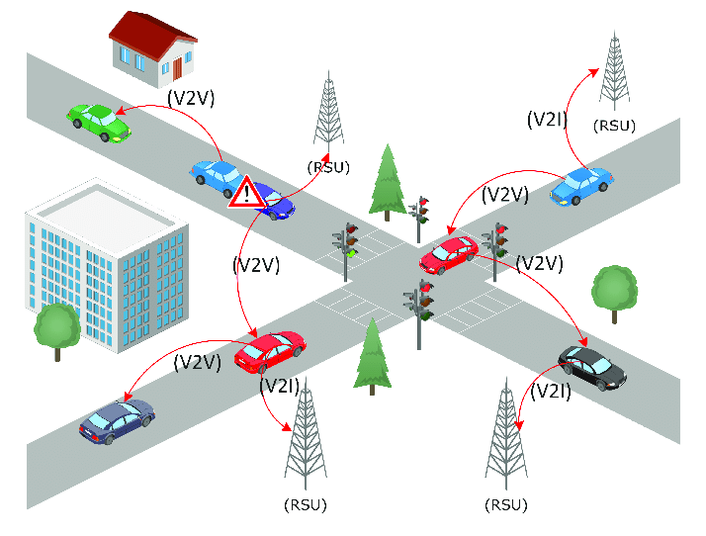
SMART VEHICLES
Smart Vehicle Functionalities:
Control
Communications
Computing technologies,
Smart Vehicle Communicate with each other and share information

Slide 4
WHY COMMUNICATION IS NEEDED BETWEEN VEHICLES?
V2V communication is the ability of the smart vehicles to wirelessly exchange information about the speed and position of surrounding vehicles shows great promise in helping to
Avoid crashes
Ease traffic congestion
Avoid accidents

Slide 5
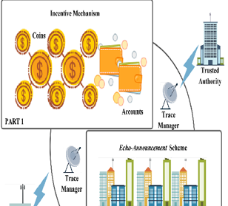
WHY INCENTIVE MECHANISM?
Incentive mechanism is to encourage the vehicles to share timely information. If the vehicles share a valid information, then it will be getting a rewards after verification.

Slide 6
WHY BLOCKCHAIN?
Vehicles do not want it’s information to be shared in a fully non trusted environment. So here comes the role of blockchain.

Slide 7
LITERATURE SURVEY:
Title | Author | Publication and Date | Approach | Approach
A BLOCKCHAIN BASED INCENTIVE PROVISIONING SCHEME FOR TRAFFIC VALIDATION AND INFORMATION STORAGE IN VANETs | Adia Khalid , A.S.Al-Mogren, Muhammad Sohaib Iftikhar, Rabiya Khalid | ELSEVIER –Information Processing and Management DECEMBER 30, 2020 | To tackle the issues of less data storage, IPFS is used Selfish behavior of the vehicles are resolved using incentive mechanism. | Sybil attack is not detected Trust score for malicious users are not reduced
CreditCoin: A Privacy Preserving Blockchain based Incentive Announcement Network for Communications of Smart Vehicles | Li, Lun; Liu, Jiqiang; Cheng, Lichen; Qiu, Shuo; Wang, Wei; Zhang, Xiangliang; Zhang, Zonghua | Institute of Electrical and Electronics Engineers Year: 2018 | To overcome the accidents and traffic events, a privacy preserving incentive mechanism is designed | Data storage is not efficient

Slide 8
Title | Author | Publication | Approach | Drawbacks
A Blockchain Based Privacy-Preserving Incentive Mechanism in Crowdsensing Applications | JINGZHONG WANG1 , (Member, IEEE), MENGRU LI 1 , YUNHUA HE1 , (Member, IEEE), HONG LI2 , (Member, IEEE), KE XIAO1 , AND CHAO WANG1 | Institute of Electrical and Electronics Engineers Date: March 5, 2018 | Proposed a privacy preserving blockchain incentive mechanism in crowdsensing applications | Data storage is not efficient
Towards a Smart Privacy-Preserving Incentive Mechanism for Vehicular Crowd Sensing | Lingling Wang , Zhongda Cao, Peng Zhou, and Xueqin Zhao1 | Hindawi Date: 17 May 2021 | Proposed a smart privacy-preserving incentive mechanism (SPPIM) for vehicular crowd sensing | Fog computing can be difficult to understand and consumes more power

Slide 9
Title | Author | Publication Date | Approach | Drawbacks
Blockchain-Based Secure Data Storage for Distributed Vehicular Networks | Muhammad Umar Javed , Mubariz Rehman , Nadeem Javaid , Abdulaziz Aldegheishem , Nabil Alrajeh and Muhammad Tahir 4 | MDPI 16 March 2020 | To optimize gas consumption and to enhance the system performance, a Proof of Authority (PoA) consensus mechanism is used to validate the transactions. A caching system is introduced at the edge nodes to store frequently used services | Fake reviews are not detected Equilibrium between system’s cost and data size is not achieved

Slide 10
DRAWBACKS:
Sybil attack is not detected
Data is not efficiently stored
Trust score is not reduced for malicious users

Slide 11





OBU
PROPOSED METHODOLOGY
Invites
Repliers
Event Information
Signs
After verification
Repliers receive rewards
Packets are generated after verification
Initialize
INCENTIVES
PACKETS
Transactions are stored in blockchain
Reputation value of sender’s vehicle
Event Information
RSU
DATA STORAGE
Generates Hash value
Using smart contract

Slide 12
GOALS:
1. It motivates users with incentives to share traffic information via announcements.
2. The request, announcements and transactions do not leak any information about their source.
3. Announcements are signed by several honest witness which provides reliability
4. It saves lots of time by sharing timely information in VANET and it is time efficient
5. IPFS is used to store event information efficiently.

Slide 13
NOVELTY:
1. If someone shares a wrong information – they need to pay some amount as a fine
2. To detect sybil attack

Slide 14
Reference:
1. Lu, Zhaojun, Gang Qu, and Zhenglin Liu. “A survey on recent advances in vehicular network security, trust, and privacy.” IEEE Transactions on Intelligent Transportation Systems 20, no. 2 (2018)
2. Feng, Qi, Debiao He, Sherali Zeadally, and Kaitai Liang. “BPAS: 630 Blockchain-Assisted Privacy-Preserving Authentication System for Vehicular Ad-Hoc Networks.” IEEE Transactions on Industrial Informatics (2019)
3. Lu, Zhaojun, Qian Wang, Gang Qu, Haichun Zhang, and Zhenglin Liu. “A blockchain-based privacy-preserving authentication scheme for vanets.” IEEE Transactions on Very Large Scale Integration (VLSI) Systems 27, no. 12 (2019)
4. Yang, Zhe, Kan Yang, Lei Lei, Kan Zheng, and Victor CM Leung. “Blockchain-based decentralized trust management in vehicular networks.” IEEE Internet of Things Journal 6, no. 2 (2018)

