Slide 1
BOTTOM LINE
By June Mitchell

Slide 2

You’re telling me that the bottom line is a
That’s not what I learned at my mother’s knees.

Slide 3

She said that humanity
honesty
loyalty

Slide 4
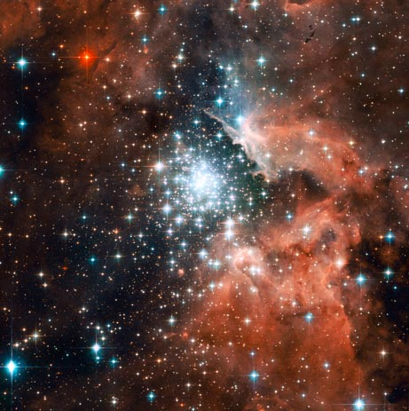
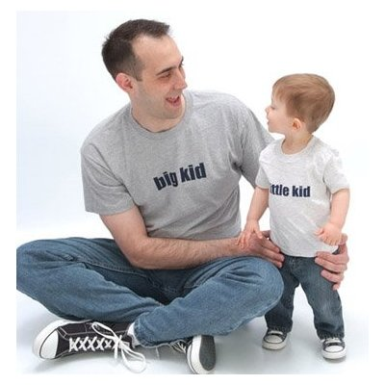
When I asked my dad one night

Slide 5

He said standing up for what is right
Always ready to fight the good fight.

Slide 6
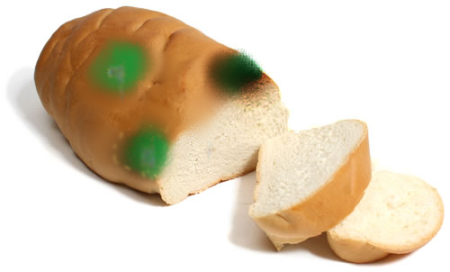
My grandma said, “its your daily bread”

Slide 7

It’s the roof that’s over your head

Slide 8

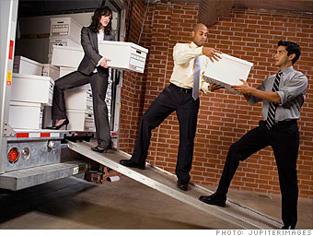
helping the others you meet on the road
My Grandpa said it’s sharing the load,
helping the others you meet on the road.

Slide 9
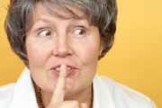
My aunt said its a duty done quietly.

Slide 10

and poetry and dancing out under the sun

Slide 11

My sister said it's a joke and a smoke.

Slide 12
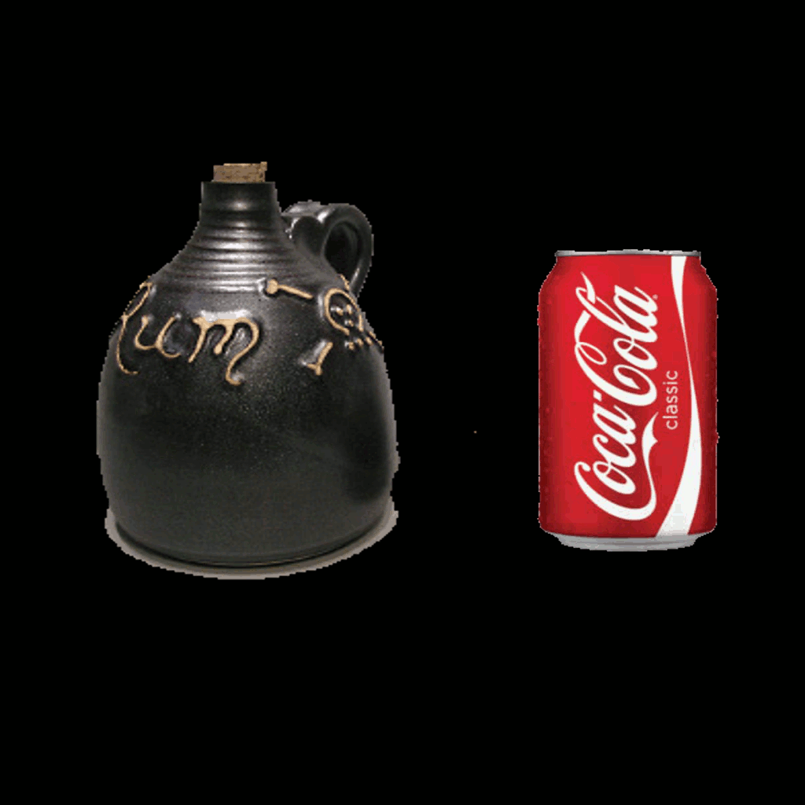
and my family....and a rum and coke

Slide 13
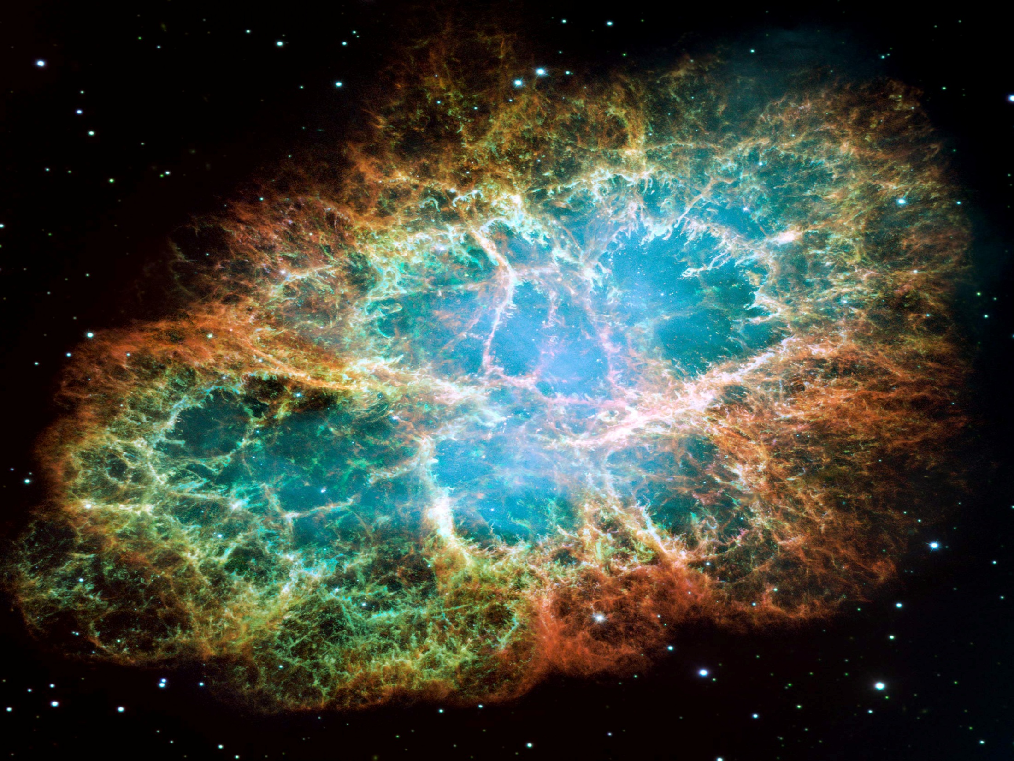
My husband said it's to be who you are and still work with others who follow their star.

Slide 14

My kids say it's children and water that's clean

Slide 15
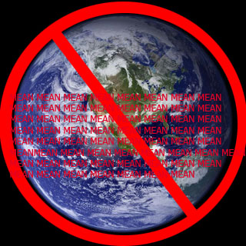
and a job that is useful and a world that's not mean

Slide 16
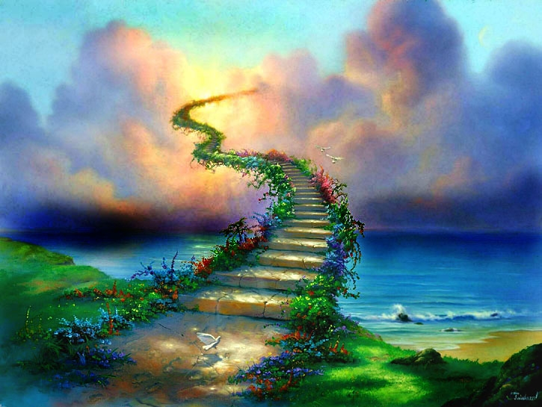
and then when i look to the heavens above

Slide 17
The creator says bottom line it is love…
And you’re telling me to believe that the bottom line is a dollar sign.
$$$$$$$$$$$$$$$$$
I decline

