Slide 1
Machine Learning to Predict Vaccination Choice
Mike Kozar, Sasmita Mohanty, Matt Pickett

Slide 2
The Situation
COVID-19 has spread globally causing over 11.5 million cases and 537,000 deaths
The key to long term management of the virus is vaccination
Vaccines are life saving -- protecting people from diseases such as Meningitis, HPV, Polio and Smallpox
Many American incorrectly, and dangerously, believe vaccination is harmful instead of helpful
Matt

Slide 3
The Problem
We need to know who would and who wouldn’t get a vaccine to appropriately plan and execute the vaccination program roll-out
Matt

Slide 4
The Data Driven Solution
Look to recent historical data covering socio-economic, demographic and opinion factors that could influence vaccination choice
National 2009 H1N1 Flu Survey
Develop machine learning algorithm to accurately and consistently predict people’s choices around vaccination
Matt

Slide 5
The Limitations of Our Solution
The scale of the current pandemic might have affected population behavior since the H1N1 survey was conducted
Attitudes around vaccination might have evolved in the past decade
Machine learning algorithms often fall short of 100% accuracy
This dataset doesn’t provide the county and city-level granularity necessary to actionably drive the development of a vaccination program
Matt

Slide 6

Engaging with ML Predictions
Humans aren’t perfect, and neither are machines
Machines can organize more information in their heads and make consistent decisions
Humans can navigate gray areas and think strategically
So how can humans and machines compliment each other?
We designed a user interface to pit human against machine to highlight the relative strength and contributions of each

Slide 7
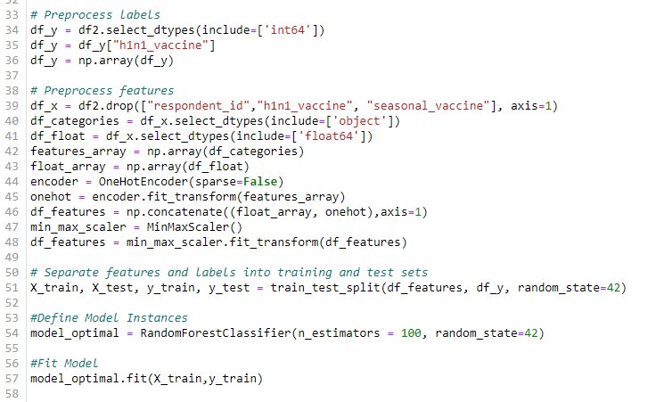
The Approach
Stage 1 – Data Preprocessing
Data import
Data cleaning
One-hot encoding
Mike

Slide 8
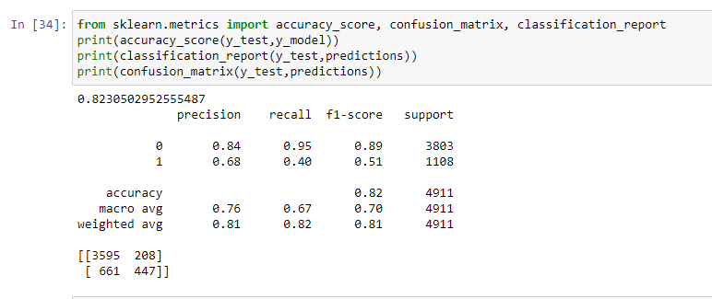
The Approach
Stage 2 – Model Development & Training
Experiment on data with multiple models (SVM, KNN, Random Forest, Naïve Bayes Classification, ANN)
Optimize hyperparameters using GridSearchCV
Evaluated models based on multiple metrics such as Accuracy, Precision, Recall, F1 etc.
Mike

Slide 9
The Approach
Stage 3 – Model Selection
Naïve Bayes Classification – 76% (No tuning, fast)
KNN – 79% (Train/Test Over/Under Optimization Approach)
ANN – 81% (2 dense layers, sigmoid activation)
SVM – 82% (GridSearchCV)
Random Forest – 82% (GridSearchCV, default optimal)
Mike

Slide 10
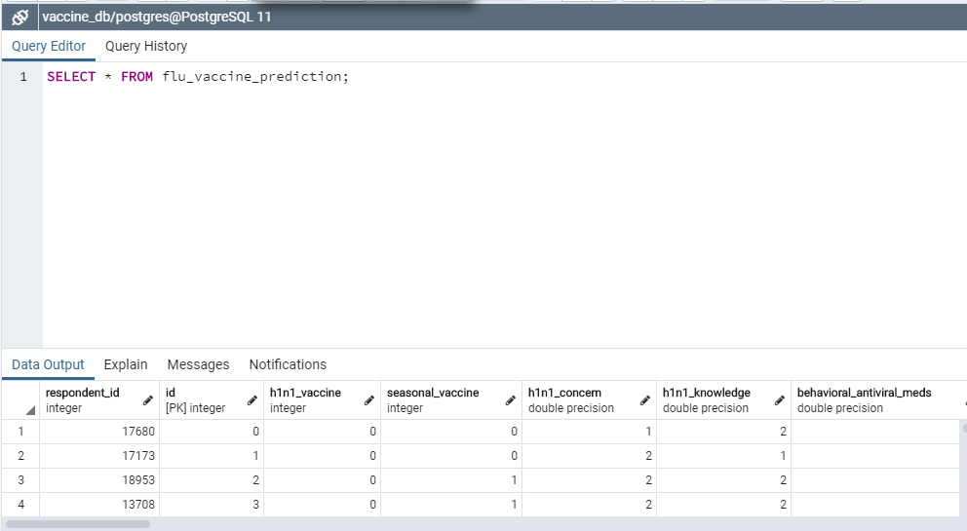
The Approach
Stage 4 – Model Prediction
Make predictions based on test data set
Store predictions in PostGre SQL database
Sasmita

Slide 11
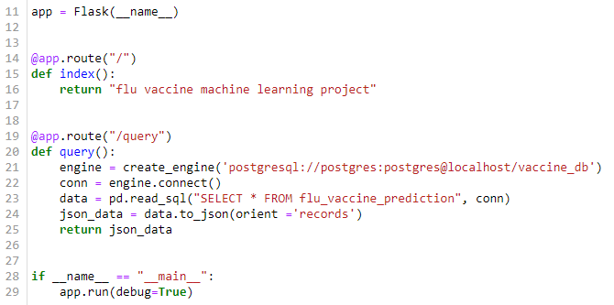
The Approach
Stage 5 – User Engagement
Develop webpage for users to explore model results using HTML/CSS
Pipe data between front end and back end leveraging Flask App
Create dynamic user experience using JavaScript
Sasmita

Slide 12
The Final Results
Random Forest was highest performing model by accuracy at 82% - less than perfect
False Positive rate was 2x higher than False Negative
We overestimated how many people will get vaccinated
GridSearchCV took significant time and achieved only +1% accuracy
Sasmita

Slide 13
Demonstration
Sasmita

