Slide 1

Kansas City 311 Data Dashboard
Sasmita, Mike, Matt, Ben R

Slide 2

Local Government Priorities
Essential Services
Voice of Citizens
Accountability + Growth
Mike

Slide 3
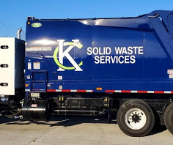
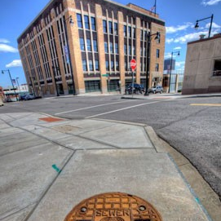
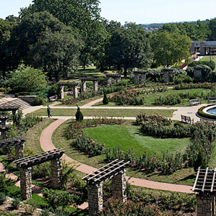
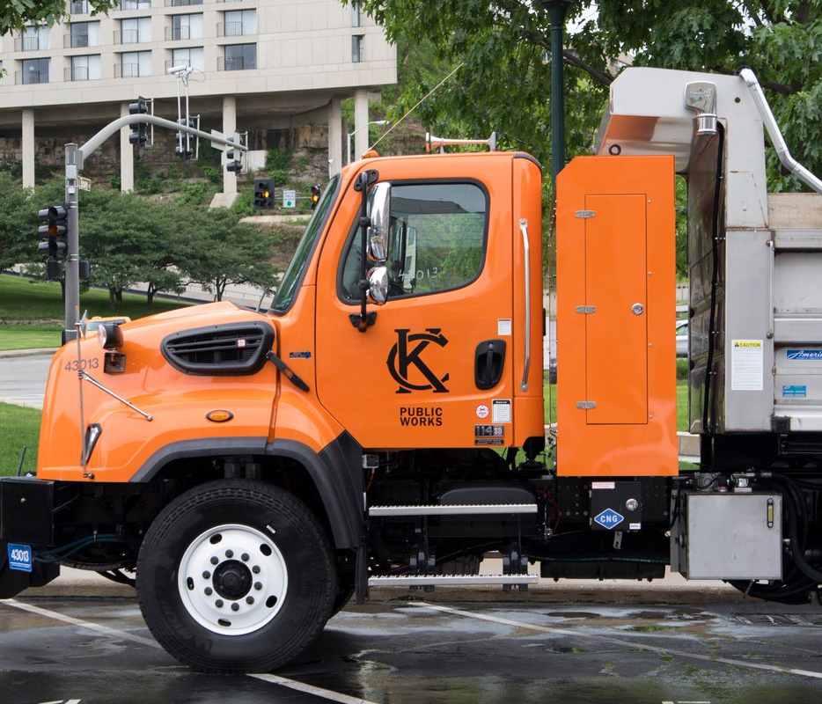
City Government is an Essential Service
Water
Waste
Roads
Parks
Housing
Safety
Mike

Slide 4
Why Kansas City 311 Data
Tracks issues in essential service delivery
Provides a path for citizens to use their voices
Holds government accountable, identifies growth areas
311 Data touches on all 3 key priorities of local government
Mike

Slide 5
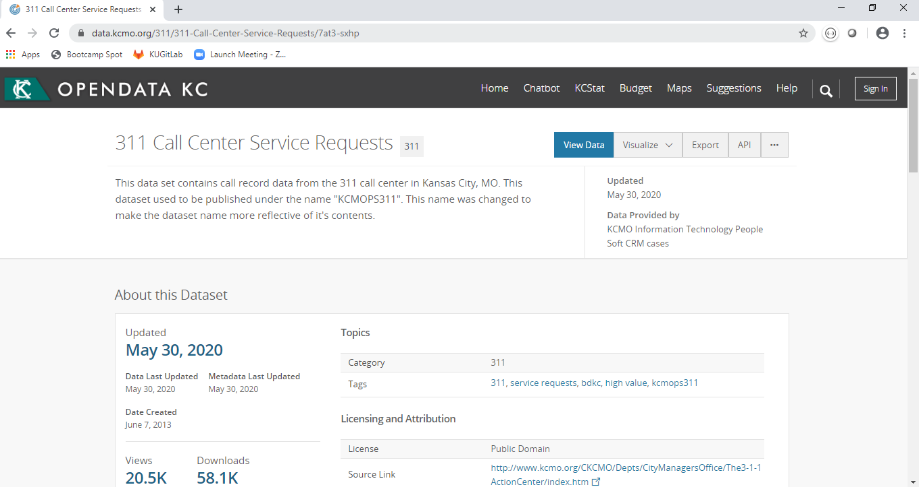
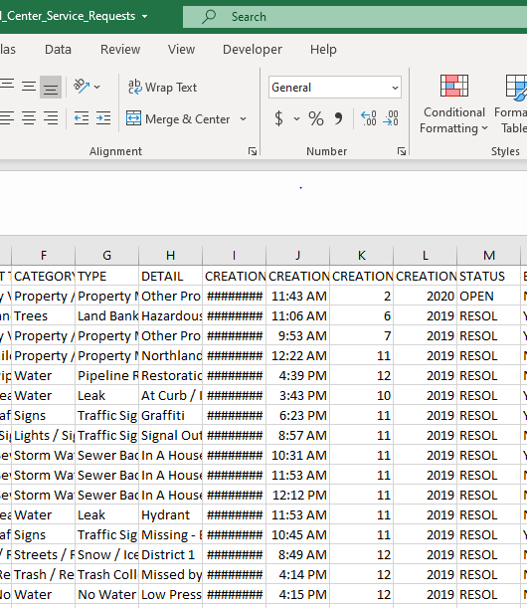
Mike

Slide 6
DATA
Mike

Slide 7
DATA
ACTION
Mike

Slide 8
Insights – but how?
DATA
ACTION
Mike

Slide 9
Our Approach
Extract
CSV
Transform
Python
Store
MongoDB
Route
Visualize
Flask
Pandas
HTML
CSS
JS/d3
PyMongo
Sasmita

Slide 10

Dashboard Components
Framed around questions to explore
Which departments received most 311 calls or the least?
What types of questions were being asked of departments?
Are departments receiving the same types of questions over, and over again?
Are those questions be resolved or put on hold?
Has the time required to close issues changed over time?
Does days to close vary by department?
If we can get answers, we can start making improvements
Matt

Slide 11

Filters
Matt

Slide 12
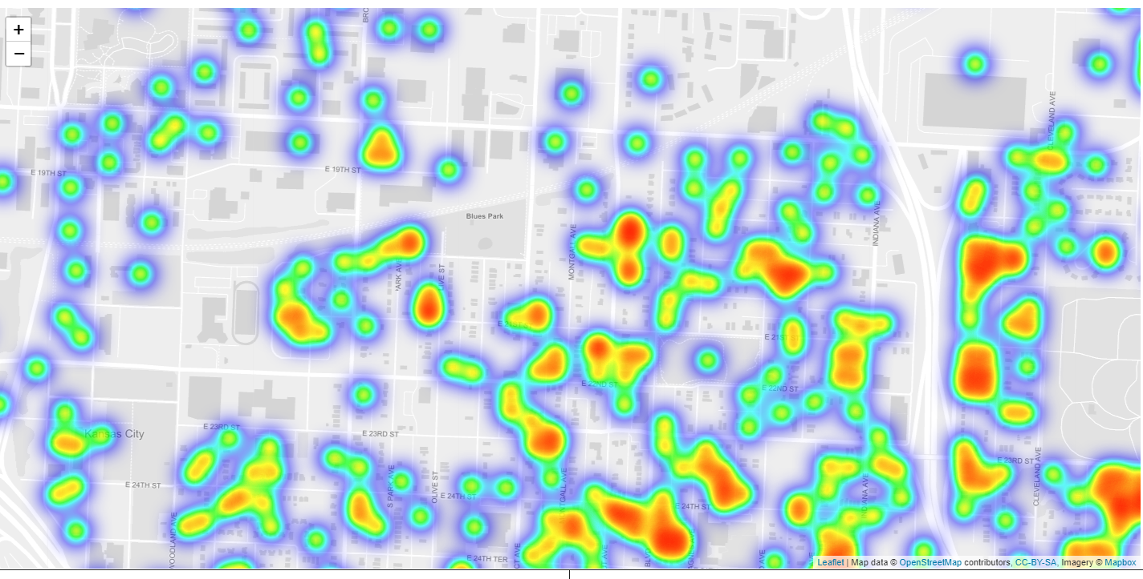
Heat Map
Sasmita

Slide 13
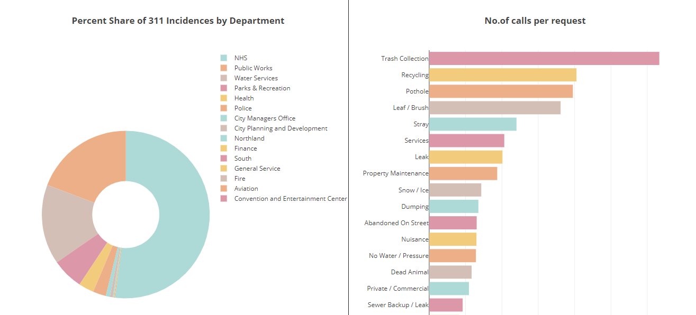
Bar + Pie Chart
Ben

Slide 14
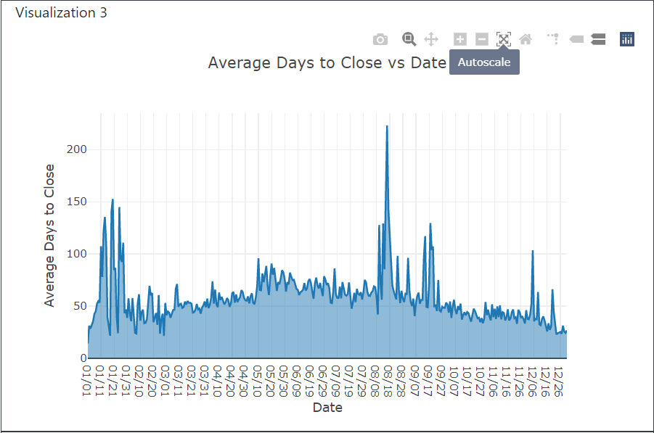
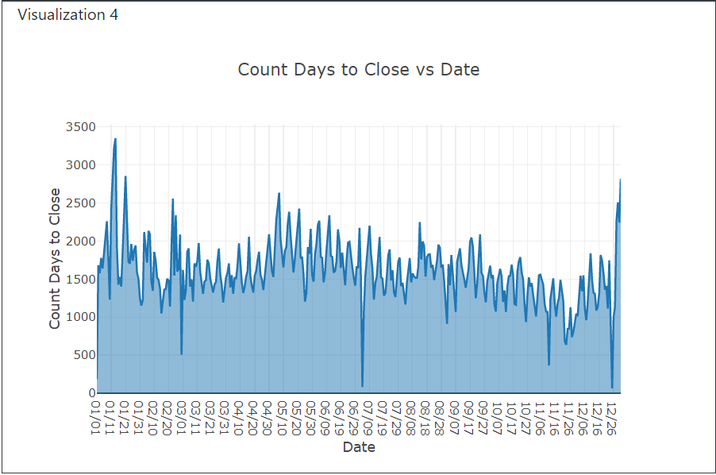
Line Chart
Ben

Slide 15
KC 311 Data Dashboard
INSERT SCREEN SHOT
Sasmita

Slide 16
Key Findings
311 Requests are evenly spread across the city (heat map)
In 2020, the most frequent issue relates to potholes and property maintenance (bar)
At 41% of total requests, Neighborhood & Housing Services received the most requests in 2019, the most common of which is Trash Collection with 16,000+ incidences (pie)
The most common form of communication is by phone (bar)
Typical requests require 20-50 days to close (line)
Average days to close tends to be significantly higher in mid-winter and late summer (line)
Matt

Slide 17
Thank you

