Slide 1

Kansas City 311 Data Dashboard

Slide 2
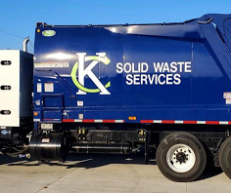
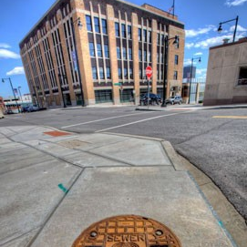
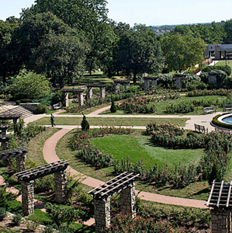
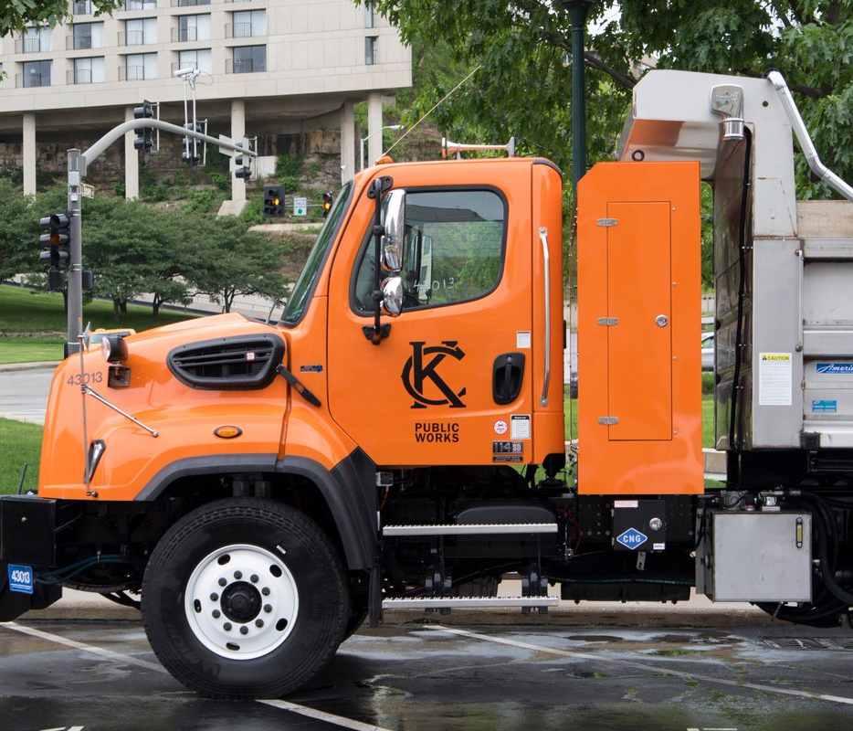
City Government is an Essential Service
Water
Waste
Roads
Parks
Housing
Safety
Mike

Slide 3

Local Government Priorities
Essential Services
Voice of Citizens
Accountability + Growth
Mike

Slide 4
Why Kansas City 311 Data
Tracks issues in essential service delivery
Provides a path for citizens to use their voices
Holds government accountable, identifies growth areas
Mike

Slide 5
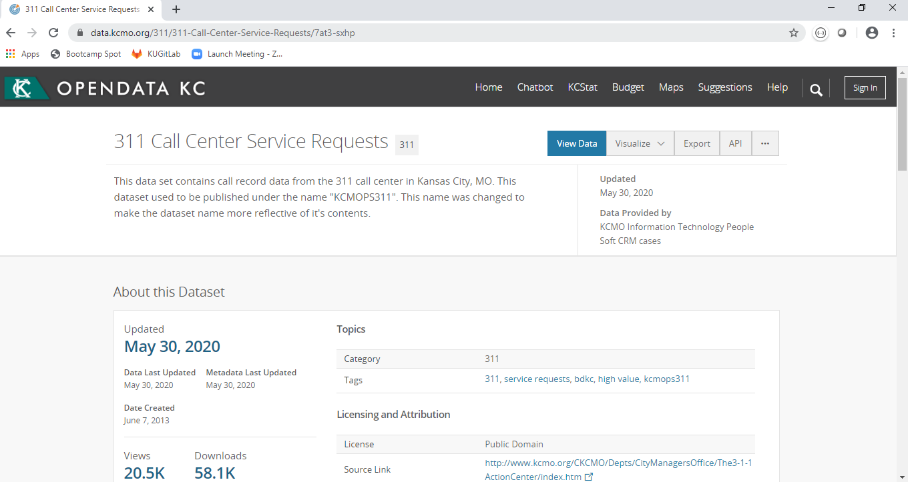
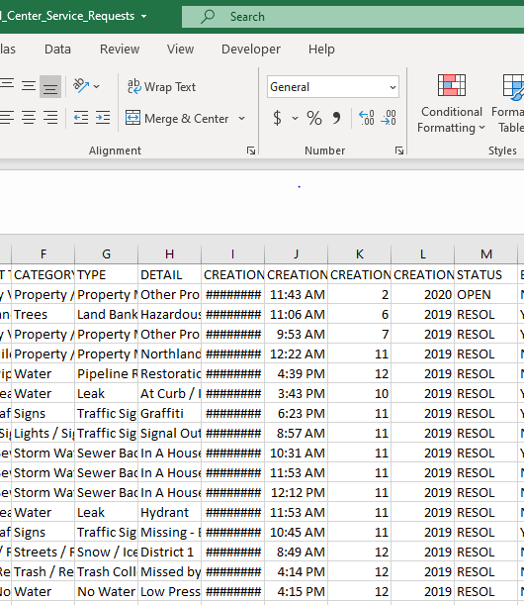
Mike

Slide 6
DATA
Mike

Slide 7
DATA
ACTION
Mike

Slide 8
Insights
DATA
ACTION
Mike

Slide 9
KC 311 Data Dashboard
INSERT SCREEN SHOT
Sasmita

Slide 10
Our Approach
Extract
CSV
Transform
Python
Store
MongoDB
Route
Visualize
Flask
Pandas
HTML
CSS
JS/d3/Jquery
PyMongo
Sasmita

Slide 11

Dashboard Components
Framed around questions to explore
Which departments received most 311 calls or the least?
What types of questions were being asked of departments?
Are departments receiving the same types of questions over, and over again?
Are those questions be resolved or put on hold?
Has the time required to close issues changed over time?
Does days to close vary by department?
If we can get answers, we can start making improvements
Matt

Slide 12
Filters
Users control how they slice the data
Matt

Slide 13
Heat Map
Explore 311 Data by neighborhood
Sasmita

Slide 14
Bar + Pie Chart
Explore by type of issue and department
Ben

Slide 15
Line Chart
Explore trends over time
Ben

Slide 16
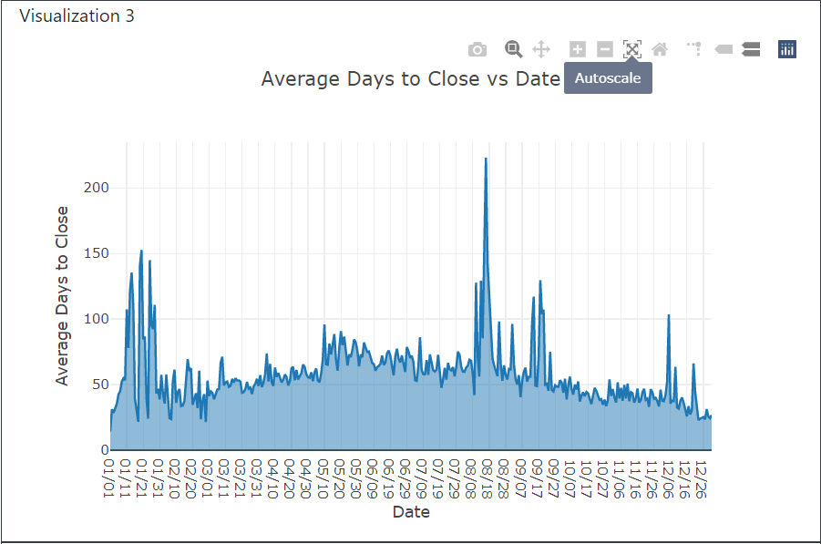
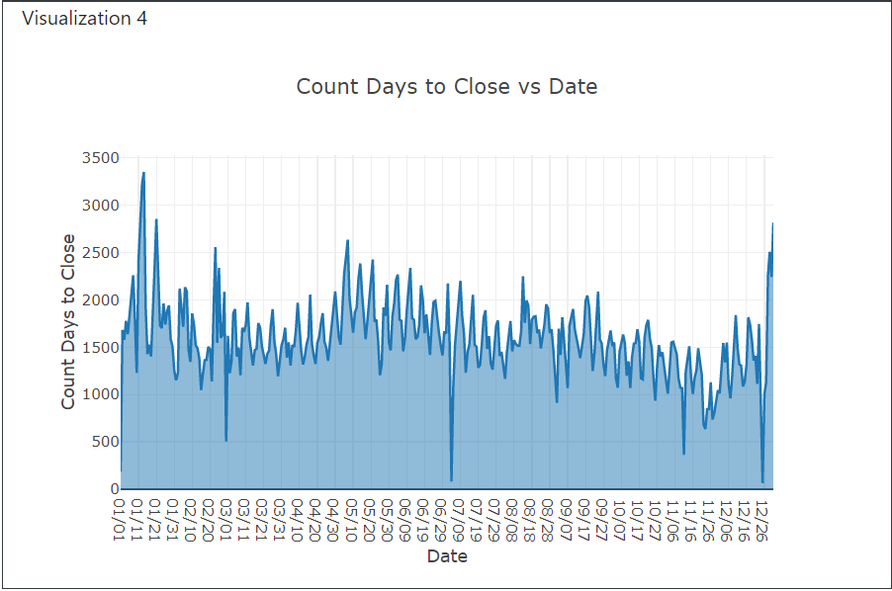
Key Findings
The number of calls for each day of the tear tends to be fairly consistent, but the average days to close for each tends to significantly higher in mid-winter and late summer.
This could indicate that extreme weather conditions tend to increase the severity of issues.
If extreme weather conditions do indeed cause more severe issues, then the city could preemptively allocate more money and resources to deal with issues at those crucial times.
Ben

Slide 17
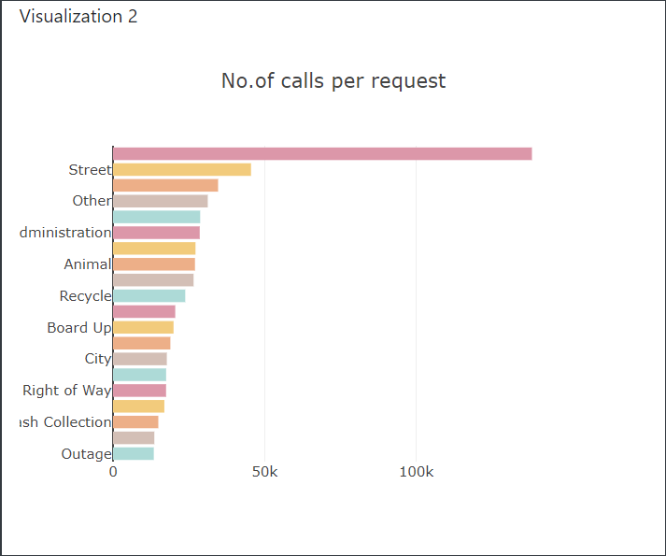
Key Findings
On the whole, calls concerning private property are the most common by far.
The next most common is related to street issues.
It was desired to dig deeper into the data, so only data belonging to the top 20 issue ‘types’ were used for the charts.
Private Property
Ben

Slide 18
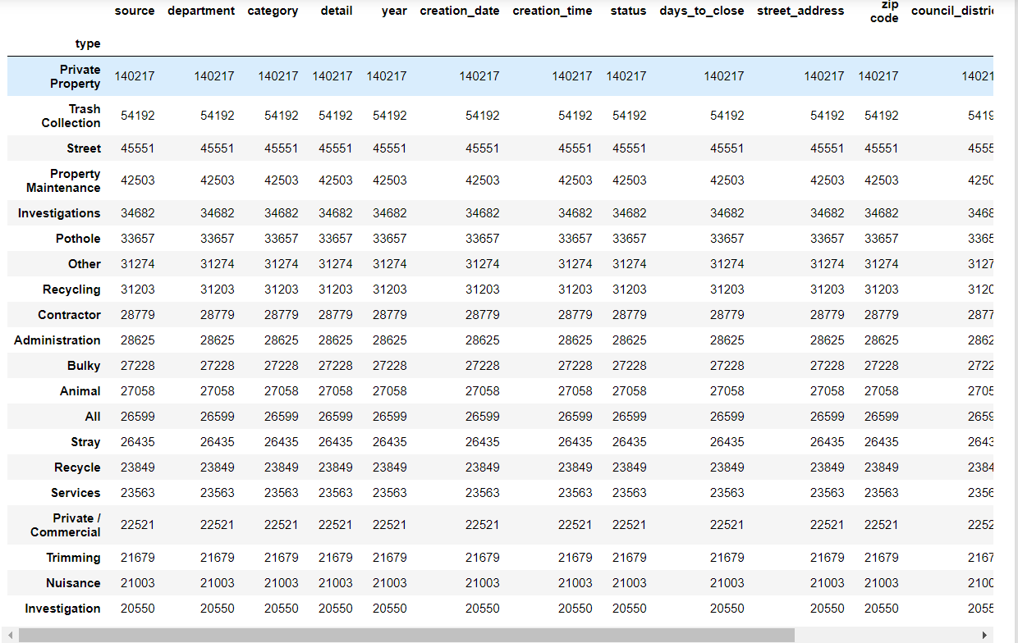
Key Findings
When looking at the top 20 issues for the whole dataset in terms of issue counts, trash collection and street issues/potlholes emerge as some of the most common.
It is desired to try to reduce the occurrence of the most common issues, so a brief investigation was conducted into these issues.
Ben

Slide 19
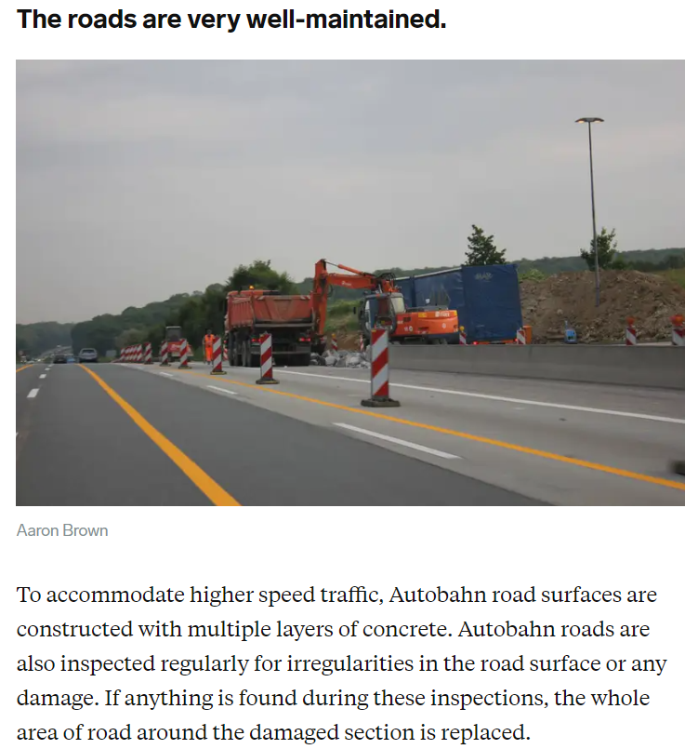
Key Findings
The city of Kansas City could see a reduction in calls related to street/pothole issues by looking to other countries for inspiration.
Case in point, the Autobahn is a world-class highway system in Germany that has differences in road construction and more preemptive maintenance.
One thing the city government could do is put multiple layers of concrete on the road.
When inspections are done, if any damage is found, replacing the segment containing damage could also be beneficial.
https://www.businessinsider.com/germanys-autobahn-vs-us-highways-compared-2016-3#passing-on-the-left-is-strictly-enforced-4
Ben

Slide 20
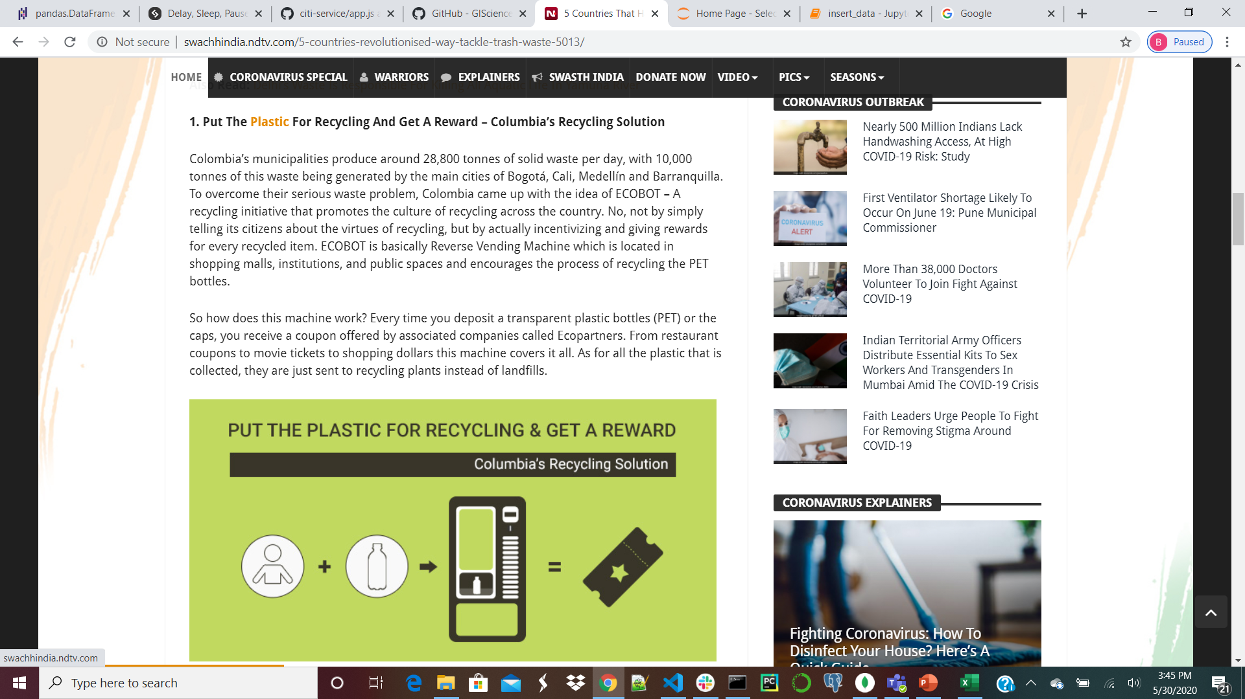
Key Findings
Trash collection is one of the other most frequent issues in Kansas City.
In order to reduce issues, citizens could try to reduce the amount of trash they generate.
Once again, the city government could lead by looking to other countries for examples.
According to one source, solutions include:
Coupons for putting plastic items in recycling – done in Columbia.
Provide healthcare services in exchange for recycling – done in Indonesia.
Take the energy that was generated by burning waste into a heating network to supply heat & electricity for private residences – as done in Sweden.
https://swachhindia.ndtv.com/5-countries-revolutionised-way-tackle-trash-waste-5013/
Ben

Slide 21
Thank you

