Slide 1
Neurocomputing
Dr. Satchidananda Dehuri, Ph.D. (CS),
Department of Information and Communication Technology, Fakir Mohan University, Vyasa Vihar,
Balasore-756019, Odisha.

Slide 2
What is Neurocomputing?
The study about computing paradigm of neurons of the human brain.
The brain is a highly complex, nonlinear, and parallel computer (a.k.a IPS).
In certain task it is much faster than fastest computer in existence today.

Slide 3
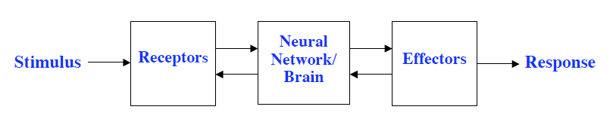
Our Nervous System

Slide 4
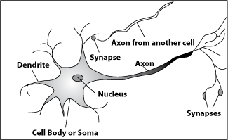
Biological Neuron

Slide 5
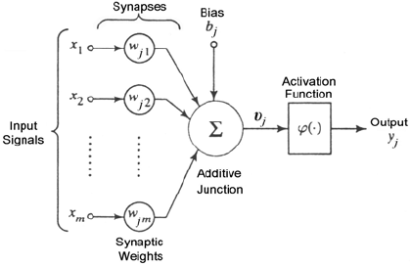
Artificial Neuron

Slide 6
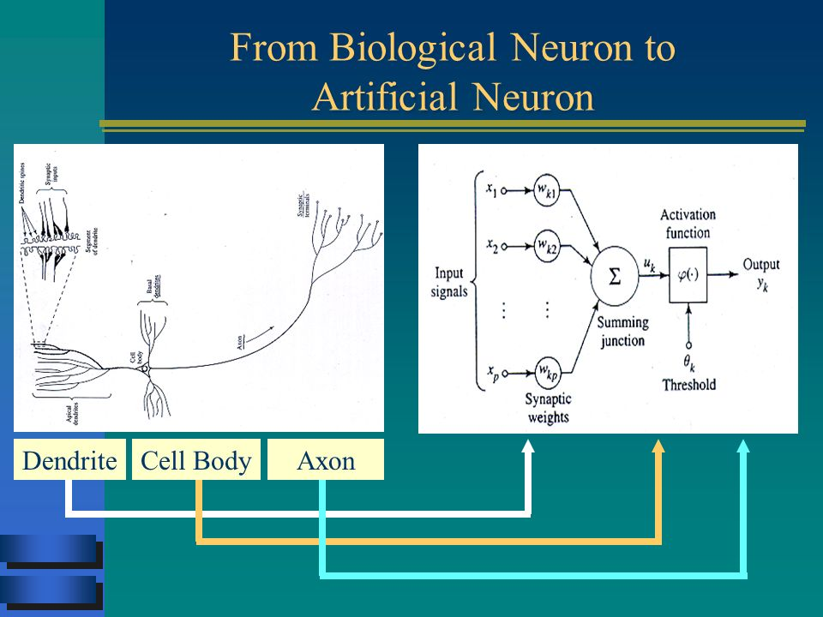
Biological Neuron to Artificial Neuron

Slide 7
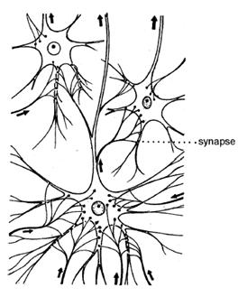
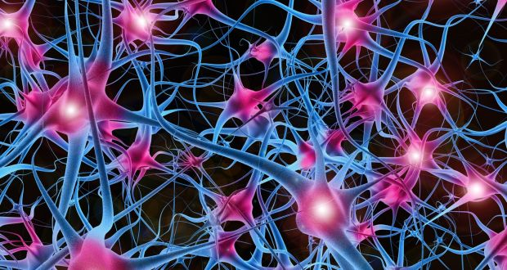
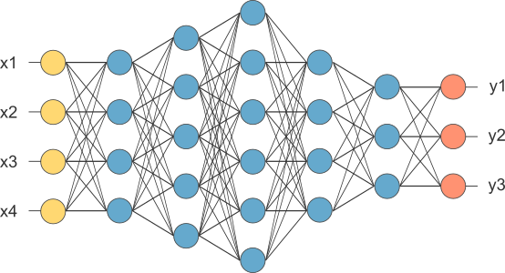
Biological NN to ANN

Slide 8
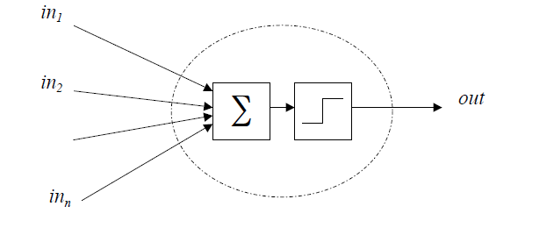
McCulloch-Pitts Neuronal model(1)

Slide 9
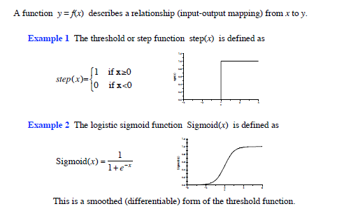
Activation Functions

Slide 10
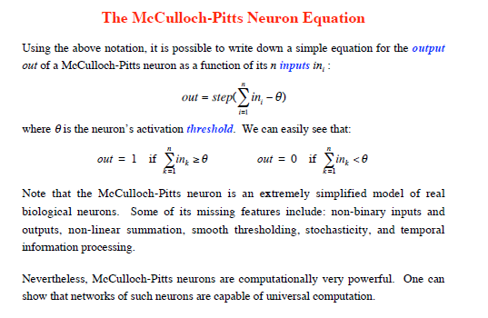
McCulloch-Pitts Neuronal model(2)

Slide 11
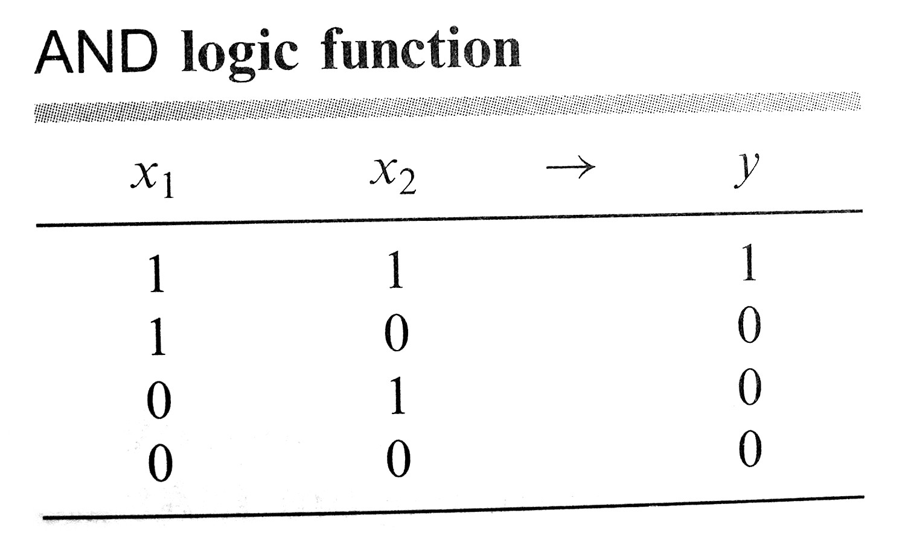
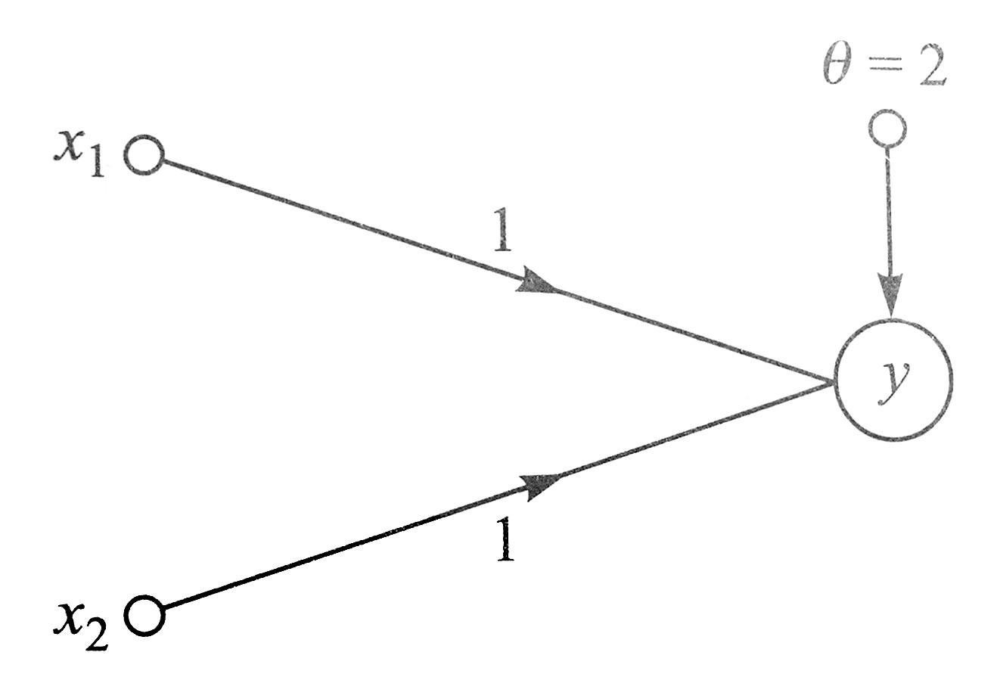
McCulloch-Pitts neuron
Example 1
  The AND logic function can be realized using the McCulloch-Pitts neuron having two synaptic connections with equal weights of 1 and a threshold θ=2.

Slide 12
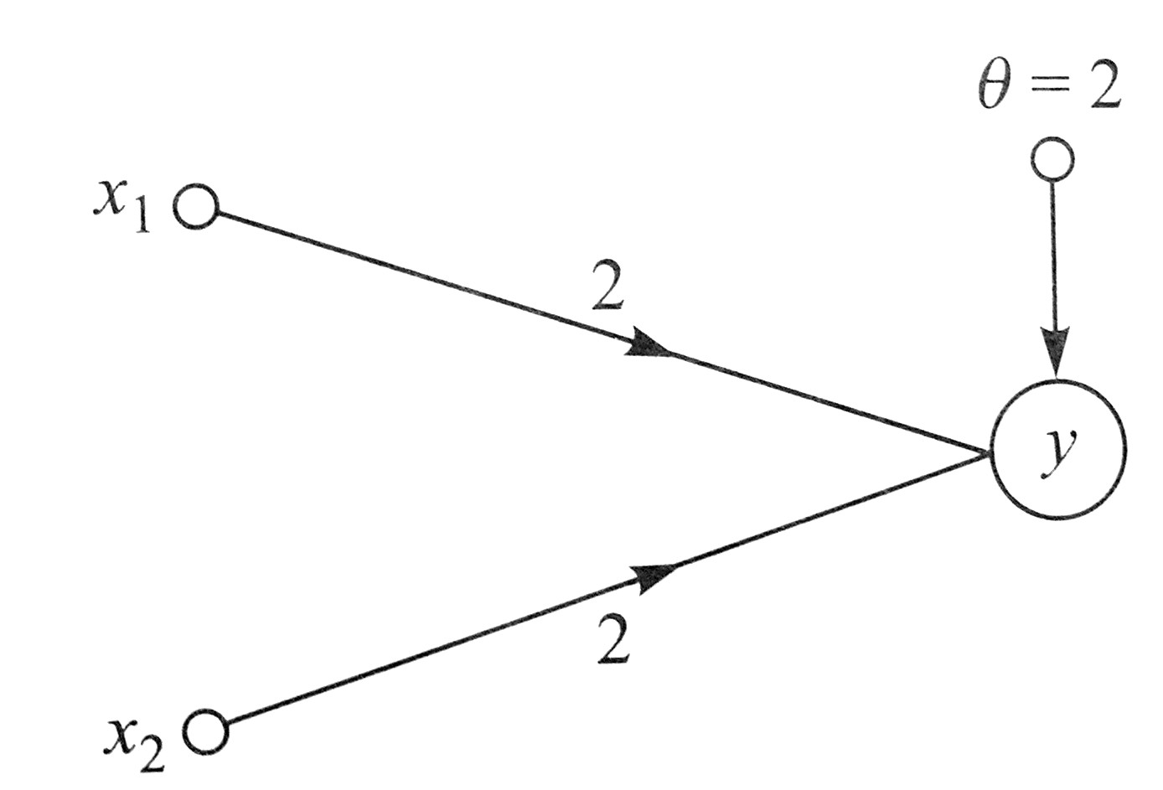
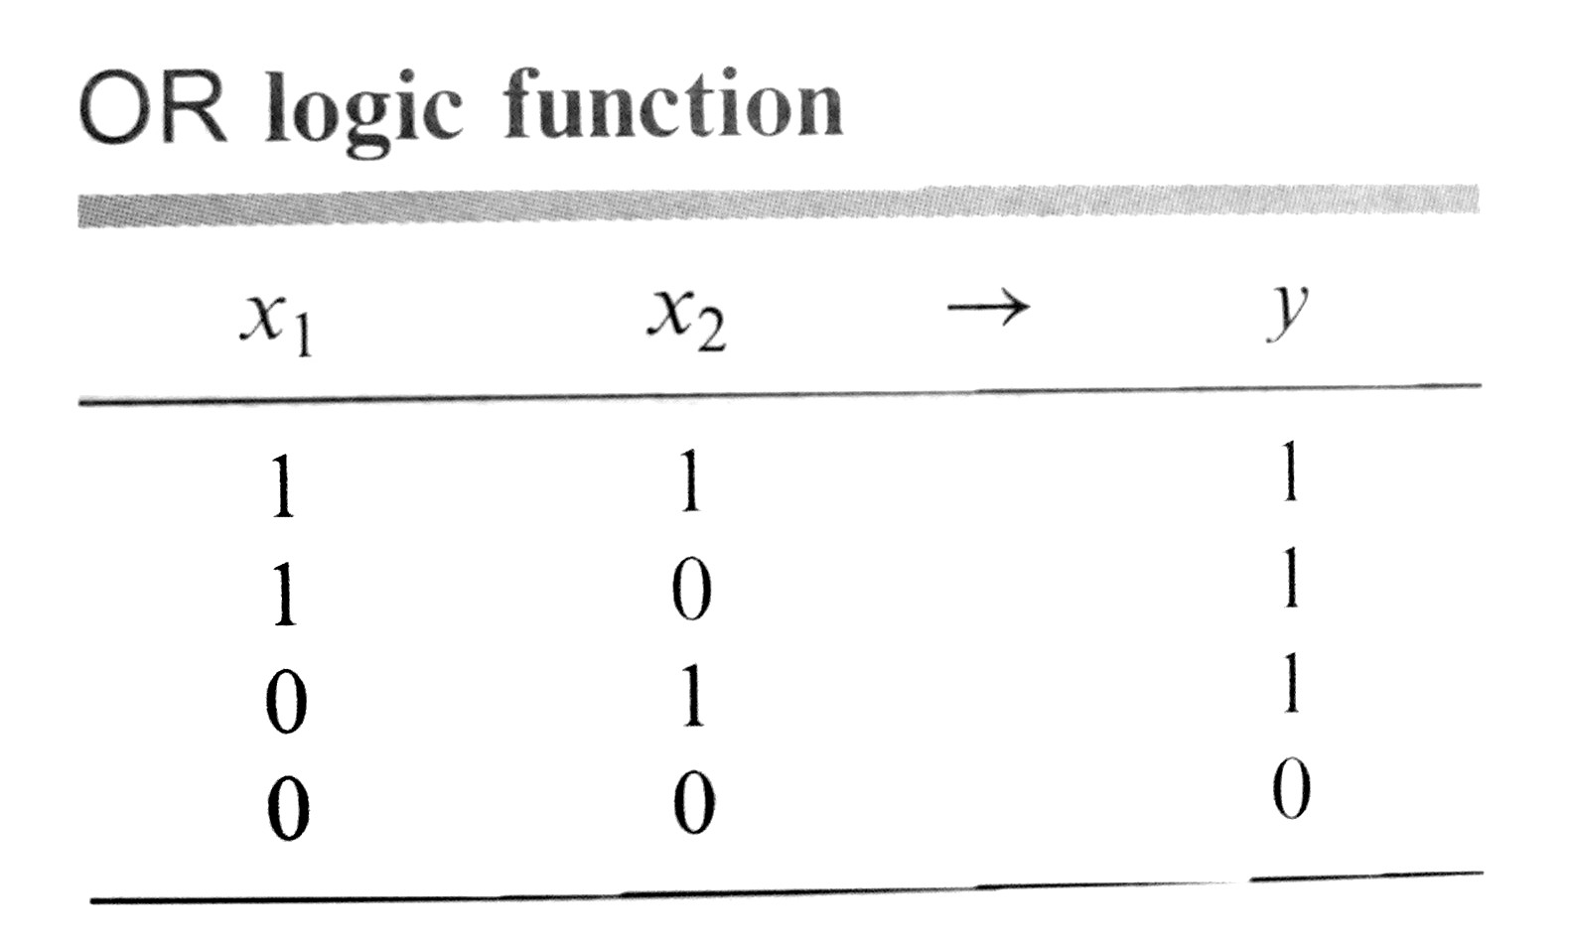
McCulloch-Pitts neuron
Example 2:
  The OR logic function can be realized using the McCulloch-Pitts neuron having two synaptic connections with equal weights of 2 and a threshold θ=2.

Slide 13
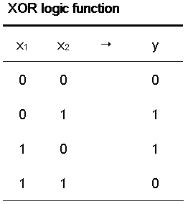
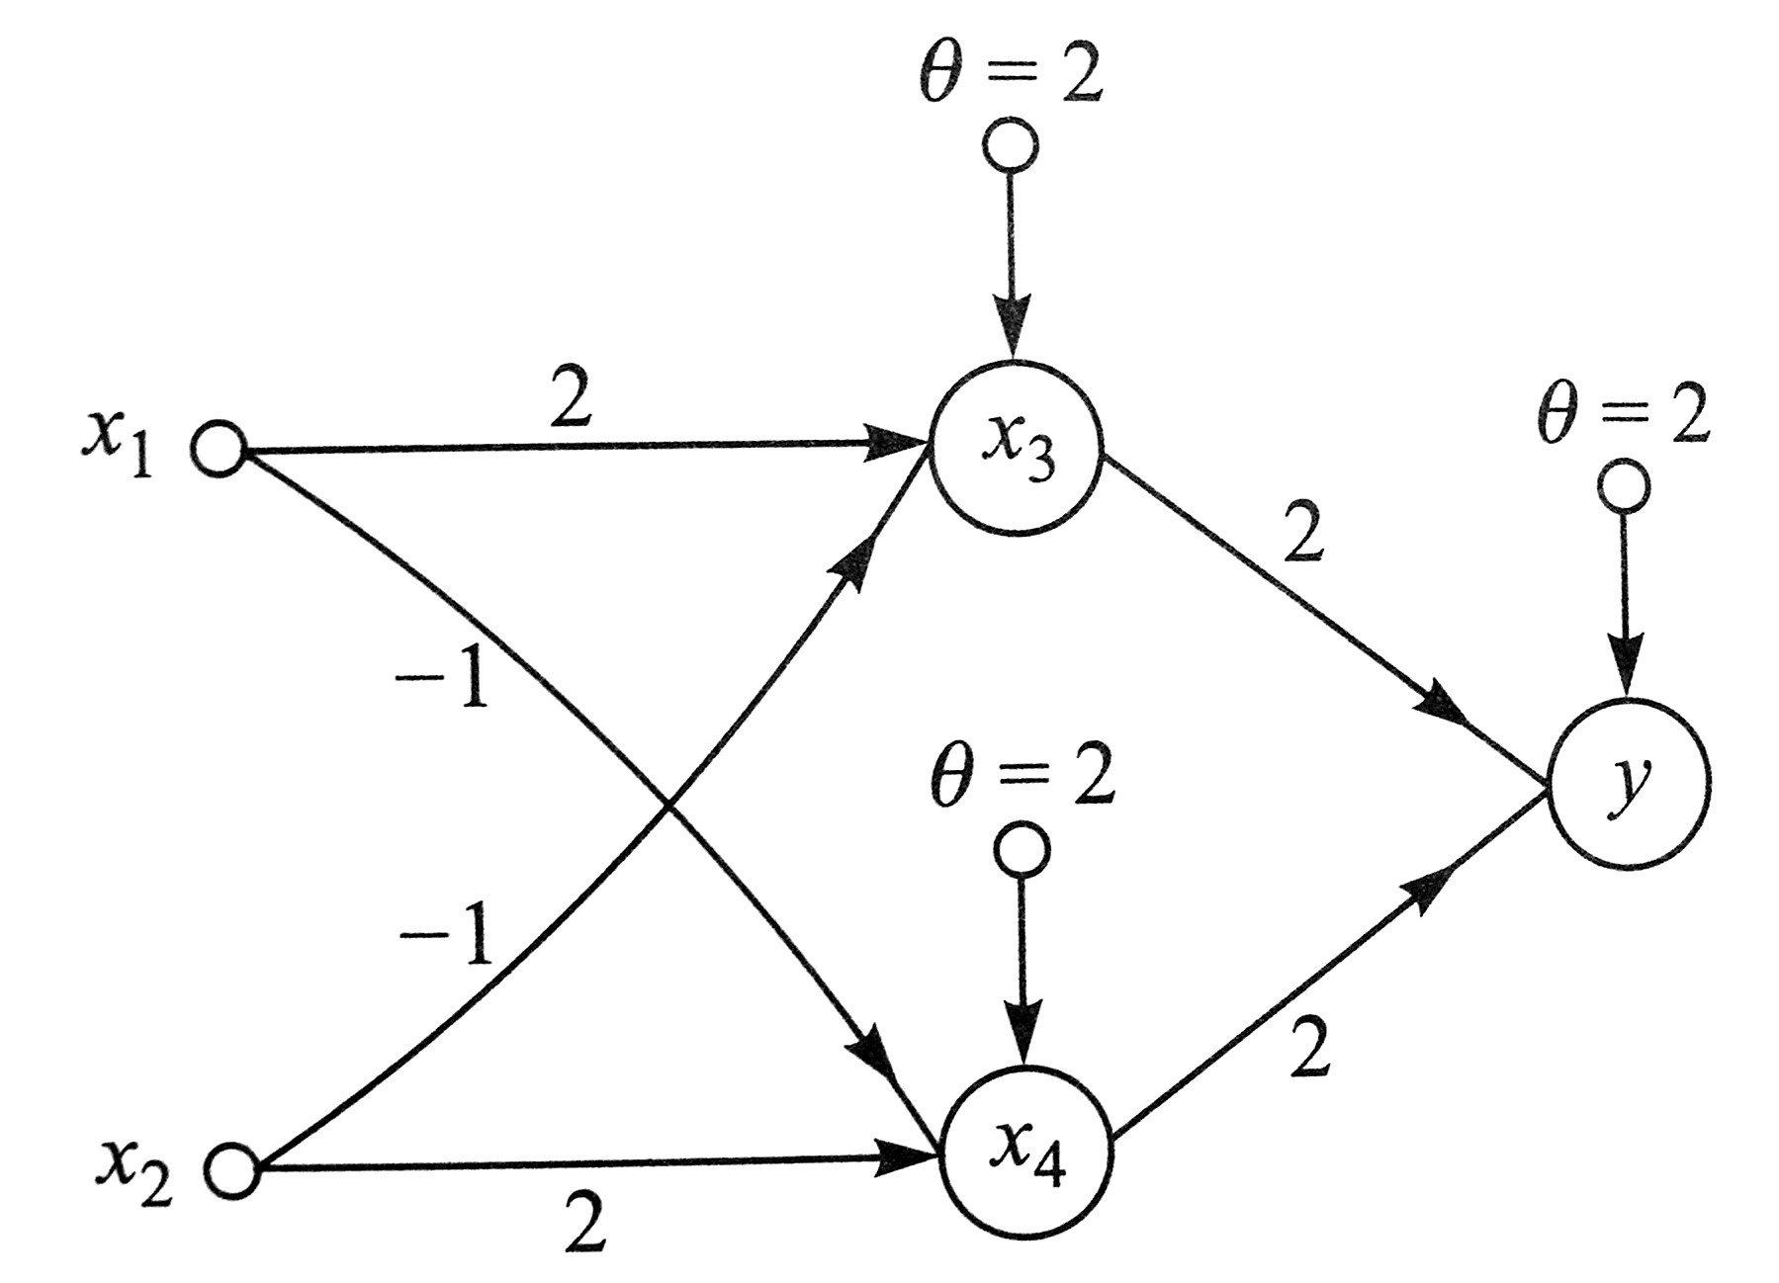
McCulloch-Pitts neuron
Example 3:
  The XOR logic function can be realized using three McCulloch-Pitts neuron having two synaptic connections with equal weights of 2 and a threshold θ=2.

Slide 14
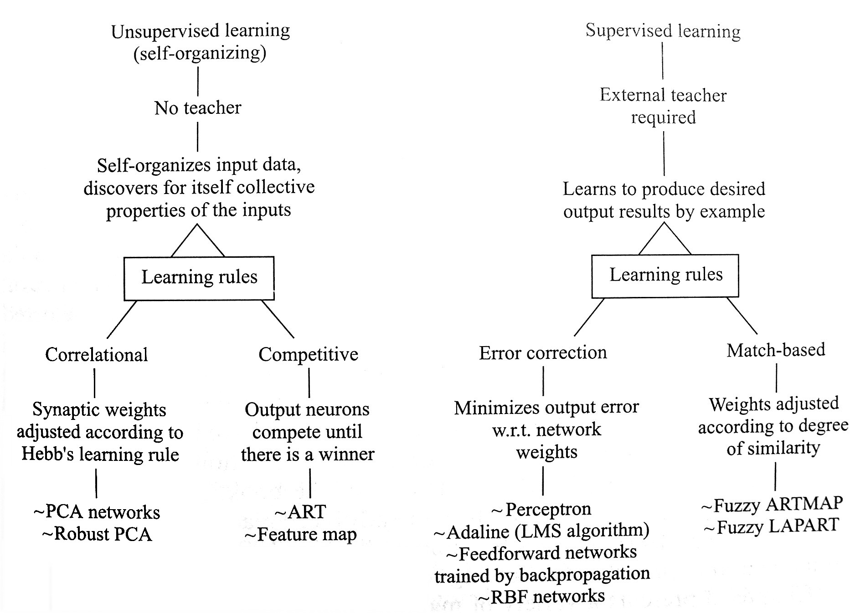
Classification of neural networks
Supervised learning vs. unsupervised learning

Slide 15
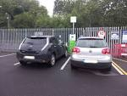
Application of ANN
Generally, a car can be parked rather easily because the final position of the car is not specified exactly. It were specified to within, say, a fraction of a millimeter and a few seconds of arc, it would take hours or days of maneuvering and precise measurements of distance and angular position to solve the problem.
High precision carries a high cost

Slide 16
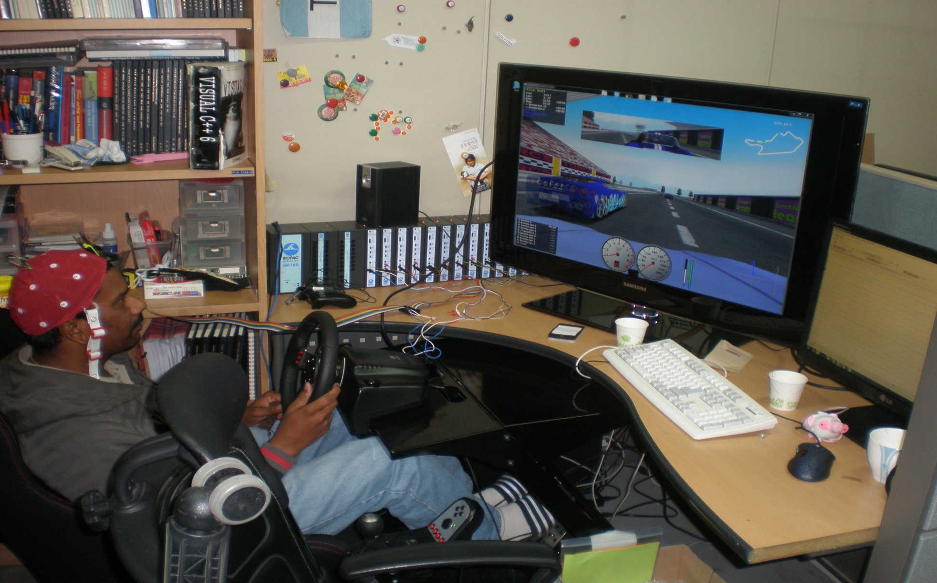
Application of ANN(2)
S. Dehuri is working at Soft Computing Lab. Yonsei University, South Korea.

Slide 17
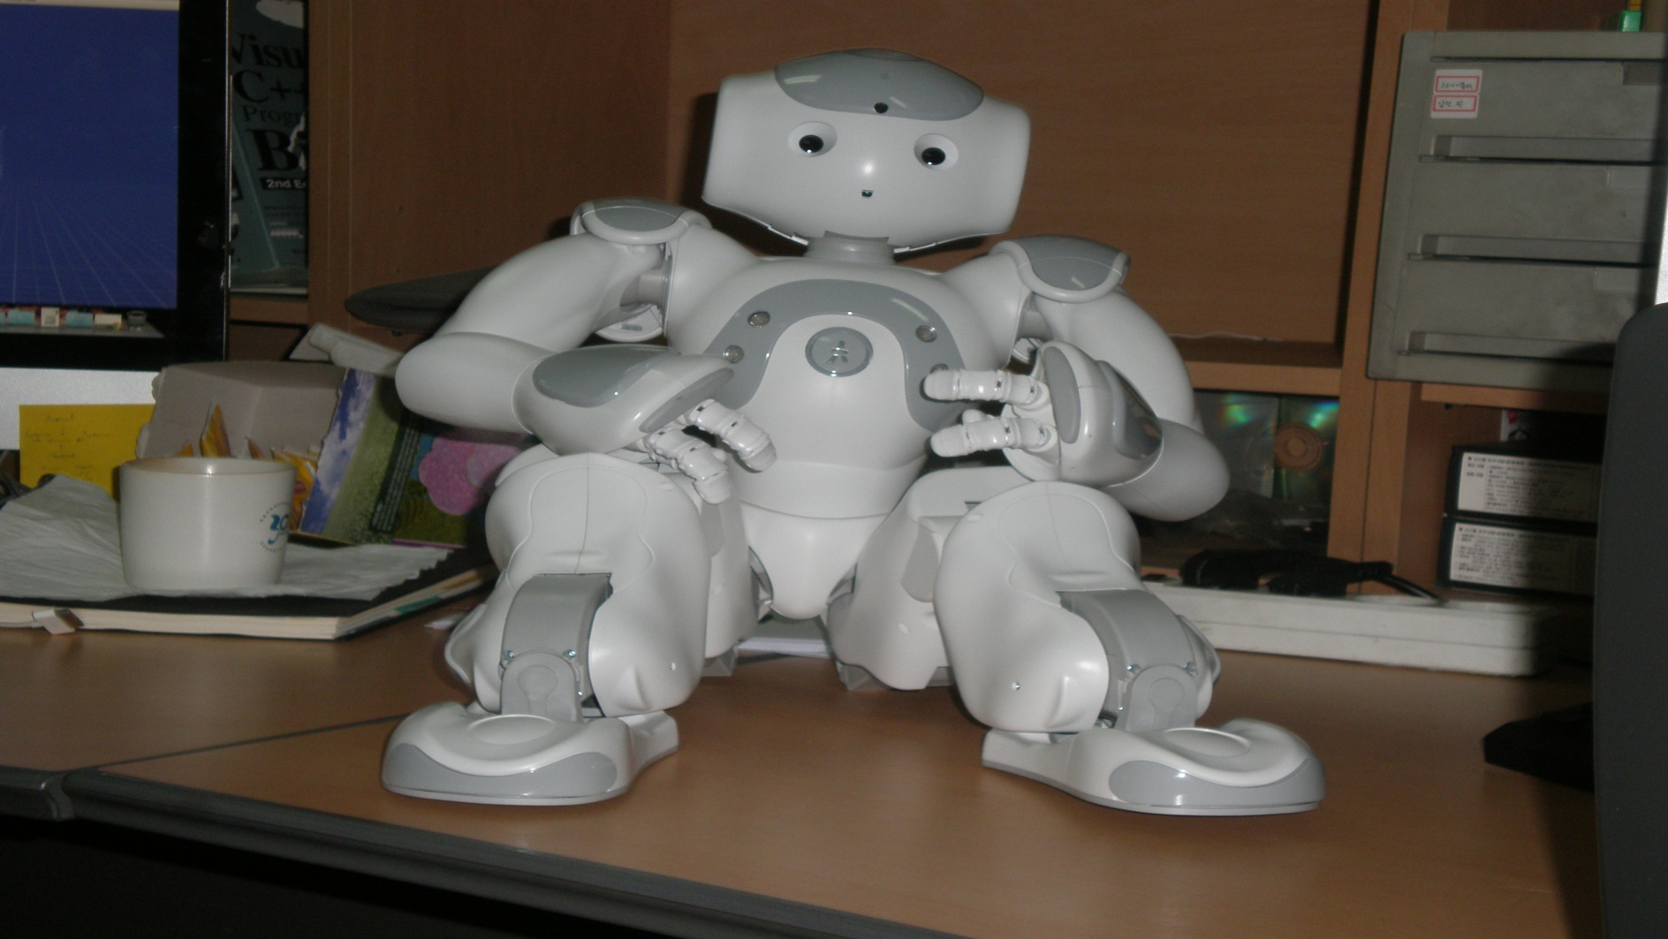
Applicationof ANN (3)
My robot is making coffee for me as per my requirement

Slide 18
Application of ANN (4)
Cash forecasting for ATM machine.
Stock index Prediction
Exchange Rate Prediction

Slide 19
Application of ANN (5)
Epileptic Seizure Identification
Cancerous Disease Identification

Slide 20
Application of ANN (6)
Agricultural Science
Intrusion Detection System

