Slide 1
Fuzzy Set Theory
Satchidananda Dehuri, Ph. D.(CS), Associate Professor,
Department of Information and Communication Technology, Fakir Mohan University, Vyasa Vihar,
Balasore-756019, ODISHA, INDIA
Email:satchi.lapa@gmail.com

Slide 2
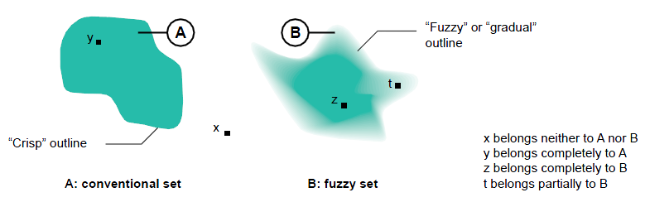
Classical Sets and Fuzzy Sets
X (Universe of discourse)
A classical set is defined by crisp boundaries
A fuzzy set is prescribed by vague or ambiguous properties; hence its boundaries are ambiguously specified

Slide 3
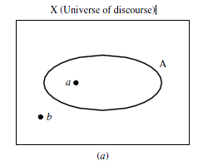
Classical Sets
the universe of discourse is the universe of all available information on a given problem
a universe of discourse, X, as a collection of objects all having the same characteristics
The clock speeds of computer CPUs
The operating temperature of a heat pump (in degrees Celsius)
The Richter magnitudes of an earthquake
The individual elements in the universe X will be denoted as x. The features of the elements in X can be discrete, countable integers or continuous valued quantities on the real line.
The total number of elements in a universe X is called its cardinal number, denoted n_{x}

Slide 4
Classical Sets
Collections of elements within a universe are called sets
universe of discourse : The Richter magnitudes of an earthquake
Set in the universe of discourse?
Collections of elements within sets are called subsets
The collection of all possible sets in the universe is called the whole set (power set).

Slide 5
Classical Sets
We have a universe comprised of three elements, X = {a, b, c}
The cardinal number, n_{x}?
The power set ,P(X)?
The cardinality of the power set?

Slide 6
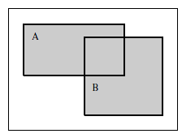
Operation on Classical Sets
Union A ∪ B = {x | x ∈ A or x ∈ B}
The union between the two sets, denoted A ∪ B,
represents all those elements in the universe that reside in (or belong to) the set A, the set B, or both sets A and B.
This operation is also called the logical or
Union of sets A and B (logical or) in terms of Venn diagrams

Slide 7
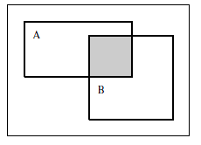
Operation on Classical Sets
Intersection A ∩ B = {x | x ∈ A and x ∈ B}
The intersection of the two sets, denoted A ∩ B, represents all those elements in the universe X that simultaneously reside in (or belong to) both sets A and B.
This operation is also called the logical and
Intersection of sets A and B.

Slide 8

Operation on Classical Sets
The complement of a set A,is defined as the collection of all elements in the universe that do not reside in the set A.
Complement of set A

Slide 9
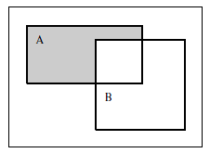
Operation on Classical Sets
The difference of a set A with respect to B, denoted A | B, is defined
as the collection of all elements in the universe that reside in A and that do not reside in B simultaneously
Difference operation A | B

Slide 10
Properties of Classical (Crisp) Sets
Commutativity A ∪ B = B ∪ A
A ∩ B = B ∩ A
Associativity A ∪ (B ∪ C) = (A ∪ B) ∪ C
A ∩ (B ∩ C) = (A ∩ B) ∩ C
Distributivity A ∪ (B ∩ C) = (A ∪ B) ∩ (A ∪ C)
A ∩ (B ∪ C) = (A ∩ B) ∪ (A ∩ C) (2.7)
Idempotency A ∪ A = A
A ∩ A = A
Identity A ∪ ∅ = A
A ∩ X = A
A ∩ ∅ = ∅
A ∪ X = X
Transitivity If A ⊆ B and B ⊆ C, then A ⊆ C

Slide 11
Properties of Classical (Crisp) Sets
Two special properties of set operations,
The excluded middle axioms
De Morgan’s principles

Slide 12

Properties of Classical (Crisp) Sets
The excluded middle axioms
not valid for both classical sets and fuzzy sets.
There are two excluded middle axioms
The first, called the axiom of the excluded middle, deals with the union of a set A and its complement,
the second, called the axiom of contradiction, represents the intersection of a set A and its complement.

Slide 13

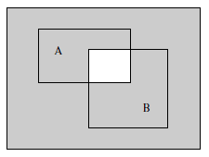
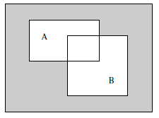
Properties of Classical (Crisp) Sets
De Morgan’s principles
information about the complement of a set (or event), or the complement of combinations of sets (or events), rather than information about the sets themselves

Slide 14
Mapping of Classical Sets to Functions
Mapping is an important concept in relating set-theoretic forms to function-theoretic representations of information.
In its most general form it can be used to map elements or subsets on one universe of discourse to elements or sets in another universe.
If an element x is contained in X and corresponds to an element y contained in Y, it is generally termed a mapping from X to Y,
f : X →Y

Slide 15

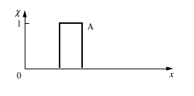
Mapping of Classical Sets to Functions
The characteristic (indicator) function χ_{A} is defined by
Membership function is a mapping for crisp set A.

Slide 16
Mapping of Classical Sets to Functions
Example : a universe with three elements, X = {a, b, c}, we desire to map the elements of the power set of X, i.e., P(X), to a universe, Y, consisting of only two elements (the characteristic function), Y = {0, 1}
the elements of the power set?
the elements in the value set V(P(X))?

Slide 17
Mapping of Classical Sets to Functions
Example : a universe with three elements, X = {a, b, c}, we desire to map the elements of the power set of X, i.e., P(X), to a universe, Y, consisting of only two elements (the characteristic function), Y = {0, 1}
the elements of the power set
P(X) = {∅, {a}, {b}, {c}, {a, b}, {b, c}, {a, c}, {a, b, c}}
the elements in the value set V(P(X))
V{P(X)} = {{0, 0, 0}, {1, 0, 0}, {0, 1, 0}, {0, 0, 1}, {1, 1, 0}, {0, 1, 1}, {1, 0, 1}, {1, 1, 1}}

Slide 18

Mapping of Classical Sets to Functions
The union of these two sets in terms of function-theoretic terms is given as follows (the symbol ∨ is the maximum):
Union A ∪ B −→ χA∪B(x) = χA(x) ∨ χB(x) = max(χA(x), χ B(x))
The intersection of these two sets in function-theoretic terms is given by (the symbol ∧ is the minimum operator):
Intersection A ∩ B −→ χA∩B(x) = χA(x) ∧ χB(x) = min(χA(x), χB(x))
The complement of a single set on universe X, say A, is given by
Example

Slide 19
Fuzzy Sets
The boundaries of the fuzzy sets are vague and ambiguous. Hence, membership of an element from the universe in this set is measured by a function that attempts to describe vagueness and ambiguity

Slide 20
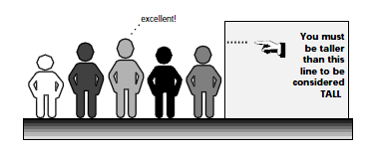
Fuzzy Sets
the set of tall people

Slide 21
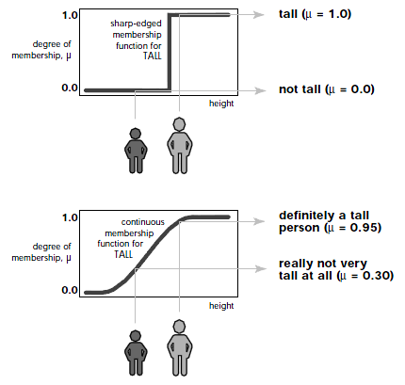
Fuzzy Sets

Slide 22
Fuzzy Sets
Elements of a fuzzy set are mapped to a universe of membership values using a
function-theoretic form.
fuzzy sets are denoted by a set symbol with a tilde understrike;
A∼ would be the fuzzy set A.
This function maps elements of a fuzzy set A∼ to a real numbered value on the interval 0 to 1.
If an element in the universe, say x, is a member of fuzzy set A∼, then this mapping is given by

Slide 23


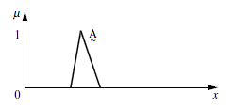
Notation Convention for Fuzzy Sets
When the universe of discourse, X, is discrete and finite, is as follows for a fuzzy setA∼ :
When the universe, X, is continuous and infinite, the fuzzy setA∼
Membership function for fuzzy set A∼
Example

Slide 24
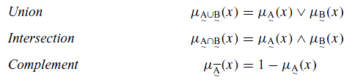
Fuzzy Set Operations
Three fuzzy sets A , B, and C on the universe X
For a given element x of the universe, the following function-theoretic operations for the set-theoretic operations of union, intersection, and complement are defined for aA, B, and C on X
Standard fuzzy operations

Slide 25
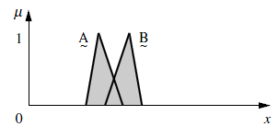
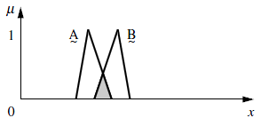
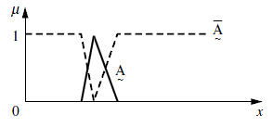
Fuzzy Set Operations
Union of fuzzy sets A∼ and B∼
Intersection of fuzzy sets A∼ and B∼
Complement of fuzzy sets A∼ and B∼
Example

Slide 26
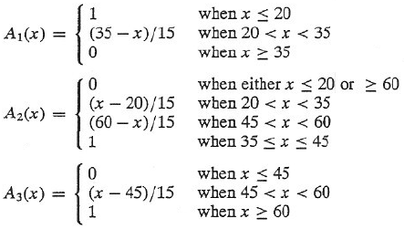
Realization of Membership
Consider three fuzzy sets that represent the concepts of a young, middle-aged, and old person. The membership functions are defined on the interval [0,80] as follows:
young
middle-aged
old

Slide 27

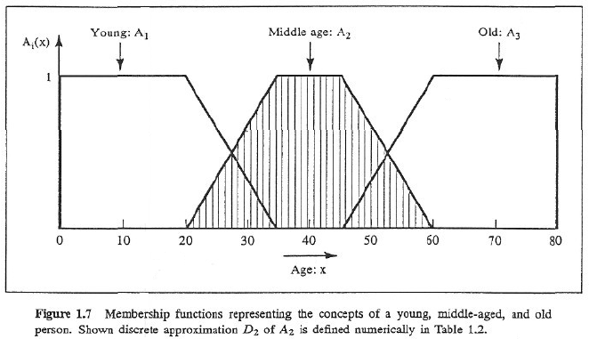
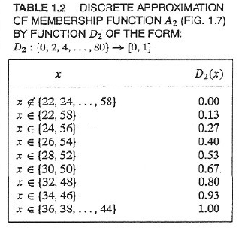
1.4 Fuzzy sets: basic concepts

Slide 28
Selected References
L. A. Zadeh, Fuzzy sets, Information and Control 8, 338-353, 1965.
L. A. Zadeh, Outline of a new approach to the analysis of complex systems and decision processes, IEEE Transactions on Systems, Man and Cybernetics SMC-3, 28-44, 1973.

