Slide 1
Recordex-C
Pratyush Khatiwada ( BCT 022 )
Prithak Lamsal ( BCT023 )
Department of Electronics and Computer Engineering
Institute of Engineering, Thapathali Campus
March 12, 2025

Slide 2
What is Recordex?
Recordex is stock management application made in C.
It is a terminal application.
It is a demo application while learning how basic function work in any application.
Libraries used:
OpenSSL
SQLite3

Slide 3
Why Recordex?
Recordex is a simple prototype application which would solve a real-world problem.
It can be used from small shop owners to high trafficked marketplace such as Big Marts.
Is it a professional application? No
Is it a project that gives theoretical concept into practice? Yes

Slide 4
Features of Recordex
User Authentication ( Login, Signup, Logout)
Hashed Password storage
Stock Management ( Adding, Deleting, Updating stocks )
Billing System ( Terminal Based )
QR code embedded with JSON return
Database Storage using SQLite 3
SQL Injection free

Slide 5
Problem faced during development
Brainstorming
First big project at C.
No prior knowledge about SQL.
Packaging library into project.
Operating System ( Windows being difficult ); had to use WSL.

Slide 6
What Recordex means to me?
A step beyond using frameworks.
Understanding on the root level.
Now, for small demanding projects, I develop low-resource solutions ( thanks to SQL learnings ).
Learnt how to plan for a project as such.
With these knowledge, I have started developing new application using different tech stacks.

Slide 7
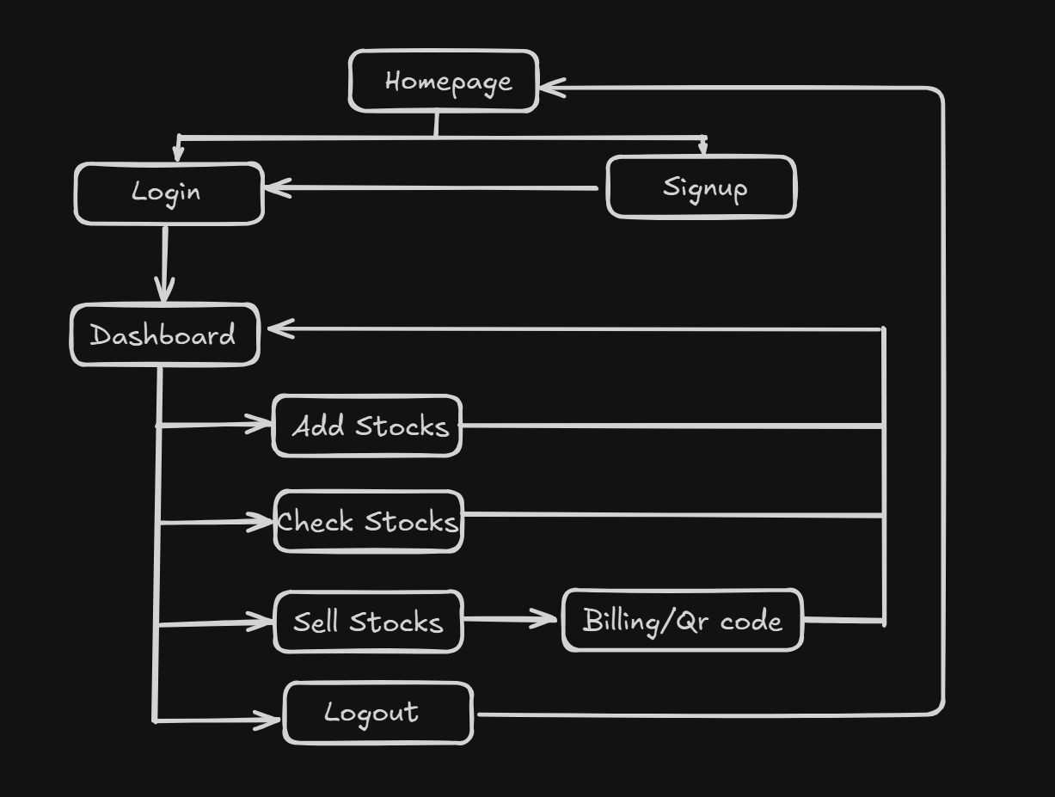
Flowchart

Slide 8
Conclusion
Project Impact: Improved security and inventory control through login, hashed passwords, and stock management.
Skills Gained: Strengthened C programming, database handling and secure coding.
Future Scope: Potential for upgrades like advanced encryption and user roles.
Practical Relevance: Scalable solution for marts and shops with real-world applicability.

