Slide 1
Uncanny AI: To click or not to click
SPRING 2023
Morgan Hilton, Emily Bannister, Jordan Sasser

Slide 2
TOPIC OF INTEREST
Research question: How does the visual appearance of a chatbot in terms of uncanny valley affect human trust in and reliance upon the AI?
E-commerce is becoming the main interface for consumers to make purchases- 76% of adults shop online
How does the chatbot’s humanistic appearance interface with human trust?
Notes:
Morgan Will do

Slide 3
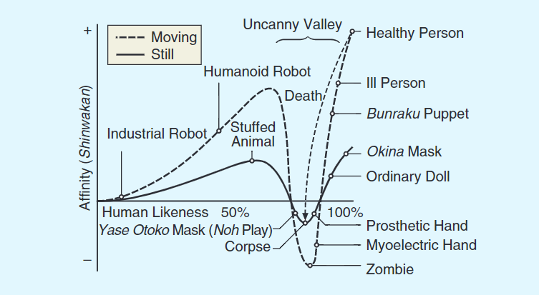
UNCANNY VALLEY EFFECT
Phenomenon where an something that appears almost, but not completely human-like, can evoke a sense of eeriness to observers (Mori et al., 2012)
Notes:
Jordan

Slide 4
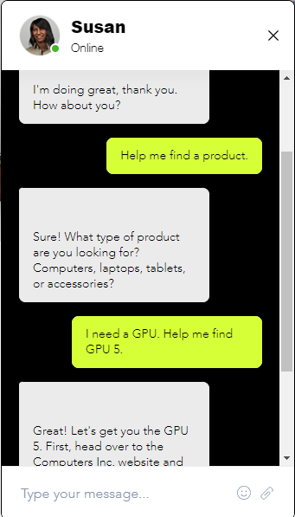
USERS' TRUST OF CHATBOTS
Social properties in chatbots were seem to have beneficial implications for user trust (Min et al., 2021)
Notes:
Slide shared amongst all of us

Slide 5
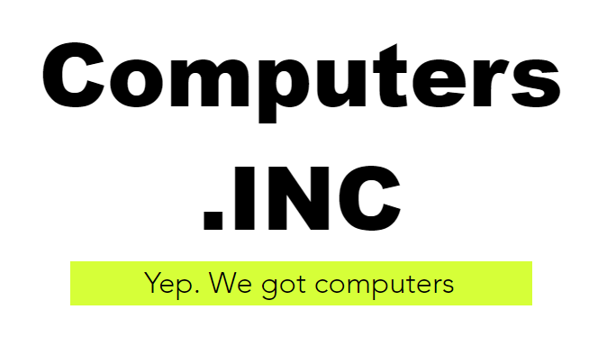

PROJECT OVERVIEW
POORLY DESIGNED WEBSITE
confusing experience drives interaction with AI chatbot
CHATBOT APPEARANCE- 3 INSTANCES
Cartoonish non-human
Realistic humanoid
Hyper realistic human
METHOD OF GATHERING EVIDENCE
Investigate clicking behaviors
Analyze survey data from questionnaires
Notes:
Emily

Slide 6

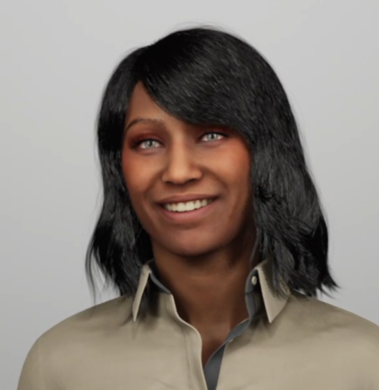

Chatbot icon examples
Hyper-realistic human
Although a small effect, Black faces were rated more trustworthy & women rated more than men (Nightingale & Farid, 2022)
Realistic
humanoid
Cartoonish Non-human
Notes:
Emily

Slide 7
EXPERIMENT DESIGN
Sample: Undergraduate population from a large Southeastern University
Apparatuses: PC with software installed to collect click data
Estimated time through experiment: 30-45 minutes
Pre survey 1
General Attitudes towards Artificial Intelligence Scale
Task
Find an item and add to your cart
Post survey 1
SUS
Post survey 2
Godspeed questionnaires
Post survey 3
CTPA – Trust scale
Pre survey 2
Demographics
Notes:
Deception based study – Tell participants that the study is looking at the usability of the website and have them complete a task that requires them to use the chatbot to be able to find the item that they need to add to their carts.
Morgan Will do

Slide 8
VARIABLES
INDEPENDENT | BEHAVIORAL DEPENDENT | PERCEIVED DEPENDENT
Realism of icon | Number of clicks on website | Anthropomorphism
Visual cues (text-based vs visual) | Number of clicks on agent | Perceived intelligence
 | Number of times agent closed | Likeability
 | Time between first opening website and engaging with agent | Trust
Notes:
Emily

Slide 9
EARLY HYPOTHESES
1. Differences should be seen between realism of AI icons in level of affinity (trust, interaction)
Cartoonish nonhuman would have higher affinity while being lower in human likeness
Realistic human would fall more in the middle with both affinity and human likeness
Hyper realistic human should invoke uncanny valley feeling- high human likeness and low affinity
2. Visual cue types should impact individuals’ likelihood to activate the chatbot to complete tasks
Cartoonish nonhuman icon will have the fastest time to activation while hyper realistic human will have the slowest
Notes:
Jordan

Slide 10
DATA COLLECTION
Data collection will yield mixed data results and will be collected through software + Qualtrics
During experiment:
Clicking behaviors recorded through software (quantitative)
Post experiment:
SUS usability scale (quantitative) [Deception questionnaire]
Godspeed questionnaire (anthropomorphism, likeability, perceived intelligence, perceived safety; quantitative)
Trust between people and automation questionnaire (quantitative)
Notes:
Morgan Will do

Slide 11
STIMULUS + QUESTIONNAIRE
Here is the survey and task
Notes:
Jordan

Slide 12
REFERENCE
https://maristpoll.marist.edu/wp-content/misc/usapolls/us180423_NPR/NPR_Marist%20Poll_Tables%20of%20Questions_May%202018.pdf
Cramer-Flood, Ethan. “Global Ecommerce Forecast 2022.” Insider Intelligence, 2 Feb. 2022, www.insiderintelligence.com/content/global-ecommerce-forecast-2022.
Jian, J., Bisantz, A., & Drury, C. (2000). Foundations for an empirically determined scale of trust in automated systems. International Journal of Cognitive Ergonomics, 4(1), 53–71.
Min, F. A. N., Fang, Z. O. U., He, Y., & Xuan, J. I. A. N. G. (2021, January). Research on Users' Trust of Chatbots Driven by AI: An Empirical Analysis Based on System Factors and User Characteristics. In 2021 IEEE International Conference on Consumer Electronics and Computer Engineering (ICCECE) (pp. 55-58). IEEE.
Mori, M., MacDorman, K. F., & Kageki, N. (2012). The uncanny valley [from the field]. IEEE Robotics & automation magazine, 19(2), 98-100.
Schepman, A., & Rodway, P. (2022). The General Attitudes towards Artificial Intelligence Scale (GAAIS): Confirmatory Validation and Associations with Personality, Corporate Distrust, and General Trust.

Slide 13
THANK YOU
ANY QUESTIONS?

