Slide 1
Uncanny AI: To click or not to click
SPRING 2023
Morgan Hilton, Emily Bannister, Jordan Sasser

Slide 2
TOPIC OF INTEREST
Research question: How does the visual appearance of a chatbot in terms of uncanny valley affect human trust in the AI?
E-commerce is becoming the main interface for consumers to make purposes- 76% of adults shop online
How does the chatbot’s humanistic appearance interface with human trust

Slide 3
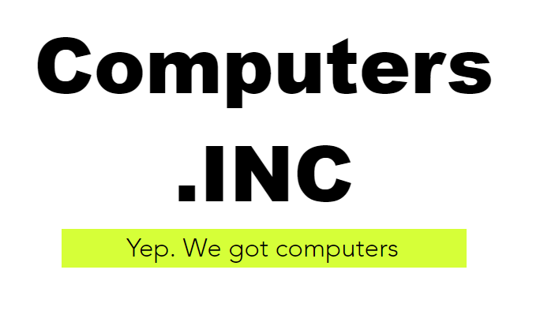
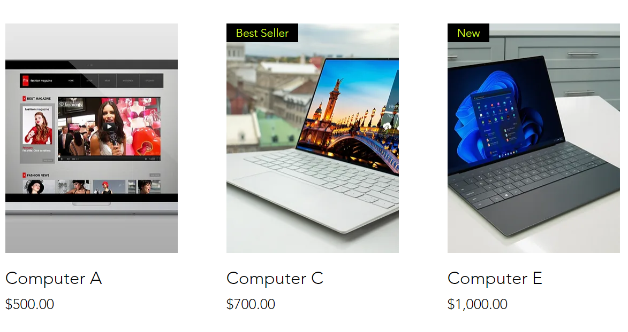
PROJECT OVERVIEW
POORLY DESIGNED WEBSITE
confusing experience drives interaction with AI chatbot
CHATBOT APPEARANCE- 3 INSTANCES
Cartoonish non-human
Realistic humanoid
Hyper realistic human
METHOD OF GATHERING EVIDENCE
Investigate clicking behaviors

Slide 4
EXPERIMENT DESIGN
Need to think this part out more- what apparatuses are we using , how many ppl , basic experiment setup & target audience etc

Slide 5
VARIABLES
INDEPENDENT | DEPENDENT
Realism of icon | Number of clicks on website
Visual cues (text-based vs visual) | Number of clicks on agent
 | Number of times agent closed
 | Time between first opening website and engaging with agent

Slide 6
DATA COLLECTION
Data collection will yield mixed data
During experiment:
  Clicking behaviors recorded through software (quantitative)
Post experiment:
  Written affirmation of trust in questionnaire (qualitative)
  SUS usability scale (quantitative)

Slide 7
EARLY HYPOTHESES
1. Differences should be seen between realism of AI icons in level of affinity (trust, interaction)
  Cartoonish nonhuman would have higher affinity while being lower in human likeness
  Realistic human would fall more in the middle with both affinity and human likeness
  Hyper realistic human should invoke uncanny valley feeling- high human likeness and low affinity
2. Visual cue types should impact individuals’ likelihood to activate the chatbot to complete tasks
  Cartoonish nonhuman icon will have the fastest time to activation while hyper realistic human will have the slowest

Slide 8
RELATED WORKS
https://maristpoll.marist.edu/wp-content/misc/usapolls/us180423_NPR/NPR_Marist%20Poll_Tables%20of%20Questions_May%202018.pdf
Cramer-Flood, Ethan. “Global Ecommerce Forecast 2022.” Insider Intelligence, 2 Feb. 2022, www.insiderintelligence.com/content/global-ecommerce-forecast-2022.
Schepman, A., & Rodway, P. (2022). The General Attitudes towards Artificial Intelligence Scale (GAAIS): Confirmatory Validation and Associations with Personality, Corporate Distrust, and General Trust.

Slide 9
THANK YOU
ANY QUESTIONS?

