Slide 1
Stock Volatility Analysis (Sasswath/Stock_volatility)
Dataset: 5 NSE stocks (2020-01-01 to 2025-12-30), 1,485 daily log returns per stock

Slide 2
2) Aim
Model daily stock-return behavior and risk using repository outputs.
Compare Normal vs Student-t fits for representative stock (TCS).
Quantify tails, volatility, simulation outcomes, and VaR implications.

Slide 3
3) Data preparation
if (nrow(df) > 1) {
df <- df %>% arrange(date)
df$log_ret <- c(NA, log(df$adj_close[-1] / df$adj_close[-nrow(df)]))
df$simple_ret <- c(NA, (df$adj_close[-1] - df$adj_close[-nrow(df)]) / df$adj_close[-nrow(df)])
ret_na <- sum(is.na(df$log_ret))
log_msg("\nH. Daily returns")
log_msg(sprintf(" Returns computed: %d (NAs: %d, first obs)", nrow(df) - 1, ret_na))
# Extreme returns: |z| > 5 on returns
r_mean <- mean(df$log_ret, na.rm = TRUE)
r_sd <- sd(df$log_ret, na.rm = TRUE)
df$z_ret <- (df$log_ret - r_mean) / r_sd
extreme_ret <- abs(df$z_ret) > 5
n_extreme_ret <- sum(extreme_ret, na.rm = TRUE)
log_msg(sprintf(" Rows with |z_ret| > 5 (extreme returns): %d", n_extreme_ret))
if (n_extreme_ret > 0) {
ext_ret <- df %>% filter(!is.na(log_ret)) %>% filter(abs(z_ret) > 5) %>%
arrange(desc(abs(log_ret)))
write_csv(ext_ret[, c("date", "ticker", "simple_ret", "log_ret", "z_ret")],
file.path(.project_root(), "output", "tables",
sprintf("extreme_returns_%s.csv", ticker)))
log_msg(" Extreme returns are EXPOSED here and retained for analysis.")
}
}
Raw rows: 7430; cleaned rows: 7430; removed: 0.
Cleaning checks: datatypes, duplicates, NA, invalid prices, date ordering.
Outliers/extreme returns are flagged (|z_ret| > 5) and retained for analysis.
Total flagged extreme returns across 5 stocks: 25.
Source: R/03_data_cleaning.R + output/tables/cleaning_summary.csv

Slide 4
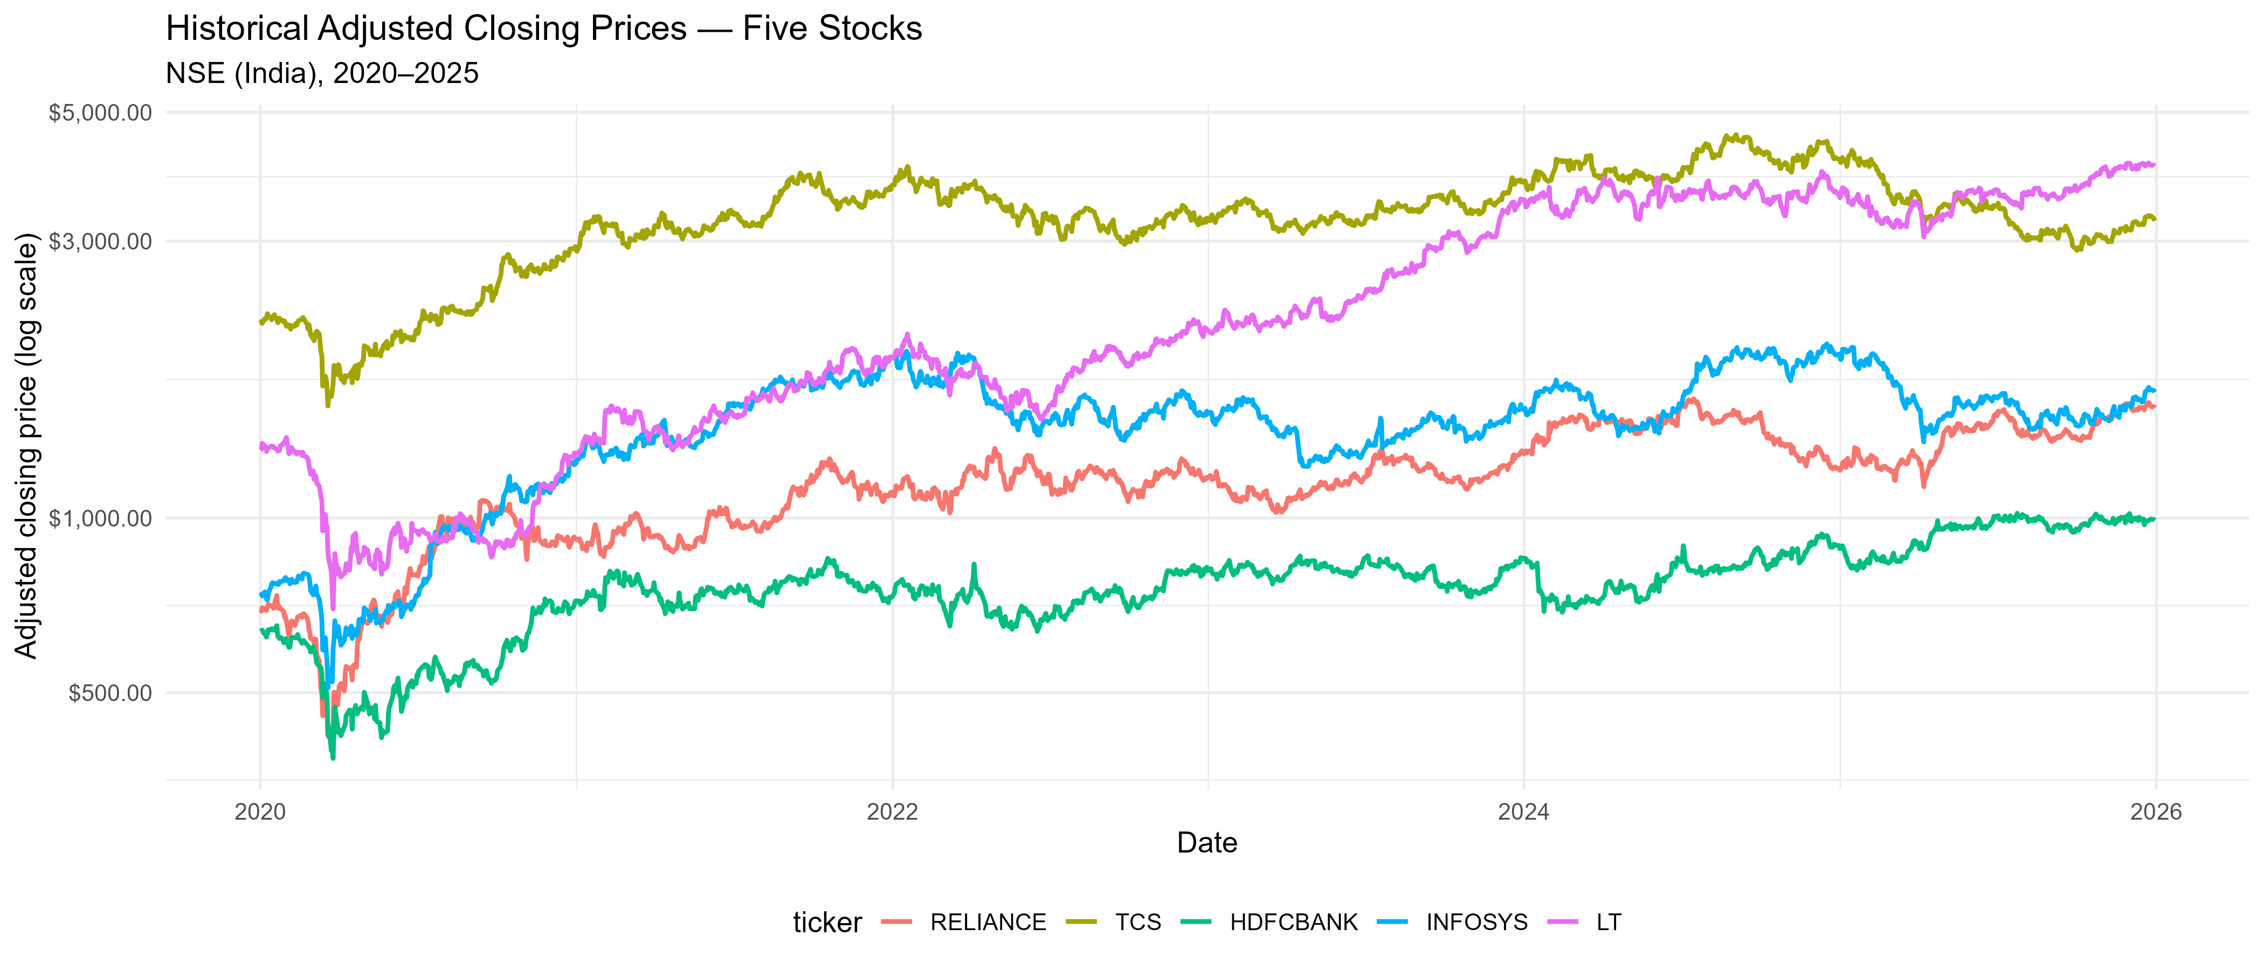
4) Data visualization
Historical adjusted prices and cumulative-return patterns differ by stock.
Distribution/volatility visuals are built from output/figures artifacts.
Representative stock selected objectively: TCS.

Slide 5
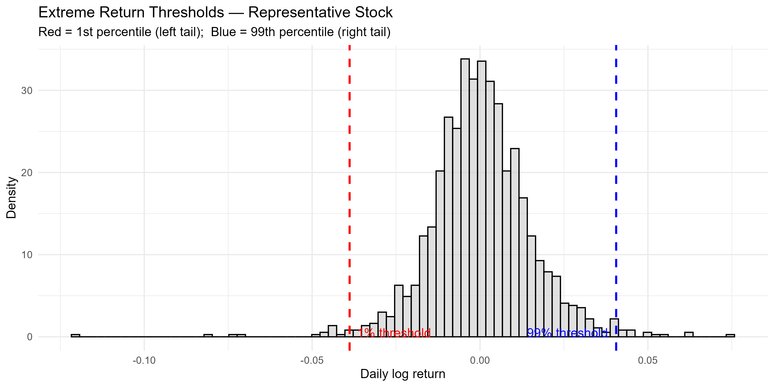
5) Outlier analysis
Method: return z-scores on daily log returns; extreme if |z_ret| > 5.
Extreme-return counts: HDFCBANK 4, INFOSYS 7, LT 8, RELIANCE 4, TCS 2.
These events are analyzed as financially meaningful tail behavior.

Slide 6
6) Removing outliers
No automatic outlier deletion was applied in this repository pipeline.
Evidence: n_raw == n_clean for all 5 stocks in cleaning_summary.csv.
Reason: preserving tail events is essential for volatility/tail-risk/VaR analysis.
Retained data supports robust comparison of Normal vs heavy-tailed Student-t.

Slide 7
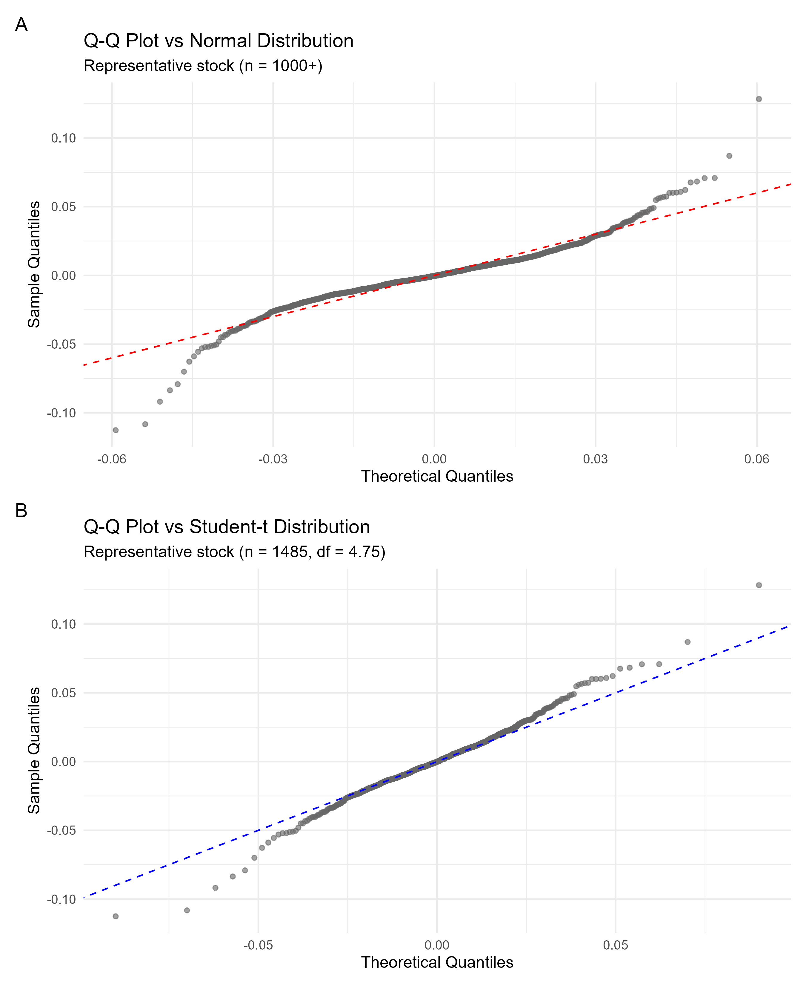
7) Graphical analysis
Diagnostic plots: Q-Q (Normal vs Student-t), density overlays, CDF comparison.
Representative stock: TCS; sample skewness ≈ -0.282, kurtosis ≈ 7.905.
Visual tail departures motivate heavy-tail modeling.

Slide 8
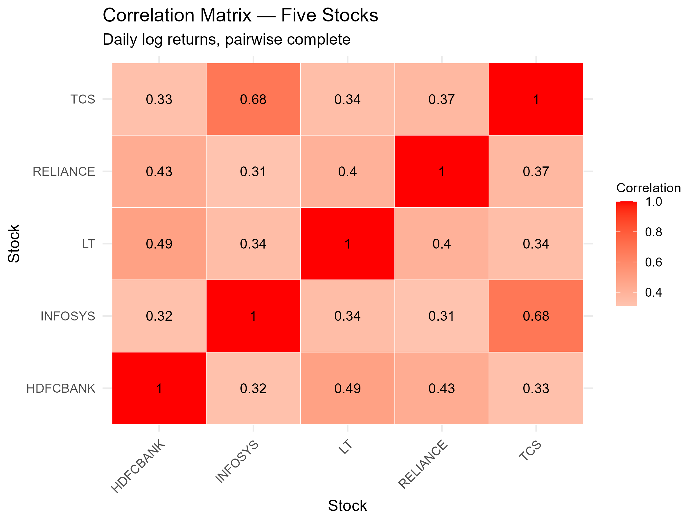
8) Correlation and variance
Highest pairwise correlation: INFOSYS–TCS = 0.684.
TCS annualized volatility: 23.8940%.
Volatility differs by stock (see comparative_volatility.png).

Slide 9
9) Regression analysis
Unavailable in current repository outputs/scripts.
No regression model (e.g., lm/glm) artifacts are produced for this workflow.
The analysis focuses on distribution fitting, diagnostics, simulation, and VaR.
Result reporting remains transparent: no fabricated regression assumptions or metrics.

Slide 10
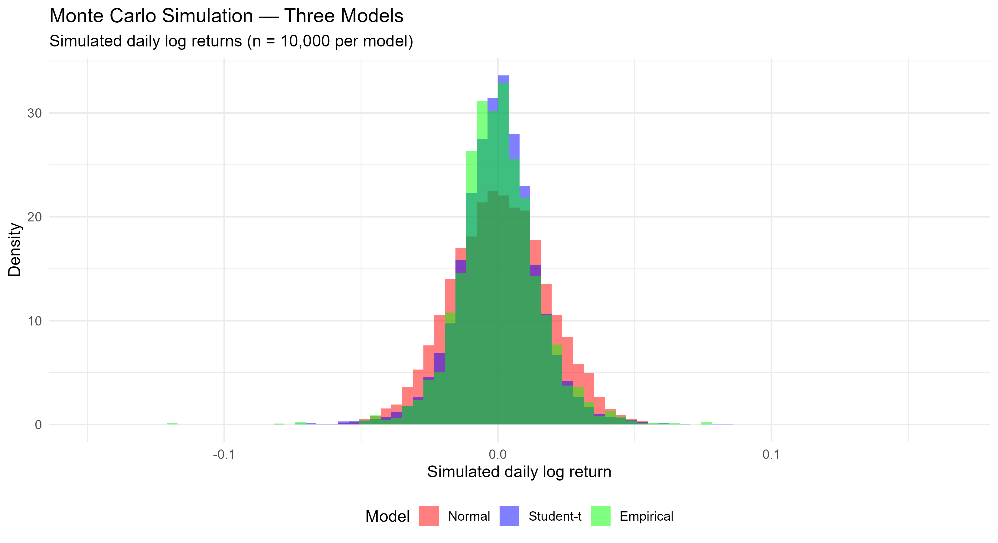
10) Prediction
Prediction artifacts are simulation-based (not price-forecast models).
Normal MC: SD=1.51%, P1=-3.58%, loss prob=0.4975.
Student-t MC: SD=1.47%, P1=-3.72%, loss prob=0.4929.
Empirical resampling: P1=-3.75%, loss prob=0.4997.

Slide 11
11) Comparing the model
Normal: AIC -8245.63, BIC -8235.02, KS p=0.
Student-t: AIC -8404.99, BIC -8389.09, KS p=0.8035.
Student-t df estimate: 4.747 (heavier tails than Normal).
Interpretation: Student-t fits observed tail behavior better on this dataset.
Why compare these two? Normal is the light-tailed benchmark; Student-t captures excess kurtosis common in returns.

Slide 12
12) Gain curve plot
Not applicable for this repository's return-distribution workflow.
Gain/lift curves require ranked classification with a binary target.
Here, outputs model continuous financial returns, volatility, and tail quantiles (VaR), not class probabilities.

Slide 13
13) Conclusion
Dataset: five stocks, 1485 daily returns each; representative ticker: TCS.
CLT check at n=100: empirical/theoretical SE ratio = 0.999.
Heavy tails matter: Student-t improves fit versus Normal on TCS tail behavior.
Why no z-test: population variance is unknown; returns are heavy-tailed/dependent, so known-variance mean-z testing is not appropriate.
Repository uses t-test (R/09) and distribution/robust risk analyses instead.

Slide 14
Sources used in this deck
Scripts: R/03_data_cleaning.R, R/07_distribution_fitting.R, R/09_hypothesis_testing.R, R/14_var_analysis.R
Tables: output/tables/cleaning_summary.csv, 5stock_descriptive_stats.csv, model_comparison_summary.csv,
goodness_of_fit_summary.csv, monte_carlo_summary.csv, clt_summary.csv, correlation_matrix.csv, t_fit_params.csv
Figures: output/figures/historical_prices.png, extreme_return_plot.png, qq_plots_combined.png,
correlation_heatmap.png, monte_carlo_simulation.png

