Slide 1
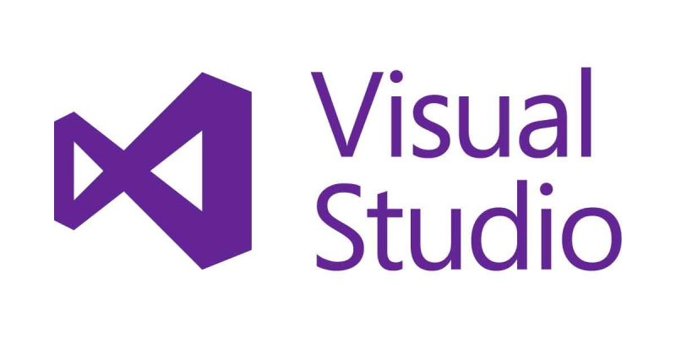
Features of Visual Studio

Slide 2
What is Visual Studio(VS)?
It’s an Integrated Development Environment(IDE) from Microsoft which is used to develop computer programs as well as websites, web apps, android apps, etc.
VS provides supports the user with 36 different programming languages and allows the code editor and debugger to support nearly any language, provided its speciservices exist.
The community edition of VS is free and the slogan is, “Free, fully-featured IDE for students, open-source and individual developers”.

Slide 3
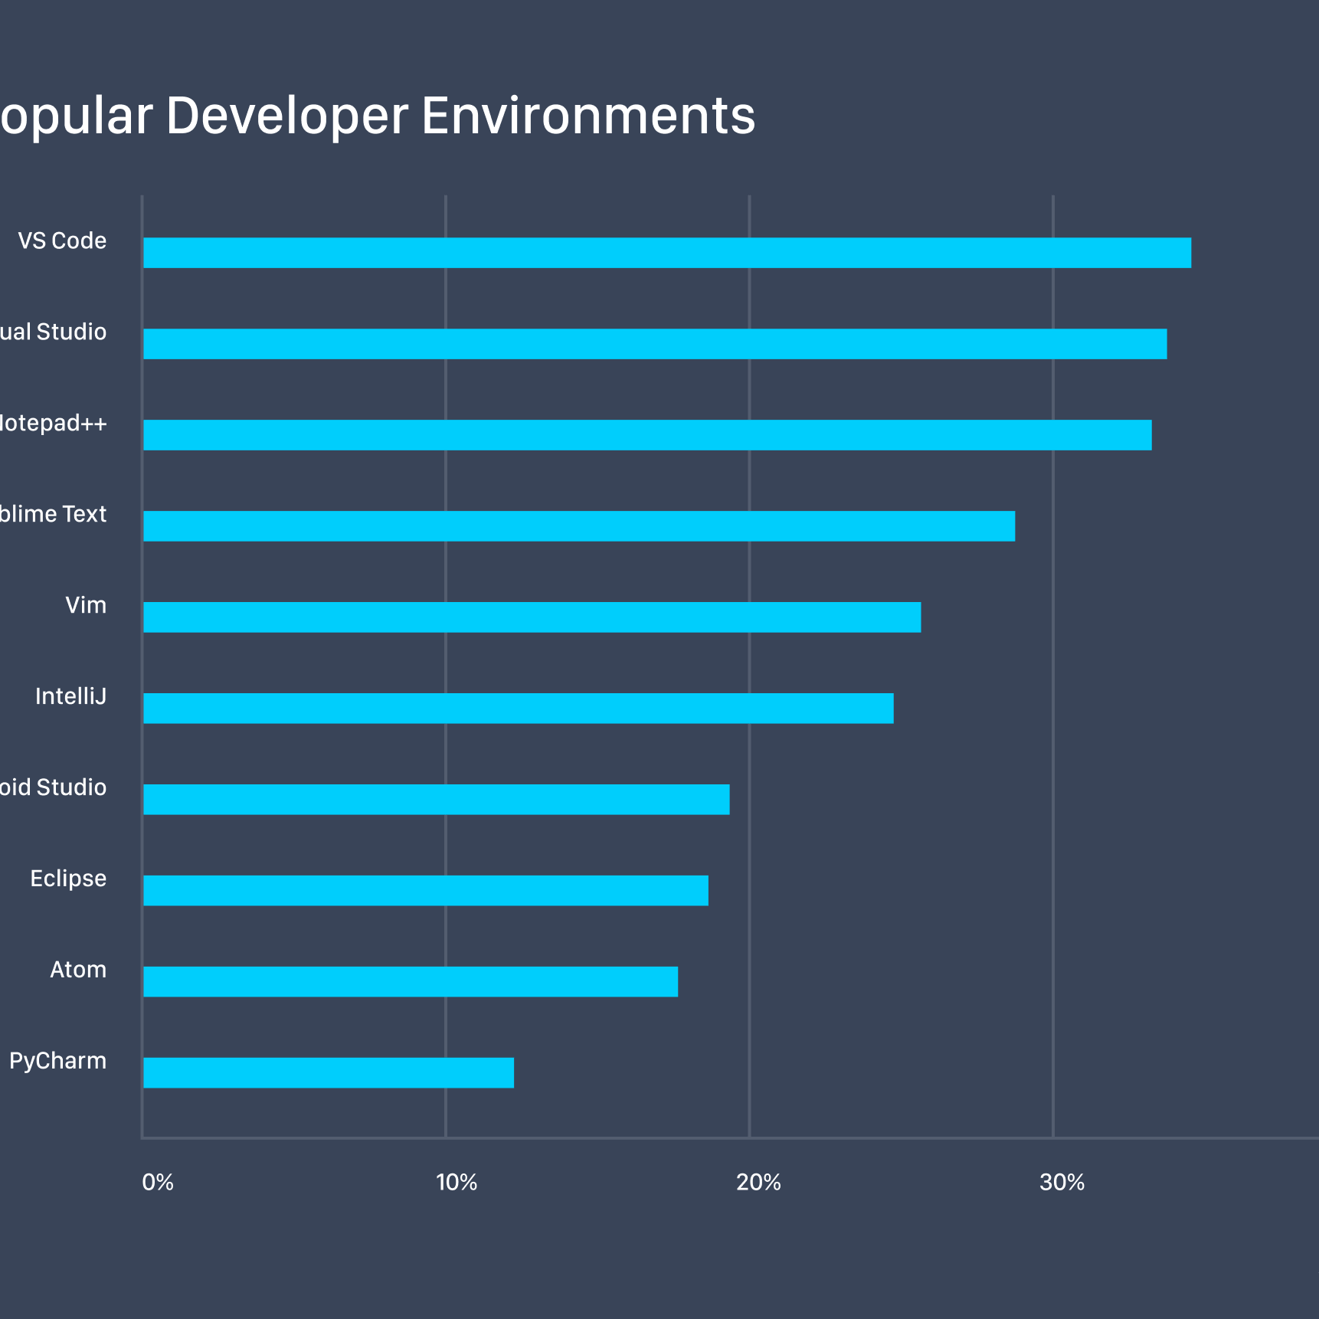
Popularity of VS
With so many options available, many of them free and open source, it’s an incredible competitive product space. However, VS and VS Code have rapidly grown their user base and upended the code editor status quo.

Slide 4
Improvements in VS
Improved search, formerly known as Quick Launch.
Refactoring and IntelliCode.
Code cleanup.
Collaborate.
VS Live Share.
Git-first start window.
Search feature while Debugging.

Slide 5
1. AI-assisted IntelliCode
IntelliCode is a set of AI-assisted capabilities that improve developer productivity, with features like contextual IntelliSense, code formatting and style rule inference.
IntelliSense trains itself across more than 2000 open-source projects on GitHub- each with over 100 stars, to generate its recommendations.

Slide 6
2. CodeLens
This feature was only available in VS professional until now but will be added in the next edition.
CodeLens shows the number of references a type or method has in a given code.
It makes key information easier to find, while keeping you in the source code.

Slide 7
3. Collaborate and Live Share
Live share enables you to share code context and debugging process with your “codemates” and get live access.
Using these features, your codemate may be able to read, edit, debug, and navigate the developing project securely in a natural way.

Slide 8
Advantages
It’s free of cost.
Excellent debugger.
Includes built-in support for other languages.
Performance tracking.
IntelliSense and refactoring.
Disadvantages
Huge memory footprint.
Long startup time.
Cost for extra features is high.
Unintuitive interface.
Slow handling of bigger projects.

Slide 9
Thank you

