Slide 1
Battle of Cities
Finding suitable City for relocation

Slide 2
Problem Statement
The culture, language and cuisine significantly varies across India. Employees in India hop jobs and move across cities very frequently. The major problem people face in doing so is to find a neighborhood which is similar to what they were used to. If someone has an option to chose among cities to move, it is important to identify which city would provide more favorable locality.

Slide 3
Data

Slide 4
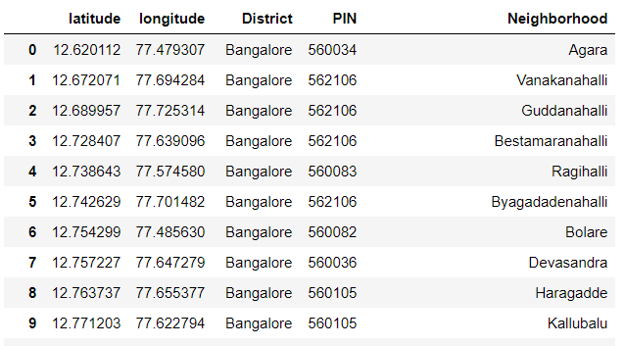
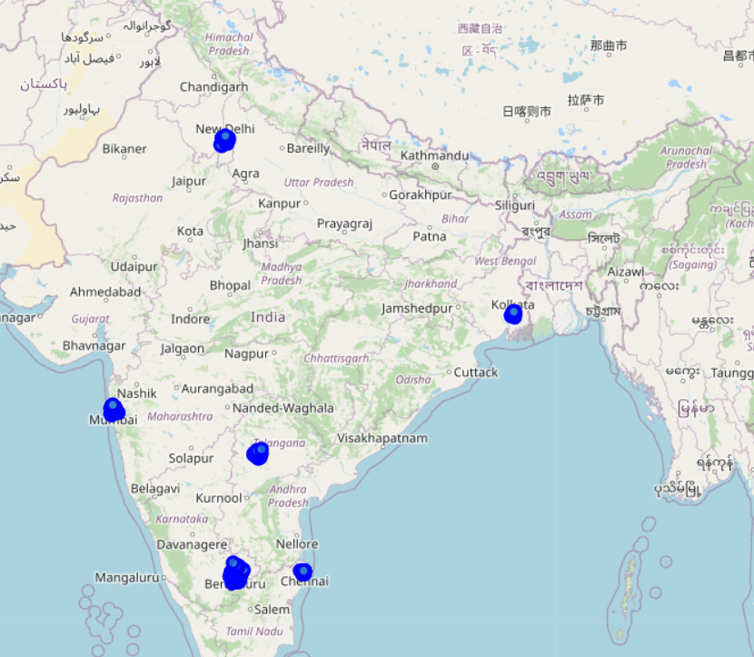
Major cities
Delhi
Mumbai
Kolkata
Hyderabad
Sample neighborhood data for major cities
Bangalore
Chennai

Slide 5
Clustering

Slide 6
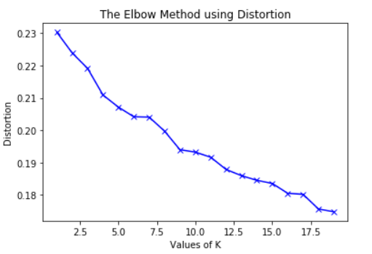
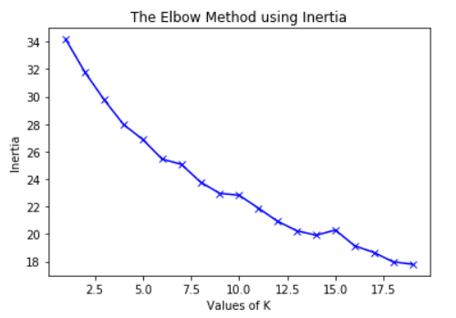
Optimal number of clusters
Distortion method
Inertia method
K value of 10 and 15 appear to suggest slight elbow

Slide 7
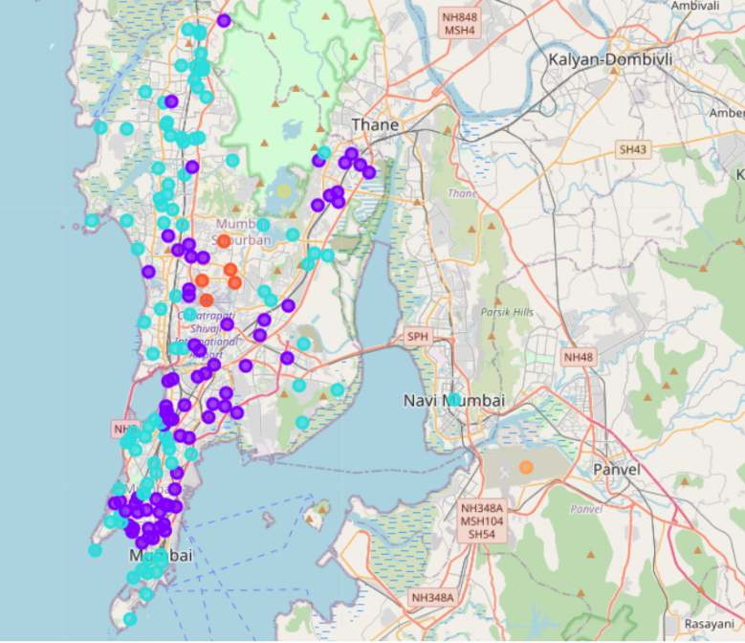
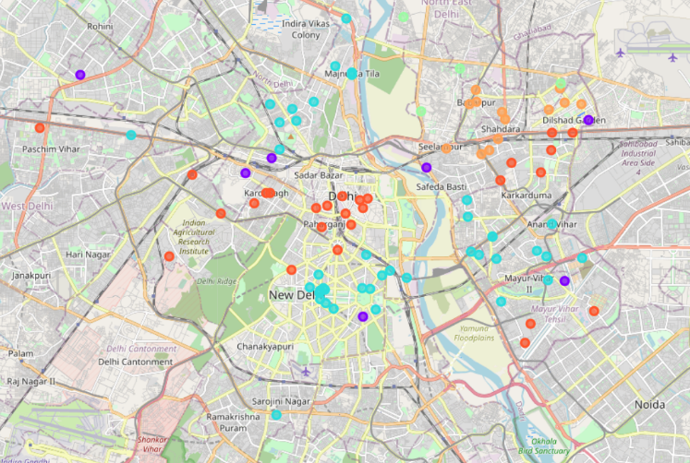
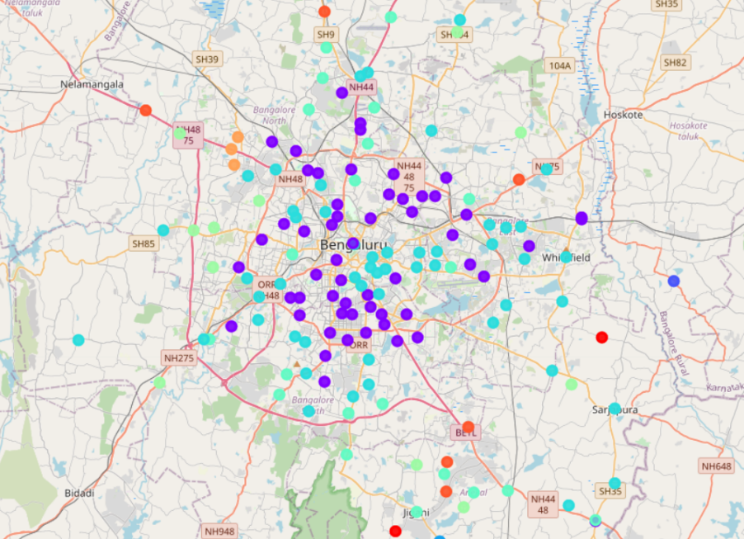
Major cities
Delhi
Mumbai
Bangalore
Observation: Cluster 1 (purple) is not a major in Delhi

Slide 8
Results & Conclusion

Slide 9
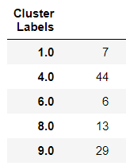
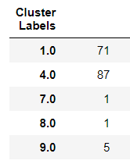
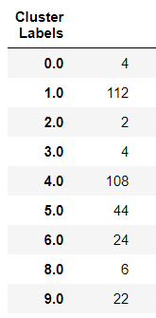
Case study
Delhi
Mumbai
Bangalore
To conclude the results from this study, consider a case where a person from Bangalore has to move to either Delhi or Mumbai. He/She can select a favorable location based on the cluster that he/she is currently located. If the current cluster is 4, either both Delhi and Mumbai seems favorable, but, if current cluster is 1, Mumbai would be the preferred option.

Slide 10
Thank you

