Slide 1
foody
a cooking assistant

Slide 2
What is foody?
Foody is an voice assistant which gives
you voice-by-voice guidance to cook your favourite menu!

Slide 3

The ‘backstage’ of foody
1
PyCharm
Python
2
tkinter
PIL, ImageTk
3
pygame
time
threading
gTTS

Slide 4
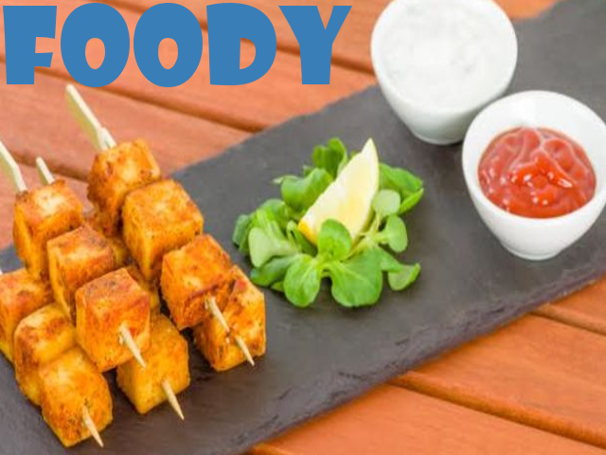
Select the Recipe!
And you’re done!!
EXPERIENCE HANDS FREE!!

Slide 5
Why foody bruh?
Foody gives you voice-by-voice guidance
to cook your favourite menu which gives you a hassle free experience
so that you have a pleasant time at your dining table!

Slide 6
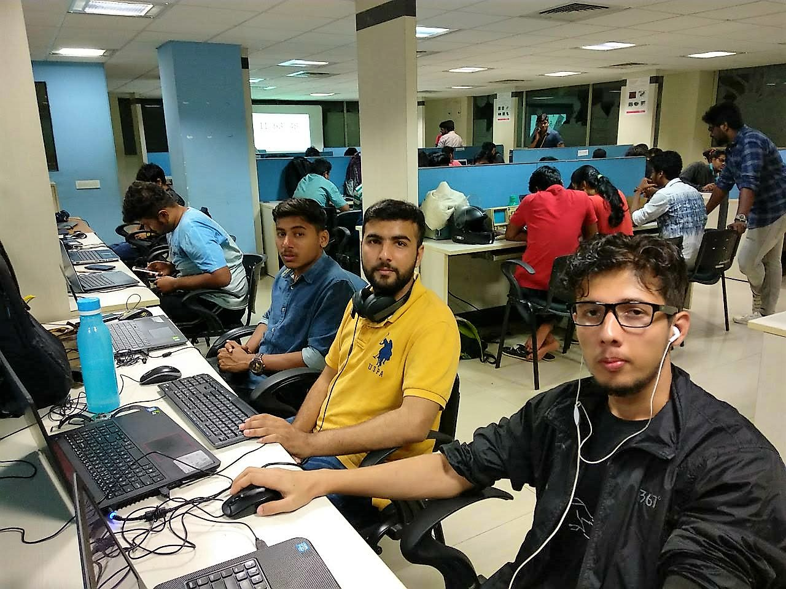
THANK YOU
.
ERROR 404

