Slide 1
AWS
Cloud Computing

Slide 2
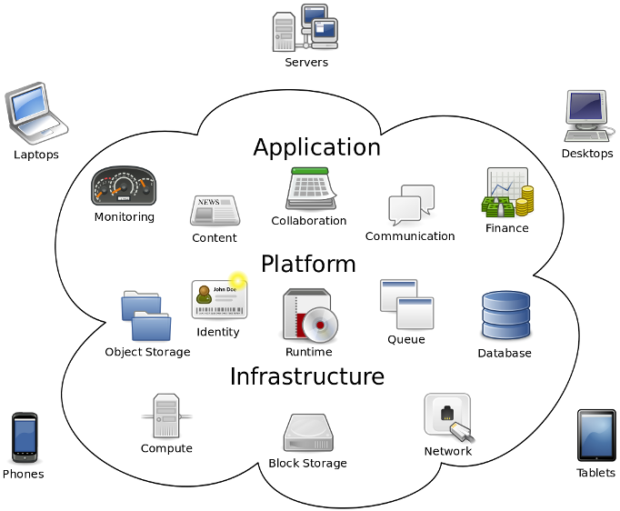
What is Cloud Computing?
–Internet-based computing in which large groups of remote servers are networked so as to allow sharing of data-processing tasks, centralized data storage, and online access to computer services or resources.
–Any computer related task that is done entirely on the Internet

Slide 3
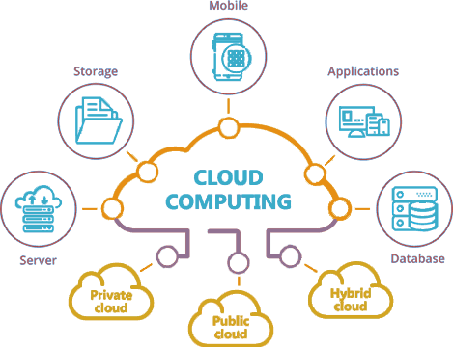
What is Cloud Computing?
Allows users to deal with the software without having the hardware.
Everything is done by remote, nothing is saved locally.

Slide 4
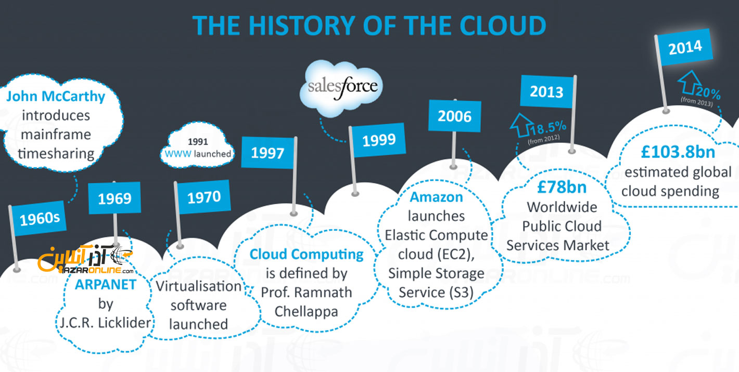
History
50's & 60's: theorized that the world would have cloud computing
90's: start of VPNs and efficient infrastructure
00's: Amazon builds efficient servers/ AWS

Slide 5
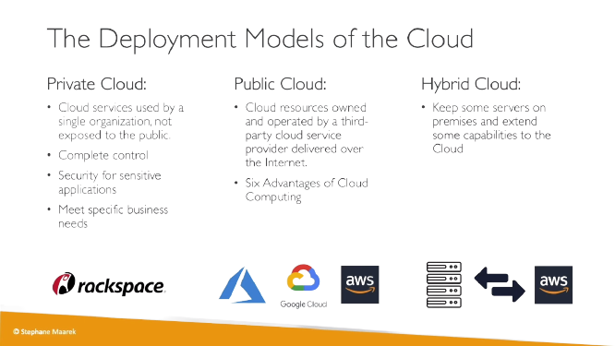

Slide 6
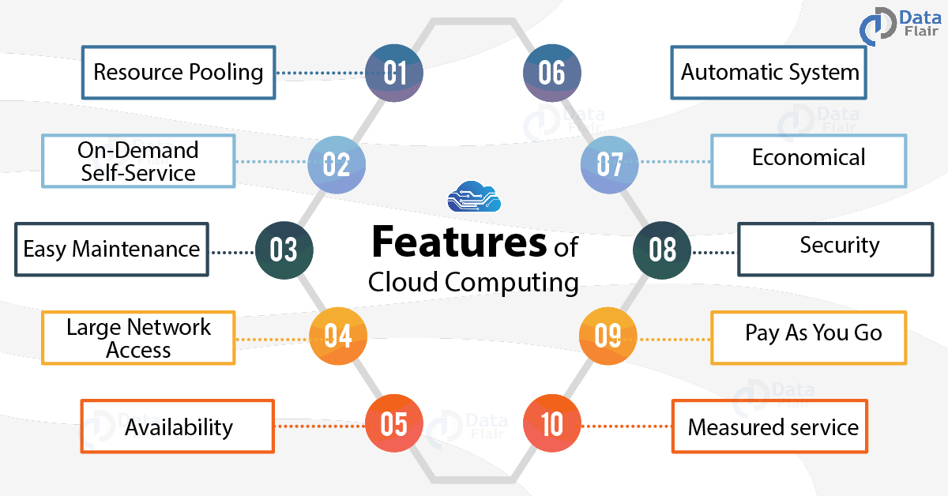

Slide 7
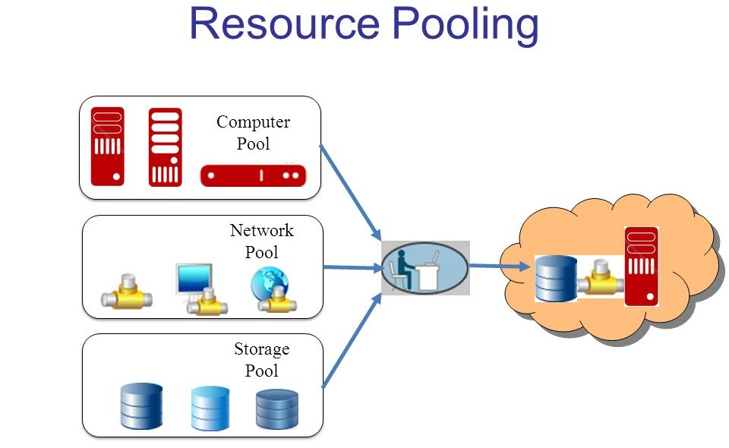
Features of Cloud Computing – 10 Major Characteristics of Cloud Computing
1. Resources Pooling
2. On-Demand Self-Service
3.Easy Maintenance
4. Large Network Access
5. Availability
6. Automatic System
7. Economical
8. Security
9. Pay as you go
10. Measured Service
1. Resources Pooling
It means that the Cloud provider pulled the computing resources to provide services to multiple customers with the help of a multi-tenant model. There are different physical and virtual resources assigned and reassigned which depends on the demand of the customer. The customer generally has no control or information over the location of the provided resources but is able to specify location at a higher level of abstraction.
2. On-Demand Self-Service
It is one of the important and valuable features of Cloud Computing as the user can continuously monitor the server uptime, capabilities, and allotted network storage. With this feature, the user can also monitor the computing capabilities.

Slide 8

Features of Cloud Computing – 10 Major Characteristics of Cloud Computing
1. Resources Pooling
2. On-Demand Self-Service
3.Easy Maintenance
4. Large Network Access
5. Availability
6. Automatic System
7. Economical
8. Security
9. Pay as you go
10. Measured Service
3. Easy Maintenance
The servers are easily maintained and the downtime is very low and even in some cases, there is no downtime. Cloud Computing comes up with an update every time by gradually making it better. The updates are more compatible with the devices and perform faster than older ones along with the bugs which are fixed.
4. Large Network Access
The user can access the data of the cloud or upload the data to the cloud from anywhere just with the help of a device and an internet connection. These capabilities are available all over the network and accessed with the help of internet.

Slide 9
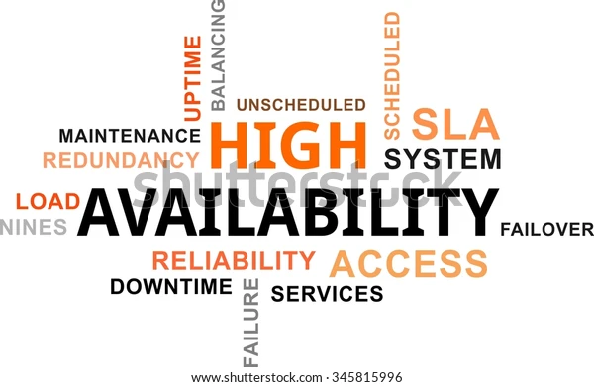
Features of Cloud Computing – 10 Major Characteristics of Cloud Computing
1. Resources Pooling
2. On-Demand Self-Service
3.Easy Maintenance
4. Large Network Access
5. Availability
6. Automatic System
7. Economical
8. Security
9. Pay as you go
10. Measured Service
5. Availability
The capabilities of the Cloud can be modified as per the use and can be extended a lot. It analyzes the storage usage and allows the user to buy extra Cloud storage if needed for a very small amount.
6. Automatic System
Cloud computing automatically analyzes the data needed and supports a metering capability at some level of services. We can monitor, control, and report the usage. It will provide transparency for the host as well as the customer.

Slide 10
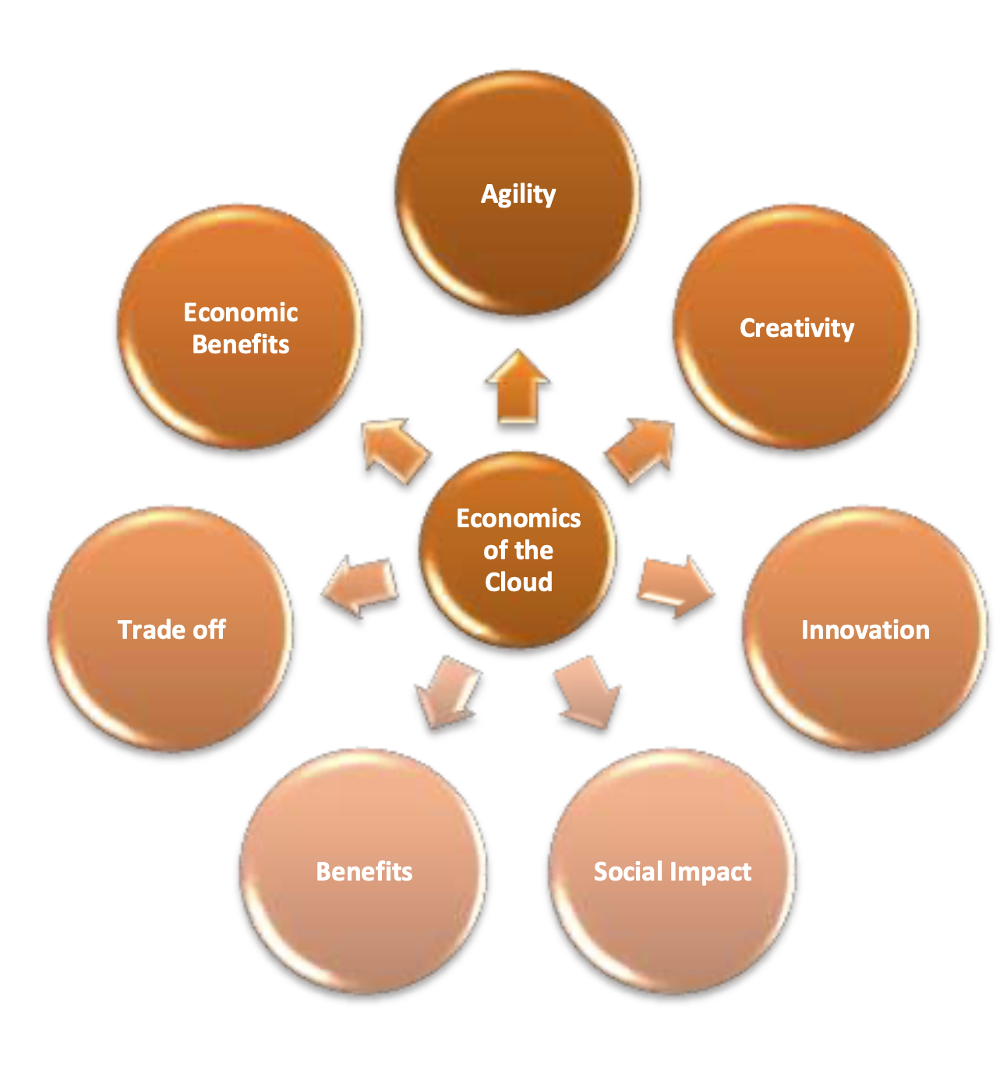
Features of Cloud Computing – 10 Major Characteristics of Cloud Computing
1. Resources Pooling
2. On-Demand Self-Service
3.Easy Maintenance
4. Large Network Access
5. Availability
6. Automatic System
7. Economical
8. Security
9. Pay as you go
10. Measured Service
7. Economical
It is the one-time investment as the company (host) has to buy the storage and a small part of it can be provided to the many companies which save the host from monthly or yearly costs. Only the amount which is spent is on the basic maintenance and a few more expenses which are very less.
8. Security
Cloud Security, is one of the best features of cloud computing. It creates a snapshot of the data stored so that the data may not get lost even if one of the servers gets damaged. The data is stored within the storage devices, which cannot be hacked and utilized by any other person. The storage service is quick and reliable.

Slide 11
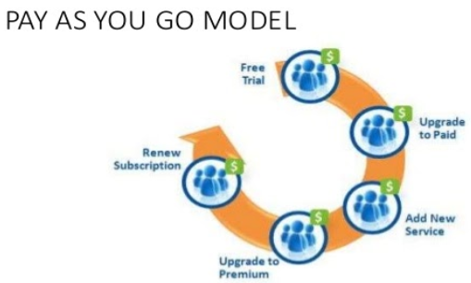
Features of Cloud Computing – 10 Major Characteristics of Cloud Computing
1. Resources Pooling
2. On-Demand Self-Service
3.Easy Maintenance
4. Large Network Access
5. Availability
6. Automatic System
7. Economical
8. Security
9. Pay as you go
10. Measured Service
9. Pay as you go
In cloud computing, the user has to pay only for the service or the space they have utilized. There is no hidden or extra charge which is to be paid. The service is economical and most of the time some space is allotted for free.
10. Measured Service
Cloud Computing resources used to monitor and the company uses it for recording. This resource utilization is analyzed by supporting charge-per-use capabilities. This means that the resource usages which can be either virtual server instances that are running in the cloud are getting monitored measured and reported by the service provider. The model pay as you go is variable based on actual consumption of the manufacturing organization.

Slide 12
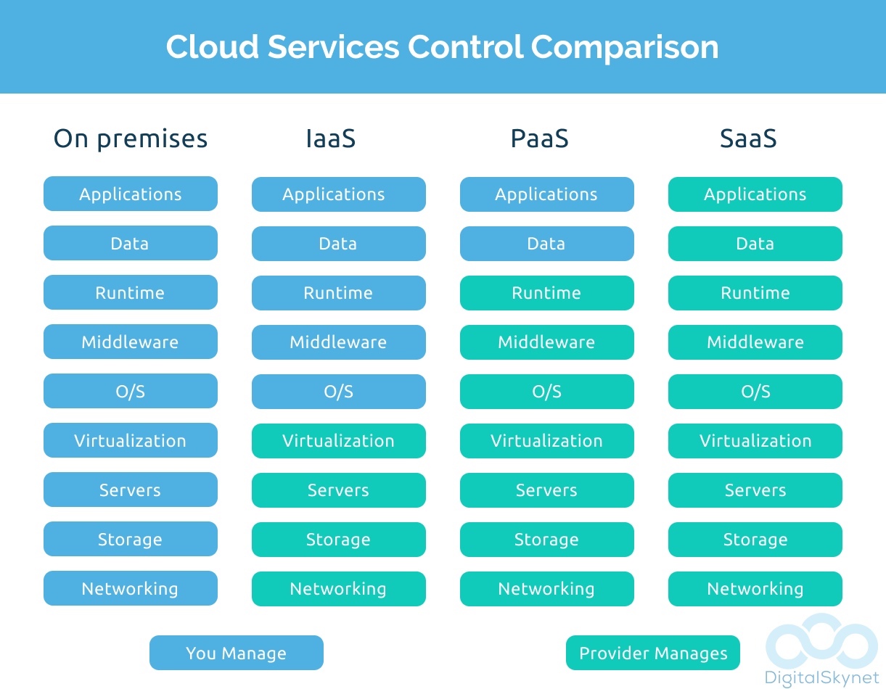
Service Models
Infrastructure as a Service (IaaS)
Infrastructure as a Service (IaaS) contains the basic building blocks for cloud IT and typically provides access to networking features, computers (virtual or on dedicated hardware), and data storage space. IaaS provides you with the highest level of flexibility and management control over your IT resources and is most similar to existing IT resources that many IT departments and developers are familiar with today.
Platform as a Service (PaaS)
Platform as a Service (PaaS) removes the need for your organization to manage the underlying infrastructure (usually hardware and operating systems) and allows you to focus on the deployment and management of your applications. This helps you be more efficient as you don’t need to worry about resource procurement, capacity planning, software maintenance, patching, or any of the other undifferentiated heavy lifting involved in running your application.
Software as a Service (SaaS)
Software as a Service (SaaS) provides you with a completed product that is run and managed by the service provider. In most cases, people referring to Software as a Service are referring to end-user applications. With a SaaS offering you do not have to think about how the service is maintained or how the underlying infrastructure is managed; you only need to think about how you will use that particular piece of software. A common example of a SaaS application is web-based email which you can use to send and receive email without having to manage feature additions to the email product or maintain the servers and operating systems that the email program is running on.

Slide 13
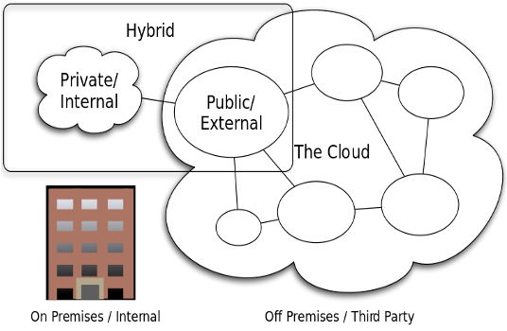
Deployment Models
Cloud
A cloud-based application is fully deployed in the cloud and all parts of the application run in the cloud. Applications in the cloud have either been created in the cloud or have been migrated from an existing infrastructure to take advantage of the benefits of cloud computing. Cloud-based applications can be built on low-level infrastructure pieces or can use higher level services that provide abstraction from the management, architecting, and scaling requirements of core infrastructure.
Hybrid
A hybrid deployment is a way to connect infrastructure and applications between cloud-based resources and existing resources that are not located in the cloud. The most common method of hybrid deployment is between the cloud and existing on-premises infrastructure to extend, and grow, an organization's infrastructure into the cloud while connecting cloud resources to the internal system. For more information on how AWS can help you with your hybrid deployment, visit our Hybrid Cloud with AWS page.
On-premises
The deployment of resources on-premises, using virtualization and resource management tools, is sometimes called the “private cloud.” On-premises deployment doesn’t provide many of the benefits of cloud computing but is sometimes sought for its ability to provide dedicated resources. In most cases this deployment model is the same as legacy IT infrastructure while using application management and virtualization technologies to try and increase resource utilization. For more information on how AWS can help, see Use case: Cloud services on-premises.

Slide 14
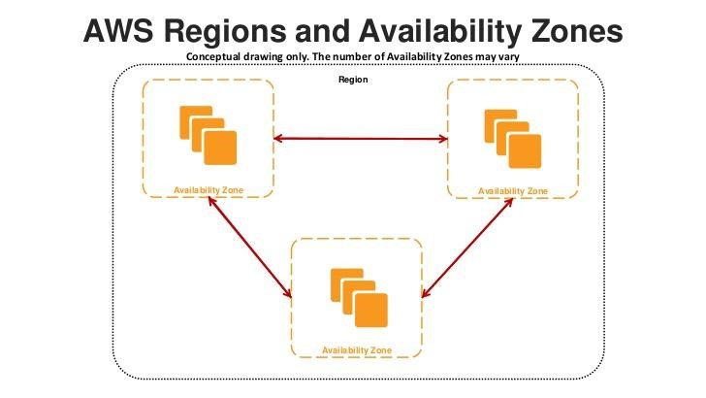
AWS Common Services Fast Overview
The AWS Cloud infrastructure is built around AWS Regions and Availability Zones. An AWS Region is a physical location in the world where we have multiple Availability Zones. Availability Zones consist of one or more discrete data centers, each with redundant power, networking, and connectivity, housed in separate facilities. These Availability Zones offer you the ability to operate production applications and databases that are more highly available, fault tolerant, and scalable than would be possible from a single data center. The AWS Cloud operates in 80 Availability Zones within 25 geographic Regions around the world, with announced plans for more Availability Zones and Regions. For more information on the AWS Cloud Availability Zones and AWS Regions, see AWS Global Infrastructure.
Each Amazon Region is designed to be completely isolated from the other Amazon Regions. This achieves the greatest possible fault tolerance and stability. Each Availability Zone is isolated, but the Availability Zones in a Region are connected through low-latency links. AWS provides you with the flexibility to place instances and store data within multiple geographic regions as well as across multiple Availability Zones within each AWS Region. Each Availability Zone is designed as an independent failure zone. This means that Availability Zones are physically separated within a typical metropolitan region and are located in lower risk flood plains (specific flood zone categorization varies by AWS Region). In addition to discrete uninterruptible power supply (UPS) and onsite backup generation facilities, data centers located in different Availability Zones are designed to be supplied by independent substations to reduce the risk of an event on the power grid impacting more than one Availability Zone. Availability Zones are all redundantly connected to multiple tier-1 transit providers.

Slide 15
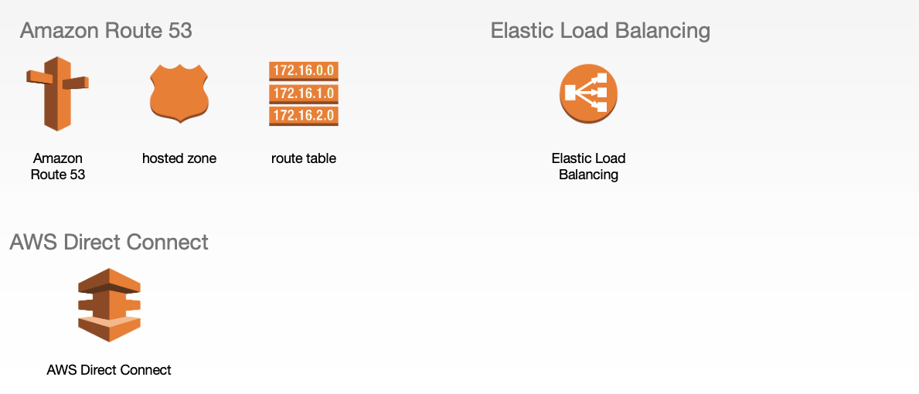
AWS Common Services Fast Overview
Amazon Route 53 is a highly available and scalable cloud Domain Name System (DNS) web service. It is designed to give developers and businesses an extremely reliable and cost-effective way to route end. Users to Internet applications by translating human readable names, such as www.example.com, into the numeric IP addresses, such as 192.0.2.1, that computers use to connect to each other. Amazon Route 53 is fully compliant with IPv6 as well. Amazon Route 53 effectively connects user requests to infrastructure running in AWS—such as EC2 instances, Elastic Load Balancing load balancers, or Amazon S3 buckets—and can also be used to route users to infrastructure outside of AWS. You can use Amazon Route 53 to configure DNS health checks to route traffic to healthy endpoints or to independently monitor the health of your application and its endpoints. Amazon Route 53 traffic flow makes it easy for you to manage traffic globally through a variety of routing types, including latency-based routing, Geo DNS, and weighted round robin—all of which can be combined with DNS Failover in order to enable a variety of low-latency, fault-tolerant architectures. Using Amazon Route 53 traffic flow’s simple visual editor, you can easily manage how your end users are routed to your application’s endpoints—whether in a single AWS Region or distributed around the globe. Amazon Route 53 also offers Domain Name Registration—you can purchase and manage domain names such as example.com and Amazon Route 53 will automatically configure DNS settings for your domains.

Slide 16
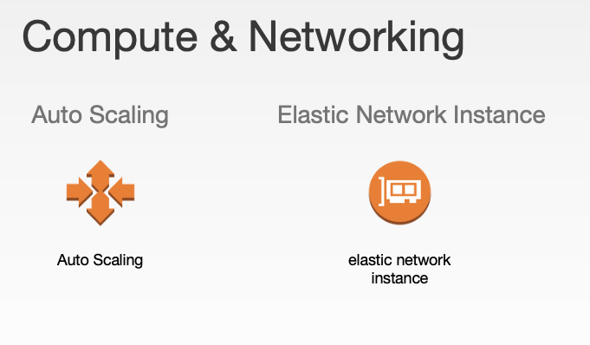
AWS Common Services Fast Overview
Amazon EC2 Auto Scaling helps you maintain application availability and allows you to automatically add or remove EC2 instances according to conditions you define. You can use the fleet management features of Amazon EC2 Auto Scaling to maintain the health and availability of your fleet. You can also use the dynamic and predictive scaling features of Amazon EC2 Auto Scaling to add or remove EC2 instances. Dynamic scaling responds to changing demand and predictive scaling automatically schedules the right number of EC2 instances based on predicted demand. Dynamic scaling and predictive scaling can be used together to scale faster.

