Slide 1

bdg.am

Slide 2

ANSIBLE ADVANCED

Slide 3
1
Agenda and Objectives
Agenda
Understanding Idempotency in Ansible.
Using Ansible Roles for Scalable Playbooks.
Advanced Playbook Concepts: Loops, Handlers, and Conditionals.
Ansible Vault: Securely Managing Secrets.
Hands-on: Creating an Ansible Role and Securing Playbooks.
Objectives
Understand idempotency and why it is crucial in automation.
Learn how to structure large-scale Ansible projects with roles.
Explore advanced playbook features like loops, handlers, and conditionals.
Secure sensitive data using Ansible Vault.

Slide 4
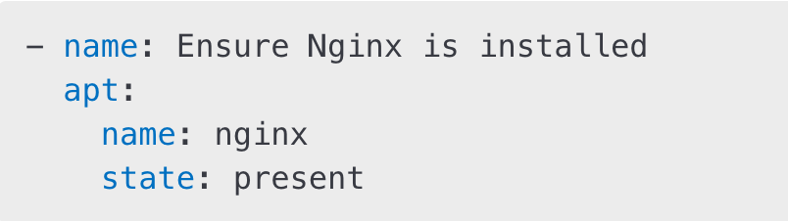
2
Idempotency in Ansible
What is Idempotency?
Idempotency ensures that running an Ansible playbook multiple times results in the same state without unintended changes.
Ansible modules are idempotent by design, meaning they check the current state before making changes.
Example of an idempotent task:
If Nginx is already installed, Ansible does nothing.
Why Idempotency Matters
Prevents accidental changes or repeated modifications.
Ensures consistency across multiple executions.
Makes automation reliable and predictable.

Slide 5
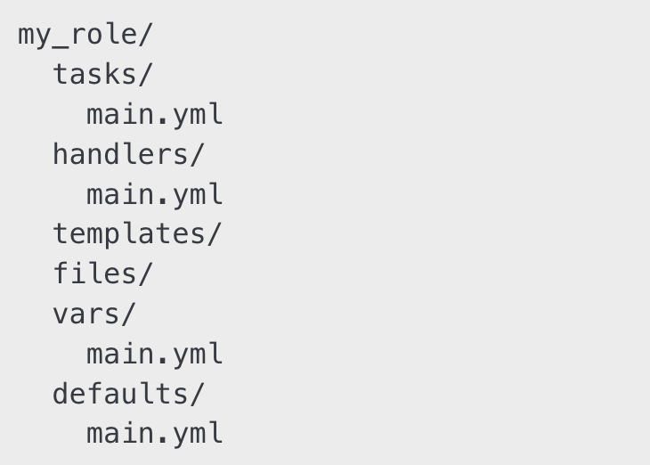

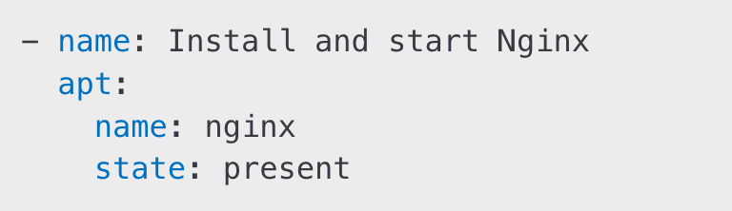
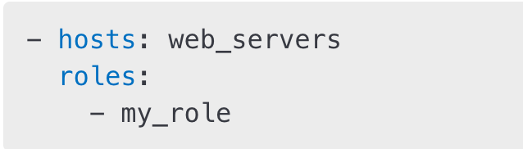
3
Ansible Roles
A role is a structured way to group Ansible configurations.
Encourages modular and reusable playbooks.
Example folder structure for a role:
Creating and Using an Ansible Role
Example main.yml inside tasks/ :
Using the role in a playbook:

Slide 6
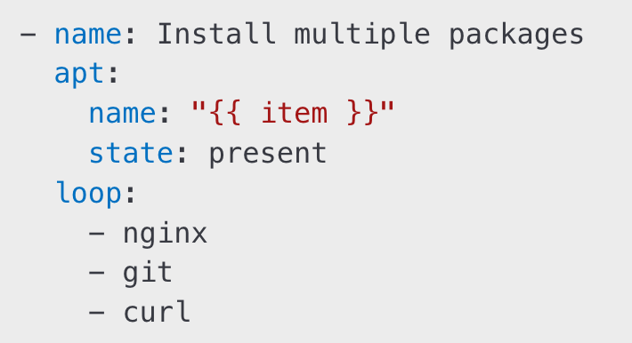
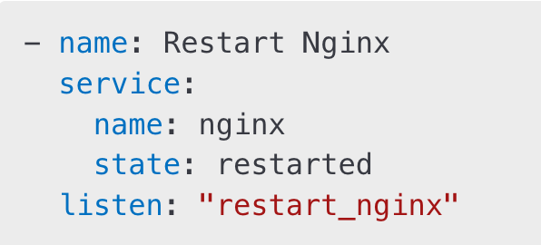
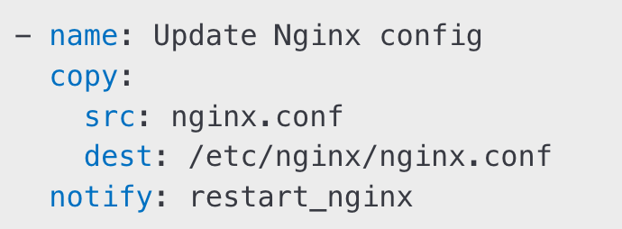
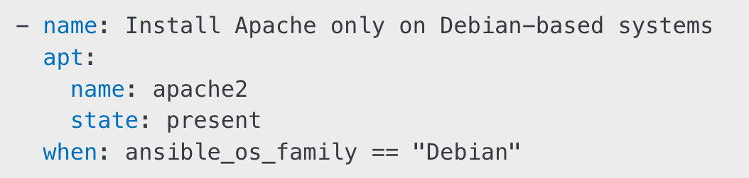
4
Playbooks Advanced
Loops in Ansible
Handlers: Event-Driven Tasks
Handlers only execute when notified:
Notifying a handler:
Conditionals in Ansible

Slide 7


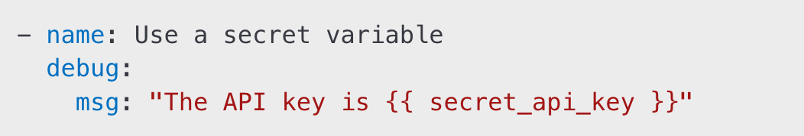
5
Ansible Vault
Why Use Ansible Vault?
Encrypts sensitive information like passwords, API keys, and certificates.
Protects data while keeping it in source control.
Creating an Encrypted File
Editing an Encrypted File
Using Vault Variables in Playbooks
Running a Playbook with Vault

Slide 8
6
Hands-On Activities
Create and Use an Ansible Role:
Generate a role structure with ansible-galaxy init.
Implement tasks and use the role in a playbook.
Work with Handlers and Conditionals:
Write a playbook that restarts a service only when a file changes.
Apply conditionals to execute tasks only on specific operating systems.
Secure Sensitive Data with Ansible Vault:
Encrypt a credentials file.
Use the encrypted variables inside a playbook.

Slide 9
7
Homework
Expand an Ansible Role:
Add multiple handlers and conditionals.
Modify an existing role to make it more reusable.
Automate Secure Configurations:
Create a secure Ansible playbook using Ansible Vault.
Encrypt and retrieve secrets dynamically.
Experiment with Loops and Advanced Variables:
Write a playbook using loops and registered variables.
Implement nested loops for more complex scenarios.

Slide 10


