Slide 1
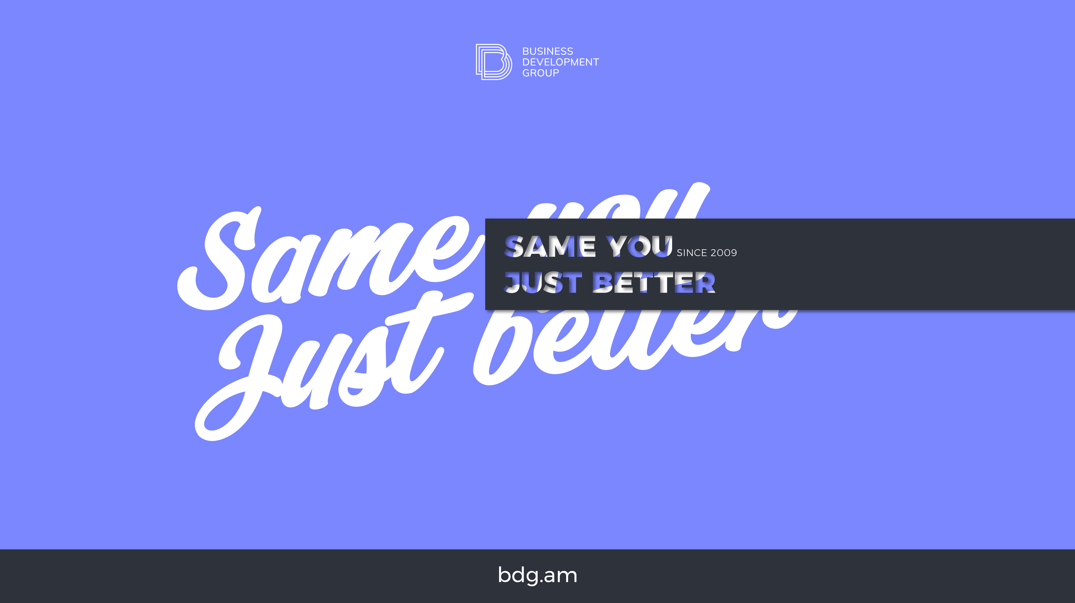
bdg.am

Slide 2

AWS
ELASTIC CONTAINER SERVICE

Slide 3
1
Agenda and Objectives
Agenda
Introduction to AWS ECS (Elastic Container Service).
ECS Architecture and Components.
Comparison: EC2 vs. Fargate Launch Types.
Deploying a Containerized Application with ECS.
Hands-on: Running a Service on ECS.
Objectives
Understand the purpose and benefits of AWS ECS.
Learn how ECS manages containerized workloads.
Deploy and manage an application using ECS.

Slide 4
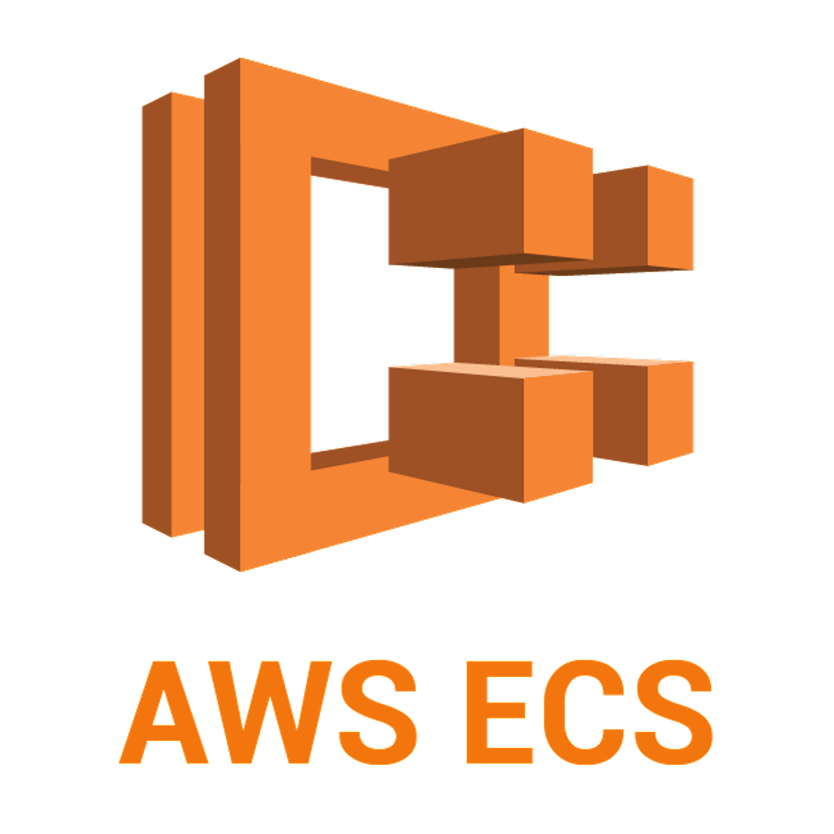
2
Introduction to AWS ECS
What is AWS ECS?
Fully managed container orchestration service that runs Docker containers on AWS.
Supports both EC2 instances and serverless (Fargate) execution models.
Integrates with other AWS services like IAM, ALB, VPC, CloudWatch for security, networking, and monitoring.
Why Use AWS ECS?
Eliminates the need to manage Kubernetes clusters.
Scales seamlessly with workload demands.
Deep integration with AWS ecosystem (IAM, ECR, CloudWatch, etc.).
Supports both EC2 and Fargate, providing flexibility.

Slide 5
3
ECS Architecture and Components
Key Components of ECS
Clusters:
Logical grouping of ECS resources.
Can be backed by EC2 instances or Fargate.
Tasks & Task Definitions:
Define how containers should run in ECS.
Contains container image, CPU/memory settings, networking, and logging configurations.
Services:
Maintain the desired count of tasks.
Can be integrated with an Elastic Load Balancer (ALB, NLB) for traffic distribution.
Container Agent:
Runs on EC2 instances and communicates with ECS Control Plane.
ECS vs. Kubernetes (EKS)
Feature | ECS | EKS (Kubernetes)
Ease of Use | Simple, Fully Managed | Setup Complexity
Control | AWS-managed | User-managed Clusters
Scaling | Automatic Scaling | Requires Configuration
Integration | Deep AWS Integration | Works across Cloud Providers

Slide 6
4
ECS Launch Types EC2 vs Fargate
EC2 Launch Type
Runs containers on EC2 instances within an ECS cluster.
Requires users to manage EC2 instances, scaling, and networking.
Best suited for customizable environments and predictable workloads.
Fargate Launch Type (Serverless Containers)
Eliminates the need to manage EC2 instances.
AWS automatically provisions and scales compute resources.
Ideal for serverless architectures and microservices.
Comparison Table
Feature | EC2 | Fargate
Instance Management | User-managed | AWS-managed
Scaling | Manual or Auto-Scaling | Fully Managed
Cost | Pay per Instance | Pay per Task
Use Case | Persistent Workloads | Serverless/Microservices

Slide 7
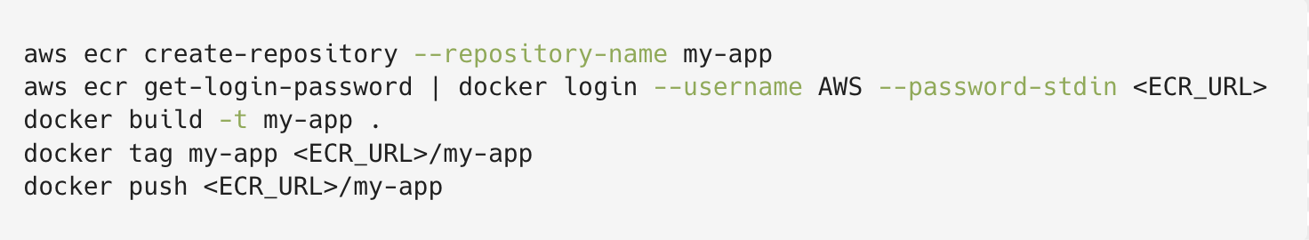
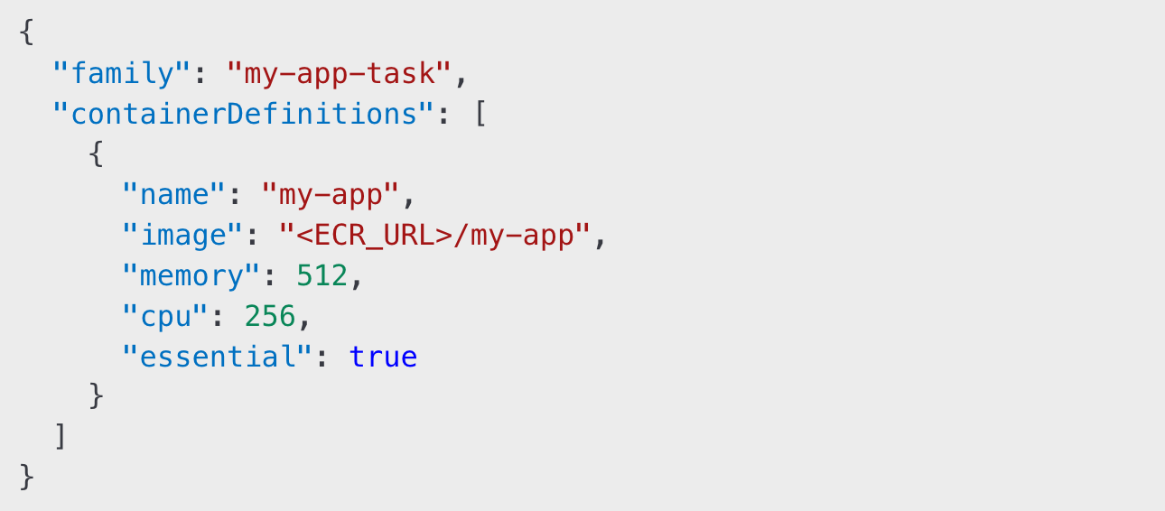
5
Deploying a Containerized App to ECS
Prerequisites
Amazon Elastic Container Registry (ECR):
Stores Docker images for use in ECS.
Push an image to ECR:
Creating an ECS Cluster:
Navigate to ECS Dashboard → Create Cluster.
Choose Fargate or EC2 launch type.
Defining a Task in ECS:
Create a Task Definition specifying container settings (CPU, memory, ports).
Example Task Definition:
Creating an ECS Service:
Deploys and maintains a desired count of tasks.
Can integrate with ALB (Application Load Balancer).
Ensures high availability and auto-scaling.

Slide 8
6
Hands-On Activities
Set Up an ECS Cluster:
Create an ECS cluster using AWS Console.
Choose EC2 or Fargate launch type.
Deploy a Containerized App:
Build and push a Docker image to ECR.
Define an ECS Task using the uploaded image.
Create an ECS Service to run and manage the task.
Scaling and Monitoring ECS Services:
Enable Auto Scaling for ECS Service.
Use CloudWatch Metrics to monitor task performance.
Scale the service manually and automatically.

Slide 9
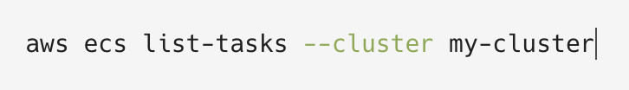

7
Homework
Deploy a Custom Application on ECS:
Choose either EC2 or Fargate.
Push an image to ECR and deploy a containerized app.
Experiment with ECS Scaling:
Configure auto-scaling for an ECS service.
Set up CloudWatch alarms to trigger scaling events.
Use the AWS CLI for ECS Management:
List running tasks:
Stop a Taks
Update a service

Slide 10


