Slide 1

bdg.am

Slide 2

AWS STORAGE:
S3 AND EBS

Slide 3
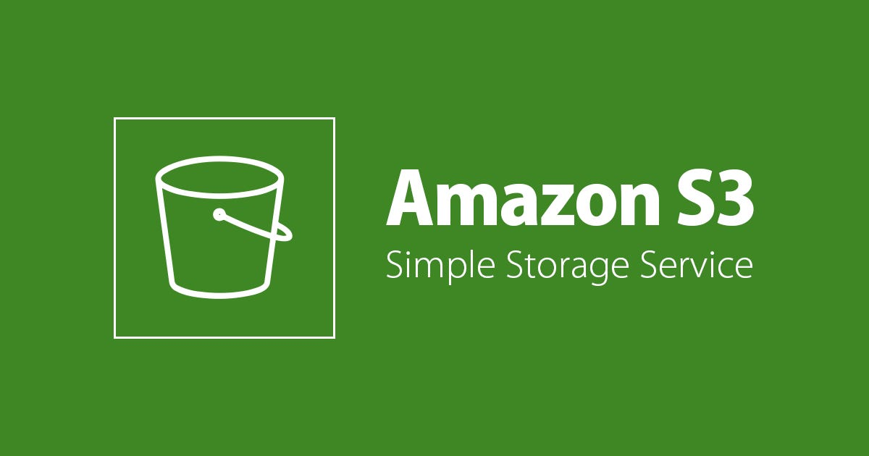


1
Agenda and Objectives
Agenda
Introduction to AWS Storage Solutions.
Understanding Amazon S3 (Simple Storage Service).
Understanding Amazon EBS (Elastic Block Store).
Hands-on: Creating and Managing S3 Buckets and EBS Volumes.
Objectives
Understand different AWS storage options and their use cases.
Learn how to store and retrieve data in S3.
Learn how to create and attach EBS volumes to EC2 instances.

Slide 4
2
Introduction to AWS Storage Solutions
Why Storage Matters in the Cloud?
Store and retrieve data efficiently at scale.
Improve performance and durability of applications.
Enable backup, disaster recovery, and cost optimization.
AWS Storage Types
Object Storage:
Amazon S3 (scalable object storage for files and backups).
Block Storage:
Amazon EBS (persistent block-level storage for EC2 instances).
File Storage:
Amazon EFS (shared file system storage for Linux instances).
Cold Storage & Archiving:
Amazon Glacier (low-cost archival storage for long-term retention).

Slide 5
3
Amazon S3
What is Amazon S3?
Scalable object storage service designed for high durability (99.999999999%).
Stores files, backups, logs, and other unstructured data.
Supports versioning, encryption, lifecycle policies, and access control.
S3 Storage Classes
Standard - General-purpose storage with high durability and availability.
Standard-IA (Infrequent Access) - Lower-cost storage for less-accessed data.
Glacier & Glacier Deep Archive - For long-term backups and archiving.
Working with S3 Buckets
Buckets: Containers for storing objects.
Objects: Files stored in buckets.
Lifecycle Policies: Automate moving objects between storage classes.

Slide 6
4
Amazon EBS
What is Amazon EBS?
Persistent block storage used for EC2 instances.
Designed for high-performance and low-latency workloads.
Volumes remain independent of the EC2 instance’s lifecycle.
EBS Volume Types
General Purpose SSD (gp3, gp2) - Balances price and performance.
Provisioned IOPS SSD (io1, io2) - High-performance for intensive workloads.
Magnetic HDD (st1, sc1) - Low-cost storage for sequential workloads.
EBS Snapshots
Create backups of EBS volumes.
Restore volumes from snapshots.

Slide 7
5
Hands-On Activities
S3 Hands-on:
Create an S3 bucket using the AWS CLI.
Upload a file to the bucket and set permissions.
Enable versioning and test object retrieval.
EBS Hands-on:
Create an EBS volume.
Attach it to an EC2 instance.
Format and mount the volume for use.
Take an EBS snapshot and restore from it.

Slide 8
6
Homework
Work with S3:
Create an S3 bucket and enable lifecycle policies.
Upload files and move them between storage classes.
Work with EBS:
Create and attach an EBS volume to your EC2 instance.
Snapshot your EBS volume and restore it.
Explore AWS CLI for Storage:
Use AWS CLI to automate S3 and EBS tasks.

Slide 9


