Slide 1

bdg.am

Slide 2


CI/CD
BASICS
bdg.am

Slide 3
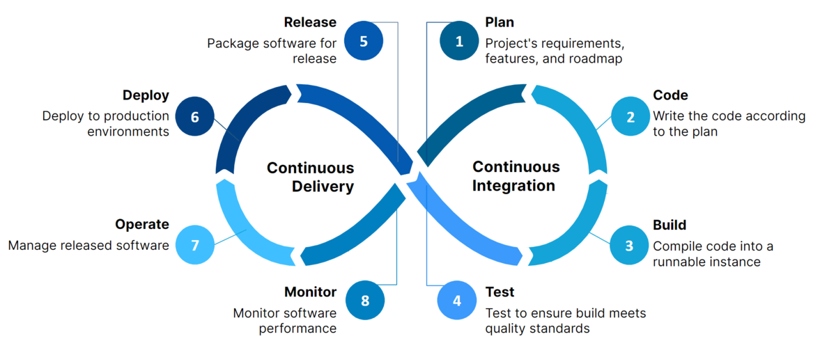
1
Agenda and Objectives
Agenda
What is CI/CD?
Key Concepts: Continuous Integration, Delivery, and Deployment.
Setting Up a Basic Pipeline.
Hands-on with GitHub Actions.
Objectives
Understand the purpose and benefits of CI/CD.
Learn the key stages of a CI/CD pipeline.
Set up and explore a basic CI/CD workflow.

Slide 4
2
What is CI/CD?
Definition
Continuous Integration (CI): Automating the integration of code changes into a shared repository.
Continuous Delivery (CD): Ensuring code is always in a deployable state.
Continuous Deployment: Automatically deploy code to production after passing all tests.
Why we need CI/CD?
Faster Feedback: Identify issues early in the development cycle.
Improved Collaboration: Automate merging and testing for better team productivity.
Higher Quality: Ensure consistent testing and deployments.
Reduced Risk: Minimize manual errors with automation.

Slide 5
3
Key Stages of a CI/CD Pipeline
Typical CI/CD Pipeline
Source Code Management:
Tools: GitHub, GitLab, Bitbucket.
Trigger: Code push or pull request.
Build Stage:
Compile code and generate artifacts (e.g., JAR, Docker images).
Tools: Maven, npm, Docker.
Testing Stage:
Run automated tests (unit, integration, functional).
Tools: JUnit, Selenium, Pytest.
Deployment Stage:
Deploy to staging or production environments.
Tools: Argo CD, Ansible, Helm, Docker.
Monitoring and Feedback:
Monitor performance and errors.
Tools: Prometheus, Grafana, ELK Stack.

Slide 6
4
Benefits and Challenges of CI/CD
Benefits
Faster delivery of features and fixes.
Higher confidence in code quality.
Streamlined collaboration between teams.
Better scalability and reproducibility.
Challenges
Initial setup complexity.
Integration with legacy systems.
Skill gaps in implementing CI/CD.
Managing pipeline failures effectively.

Slide 7
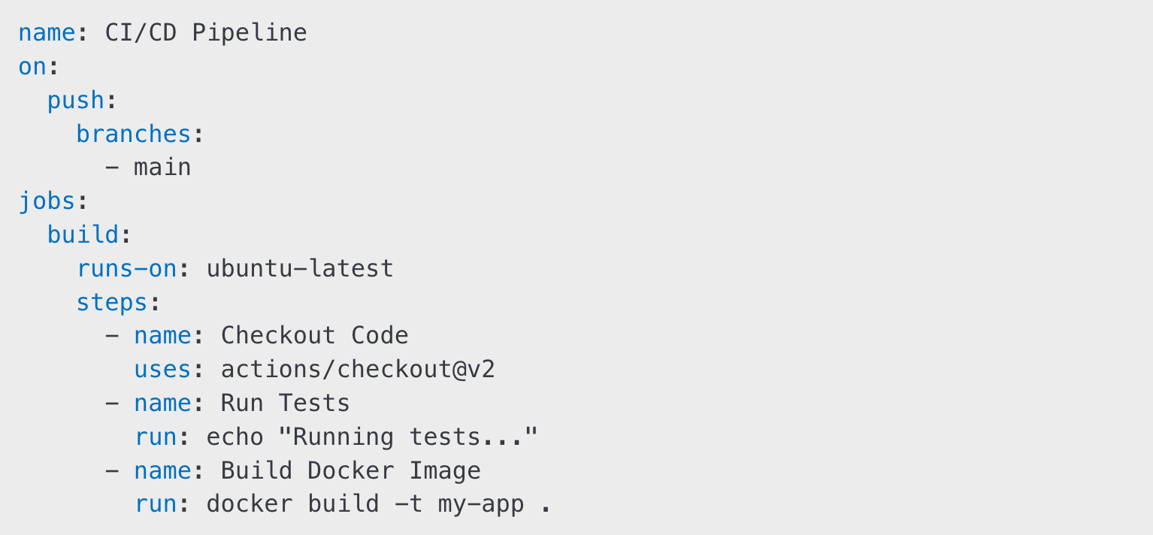
5
Hands-On Activities
Activity 1: Setting Up a Basic Pipeline
Use GitHub Actions or Jenkins to set up a simple pipeline.
Trigger pipeline on code push.
Add stages for:
Build: Compile code or create a Docker image.
Test: Run basic unit tests.
Deploy: Deploy to a test environment (e.g., run a container).
Example Workflow File for GitHub Actions
Activity 2: Analyzing Pipeline Logs
Identify success and failure points.
Modify the pipeline to improve efficiency.

Slide 8
6
Homework
Set Up a Pipeline in GitHub Actions:
Create a workflow that triggers on push to the main branch.
Include stages for building and testing the application.
Enhance the Workflow:
Add notifications to the pipeline (e.g., email or Slack).
Include a deployment step to run the application in a container.
Debugging Practice:
Intentionally introduce a pipeline error (e.g., a failing test) and troubleshoot it using logs.

Slide 9

Քո կարծիքը կարևոր է

Slide 10


