Slide 1

bdg.am

Slide 2


CI/CD
ADVANCED
bdg.am

Slide 3
1
Agenda and Objectives
Agenda
Review of CI/CD Basics.
Introduction to Multi-Stage Pipelines with Jenkins.
Advanced Testing Strategies in CI/CD.
Deployment to Production.
Integrating CI/CD with Jenkins and Other Tools.
Objectives
Build and manage advanced multi-stage pipelines using Jenkins.
Learn techniques for automating and scaling CI/CD workflows.
Understand how to deploy code to production environments.

Slide 4
2
Review of CI/CD Basics
Key Concepts Recap
Continuous Integration (CI): Automating code integration and running tests.
Continuous Delivery (CD): Ensuring code is always in a deployable state.
Continuous Deployment: Automatically deploying changes to production after testing.
Key Pipeline Stages
1. Source Code Management (e.g., GitHub, GitLab).
2. Build Stage: Compiling and artifact generation.
3. Testing Stage: Automated unit and integration tests.
4. Deployment Stage: Automated deployment to staging/production environments.

Slide 5

3
Understanding Jenkins
What is Jenkins?
Jenkins: An open-source automation server designed to build, test, and deploy software.
Why Jenkins?:
Extensible through plugins.
Supports complex, highly customizable pipelines.
Integrates with various tools and platforms.
Comparing Jenkins with GitHub Actions and GitLab CI
Jenkins:
Highly flexible and configurable.
Requires manual setup and maintenance.
Ideal for enterprise-level workflows with multiple integrations.
GitHub Actions:
Built into GitHub; seamless for GitHub repositories.
Limited to GitHub-hosted projects.
Simpler for smaller teams and projects.
GitLab CI/CD:
Integrated into GitLab; tight coupling with GitLab repositories.
Offers extensive DevOps lifecycle features.
Self-hosted and SaaS options.

Slide 6
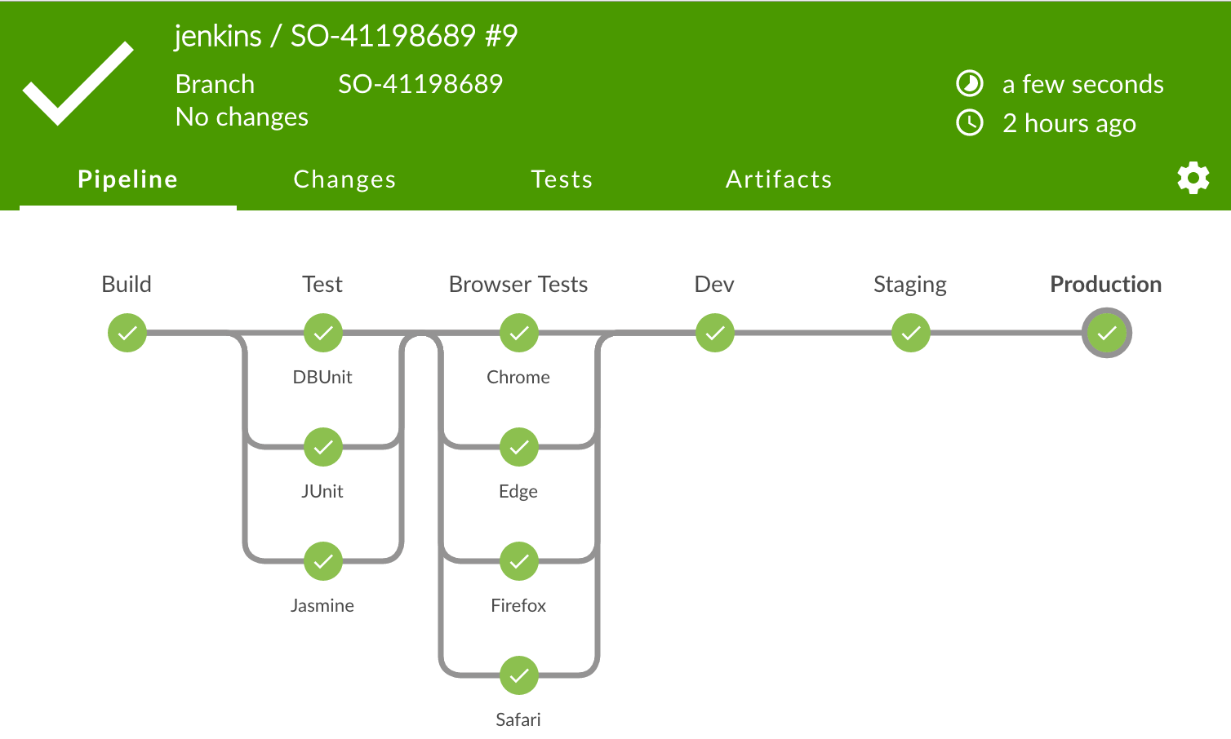
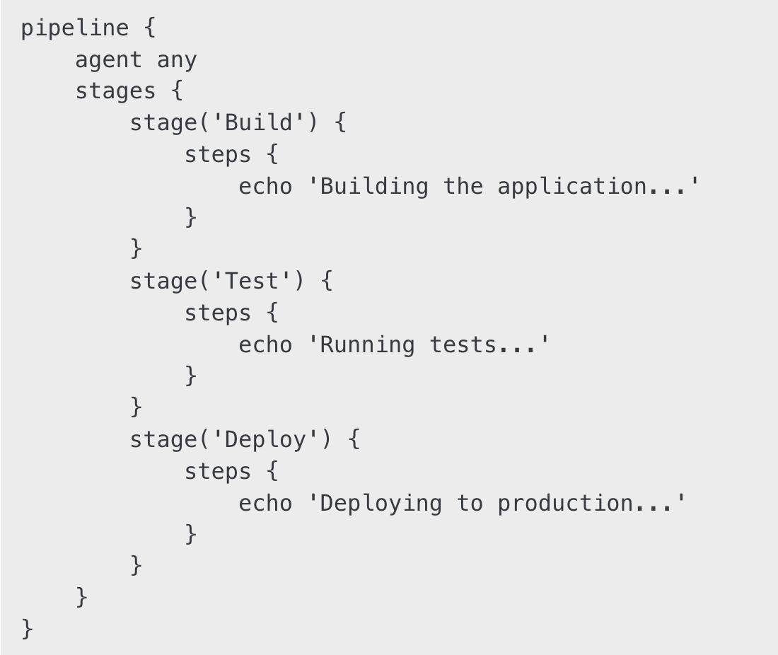
4
Multi-Stage Pipelines with Jenkins
What are Multi-Stage Pipelines?
Pipelines that separate and organize tasks into distinct stages (e.g., build, test, deploy).
Benefits:
Better organization and clarity.
Easier debugging and monitoring.
Parallel execution for faster workflows.
Setting Up a Multi-Stage Pipeline in Jenkins
Install Plugins:
Pipeline Plugin.
Git Plugin.
Create a Jenkinsfile:
Define pipeline stages in Groovy syntax.
Example Jenkinsfile:

Slide 7
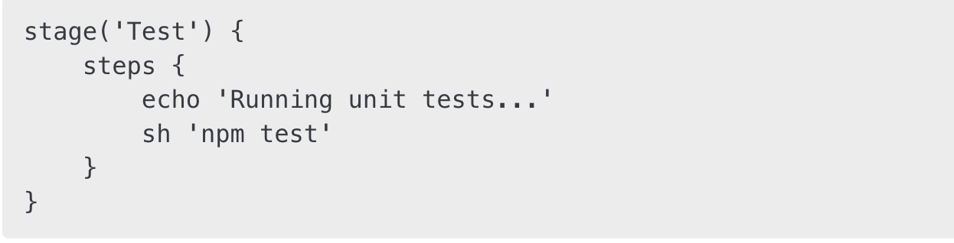
5
Advanced CI/CD Testing Strategies
Types of Tests
Unit Tests:
Focus on individual components or functions.
Example: Using pytest or JUnit.
Integration Tests:
Test interactions between components.
Example: Testing API endpoints.
End-to-End (E2E) Tests:
Simulate real user workflows.
Tools: Selenium, Cypress.
Automating Tests in Jenkins Pipelines
Add testing stages to the Jenkinsfile:

Slide 8
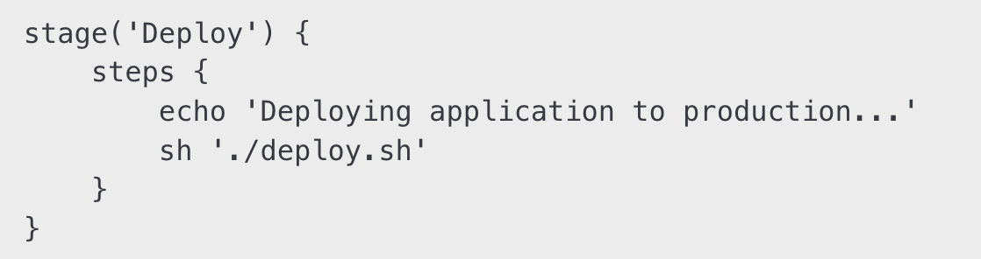
6
Deployment to Production
Strategies for Safe Deployment
Blue-Green Deployments:
Deploy new code to a separate environment (blue) while old code (green) remains live.
Switch traffic to blue after validation.
Canary Releases:
Gradually roll out changes to a subset of users.
Rolling Updates:
Incrementally update instances to the new version.
Example Deployment in Jenkins:

Slide 9
7
Integrating Jenkins with other tools
Popular Integrations
Infrastructure as Code:
Use Terraform or Ansible to provision and configure infrastructure.
Monitoring and Alerting:
Integrate Jenkins with Prometheus and Grafana to track pipeline performance.
Container Orchestration:
Deploy Docker containers using Jenkins pipelines.
Benefits of Integrations
Streamline workflows.
Gain better insights into pipeline performance.
Improve deployment automation.

Slide 10
8
Hands-On with Jenkins
Create a Multi-Stage Pipeline in Jenkins:
Add stages for building, testing, and deploying an application.
Use a Jenkinsfile to define the pipeline.
Enhance Testing:
Add unit and integration tests to the pipeline.
Use a testing framework like pytest or JUnit.
Deploy Safely:
Implement a blue-green deployment using a script or a deployment tool.

Slide 11
9
Homework
Advanced Pipeline Creation:
Build a multi-stage pipeline in Jenkins.
Include build, test, and deployment stages.
Test Integration:
Automate tests for a sample application in Jenkins.
Deployment Practice:
Simulate a rolling update or blue-green deployment in a test environment.

Slide 12


