Slide 1

bdg.am

Slide 2


CLOUD COMPUTING
AND
AWS BASICS
bdg.am

Slide 3



1
Agenda and Objectives
Agenda
Introduction to Cloud Computing.
Understanding Cloud Service Models (IaaS, PaaS, SaaS).
Overview of AWS and its Core Services.
Setting Up and Managing EC2 Instances.
Hands-on: Launching and Configuring EC2.
Objectives
Understand the fundamentals of cloud computing.
Learn about AWS and its key services.
Deploy and configure an EC2 instance.

Slide 4
2
Introduction to Cloud Computing
What is Cloud Computing?
The delivery of computing services (servers, storage, databases, networking, software) over the internet.
Enables on-demand access to IT resources without owning hardware.
Key features:
Scalability: Resources can be scaled up or down as needed.
Flexibility: Pay only for what you use (pay-as-you-go model).
Reliability: High availability and disaster recovery solutions.
Why Use Cloud Solutions?
Cost Efficiency: No upfront infrastructure investment.
High Availability: Global data centers ensure uptime.
Security: Advanced security controls and compliance support.
Performance Optimization: Load balancing and automated scaling.

Slide 5
3
Cloud Service Models
Infrastructure as a Service (IaaS)
Provides virtualized computing resources over the internet.
Users manage operating systems, applications, and configurations.
Examples: AWS EC2, Azure Virtual Machines, Google Compute Engine.
Platform as a Service (PaaS)
Provides a development platform that abstracts infrastructure management.
Developers focus on code while the provider manages runtime, databases, and scaling.
Examples: AWS Elastic Beanstalk, Google App Engine, Heroku.
Software as a Service (SaaS)
Cloud-based software applications accessible via the internet.
Fully managed by the provider, users only consume the service.
Examples: Google Workspace, Dropbox, Salesforce.

Slide 6
4
AWS Core Services
What is AWS?
Amazon Web Services (AWS) is the leading cloud platform providing a vast array of cloud services.
AWS operates across multiple global regions and availability zones.
Core AWS Services
Compute: EC2 (virtual machines), Lambda (serverless functions), ECS (container management).
Storage: S3 (object storage), EBS (block storage), Glacier (archival storage).
Networking: VPC (Virtual Private Cloud), Route 53 (DNS), Elastic Load Balancer.
Databases: RDS (managed relational databases), DynamoDB (NoSQL), Redshift (data warehouse).
Security & Identity: IAM (Identity & Access Management), KMS (encryption), AWS Shield (DDoS protection).

Slide 7
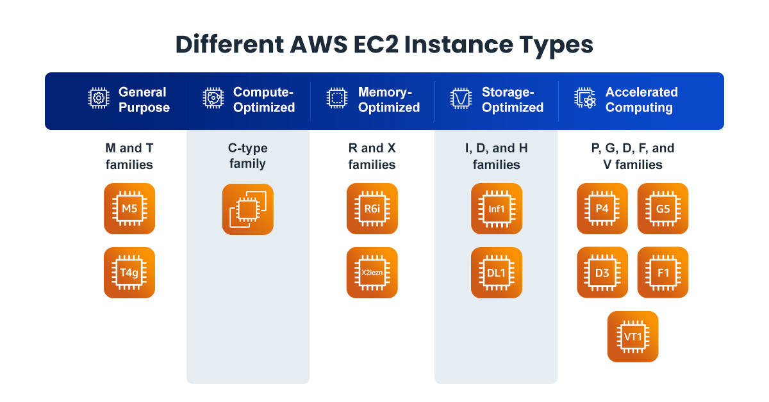
5
Introduction to Amazon EC2
What is EC2 (Elastic Compute Cloud)?
Virtual servers in the cloud that allow users to run applications.
Provides various instance types optimized for compute, memory, or storage needs.
EC2 Features
Scalability: Adjust capacity as needed.
Security: IAM roles, Security Groups, Key Pair authentication.
Storage Options: EBS (persistent storage), Instance Store (ephemeral storage).
EC2 Pricing Models
On-Demand: Pay for compute capacity by the second or hour.
Reserved Instances: Commit for 1-3 years for discounts.
Spot Instances: Purchase spare capacity at a lower price.
Savings Plans: Flexible pricing model for long-term usage.

Slide 8
6
Hands-on with AWS
Step 1: Sign into AWS and Navigate to EC2
Go to AWS Management Console.
Open the EC2 Dashboard.
Step 2: Launch an EC2 Instance
Click Launch Instance.
Select an Amazon Machine Image (AMI) (e.g., Ubuntu, Amazon Linux).
Choose an Instance Type (e.g., t2.micro for free-tier eligible users).
Configure instance details (networking, IAM roles).
Attach storage (EBS volume, default 8GB for Ubuntu).
Configure Security Groups (Allow SSH, HTTP, HTTPS traffic).
Generate or select an SSH key pair for secure access.
Step 3: Connect to the Instance
Via SSH:

Slide 9
7
Homework
Launch an EC2 Instance:
Create an AWS account (if not done already).
Launch a t2.micro instance and connect via SSH.
Configure a Web Server:
Install and start Nginx or Apache on your instance.
Open necessary ports in the security group.
Look for options to expose your web server to internet

Slide 10


