Slide 1

bdg.am

Slide 2

CONFIGURATION MANAGEMENT
WITH
ANSIBLE

Slide 3



1
Agenda and Objectives
Agenda
Introduction to Configuration Management.
What is Ansible and How It Works?
Setting Up Ansible.
Writing and Running Ansible Playbooks.
Hands-on: Configuring a Server with Ansible.
Objectives
Understand the need for configuration management.
Learn how Ansible automates infrastructure provisioning.
Write and execute Ansible playbooks.

Slide 4
2
Introduction to Configuration Management
Why is Configuration Management Important?
Ensures consistency across multiple servers.
Automates manual configuration tasks.
Reduces human errors and deployment time.
Supports scalability in cloud environments.
Common Configuration Management Tools:
Tool | Language | Agent Required | Cloud Support
Ansible | YAML | No | Multi-Cloud
Puppet | DSL | Yes | Multi-Cloud
Chef | Ruby | Yes | Multi-Cloud
SaltStack | Yaml | Yes | Multi-Cloud

Slide 5
3
What is Ansible
What is Ansible?
Open-source configuration management and automation tool.
Uses agentless architecture, relying on SSH.
Uses YAML-based playbooks to define configurations.
Key Ansible Components
Inventory - Defines managed hosts.
Playbooks - Declarative configuration files.
Modules - Pre-built automation tasks.
Tasks - Individual automation actions.
Handlers - Execute actions when triggered.
How Ansible Works
The control node (Ansible host) runs playbooks.
Uses SSH to connect and apply configurations to remote hosts.

Slide 6
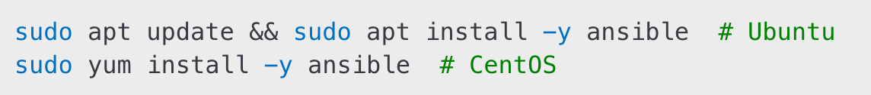
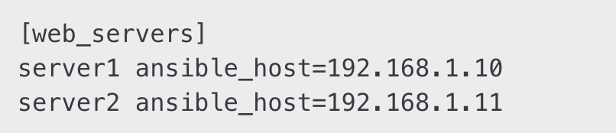
4
Setting Up Ansible
Installing Ansible (Linux/MacOS)
Configuring Ansible Inventory
Testing Ansible Connection
Expected Output:

Slide 7
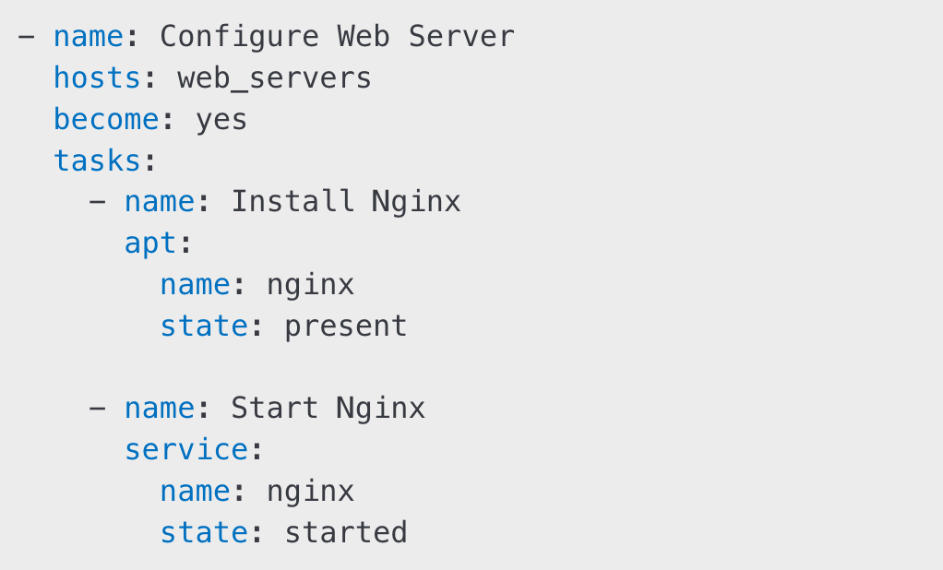
5
Writing and Running Playbooks
What is a Playbook?
A YAML-based script defining automation tasks.
Describes desired system state rather than procedural steps.
Sample Ansible Playbook:
Running an Ansible Playbook:

Slide 8
6
Hands-On with Ansible
Set Up Ansible Inventory:
Define a new inventory file.
Add multiple hosts to different groups.
Run Basic Ansible Commands:
Check connectivity with ansible all -m ping.
Gather system facts using ansible all -m setup.
Deploy a Web Server with Ansible:
Write a playbook to install and start Nginx.
Configure firewall rules using Ansible.

Slide 9
7
Homework
Expand Ansible Playbook:
Add a task to create a new user.
Configure an SSH key for the new user.
Use Ansible Modules:
Experiment with copy, file, and cron modules.
Apply changes to managed servers.
Set Up Ansible Vault:
Encrypt a file containing sensitive data.
Use it in an Ansible playbook.

Slide 10


