Slide 1

bdg.am

Slide 2


DOCKER ADVANCED CONCEPTS
bdg.am

Slide 3
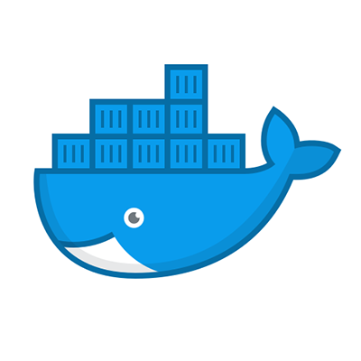


1
Agenda and Features
Agenda
Building Custom Docker Images with Dockerfile.
Advanced Docker Networking.
Persistent Data with Volumes.
Multi-Container Applications using Docker Compose.
Key Features Covered
Automating container image creation with Dockerfile.
Configuring container communication via Docker networks.
Managing data persistence with Docker volumes.
Simplifying multi-container setups with Docker Compose.

Slide 4
2
Building Custom Images with Dockerfile
What is a Dockerfile?
Definition: A text file containing instructions to build a Docker image.
Why Use Dockerfile?:
Automates image creation.
Ensures consistency across environments.
Common Dockerfile Instructions
FROM: Specifies the base image.
Example: FROM ubuntu:latest
RUN: Executes a command during image build.
Example: RUN apt-get update && apt-get install -y nginx
COPY or ADD: Adds files to the image.
Example: COPY index.html /usr/share/nginx/html/
CMD or ENTRYPOINT: Defines the default command.
Example: CMD ["nginx", "-g", "daemon off;"]
Building and Running the Image
Build an image:
docker build -t my-nginx .
Run the container:
docker run -d -p 8080:80 my-nginx

Slide 5
3
Docker Networking
Why We Need Networking in Docker?
Enables communication between containers.
Connects containers to external networks.
Docker Network Types
Bridge:
Default network for standalone containers.
Containers can communicate with each other within the bridge.
Host:
Shares the host's network namespace.
No network isolation between container and host.
Overlay:
Used for multi-host communication in Swarm mode.
None:
Completely disables networking.
Key Networking Commands
List networks:
docker network ls
Create a network:
docker network create my-network
Connect a container to a network:
docker network connect my-network <container_id>

Slide 6
4
Docker Volumes
What are Volumes?
Definition: A mechanism to persist data generated by and used in containers.
Why Use Volumes?:
Store application data outside the container's filesystem.
Enable data sharing between containers.
Key Volume Commands
Create a volume:
docker volume create my-volume
Use a volume in a container:
docker run -d -v my-volume:/data ubuntu
Inspect volumes:
docker volume inspect my-volume
Remove a volume:
docker volume rm my-volume

Slide 7
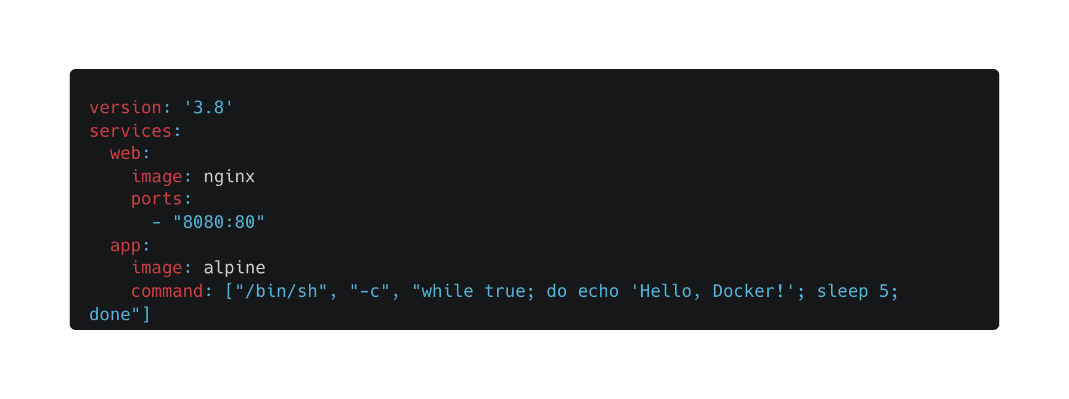
5
Docker Compose
What is Docker Compose?
Definition: A tool to define and run multi-container applications.
Why Use Docker Compose?:
Simplifies multi-container setups.
Uses a YAML file to define services, networks, and volumes.
Example docker-compose.yml File
Key Commands
Start services:
docker-compose up
Stop services:
docker-compose down

Slide 8
6
Hands-On Activities
Building a Custom Image:
Write a Dockerfile to build an image with Apache installed.
Build and run the container, exposing it on port 8080.
Networking:
Create a custom network.
Connect two containers (e.g., a web server and a simple app) to the network.
Test communication between the containers.
Using Volumes:
Create a volume and use it to store data for a container.
Verify the persistence of data by stopping and restarting the container.
Multi-container Setup:
Write a docker-compose.yml file for a simple web application and an app that outputs logs.
Start the setup using docker-compose and verify connectivity.

Slide 9
7
Homework
Create a Dockerfile:
Build a custom image that runs a Python application.
Test the image by running the container.
Practice Networking:
Create a bridge network.
Run two containers and test communication using ping.
Use Docker Compose:
Define a multi-container setup for a web app and its backend.
Test the setup locally.

Slide 10

Քո կարծիքը կարևոր է

Slide 11


