Slide 1

bdg.am

Slide 2


INTRODUCTION
TO
DEVOPS CONCEPTS AND TOOLS
bdg.am

Slide 3
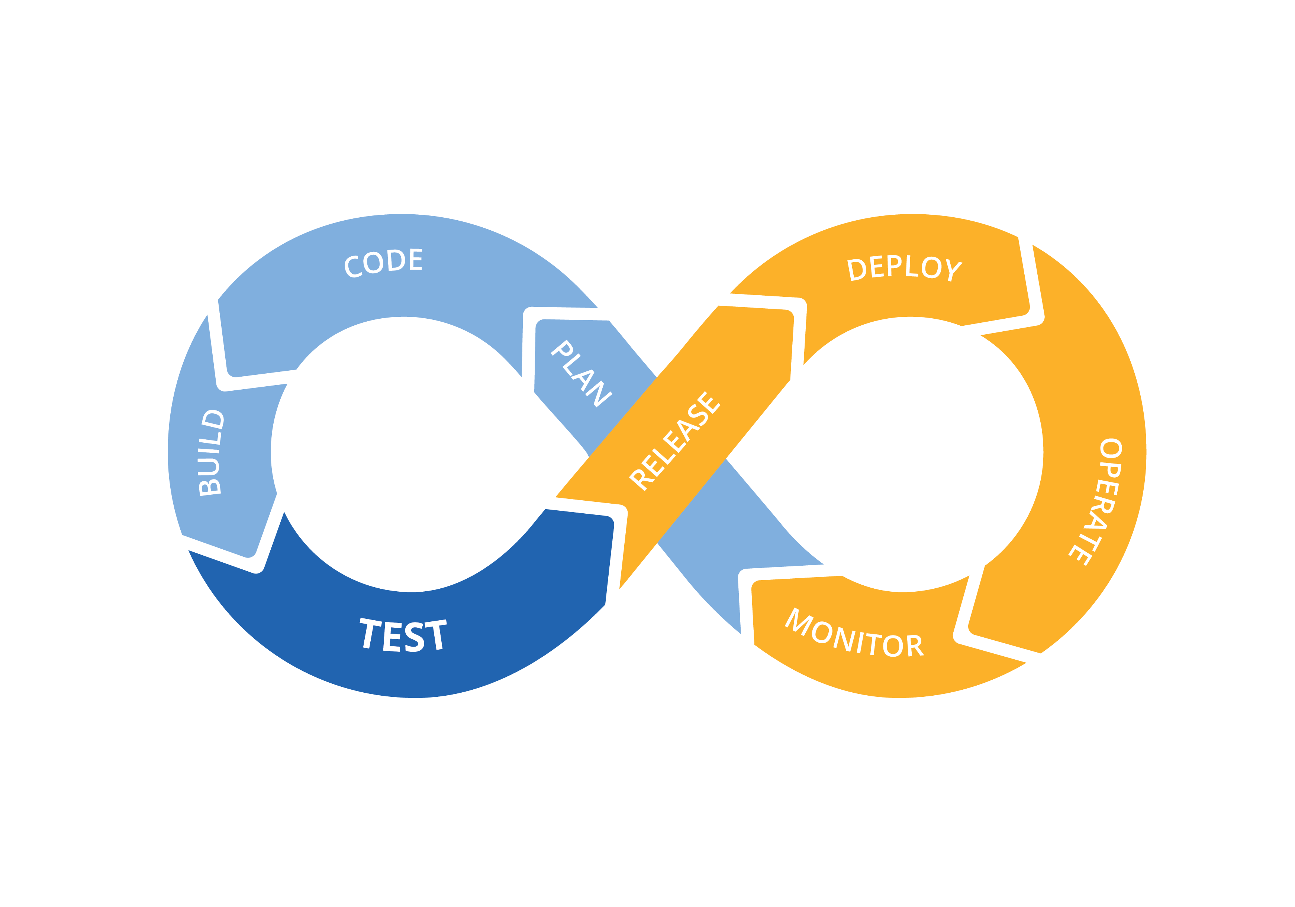
1
Agenda and Objectives
Agenda
What is DevOps?
Key DevOps Principles and Practices.
Overview of Popular DevOps Tools.
Benefits and Challenges of Adopting DevOps.
Objectives
Understand the purpose and goals of DevOps.
Familiarize with core DevOps practices like CI/CD and IaC.
Learn about commonly used DevOps tools.

Slide 4
2
What is DevOps?
Definition
DevOps: A set of practices that combines software development (Dev) and IT operations (Ops) to shorten the development lifecycle and deliver high-quality software.
Goals of DevOps
Faster Delivery: Accelerate development and deployment cycles.
Improved Collaboration: Break silos between development and operations teams.
Higher Reliability: Deliver stable, bug-free software consistently.
Scalability: Automate processes to manage complex and growing systems.

Slide 5
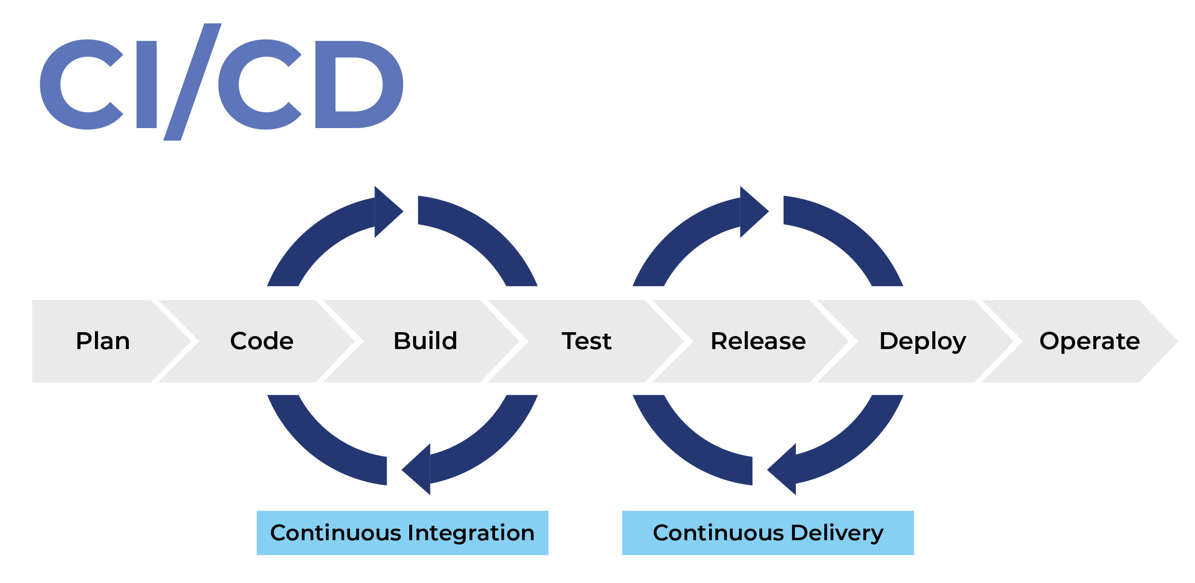

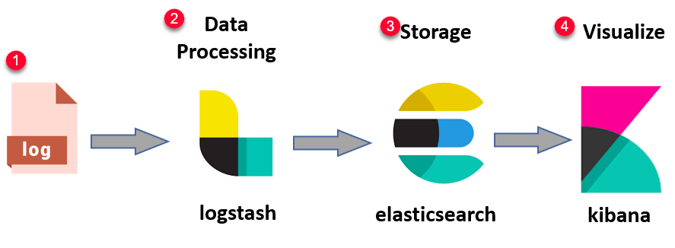
3
Key DevOps Principles and Practices
Principles
Collaboration: Foster a culture of shared responsibility.
Automation: Reduce manual tasks for speed and consistency.
Continuous Improvement: Emphasize feedback and iteration.
Monitoring and Feedback Loops: Gain insights into performance and user behavior.
Practices
Continuous Integration (CI): Merge code changes frequently into a shared repository.
Continuous Deployment (CD): Automate the release process for faster delivery.
Infrastructure as Code (IaC): Manage infrastructure using code to ensure consistency.
Monitoring and Logging: Track system performance and detect issues early.

Slide 6
4
Overview of Popular DevOps Tools
Categories of Tools
Version Control Systems: Git, GitHub, GitLab.
Continuous Integration/Continuous Deployment (CI/CD): Jenkins, GitHub Actions, GitLab CI/CD.
Containerization and Orchestration: Docker, Kubernetes.
Infrastructure as Code: Terraform, CloudFormation.
Configuration Management: Ansible, Chef, Puppet.
Monitoring and Logging: Prometheus, Grafana, ELK Stack (Elasticsearch, Logstash, Kibana).
Example Workflow with Tools
Developer pushes code to GitHub.
CI/CD tool (e.g., Jenkins) builds and tests the application.
Docker containers are created and deployed.
Monitoring tools (e.g., Prometheus) track performance.

Slide 7
5
Benefits and Challenges of DevOps
Benefits
Faster delivery of features.
Improved collaboration and communication.
Higher software quality and reliability.
Better scalability and infrastructure management.
Challenges
Cultural shifts: Breaking silos and fostering collaboration.
Complexity of tools: Learning and integrating new technologies.
Continuous improvement: Adapting to changing requirements.

Slide 8
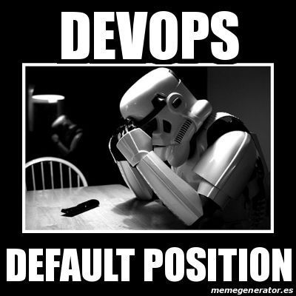
6
Hands-On Activities
DevOps Principles in Action:
Discuss how DevOps practices can be applied in your current workflows.
Tool Exploration:
Set up a free GitHub repository.
Push a small project and explore GitHub Actions.
Write a simple CI/CD pipeline in GitHub Actions to build and test the code.

Slide 9
7
Homework
Explore DevOps Tools:
Set up a personal project repository on GitHub or GitLab.
Implement a basic CI/CD pipeline using GitHub Actions or GitLab CI/CD.
Identify DevOps Practices:
Reflect on how DevOps principles could improve workflows in your projects or work.
Research Monitoring Tools:
Learn about Prometheus or Grafana, and list scenarios where monitoring is essential.

Slide 10

Քո կարծիքը կարևոր է

Slide 11


