Slide 1

bdg.am

Slide 2

INFRASTRUCTURE AS CODE
WITH
TERRAFORM

Slide 3
1
Agenda and Objectives
Agenda
Introduction to Infrastructure as Code (IaC).
Overview of Terraform and its Benefits.
Terraform Configuration and State Management.
Hands-on: Deploying AWS Resources with Terraform.
Objectives
Understand the fundamentals of Infrastructure as Code.
Learn how Terraform automates cloud infrastructure deployment.
Write and apply basic Terraform configurations.

Slide 4
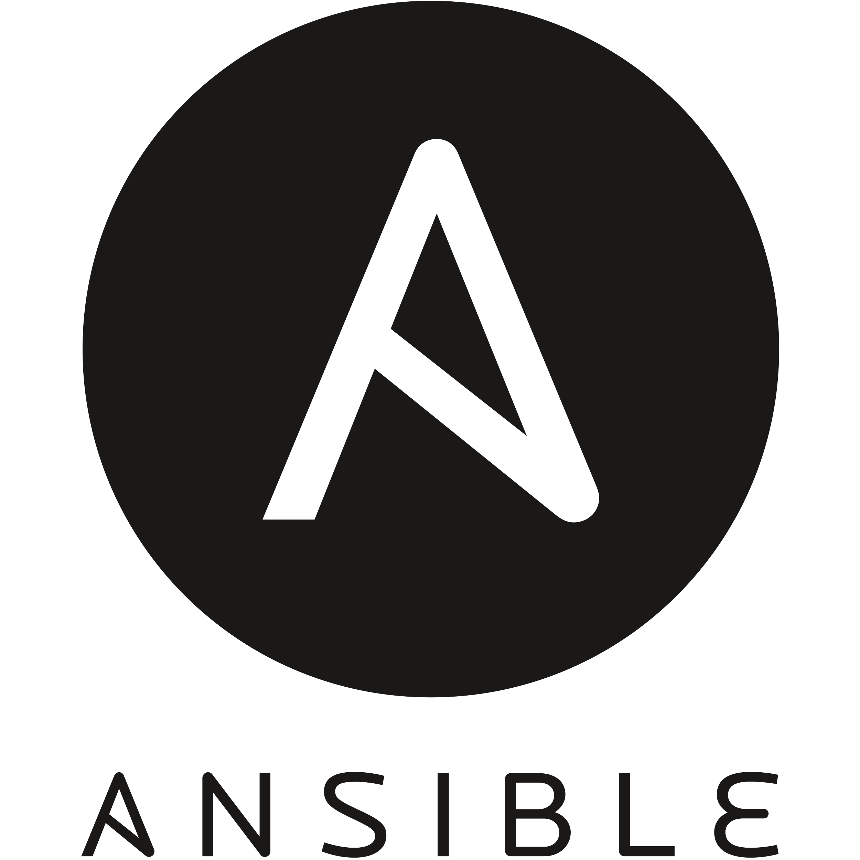

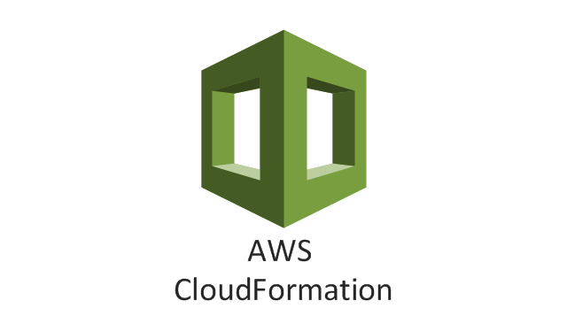
2
Introduction to IaC
What is Infrastructure as Code?
Managing and provisioning cloud infrastructure using code instead of manual processes.
Enables automation, version control, and consistency.
Example tools: Terraform, AWS CloudFormation, Ansible.
Why Use IaC?
Automation: Reduces manual effort and errors.
Scalability: Infrastructure can be replicated easily.
Version Control: Infrastructure definitions can be tracked in Git.
Faster Deployments: Reduces setup time.

Slide 5
3
Introduction to Terraform
What is Terraform?
Open-source IaC tool by HashiCorp.
Uses a declarative configuration language called HCL (HashiCorp Configuration Language).
Supports multiple cloud providers (AWS, Azure, GCP, etc.).
Benefits of Terraform
Multi-cloud support: Works across cloud platforms.
State Management: Tracks changes to infrastructure.
Reusable Modules: Helps organize and simplify complex configurations.
Terraform vs. Other IaC Tools
Feature | Terraform | AWS Cloud Formation | Ansible
Cloud Support | Multi-cloud | AWS-only | Multi-cloud
Language | HCL | JSON/YAML | YAML
Configuration Type | Declarative | Declarative | Procedural

Slide 6
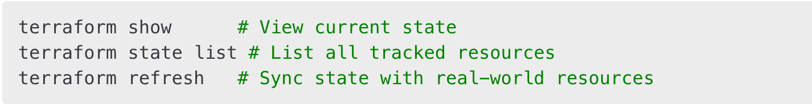
4
Terraform Configuration and State
Terraform Workflow
Write Configuration (.tf files define resources).
Initialize Terraform (terraform init).
Plan Execution (terraform plan previews changes).
Apply Changes (terraform apply deploys infrastructure).
Terraform State
Maintains a state file (terraform.tfstate) that tracks infrastructure changes.
Used to compare real-world resources with the declared configuration.
Example state commands:

Slide 7

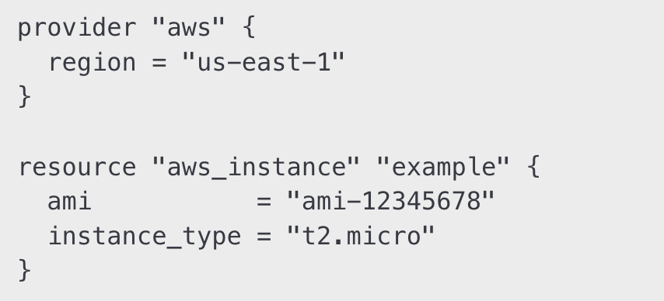
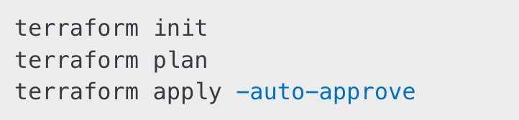

5
Hands-On Activities
Step 1: Install Terraform
Download from terraform.io.
Verify installation:
Step 2: Write a Simple Terraform Configuration
Step 3: Initialize, Plan, and Apply
Step 4: Destroy Resources

Slide 8
6
Homework
Create a Terraform Configuration:
Define a VPC, Subnets, and an EC2 instance.
Apply and validate the infrastructure.
Modify Terraform Resources:
Update the instance type and reapply the configuration.
Explore Terraform Modules:
Use a module from Terraform Registry to deploy a web server.

Slide 9


