Slide 1

bdg.am

Slide 2


INTRODUCTION
TO
LINUX
bdg.am

Slide 3

1
Introduction to Linux
AGENDA
Basics of Linux and Unix
Linux File System Hierarchy
Hands-on Practice
Permissions and Ownership
Q&A and Homework

Slide 4





2
Introduction to Linux
What Are Linux and Unix?
History and Evolution:
Unix: Developed in the 1970s by AT&T Bell Labs, Unix set the standard for file and process management. It is the basis for modern OS architectures.
Linux: A free and open-source OS kernel created by Linus Torvalds in 1991, combined with GNU utilities to form a complete operating system.
Key Features:
Multi-user and multitasking capabilities.
Portability: Runs on multiple hardware platforms.
Stability, security, and performance.
Open-source: Thousands of contributors worldwide ensure constant improvement.
Popular Linux Distributions:
Ubuntu: Beginner-friendly, often used for desktops and servers.
CentOS/RHEL: Preferred for enterprise environments.
Debian: Base for many distributions, valued for stability.
Fedora: Focused on innovation and development tools.
Arch Linux: Minimalist, allows customization but requires expertise.
Discussion: Why do you think open-source systems are significant for technology innovation?

Slide 5
3
Introduction to Linux
Why Learn Linux?
Importance in DevOps:
Linux powers most server infrastructures, cloud platforms, and DevOps tools.
Tools like Docker, Kubernetes, and CI/CD pipelines rely heavily on Linux.
Statistics:
Over 90% of public clouds run on Linux (AWS, Azure, Google Cloud).
It powers Android devices, IoT, supercomputers, and the majority of web servers.
Real-World Usage Examples:
Facebook, Google, Amazon rely on Linux servers.
NASA uses Linux for research and simulations.
Linux is standard in high-performance computing.
Quote: "Linux is the foundation of the modern digital ecosystem.”
Engagement: Ask learners where they’ve seen or used Linux in real life.

Slide 6
4
Introduction to Linux
Linux File System Overview
What is the File System?
The structure for managing data storage and retrieval on a disk.
Hierarchical organization with directories containing files or subdirectories.
Key Characteristics of Linux File Systems:
Case-sensitive naming.
Unified tree structure: Everything starts at /.
Logical and physical separation: Logical directories don’t directly map to hardware.
Common File Systems:
Ext4: Default for many Linux distributions.
XFS: High-performance journaling.
Btrfs: Advanced features like snapshots.
Structure:
Root Directory (/): The origin of all directories.
Important Subdirectories:
/bin: Core executable programs like ls, cat.
/etc: Configuration files such as passwd and system settings.
/home: Personal directories for users.
/var: Dynamic files like logs and cache.
/tmp: Temporary file storage, cleared after reboot.
/usr: User applications, documentation, and libraries.
Interactive Exercise: Use the tree command to illustrate this hierarchy visually.

Slide 7
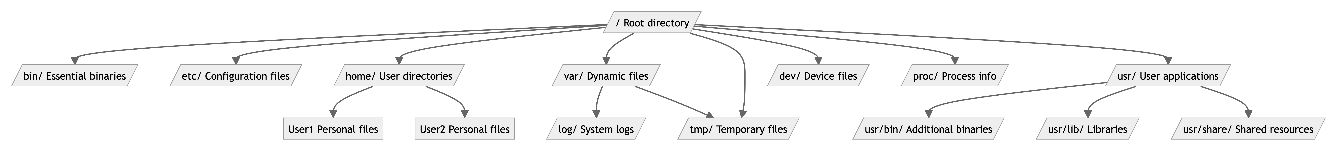
5
Introduction to Linux
Hands-On: Navigating the File System
Essential Commands:
pwd: Print the current working directory.
ls: List files in the current directory.
Use options like ls -a (all files) and ls -l (detailed view).
cd: Change the directory.
Navigate with absolute (/etc) and relative (../) paths.
Activity:
Open a terminal and explore the current directory using pwd.
Use ls to list the contents of /home, /etc, and /usr.
Change to /var/log and view its contents.
Use ls -lh to view file sizes in human-readable format.
Pro Tip: Combine commands like cd .. && ls to explore hierarchically.

Slide 8
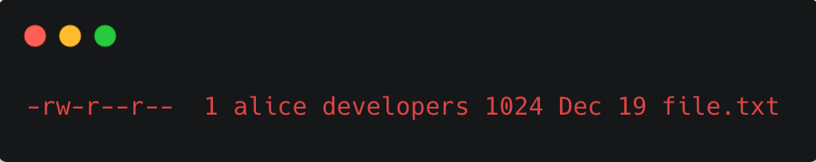
6
Introduction to Linux
Understanding Permissions
What Are File Permissions?
Control access levels to files and directories.
Represented as rwx (read, write, execute) for owner, group, and others.
User Types:
Owner: The user who created the file.
Group: Users in the same group as the owner.
Others: Everyone else.
Permission Representation:
Numerical mode: chmod 755 file translates to:
Owner: rwx (7)
Group: r-x (5)
Others: r-x (5)
Commands:
chmod: Modify file permissions.
chown: Change file ownership.
ls -l: Display detailed file information, including permissions.
Detailed Example:
Owner: alice has read and write access.
Group: developers have read access.
Others: Can only read.

Slide 9
7
Introduction to Linux
Hands-On: Modifying Permissions
Activity Steps:
Create a file: touch practice.txt.
Check initial permissions using ls -l.
Restrict write access for others: chmod o-w practice.txt.
Verify changes with ls -l.
Create a group (if sudo available): sudo groupadd learners.
Change group ownership: sudo chown :learners practice.txt.
Add write access to the group: chmod g+w practice.txt.
Discussion Questions:
How would you secure sensitive configuration files?
What permissions would you set for shared project files?

Slide 10
8
Introduction to Linux
Recap and Q&A
Key Takeaways:
Linux and Unix are foundational technologies.
The Linux file system is hierarchical and logical, designed for efficiency.
Permissions and ownership enhance security and collaboration.
Interactive Q&A:
Invite learners to share their observations.
Clarify doubts with practical examples or live demonstrations.

Slide 11
9
Introduction to Linux
Homework
Tasks:
Research and summarize the roles of /bin, /etc, /home, and /var.
Practice commands (ls, cd, pwd, chmod) in various directories.
Experiment with creating and modifying directories under /tmp.
Advanced: Explore the man command to learn about chmod and chown.
Create a directory named test under /tmp, change its ownership to your username, and set permissions to allow only you to read, write, and execute.
Write a short explanation of the difference between absolute and relative paths.

Slide 12

Քո կարծիքը կարևոր է

Slide 13


