Slide 1

bdg.am

Slide 2


LINUX SHELL
AND
COMMANDS
bdg.am

Slide 3
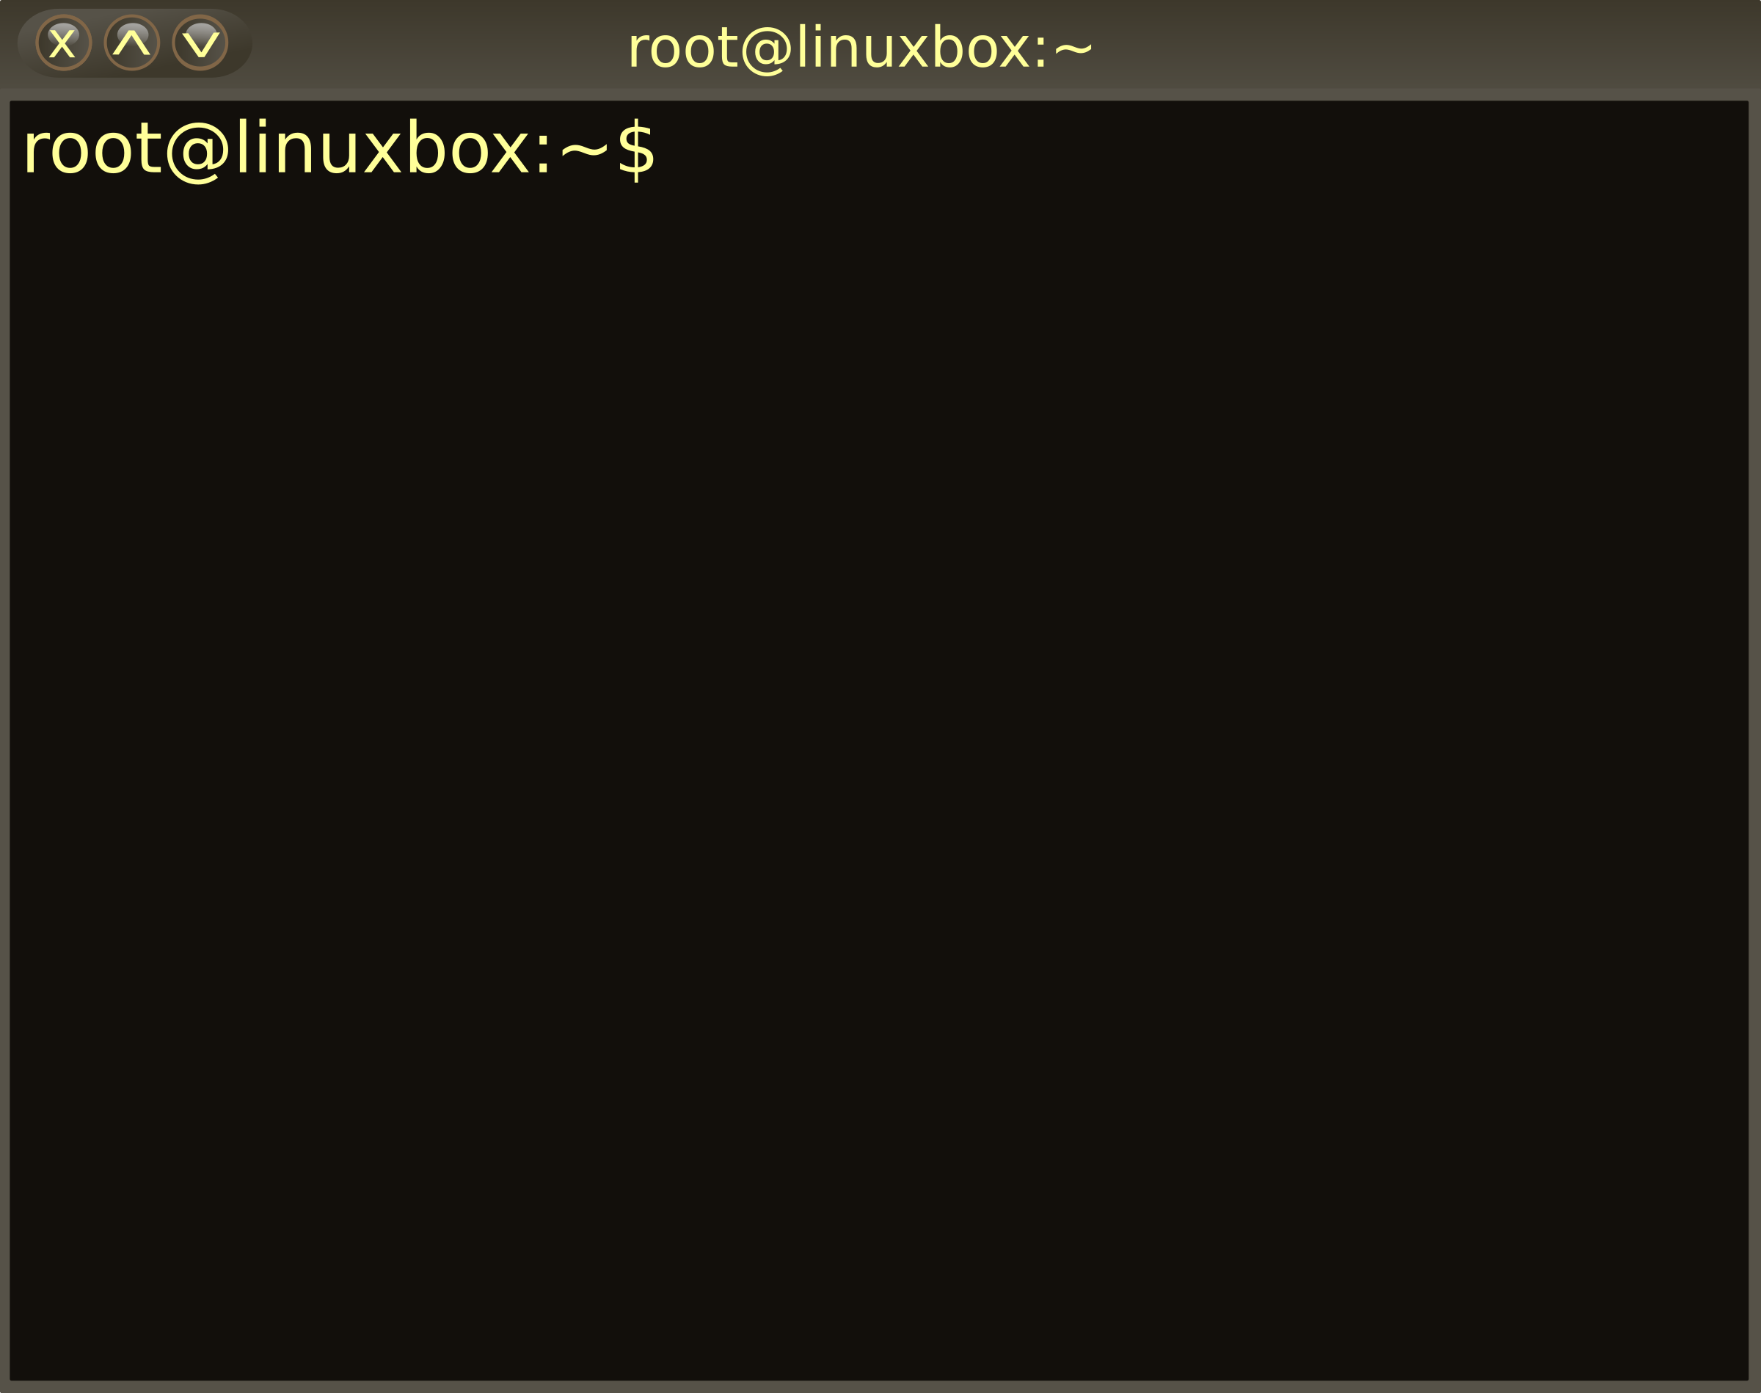
1
Linux Shell and Commands
Introduction to the Shell
What is a Shell?
Definition: A shell is a command-line interface that acts as an intermediary between the user and the operating system’s kernel.
Purpose: Allows users to execute commands to perform operations like file manipulation, program execution, and process management.
Common Shells:
Bash (Bourne Again Shell): Most widely used.
Zsh (Z Shell): Known for advanced features and scripting capabilities.
Fish (Friendly Interactive Shell): User-friendly and interactive.
Shell vs Terminal
Terminal: A program that opens a window for interacting with the shell.
Shell: The interpreter that processes commands within the terminal.

Slide 4
2
Linux Shell and Commands
Basic Commands
File System Navigation
ls: Lists files and directories.
Example: ls -l (detailed list with permissions).
cd: Changes the current directory.
Example: cd /home/user (navigates to user’s home directory).
pwd: Displays the current working directory.
File Manipulation
cp: Copies files or directories.
Example: cp file.txt /backup/ (copies file.txt to /backup/).
mv: Moves or renames files.
Example: mv file.txt newfile.txt (renames file.txt to newfile.txt).
rm: Deletes files or directories.
Example: rm -r /folder (removes a folder recursively).
mkdir: Creates a new directory.
Example: mkdir project (creates a folder named ‘project’).
Viewing Files
cat: Displays file contents.
Example: cat file.txt.
less/more: Displays file content page by page.
Example: less file.txt.
head: Displays the first few lines of a file.
Example: head -n 10 file.txt (shows first 10 lines).
tail: Displays the last few lines of a file.
Example: tail -n 5 file.txt (shows last 5 lines).

Slide 5
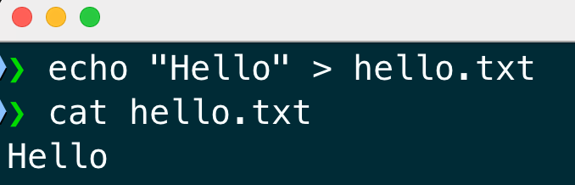
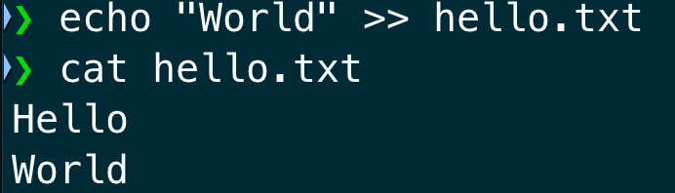
3
Linux Shell and Commands
Pipes and Redirection
Pipes ( | )
Definition: Pipes combine multiple commands by passing the output of one command as input to another.
Example: ls | grep .txt (lists files ending with .txt).
Input and Output Redirection
Output Redirection:
>: Writes output to a file, overwriting if the file exists.
Example: echo "Hello" > hello.txt.
>>: Appends output to a file.
Example: echo "World" >> hello.txt.
Input Redirection:
<: Reads input from a file.
Example: sort < names.txt.

Slide 6
4
Linux Shell and Commands
File Searching and Sorting
Searching for Files
find: Searches for files and directories.
Example: find / -name "file.txt" (searches for file.txt from the root).
locate: Quickly finds files using an indexed database.
Example: locate file.txt.
Searching Within Files
grep: Searches for patterns in files.
Example: grep "error" logfile.txt.
egrep: Extended version of grep with more advanced pattern matching.
Example: egrep "(error|warning)" logfile.txt.
Sorting and Filtering
sort: Sorts lines in a file.
Example: sort names.txt.
uniq: Removes duplicate lines.
Example: sort names.txt | uniq (sorts and removes duplicates).

Slide 7
5
Linux Shell and Commands
Wildcards and Globbing
What are Wildcards?
*: Matches zero or more characters.
Example: ls *.txt (lists all .txt files).
?: Matches exactly one character.
Example: ls file?.txt (matches file1.txt, file2.txt, etc.).
[ ]: Matches any one of the enclosed characters.
Example: ls file[1-3].txt (matches file1.txt, file2.txt, file3.txt).
Wildcard Tester

Slide 8
6
Linux Shell and Commands
Combining Commands
Using Operators
&& : Runs the next command only if the previous one succeeds.
Example: mkdir test && cd test.
|| : Runs the next command only if the previous one fails.
Example: mkdir test || echo "Failed to create directory".
; : Runs commands sequentially regardless of success.
Example: mkdir test; cd test.
Background Processes
& : Runs a command in the background.
Example: sleep 10 &.
jobs : Displays background jobs.

Slide 9
7
Linux Shell and Commands
Hands-on Activities
Navigation and File Manipulation:
Navigate to a specific directory using cd.
Create files and directories using touch and mkdir.
Move and rename files using mv.
Copy files to another directory using cp.
Using Pipes and Redirection:
List all .txt files in the home directory and save them to files.txt:
ls ~ | grep \.txt > files.txt.
Search and Sort:
Find all .log files in /var/log, sort them, and save to a file:
find /var/log -name "*.log" | sort > logs.txt.
Wildcards:
Delete all files that start with ‘temp’ and end with ‘.log’:
rm temp*.log.

Slide 10
8
Linux Shell and Commands
Homework
Practice basic commands by creating, renaming, and deleting files and directories.
Write a script that:
Finds all .txt files in a directory.
Sorts them by size.
Saves the result to a file named sorted_files.txt.

Slide 11

Քո կարծիքը կարևոր է

Slide 12


