Slide 1

bdg.am

Slide 2

SECURITY
IN
DEVOPS

Slide 3
1
Agenda and Objectives
Agenda
Understanding Security in DevOps.
DevSecOps: Integrating Security into DevOps.
Managing Secrets and Secure Configurations.
Best Practices for Infrastructure Security.
Hands-on: Implementing Security Measures in DevOps Pipelines.
Objectives
Learn how security integrates into DevOps workflows.
Explore tools for managing secrets and secure configurations.
Apply security best practices to infrastructure and CI/CD pipelines.

Slide 4
2
Understanding Security in DevOps
Why is Security Important in DevOps?
Security vulnerabilities can lead to data breaches, financial loss, and compliance violations.
DevOps introduces automation and speed, which can also introduce risks.
Security must be continuous, automated, and proactive.
Common Security Challenges in DevOps
Misconfigurations: Exposing services publicly by mistake.
Hardcoded Credentials: Storing API keys in source code.
Unpatched Software: Running outdated dependencies.
Insecure CI/CD Pipelines: Lack of security controls in automated builds.
Lack of Monitoring and Auditing: No real-time detection of attacks.

Slide 5
3
DevSecOps
What is DevSecOps?
DevSecOps = Development + Security + Operations.
Integrates security automation into CI/CD pipelines.
Ensures security is applied from development to deployment.
DevSecOps Principles
Shift Left Security: Security is implemented early in the development cycle.
Automated Security Checks: Vulnerability scanning in CI/CD.
Least Privilege Access: Restrict access to only what is necessary.
Continuous Monitoring: Detect threats in real-time.
Security Area | Tool Example
Code Scanning | SonarQube, Semgrep
Secrets Management | HashiCorp Vault, AWS Secrets Manager
Container Security | Trivy, Anchore, Clair
Infrastructure Security | Terraform Sentinel, Open Policy Agent
Runtime Security | Falco, Sysdig

Slide 6
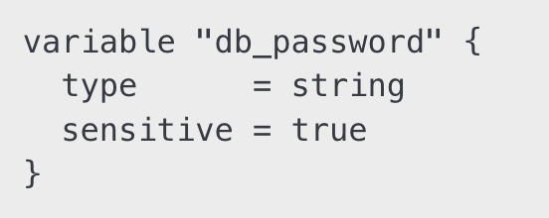
4
Secret Management
Why is Secret Management Important?
Avoid hardcoding credentials in code repositories.
Reduce the risk of credential leaks and unauthorized access.
Tools for Secrets Management
HashiCorp Vault: Securely stores API keys, tokens, passwords.
AWS Secrets Manager: Encrypts and rotates AWS credentials.
Ansible Vault: Encrypts sensitive configuration files in playbooks.
SOPS (Mozilla): Encrypts YAML/JSON configurations.
Example: Storing a Secret in HashiCorp Vault
Using Secrets in Terraform

Slide 7
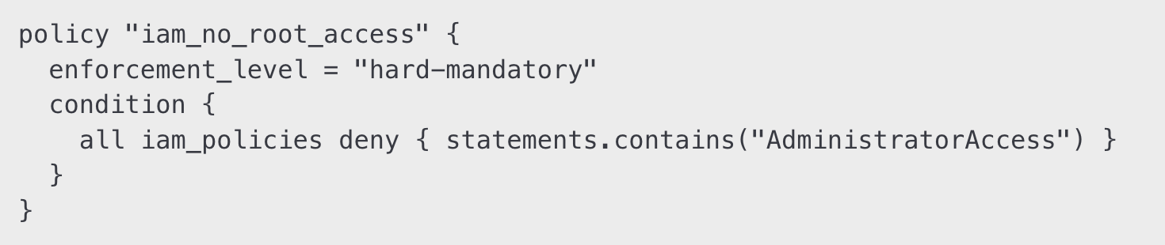
5
Infrastructure Security
Securing Cloud Resources
Use IAM Roles and Policies
Grant least privilege access.
Avoid using root credentials for automation.
Enable Logging and Auditing
Use AWS CloudTrail, Azure Monitor, GCP Audit Logs.
Implement SIEM solutions for log analysis.
Encrypt Data in Transit and at Rest
Use TLS certificates for securing communication.
Encrypt storage (EBS, S3, RDS) using KMS keys.
Secure CI/CD Pipelines
Scan images for vulnerabilities before deployment.
Apply code signing to prevent unauthorized code changes.
Restrict access to CI/CD runners and limit pipeline execution.
Example: Terraform Sentinel Policy for IAM Security

Slide 8
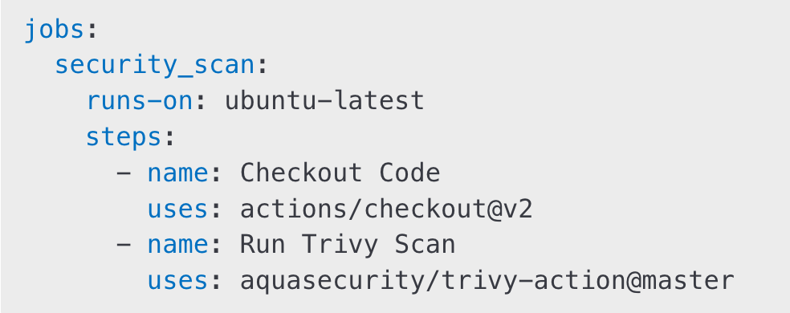
6
Understanding Security in DevOps
1. Implement Security in CI/CD Pipelines:
Run Snyk or Trivy in a GitHub Actions pipeline to scan container images.
Example GitHub Actions workflow:
2. Use HashiCorp Vault for Secret Management:
Store a database password securely.
Retrieve and use it in an Ansible playbook.
3. Apply IAM Best Practices:
Create a least privilege IAM role for an EC2 instance.
Enable AWS GuardDuty for threat detection.

Slide 9
7
Homework
Secure a Cloud Resource:
Apply IAM least privilege to an AWS EC2 instance.
Enable logging and encryption.
Automate Security Scanning:
Add SonarQube, Trivy, or Checkov to a GitHub Actions pipeline.
Review scan results and mitigate vulnerabilities.
Implement Secrets Management:
Store a secret in HashiCorp Vault and retrieve it via Ansible.
Use AWS Secrets Manager to store and retrieve an RDS password.

Slide 10


