Slide 1
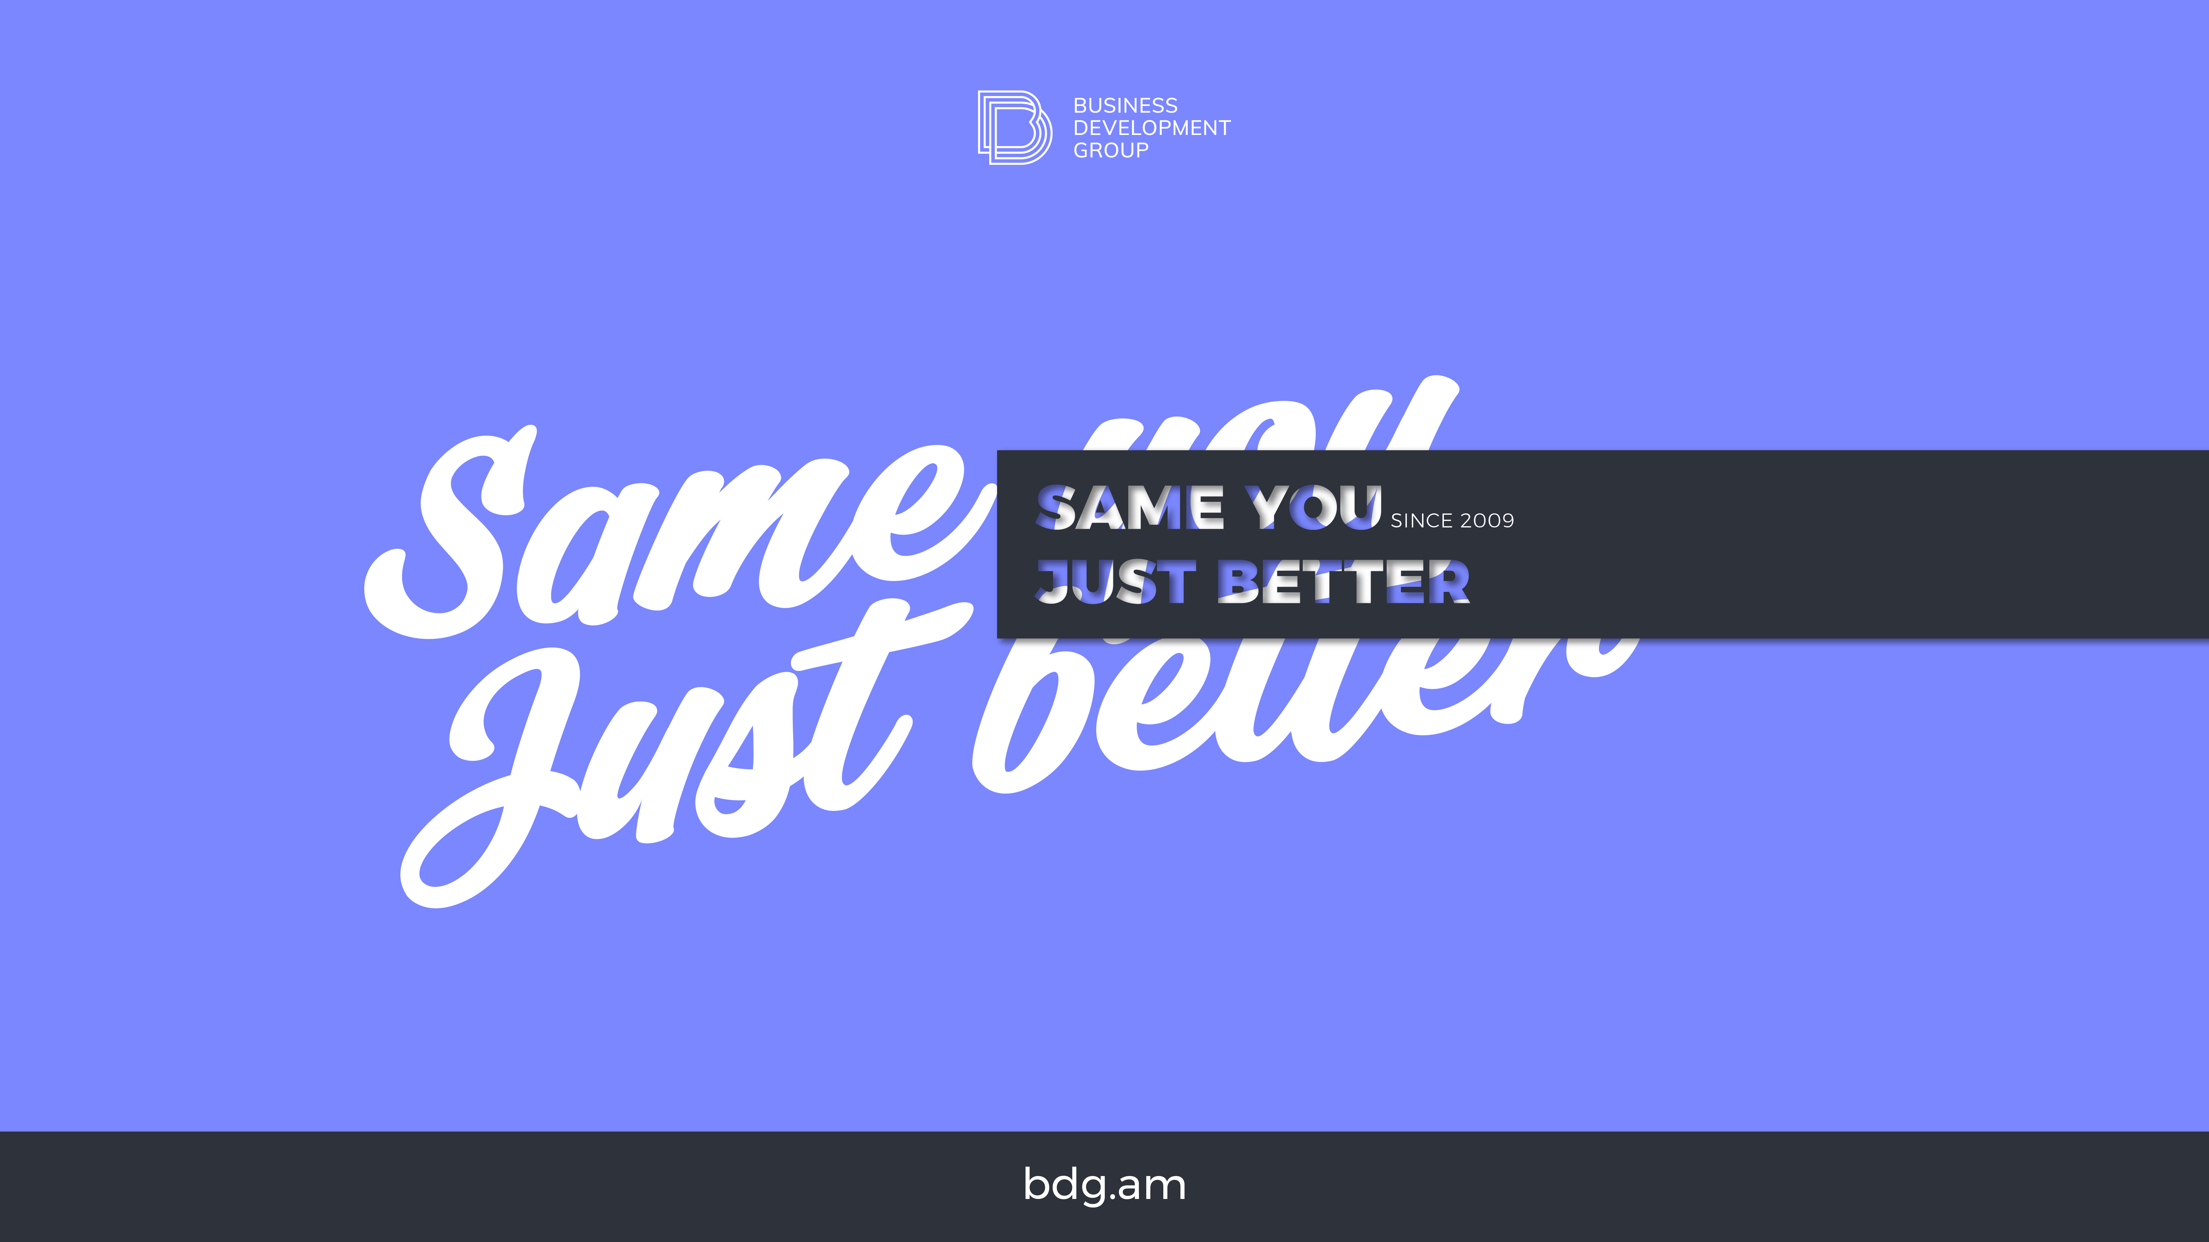
bdg.am

Slide 2

TERRAFORM
ADVANCED

Slide 3
1
Agenda and Objectives
Agenda
Advanced Terraform Concepts.
Terraform Blocks and Variables.
Dynamic Blocks and Null Resources.
Terraform Modules and Reusability.
Managing Terraform State Effectively.
Working with Remote Backends.
Hands-on: Deploying a Scalable Infrastructure with Terraform.
Objectives
Understand advanced Terraform features and best practices.
Learn how to modularize Terraform code for better reusability.
Explore remote state management and collaboration.

Slide 4
2
Advanced Terraform Concepts
Key Features of Advanced Terraform
Terraform Modules: Break down configurations into reusable components.
Remote State Management: Store and share Terraform state in a remote backend.
Terraform Workspaces: Manage multiple environments (e.g., dev, staging, prod).
Provisioners & Null Resources: Run scripts on provisioned infrastructure.
Dynamic Blocks: Create flexible configurations dynamically.
Variables and Outputs: Manage input variables and retrieve outputs.
Why Use Advanced Terraform Features?
Simplifies complex infrastructure.
Enables collaboration across teams.
Enhances automation and scalability.

Slide 5
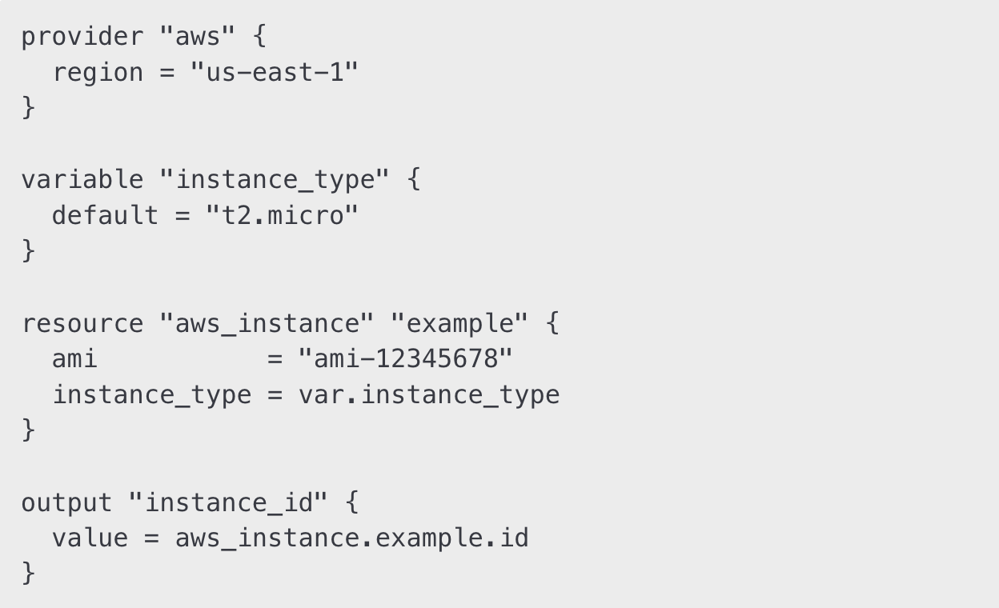
3
Terraform Blocks and Variables
Terraform Blocks
Provider Block: Defines cloud provider configurations.
Resource Block: Declares infrastructure components.
Variable Block: Defines input values to make configurations flexible.
Output Block: Displays information about deployed resources. Example:

Slide 6
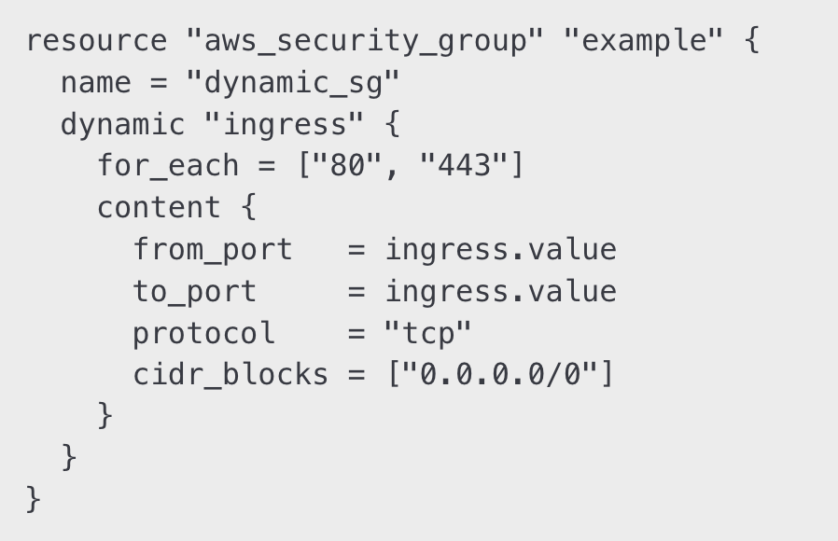
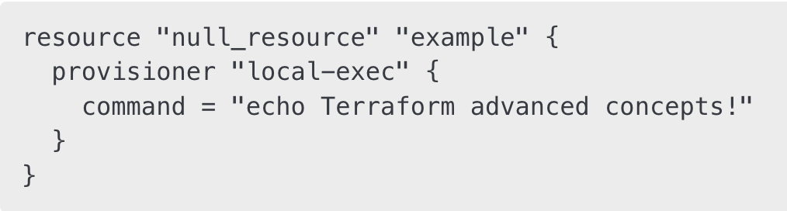
4
Dynamic Blocks and Null Resources
Dynamic Blocks
Used to generate multiple resource configurations dynamically.
Helps reduce redundant code.
Example:
Null Resource & Provisioners
Used when no actual resource needs to be managed but actions must be executed.
Supports local-exec and remote-exec provisioners.
Example:

Slide 7
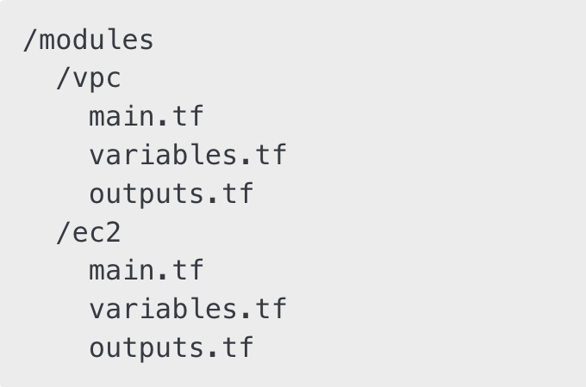
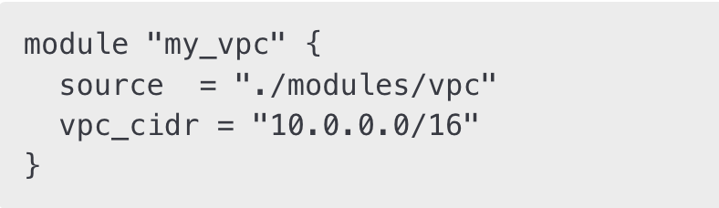
5
Terraform Modules and Reusability
What are Terraform Modules?
A way to package Terraform configurations into reusable components.
Helps standardize infrastructure across multiple environments.
Makes managing large-scale infrastructure easier and more modular.
Example Module Structure
Using a Terraform Module

Slide 8
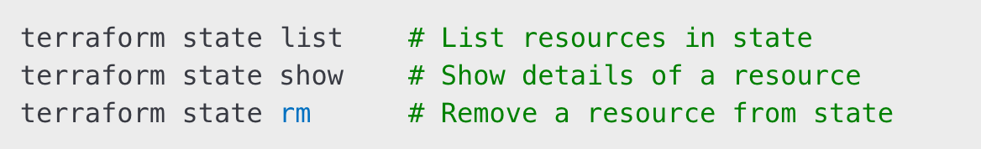
6
Terraform State Management
What is Terraform State?
A record of deployed infrastructure.
Used for tracking changes and preventing drift.
Best Practices for Managing Terraform State
Use Remote State: Store the state file in a shared location.
Enable State Locking: Prevent conflicts in a multi-user environment.
Use State Commands:

Slide 9
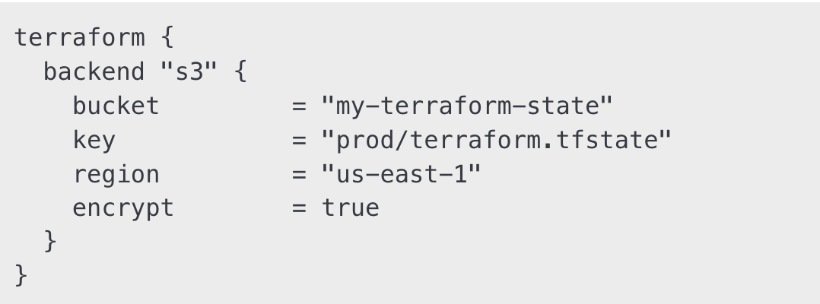
7
Working with Remote Backends
Why Use a Remote Backend?
Allows multiple team members to access Terraform state.
Ensures state consistency across environments.
Configuring an S3 Backend for Terraform State

Slide 10
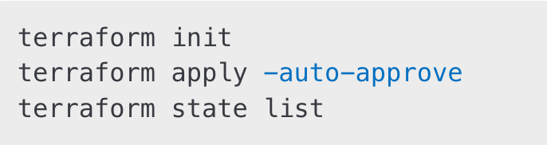
8
Hands-On Activities
Step 1: Create a Terraform Module
Define a module for deploying an EC2 instance with a security group.
Step 2: Use a Remote Backend
Configure Terraform to store state in S3 with DynamoDB locking.
Step 3: Apply and Validate
Step 4: Modify and Apply Again
Change instance type and reapply the configuration.

Slide 11
9
Homework
Modularize an Existing Terraform Configuration:
Break down your infrastructure into reusable modules.
Implement Remote State Storage:
Store Terraform state in S3 with DynamoDB locking.
Use Workspaces for Multiple Environments:
Create a dev, staging, and production workspace.
Experiment with Dynamic Blocks:
Write a Terraform configuration using dynamic blocks.

Slide 12


