Slide 1

bdg.am

Slide 2


VIRTUALIZATION
AND INTRODUCTION TO DOCKER
bdg.am

Slide 3
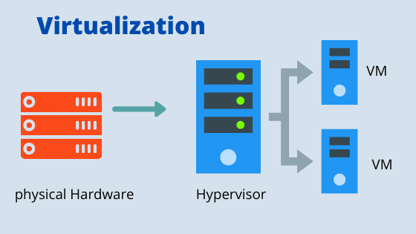
1
Introduction to Virtualization
What is Virtualization?
Definition: Virtualization is the process of creating virtual instances of hardware resources, such as CPUs, storage, and networks, on a single physical machine.
Why we need Virtualization?:
Efficient resource utilization.
Isolation of environments.
Flexibility and scalability.
Types of Virtualization
Full Virtualization: Uses a hypervisor to emulate hardware (e.g., VMware, VirtualBox).
Paravirtualization: Guest OS interacts directly with the hypervisor (e.g., Xen).
Container-based Virtualization: Lightweight virtualization using OS-level isolation (e.g., Docker).

Slide 4
2
Understanding Hypervisors
What is a Hypervisor?
A software layer that enables multiple operating systems to run on a single physical machine.
Types of Virtualization Technologies
Type 1 (Bare-metal Hypervisors):
Run directly on physical hardware.
Provide better performance and lower overhead as they have direct access to hardware resources.
Common examples:
VMware ESXi: Enterprise-grade hypervisor for large-scale deployments.
Microsoft Hyper-V: Integrated with Windows for server virtualization.
KVM (Kernel-based Virtual Machine): Open-source hypervisor built into the Linux kernel.
Type 2 (Hosted Hypervisors):
Run on top of an existing operating system.
Easier to set up but slightly less efficient due to reliance on the host OS.
Common examples:
VirtualBox: Popular for personal and development use.
VMware Workstation: Versatile for testing and development environments.
OS-level Virtualization:
Uses the host operating system's kernel to isolate applications.
Lightweight and faster compared to traditional hypervisors.
Common examples:
Docker: Ideal for microservices and containerized applications.
LXC (Linux Containers): Provides system-level virtualization for Linux environments.

Slide 5
3
How Virtualization technologies Work
Understanding Hypervisors in Detail
Hyper-V:
Developed by Microsoft, Hyper-V is a Type 1 hypervisor built into Windows.
It enables running multiple operating systems on Windows Server or Windows 10/11.
Features include:
Live migration of virtual machines.
Integration services for better performance.
Dynamic memory allocation.
KVM (Kernel-based Virtual Machine):
An open-source Type 1 hypervisor included in the Linux kernel.
Converts Linux into a hypervisor, allowing it to run multiple virtual machines.
Features include:
Support for hardware-assisted virtualization (Intel VT or AMD-V).
High performance with minimal overhead.
Integration with libvirt and other tools for VM management.
Docker and OS-level Virtualization:
Docker does not use traditional hypervisors. Instead, it relies on OS-level virtualization.
Utilizes Linux kernel features like cgroups and namespaces to isolate containers.
Differences from traditional virtualization:
Containers share the host OS kernel instead of emulating hardware.
Lightweight and faster than virtual machines.
Use Cases of Virtualization Technologies
Hyper-V: Enterprise server environments for Windows-centric workloads.
KVM: Preferred in Linux-based server environments and cloud platforms.
Docker: Ideal for microservices architecture, development, and CI/CD pipelines.

Slide 6
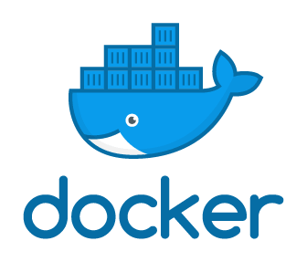
4
Introduction to Docker
What is Docker?
Docker is a platform for container-based virtualization, allowing developers to package applications with all their dependencies into containers.
Why Docker?
Lightweight compared to traditional VMs.
Consistent environments across development, testing, and production.
Faster startup and resource-efficient.
Key Concepts
Container: A lightweight, standalone, executable package.
Image: A blueprint for a container.
Docker Engine: The runtime that manages containers.
Docker Hub: A repository for storing and sharing Docker images.

Slide 7
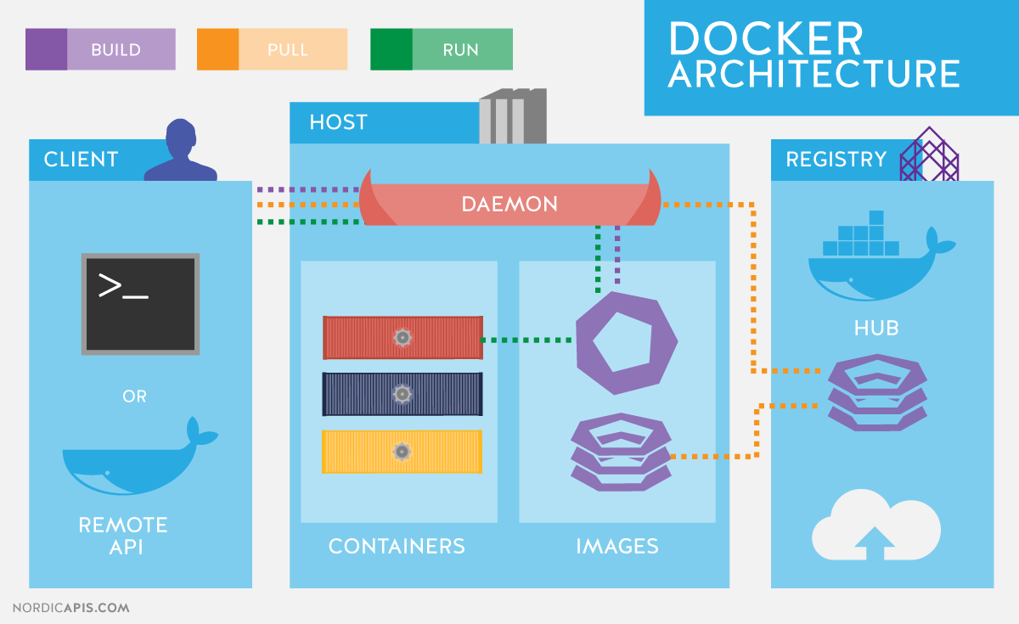
5
Docker Architecture
How Docker Works
Docker Daemon:
Runs on the host machine and manages images, containers, and networks.
Docker Client:
The interface used to interact with Docker (e.g., CLI commands).
Registry:
Stores Docker images (e.g., Docker Hub).
Containers:
Instances created from Docker images.
Key Docker Commands
docker run: Start a container from an image.
docker ps: List running containers.
docker stop: Stop a running container.
docker rm: Remove a container.

Slide 8
6
Hands-On with Docker
Installing Docker:
Follow instructions for your OS from Docker Docs.
Running Your First Container:
Pull an image from Docker Hub:
docker pull hello-world
Run the container:
docker run hello-world
Exploring Docker Commands:
List running containers:
docker ps
List all containers:
docker ps -a
Stop a container:
docker stop <container_id>
Remove a container:
docker rm <container_id>

Slide 9

7
Homework
Virtualization:
Set up a lightweight virtual machine using a Type 2 hypervisor (e.g., VirtualBox) and install a Linux OS.
Use df and top commands inside the VM to explore its resource usage.
Docker Basics:
Install Docker on your system.
Pull and run an image (e.g., nginx or alpine).
Practice starting, stopping, and removing containers.

Slide 10

Քո կարծիքը կարևոր է

Slide 11


